Slide 1
C/W
06/10/2020
7Ia2 How our bodies use food
Humans and other animals use food as a source of energy to:
1.
2.
3.
4.
 List anything you can think of or remember from KS2 that we use food for.
What would you not be able to do without food?

Slide 2
Objectives
Recall the factors that affect the amount of energy needed in a person’s diet.
Describe the factors that affect body mass.
Explain the differing energy needs of people of different ages and activity levels.
Calculate the energy requirements for a particular person or activity.

Slide 3
C/W
06/10/2020
7Ia2 How our bodies use food
Humans and other animals use food as a source of energy to:
1. Grow ✓
2. Repair our bodies ✓
3. Move around ✓
4. Keep warm ✓
Look at your nutrition information labels.
What units can you see for energy?

Slide 4
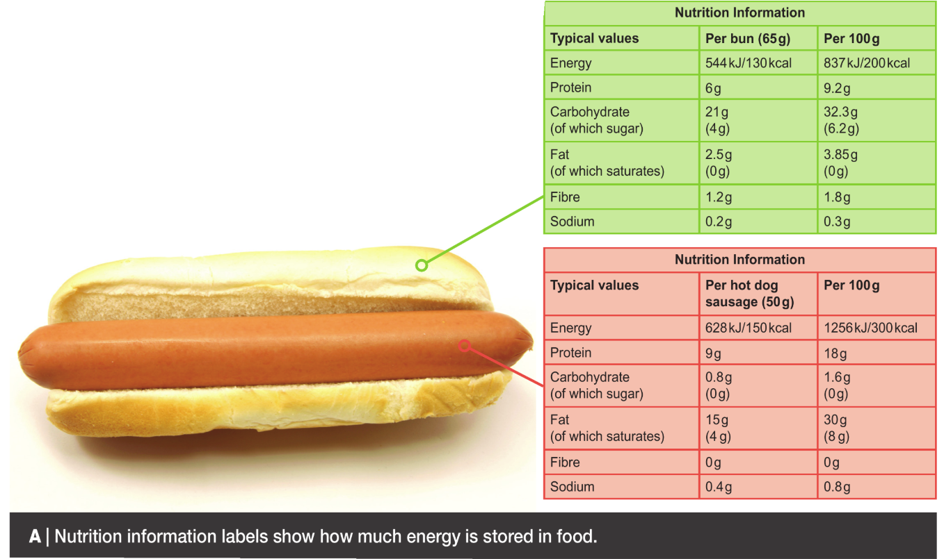
joules
Energy is measured in ______ (J).
1J is a tiny amount so we often use ______________.
How many joules in a kilojoule?
kilojoules (kJ)
What units can you see for energy?

Slide 5
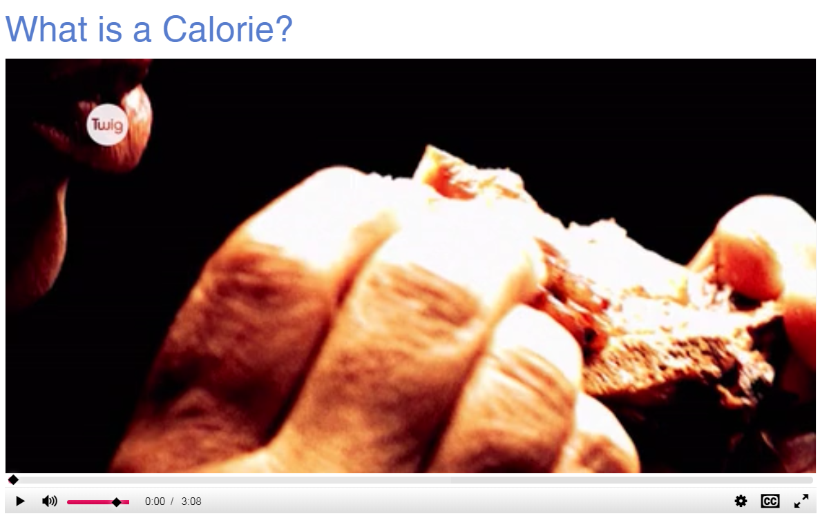
joules
Energy is measured in ______ (J).
1J is a tiny amount so we often use ______________.
kilojoules (kJ)
1000
1 kJ = ____ J.
Average energy recommendation, for
men:
women:
 From the next video, note down the recommended average energies per day.
What other unit do we often use?
How many kilojoules should we eat per day?
up next:

Slide 7
joules
Energy is measured in ______ (J).
1J is a tiny amount so we often use ______________.
kilojoules (kJ)
1000
What about children?
1 kJ = ____ J.
Average energy recommendation, for
men:
women:
10 500 kJ / day
Why might some people need more or less than this?
8 400 kJ / day

Slide 8
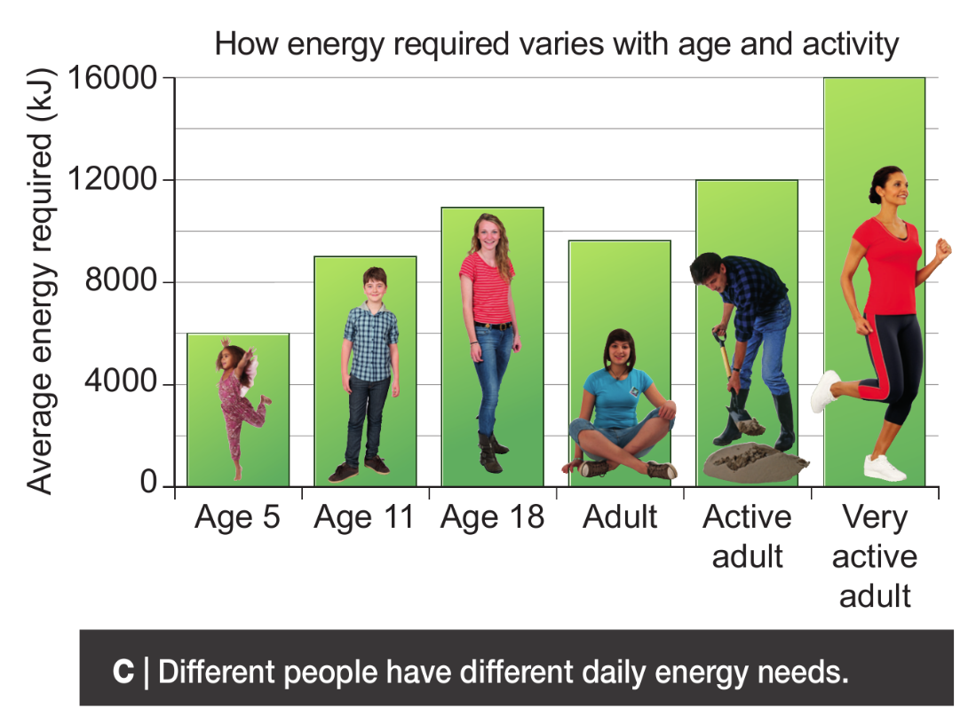

Slide 9
 Answer q.3&4 in full sentences. See end of slides for all questions to use for revision.

Slide 11
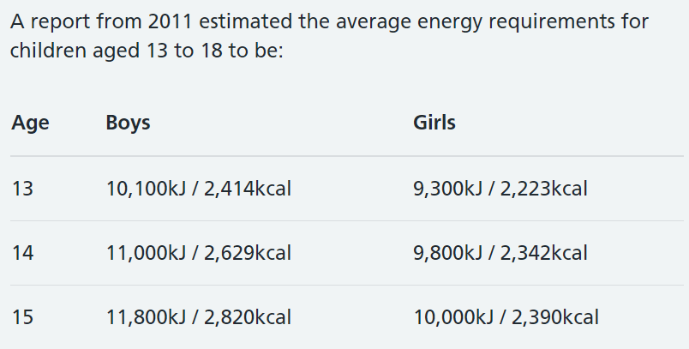
What foods will provide the most energy?
Remember the foods we tested last lesson?
up next:

Slide 12
 Slide 7.
 Teachers: Click image to run Doddle interactive.
 Students: log in to Doddle & search for “Energy use at Home – Energy in Food”.

Slide 13
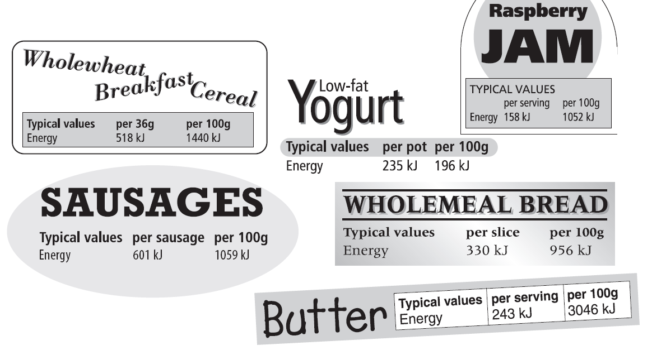
My food for one day
Decide what you are going to eat for a day from your food labels. Fill in your table with the amount of each food you have & the total energy for that meal
Aim for:
boys 10 000 kJ
girls: 9000 kJ
What else should you consider as well as energy?

Slide 14
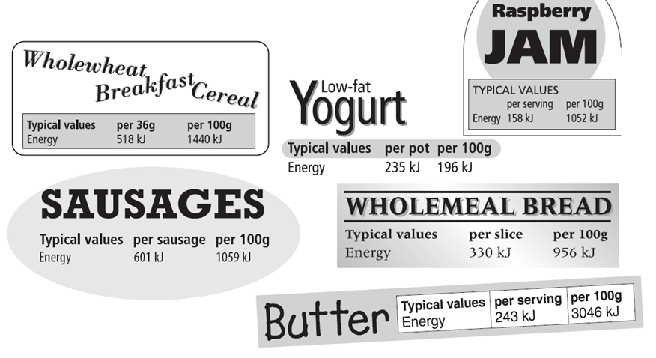

Slide 15
 | Food | Serving size | Energy per serving (kJ) | Energy intake (kJ)
Breakfast
Lunch
Dinner
Snacks
 |  |  | Total

Slide 16
Compare the total energy intake from your table with the recommended totals.
Write what would happen if your diet contains more or less energy than you need.
Add what else a good balanced diet needs as well as the correct amount of energy.

Slide 17
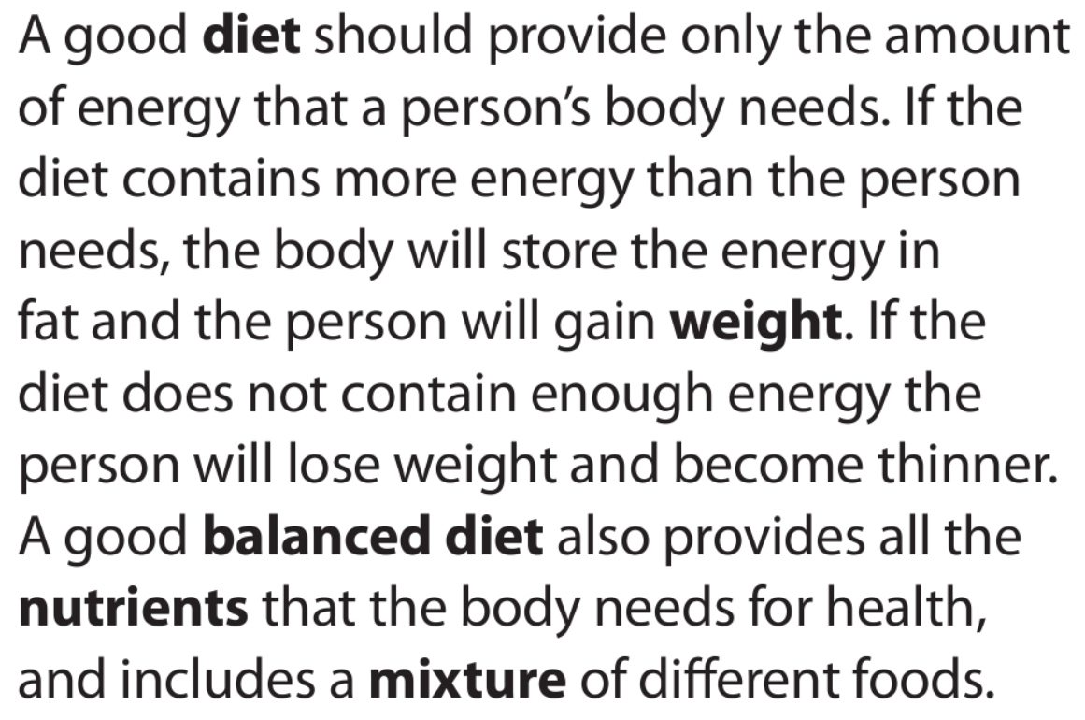
What are some examples of specific nutrients we need in our diet?

Slide 19
Objectives
Recall the factors that affect the amount of energy needed in a person’s diet.
Describe the factors that affect body mass.
Explain the differing energy needs of people of different ages and activity levels.
Calculate the energy requirements for a particular person or activity.

Slide 20
Thinking skills
Energy from food

Slide 21
Consider all the possible answers to this statement:
A person is getting thinner.
Possible answers
Next question

Slide 22
Consider all the possible answers to this statement:
A person is getting thinner.
They are eating less food than they need to maintain their size.
They are eating the same amount of food but exercising more.
They have had liposuction/surgery to make them thinner.
They have something wrong with them and cannot extract all the energy from the food they eat.
Possible answers
Next question
© Pearson Education Ltd 2014. Copying permitted for purchasing institution only. This material is not copyright free.

Slide 23
Consider all the possible answers to this statement:
Ben needs to eat more than Hilary.
Possible answers
Next question
© Pearson Education Ltd 2014. Copying permitted for purchasing institution only. This material is not copyright free.

Slide 24
Consider all the possible answers to this statement:
Ben needs to eat more than Hilary.
Ben is a teenager and Hilary is a toddler.
Ben is more active than Hilary.
Ben and Hilary have similar activity levels but Ben is trying to gain weight.
Possible answers
Next question
© Pearson Education Ltd 2014. Copying permitted for purchasing institution only. This material is not copyright free.

Slide 25
Think of a Plus, a Minus and an Interesting point about this statement:
There should be no energy stored in sugar.
Possible answers
End show
© Pearson Education Ltd 2014. Copying permitted for purchasing institution only. This material is not copyright free.

Slide 26
Think of a Plus, a Minus and an Interesting point about this statement:
There should be no energy stored in sugar.
Plus: We could eat lots of sweet things without gaining mass/weight.
Minus: Sugar would still be bad for our teeth so this might lead to more tooth decay!
Interesting: Could the countries that grow sugar produce enough to meet the demand? We already have artificial sweeteners that taste sweet without providing any/much energy.
Possible answers
Back to start
End show
© Pearson Education Ltd 2014. Copying permitted for purchasing institution only. This material is not copyright free.

Slide 30
