Slide 1
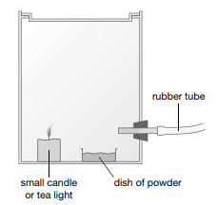
Requisitions
Demo:
Powder explosion demonstration
Measure a spatula of cornflour into each of two heat-resistant dishes. Place one dish on a heat resistant mat and use a wax taper to try to set light to the powder. It probably will not light, but try hard. Students should note what happens.
Tell students that the second dish will be placed inside the apparatus shown above. When the lid of the tin is closed, powder will be gently blown into the flame. Give them time to compare the two set-ups and to predict what will happen with the tin arrangement. Then place the second dish in the tin, light the candle, close the lid firmly and gently blow the powder using the pump. An explosion should occur, removing the lid of the tin. Students should identify that oxygen in the air is needed for combustion. Blowing the cornflour using a stream of air increases the surface area of cornflour in
worksheets:
8Ec-1
8Ec-3 or 7
8Ec-5
© Pearson Education Ltd 2014. Copying permitted for purchasing institution only. This material is not copyright free.

Slide 2
Objectives
Name the three sides of the fire triangle.
Describe how to stay safe in familiar situations.
Recognise hazard symbols.
Use the idea of the ‘fire triangle’ to explain how to extinguish a fire.
Explain why different types of fire need to be put out in different ways. Describe what is meant by exothermic changes.
Compare the temperature rise of water when some fuels are burnt.
Apply knowledge of explosive reactions to explain why they occur more/less rapidly when variables (proportion of fuel/oxygen mixture, the droplet size, the oxidiser) are changed.
Justify methods of risk reduction.
Evaluate data on burning fuels to deduce the best energy per gram of fuel.

Slide 3
CW
8Ec Fire Safety
What do these hazard symbol mean?
Stick in your sheet
@hpscience

Slide 4
Learning Objectives
Developing | Securing | Exceeding
Must… | Should… | Could…
Name the three sides of the fire triangle. Describe how to stay safe in familiar situations. Recognise hazard symbols. Use the idea of the ‘fire triangle’ to explain how to extinguish a fire. Explain why different types of fire need to be put out in different ways. | Describe what is meant by exothermic changes. Compare the temperature rise of water when some fuels are burnt. Apply knowledge of explosive reactions to explain why they occur more/less rapidly when variables (proportion of fuel/oxygen mixture, the droplet size, the oxidiser) are changed. | Justify methods of risk reduction. Evaluate data on burning fuels to deduce the best energy per gram of fuel.

Slide 5
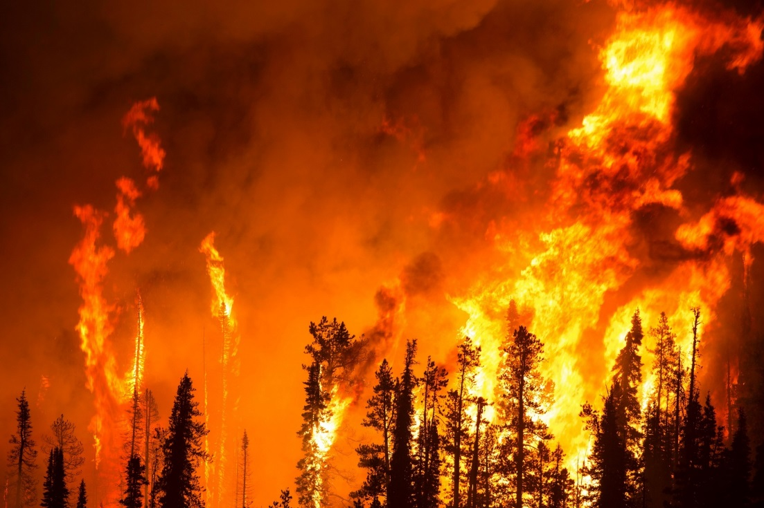
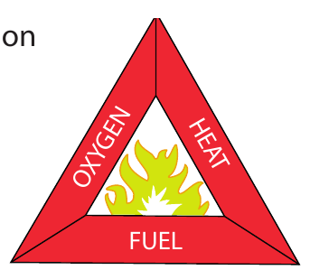
What you think is required for a fire to start and keep going?
Fuel
Oxygen
Heat

Slide 6
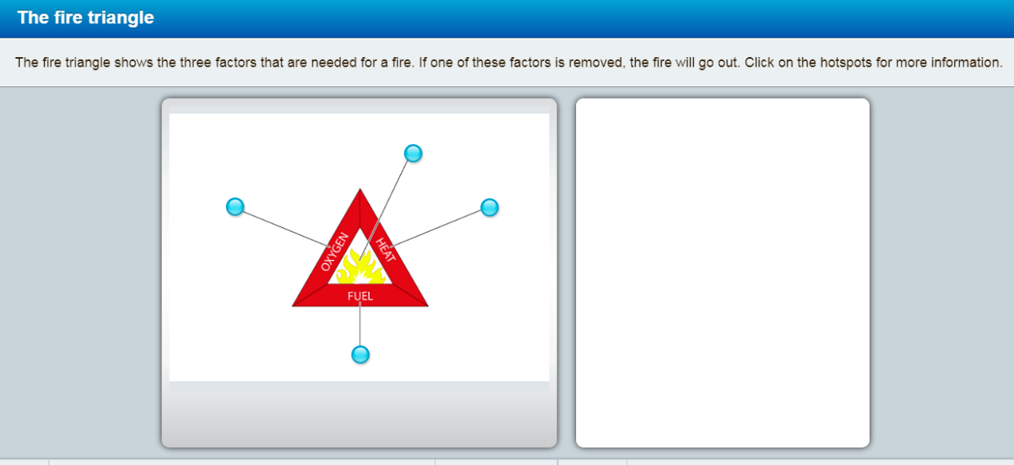
Note: Use the Fire Triangle activity on P74 of the Yr 8 active Book

Slide 7
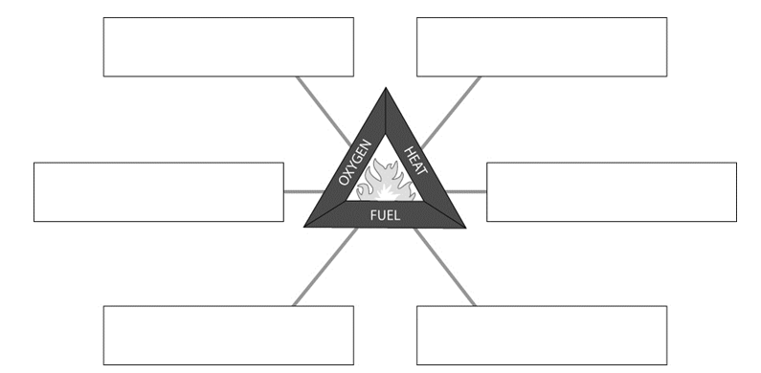
Complete w/s 8Ec - 1

Slide 8
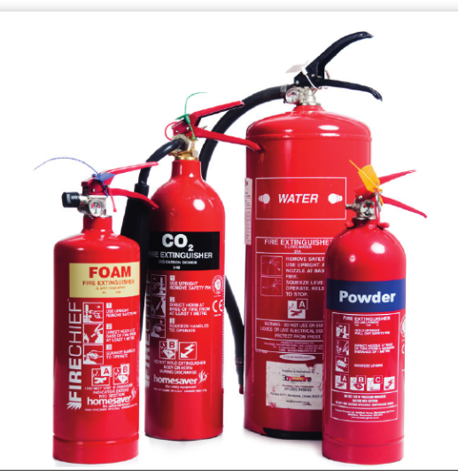
Why are there different types of fire extinguishers
Why should a water extinguisher not be used on
An oil fire
An electrical fire
Note: see p75

Slide 9
Learning Objectives
Developing | Securing | Exceeding
Must… | Should… | Could…
Name the three sides of the fire triangle. Describe how to stay safe in familiar situations. Recognise hazard symbols. Use the idea of the ‘fire triangle’ to explain how to extinguish a fire. Explain why different types of fire need to be put out in different ways. | Describe what is meant by exothermic changes. Compare the temperature rise of water when some fuels are burnt. Apply knowledge of explosive reactions to explain why they occur more/less rapidly when variables (proportion of fuel/oxygen mixture, the droplet size, the oxidiser) are changed. | Justify methods of risk reduction. Evaluate data on burning fuels to deduce the best energy per gram of fuel.

Slide 10
Combustion is an exothermic reaction.
What does this mean?
Exothermic reactions release energy that we can feel as heat.
This release of energy will increase the temperature of the surroundings.
Different fuels release different amounts of energy.
Copy this into your book

Slide 11
Comparing fuels practical – this could be used for the ws ‘fair testing’ objectives
Energy in fuels – no prac data exercise

Slide 12
Learning Objectives
Developing | Securing | Exceeding
Must… | Should… | Could…
Name the three sides of the fire triangle. Describe how to stay safe in familiar situations. Recognise hazard symbols. Use the idea of the ‘fire triangle’ to explain how to extinguish a fire. Explain why different types of fire need to be put out in different ways. | Describe what is meant by exothermic changes. Compare the temperature rise of water when some fuels are burnt. Apply knowledge of explosive reactions to explain why they occur more/less rapidly when variables (proportion of fuel/oxygen mixture, the droplet size, the oxidiser) are changed. | Justify methods of risk reduction. Evaluate data on burning fuels to deduce the best energy per gram of fuel.

Slide 13
Watch the following demos then try to explain what you have seen
When the fine mist of powder is blown across the candle flame, the combustion reaction happens very quickly. The carbon dioxide and water vapour are released, rapidly over filling the tin. The lid will then pop off.

Slide 14
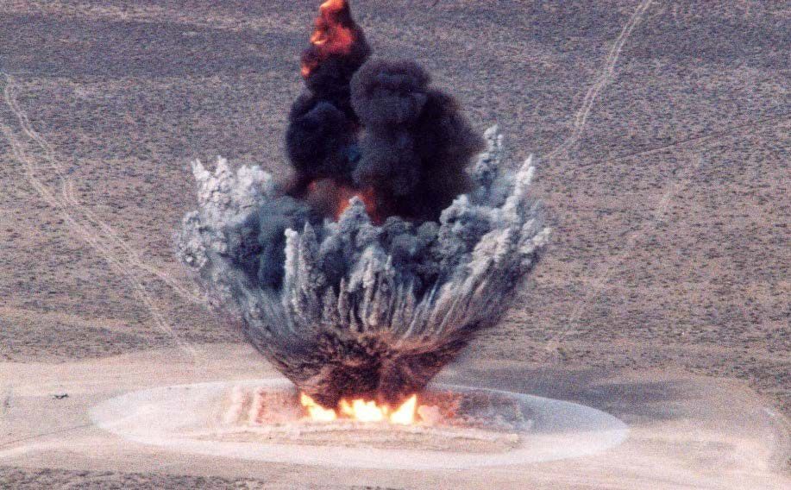
An explosion is a rapid increase in volume and release of energy in an extreme manner, usually with the generation of high temperatures and the release of gases.

Slide 15
Learning Objectives
Developing | Securing | Exceeding
Must… | Should… | Could…
Name the three sides of the fire triangle. Describe how to stay safe in familiar situations. Recognise hazard symbols. Use the idea of the ‘fire triangle’ to explain how to extinguish a fire. Explain why different types of fire need to be put out in different ways. | Describe what is meant by exothermic changes. Compare the temperature rise of water when some fuels are burnt. Apply knowledge of explosive reactions to explain why they occur more/less rapidly when variables (proportion of fuel/oxygen mixture, the droplet size, the oxidiser) are changed. | Justify methods of risk reduction. Evaluate data on burning fuels to deduce the best energy per gram of fuel.

Slide 16
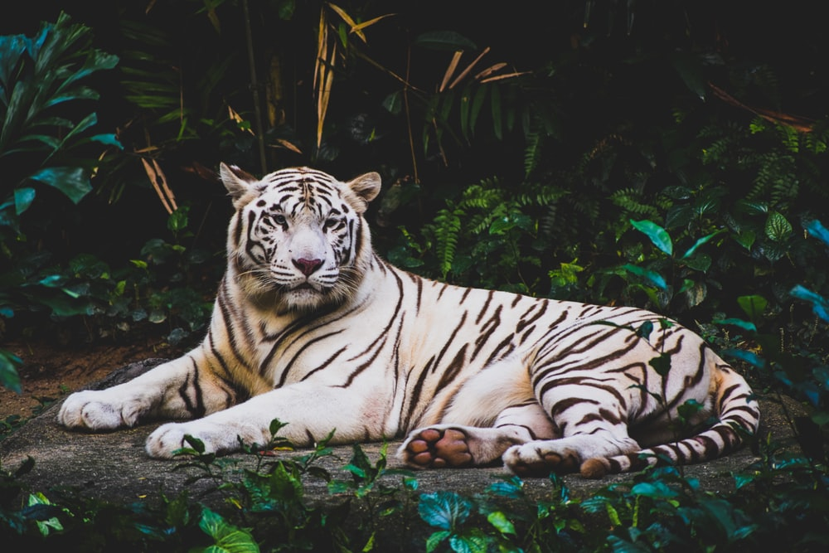
Homework:
w/s 8Ec5 – Fire Safety
Active learn: Exercises 8Ec developing, secure & exceeding
Date due:

Slide 17
Thinking skills
Fire safety

Slide 18
Consider all the possible answers to this statement:
A fire is extinguished.
Possible answers
Next question
© Pearson Education Ltd 2014. Copying permitted for purchasing institution only. This material is not copyright free.

Slide 19
Consider all the possible answers to this statement:
A fire is extinguished.
Oxygen is excluded from the fire.
The heat is taken from the fuel by reducing its temperature with water.
The fuel is used up.
Possible answers
Next question
© Pearson Education Ltd 2014. Copying permitted for purchasing institution only. This material is not copyright free.

Slide 20
Think of a Plus, a Minus and an Interesting point about this statement:
Oxygen should be removed from air.
Possible answers
Next question
© Pearson Education Ltd 2014. Copying permitted for purchasing institution only. This material is not copyright free.

Slide 21
Think of a Plus, a Minus and an Interesting point about this statement:
Oxygen should be removed from air.
Plus: This would prevent fires happening.
Minus: Living organisms wouldn’t be able to breathe.
Interesting: Fires didn’t happen on Earth until the concentration of oxygen released from photosynthesis into the air was high enough for combustion to take place. What concentration of oxygen is needed for combustion?
Possible answers
Next question
© Pearson Education Ltd 2014. Copying permitted for purchasing institution only. This material is not copyright free.

Slide 22
Which is the odd one out in this list?
Oxygen Carbon dioxide Powder
Possible answers
End show
© Pearson Education Ltd 2014. Copying permitted for purchasing institution only. This material is not copyright free.

Slide 23
Which is the odd one out in this list?
Oxygen Carbon dioxide Powder
Powder because it is not a gas.
Oxygen because it is needed for a fire to burn whereas the others can be used to put a fire out.
Possible answers
Back to start
End show
© Pearson Education Ltd 2014. Copying permitted for purchasing institution only. This material is not copyright free.

