Slide 1
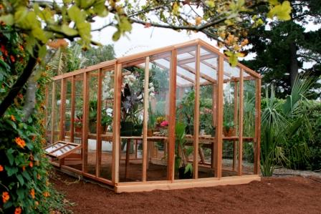
8Ee Global Warming
CW
Do Now:
How does a greenhouse work?

Slide 2
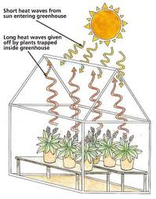

Slide 3
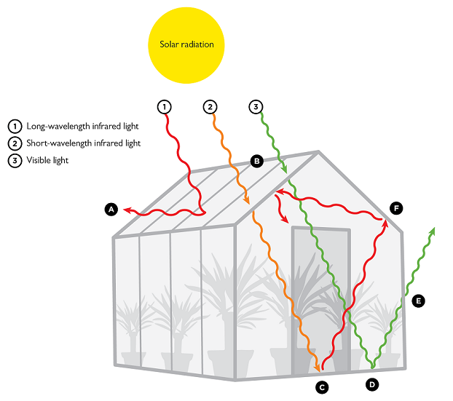

Slide 4
Worksheet 8Ee.1

Slide 5
Some reflected energy is transferred to space. | As the Earth’s surface gets warmer, it emits more energy.
Energy is transferred from the Sun to the Earth’s surface. | Some energy is absorbed by greenhouse gases and transferred back to the Earth’s surface.
Most energy is absorbed by the Earth’s surface, making it warmer.

Slide 6
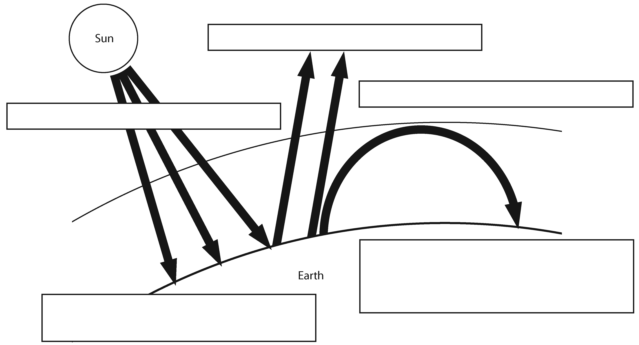
The Greenhouse Effect
Some reflected energy is transferred to space.
As the Earth’s surface gets warmer, it emits more energy.
Energy is transferred from the Sun to the Earth’s surface.
Some energy is absorbed by greenhouse gases and transferred back to the Earth’s surface.
Most energy is absorbed by the Earth’s surface, making it warmer.

Slide 7
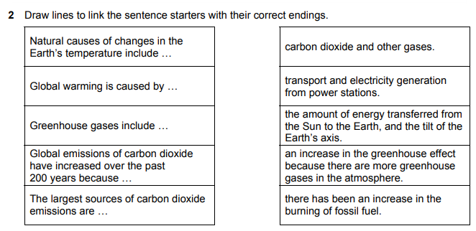

Slide 8
What is Global Warming? (video)
Global Warming is the increase in the average temperature of the Earth’s atmosphere and oceans.
3. What is the evidence for global warming?
Worksheet

Slide 9
What do most scientists think is causing the rise in global temperatures?
What effects could this temperature rise have?
What is meant by the ‘greenhouse effect’?
Would we be better off on Earth without the greenhouse effect? Explain your answer.
Increased burning of fossil fuels
Extreme weather, sea-levels rising
The energy from the sun is trapped in the Earth’s atmosphere
No because it would be too cold for life.

Slide 10
Q. List two main causes of the rising concentration of carbon dioxide in the atmosphere.

Slide 11
Q. List two main causes of the rising concentration of carbon dioxide in the atmosphere. Burning more fossil fuels Cutting down forests
Increased carbon dioxide levels are caused by burning fossil fuels and deforestation

Slide 12
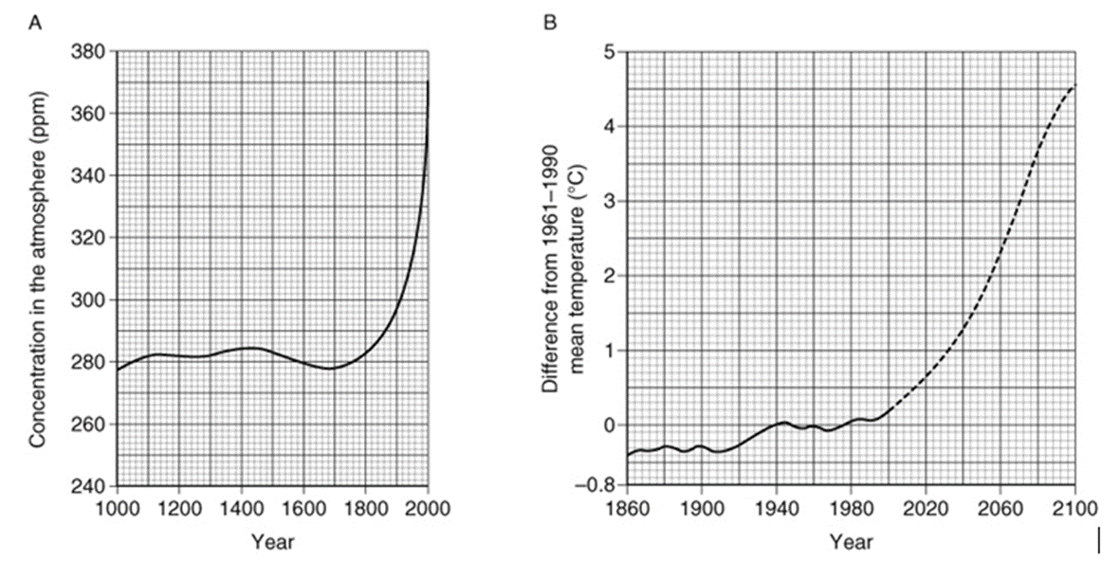
Graph A shows the changes in carbon dioxide concentration over the last 1000 years in parts per million (ppm).
Graph B shows the mean temperature of each year compared to the mean temperature for the years 1961–1990 (this is set at 0 on the graph). The dashed line shows the predicted increase in temperature from 2000.

Slide 13
What was the carbon dioxide concentration (approximately) between 1000 and 1800?
In 1900, how much lower was the mean temperature than it was in 1961–1990?
In which year did temperature levels start to rise above the mean value for 1961–1990?
Describe the current trend in carbon dioxide concentration.
What has been the general trend in mean world temperature over the last 100 years?
What does the graph predict will happen to mean temperature over the next 100 years?
Using the graphs, describe any link between the mean world temperature and the carbon dioxide level.
Do you think these graphs provide good evidence that rising temperatures are caused by rising concentration of carbon dioxide? Explain your answer.
about 280 ppm
approx. –0.3°C
about 1980
It is rising fast.
It has been slowly rising.
It will rise at a much faster rate, by about 4.5°C.
As the level of carbon dioxide has risen, the average global temperature has risen similarly.
Not strong evidence as the graphs are on different time scales and provide too little detail.

Slide 14
5 Scientists use computer models to predict how rising temperatures could affect the future climate of the Earth.
a What information do you think they need to put into such computer models?
b Suggest why different computer models give different predictions about future climates.
include factors such as
the amount of energy reaching the Earth from the Sun
the amount of carbon dioxide and other greenhouse gases in the air
how much energy is reflected by the Earth
how much is absorbed by the atmosphere
There is a lot of different information needed by the models, and scientists do not have accurate data for all the inputs.
Also, the climate is very complex, and might be modelled in different ways.

