Slide 1
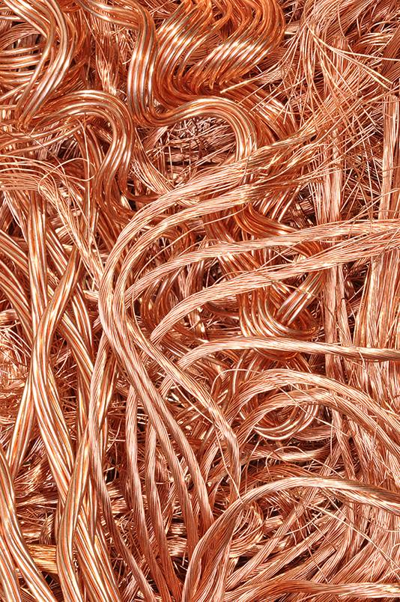
8Ge Pure Metals and Alloys

Slide 2
Alloys are a mixture of a metal element with another element.
Bronze contains Cu and Sn (________ +___)
Brass contains Cu and Zn (______+____)
Solder contains Pb and Sn (______+___)
Stainless teel contains Fe and C (____ , ______ + _________)
Duralumin Al, Cu and Mg (_________ , ______ + ___________)
copper
tin
copper
zinc
lead
tin
iron
carbon
chromium
aluminium
copper
magnesium

Slide 3
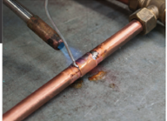
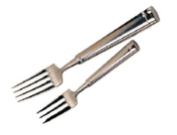
Alloys have different properties than the elements used to make them
Alloy Main metal Added element Improved property Example of use
Copper &
magnesium
tin
Carbon and chromium
Stronger and more corrosion resistant than main metal
Solder
Duralumin
Stainless steel
iron
aluminium
lead
solder
Lighter and stronger than main metal
Duralumin
Lower melting point than main metal
Stainless steel

Slide 4
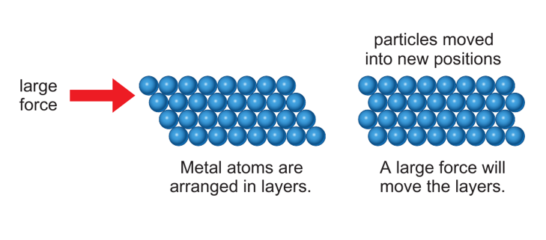
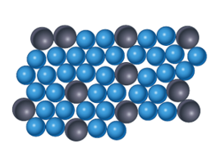
Metals are malleable because layers of atoms can slide over each other when under stress
In an alloy…
This is a particle diagram of an alloy.
How would the addition of larger atoms affect the malleability?
the different atoms jam up the structure so the layers cannot slide easily.

Slide 5
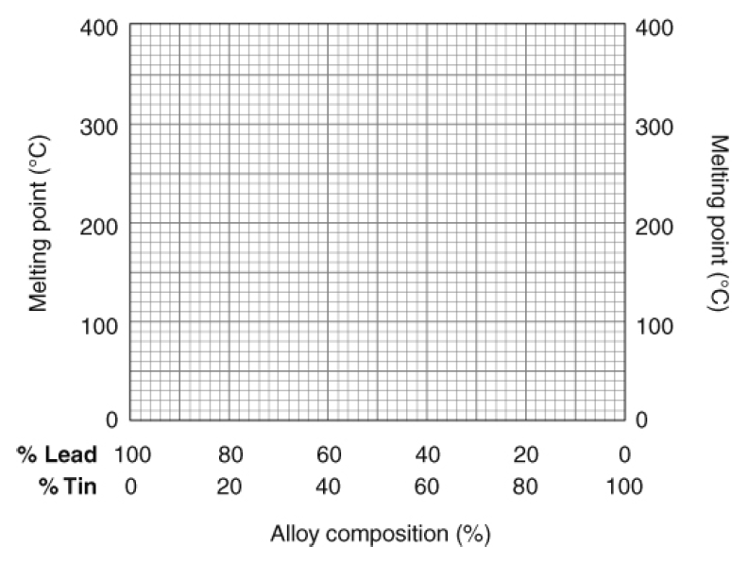
Plot the graph.
Describe how the melting point changes as the percentage of tin increases.
The melting point of solder…
x
x
x
steeply decreases down to 40% tin and then increases less steeply to 100% tin.
x
x
x
x
x
x
x
x
Graph F

Slide 6
327ºC
60% lead 40% tin
Sample X is the pure iron because it has a fixed melting point
Iron alloys are stronger and more corrosion resistant than iron.

Slide 7
Melting Points
Pure substances have fixed melting points.
e.g.
Sugar
Water
Iron
0 °C
186 °C
1,538 °C

Slide 8
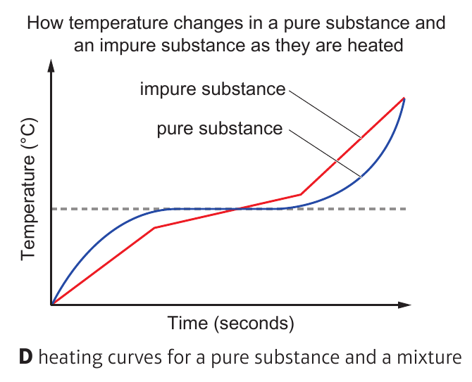
Add the labels ‘pure substance’ and ‘impure substance’
Impure substance
Pure substance

Slide 9
Alloy Main metal Added element Improved property Example of use
Copper &
magnesium
tin
Carbon and chromium
Stronger and more corrosion resistant than main metal
Solder
Duralumin
Stainless steel
iron
aluminium
lead
solder
Lighter and stronger than main metal
Duralumin
Lower melting point than main metal
Stainless steel

