Slide 1
CW
7Cc Sentences (L&C)
What is a sentence?
What is a conjunction?
@hpscience

Slide 2
Teacher notes
You can either print out the worksheet, or get students to write it down or just go through the exercise on the board as a class.
I wouldn’t spend too much time on this exercise.

Slide 3
Scientists have to share their discoveries with other scientists if they want their work to be accepted.
Therefore, written communication is crucial to science.
Written communication is another essential skill that can be improved through studying science.

Slide 4
Quite often a students is let down by their written communication in exams.
If you write clearly and scientifically in tests you will achieve higher grades.
It is something that most people are able to improve upon.

Slide 5
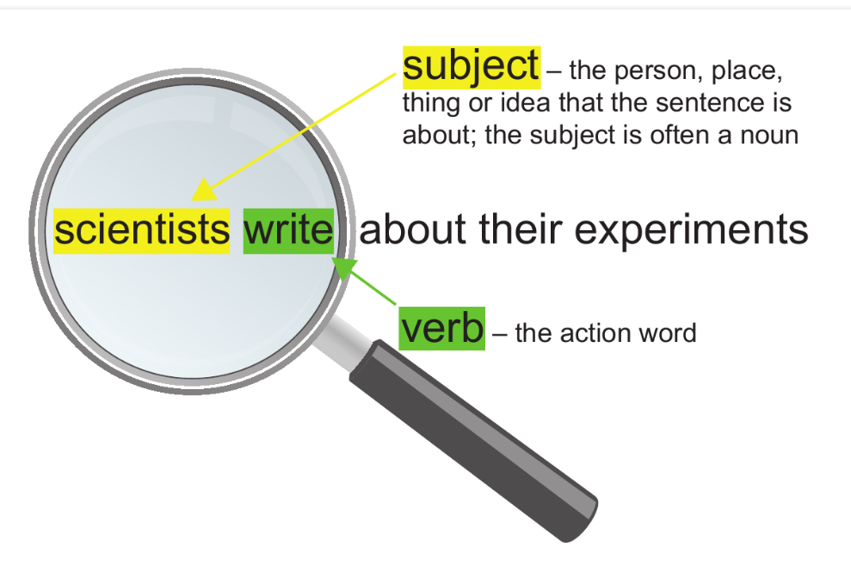
A sentence is made up of clauses.
A clause contains a subject and a
verb.
If the clause makes sense on it’s own then it is called the main clause.
Short single-clause sentences are good for writing methods or introducing a topic.

Slide 6
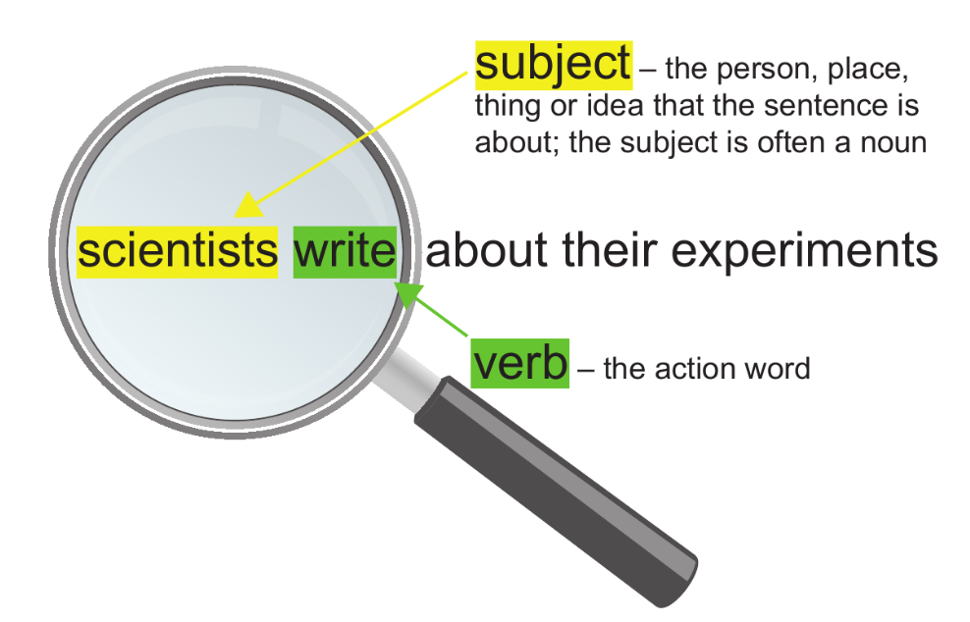
You may want to use the 7cc2 worksheet or get students to copy and complete
2. In each sentence, underline the subject and circle the verb.
A Bones are organs.
b Some bones help to support organs.
c The skull protects the brain.
d Joints contain muscles and bones.

Slide 8
Complex sentences
Sometimes we need to give extra information (subordinate clause) in a sentence to back up our main point.
In this case we may choose to write a complex sentence.
You need to be able to write complex sentences in tests and exams.
This is how you can improve your results.

Slide 9
Complex sentences
Main
clause
Subordinating conjunction
Subordinate clause
Complex sentence
+
+
=
https://www.activeteachonline.com/default/player/splitzoom/id/286381/external/0
Main
subject
Extra information
Complex sentence
+
Link word
+
=

Slide 10
Underline the subordinate clause and circle the subordinating conjunction.
The bones in a flexible joint are moved by muscles, which are attached by tendons.
Some questions have not been answered because of a lack of data.
People say that they have pulled a muscle, though often they mean a tendon.

Slide 11
3. Add conjunctions to this paragraph.
Scientists write about their experiments are published in scientific journals. Scientific journals contain a number of different papers there is a convention for how a scientific report is set out. Scientists also need to follow grammatical rules when they write this makes their papers easily understood. Other scientists read papers in journals they can learn about new discoveries about how those new discoveries were made.

Slide 12
What you really need to know;
Write clearly and accurately.
Give extra information in your sentences to make the easier to fully understand.
Don’t use slang words.

