Slide 1
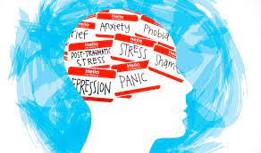
Wellbeing Morning: Monday 7th March 2022
Your Mental Health Matters
Funded by Eliana Richards Jack Petchey award

Slide 2
To assist you with understanding a range of wellbeing issues and help you learn a variety of coping strategies a wellbeing morning for year 12 students has been organised. This is a compulsory event for year 12 students and will take place on Monday 7th March from 8:40 – 9:55. Therefore you will not go to form or period 1 and then will continue your lessons from period 2 Please read the following slides and select which workshop you would like to attend using the link below, I hope you enjoy the morning. Well-being day selection sheet : https://highamspark-my.sharepoint.com/:x:/g/personal/dstephens_highamsparkschool_co_uk/Ectcgoc5apJOp8VslLOGTrMBa-X1Sql87Px2wsasqbZMRA?e=8PRku0
Your Mental Health Matters

Slide 3
Option 1
Helping young people to make safer choices around drugs, alcohol and their wellbeing
The Amy Winehouse Resilience Programme is designed to cover a wide range of issues, so that young people receive the most comprehensive and useful education around drugs, alcohol, mental health and emotional resilience
It can increase young people’s awareness and knowledge regarding drugs and alcohol, as well as associated risks (such as offending or anti-social behaviour)
It can increase young people’s levels of resilience, self esteem and resistance to peer pressure, thereby helping to reduce potential harms to young people, their families and the local community
Session delivered by: Joe Sheerer an ex Highams Park student
Amy Winehouse Foundation - Amy Winehouse Foundation

Slide 4
Option 2
Home | NELFT NHS Foundation Trust

Slide 5
Option 3
Andrea is a former secondary school teacher, turned passionate Transformational Mindset Coach & Resilience Practitioner (The PT for your Mind), UKBFF British Champion Bodybuilder, Personal Trainer, and the Founder & Director of Focus On Creating Your Ultimate Self (FOCUS)CIC, a non profit organisation that she formed in 2016 to educate and empower young people about the benefits and importance of physical and mental health.
Session will include
What is mental health vs mental ill health
How the mind is affected by events and environment
How actions affect the mind, and how to take positive steps to stay healthy and happy
Mindapple cards (5 things to do for your mental wellbeing)
Signposting
Transformational Life Coach| Resilience Practitioner | Andrea Corbett

Slide 6
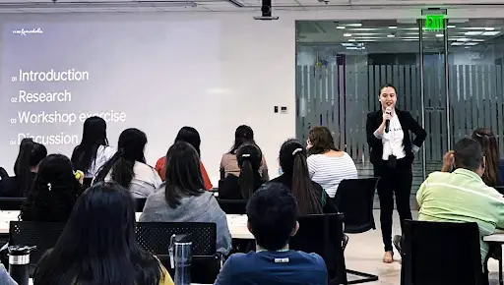
Option 4
Maximum number of students = 20
#IamRemarkable is a Google initiative empowering women and other underrepresented groups to celebrate their achievements in the workplace and beyond.
#Iamremarkableyouth is a pilot programme that focuses on young people in the UK aged between 16-18.
The session will include:
How to boost confidence, self-esteem, personal skills and capabilities to help with the next step in careers and life paths.
#IamRemarkable

Slide 7
Option 5
Educate, prevent, employ.
The session will cover
Unhealthy and Healthy Relationships
Indecent Material
Characteristics of Abuse
talking Charity | Straight Talking Peer Education / RSE courses | England

Slide 8
Option 6
The Yoga Project UK (TYPUK) connects inspiring yoga teachers with schools across the UK. Our yoga team of teachers translates the ancient practice of yoga into a language that is easy to understand and apply to daily life.
Mindfulness and meditation class
Learn the basic principles of the Autonomic Nervous System and the difference between the parasympathetic nervous system and the sympathetic nervous system.
Have a clear understanding of why our breath and simple movements can be used as a way to manage our stress response.
Gain a clear understanding of the concept of Neuroplasticity and how we can use mindfulness and meditation as a way to rewire our thinking patterns.
Be lead through a guided mindfulness practice and be given a script that you can use for yourself and within the classroom.
Practice different mindfulness meditation exercises that they can use themselves as well as within the classroom.
Learn how to embed mindfulness meditation into the school day.
The Yoga Project UK - Alice Louise Yoga

Slide 9
Study skills: With Nigel Armsby
Option 7
The session will include:
Organisation
The memory clock
The forgetting curve
Techniques for revision
Stress reducers

Slide 10
Your Mental Health Matters
Contact numbers for support
online mental wellbeing community
https://www.kooth.com/
Provides free, 24/7 support for young people across the UK with a range of mental health needs
https://www.youngminds.org.uk/
Offers support to anyone under 25 about anything that’s troubling them. 088084994
https://www.themix.org.uk/
Provides information about local counselling and advice services for young people aged 12-25.
https://www.youthaccess.org.uk/
Supports people struggling with panic attacks, phobias, obsessive compulsive disorder (OCD) and other anxiety-related issues. 0330 606 1174. Call 01952 680835 for a recorded breathing exercise
https://nopanic.org.uk/
Offers information and support for anybody affected by eating disorders.
0808 801 0677 / 0808 801 0711
help@beateatingdisorders.org.uk
studentline@beateatingdisorders.org.uk
Provides support to anyone in the UK who is feeling down and needs to talk or find information ( Depression)
0800 58 58 58
https://www.thecalmzone.net/
Supports transgender, nonbinary and gender-diverse young people until their 20th birthday
0808 801 0400
https://mermaidsuk.org.uk/about-us/
Offers free, confidential support to people living with cancer and their loved ones. 08088080000.
Macmillan Cancer Support
If you’re under 19 you can confidentially call, chat online or email about any problem big or small.
https://www.childline.org.uk/
Support young people when they are facing bereavement
0808 808 1677
https://www.hopeagain.org.uk/

