Slide 1
Welcome to 6th Form Parents information Evening
Notes:
Before we start, please turn off mobiles
Presentation will be available on Firefly
Q+A at the end

Slide 2
Programme
1)Achievements, Key Dates & Assessment Information
Mrs Stephens
Head of 6th Form, student’s academic & pastoral support.
dstephens@highamsparkschool.co.uk
2) Academic Progress & Support
Mrs Whitehead
Head of Year 12
jwhitehead@highamsparkschool.co.uk

Slide 3
Highams Park Sixth Form Results
Mrs Stephens

Slide 4
Results Overview
A Level ALPS
Red 3
Progress based on CAG targets
Notes:
Several Red subjects – keeping our ALPS progress score in the Top 25% of schools nationally.
A level QI score = 1.00
With 57% of grades at A*-B
Remember Progress based on CAG targets

Slide 5
Results Overview
Results have equated to fantastic individual achievements and pathways
134 out of 176 students (72%) have accepted University places
Notes:
Many have attained their firm choice

Slide 6
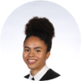
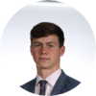
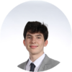
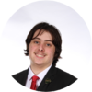
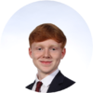
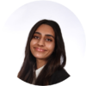
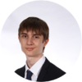
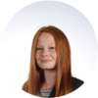
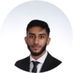
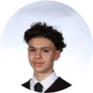
Successes:
Nicholas Crossley –
A*,A*,A*,A* (Further Maths, Maths, Chemistry & Physics)
Engineering - University of Cambridge
Samuel Raine-Jenkins
A*,A*,A (Geography, History, Philosophy),
History - University of Cambridge
Straight A*
Aiden Crowe-Economics- Queen Mary University of London
Amy Johnson– Art - London Metropolitan
Valentine Rabrenovik – Electrical Engineering - Southampton
A*A*B
A*A*A
Harry Bond,
Madhiya Khan
Nazim Masseus
Madeline Drew,
Haroon Malik,
Lois Mayfield,
Luke Newbury-Neale,
Afolabi Nurse
Martina Rabrenovic
Ethan Olliver
D*D*, D*– (Business BTEC & IT Technical Award)
Project Search Barts Healthcare Trust
Samuel White
D*D* B, A(Sport BTEC History & EPQ)
Sport Management
Loughborough University
Alternative Courses
Reggie Dunsdon – Astrophysics
Dilara Eygul – Midwifey
Emma Findlay– Police Force
Romana Haque – Global Studies with Politics
Frank Marsden – Aerospace Engineering
Jonathan Mohamed – Film and Screen Studies
Ellie Ward-Mills– Zoology
Joseph Darnborough
A,A,C (Business, Geography, English Language)
TFL General Management Level 6 Degree Apprenticeship
Mahima Miah
A,A,B (Biology, Chemistry, Economics) Neuroscience
University College London
Notes:
Results have equated to fantastic individual achievements and pathways (145 out of 153 (94%) accepted Uni places)

Slide 7
Results Overview
Results have equated to fantastic individual achievements and pathways
145 out of 153 students (94%) have accepted University places
Notes:
Many have attained their firm choice

Slide 8
8, 8, 8 Rule
8 hours of Academic Work
8 hours of Leisure and Relaxation Time
8 hours of Sleep
The most successful students are able to strike a good balance in all areas, in order to do this students should not be doing more than 8 hours a week in part time employment
Notes:
How students were successful - Want more of the fantastic results.
But need balance!

Slide 9
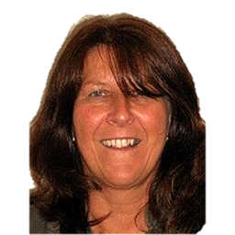
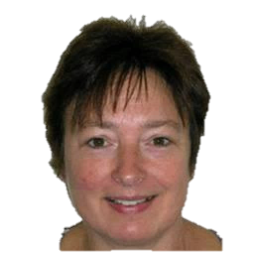
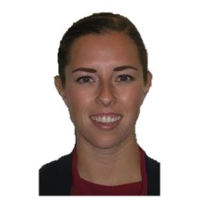
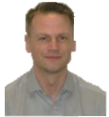
…………….
6th Form Team
Head of Year 12
Head of Year 13
6th Form Secretary
Head of 6th Form
Jenny Browne
Mrs Whitehead
Ms Wallace
Deputy Head of Year (Destinations of students)
Deputy Head of Year (Bridging Curriculum)
Mrs Stephens
Study Supervisor
Sheridan Vickers
Ms Clump
Dr Moore
9
Notes:
6th Form Team 2022 - 23

Slide 10
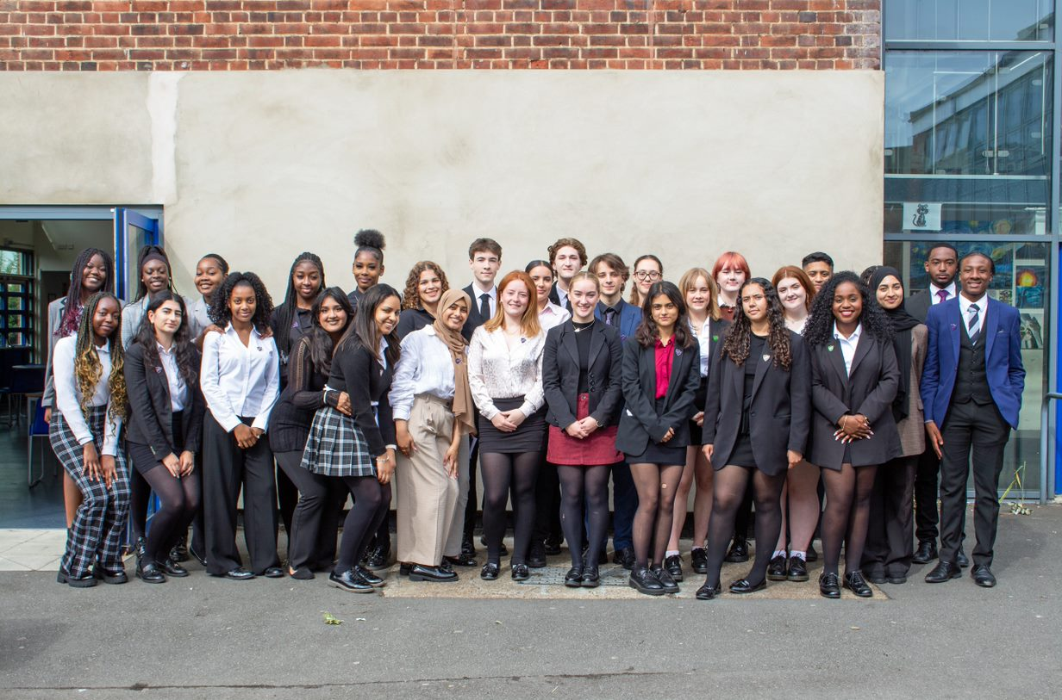
Senior Prefect support!
Zunairah Mustaq
Karima Srhir
Pheobe Dewar
Lily Peter
Roanna Reid
Meenakshi Hari
Ti-Anna Hepburn
Jack Hill
Jasmine Nsbuga
Maddie McDermott
Venuja Senthivel
Rojda Aydemir
Doreen Akomeah
Ava Stephenson
Eli Naylor
Shilah Bowes- Armstrong
Eliana Richards
Conor Dunne
Digby Gough- Boyack
Gracie Purton
Nasra Gram
Fatima Zait
Bianca Durche
Alice Jarvis
Aaron Wilson
Omari Wallace Corbett
Lily Etherington
Hassan Akhtar
Shauna Lawrance
Hadeea Sohail
Jada Byfield
Prefects

Slide 11
Key Dates & Assessment Information
Mrs Stephens

Slide 12
Key Dates
Friday 9th September 2022
Student individual photographs
Friday 16th September 2022
Subject change deadline
Friday 23rd September 2022
Bursary application deadline

Slide 13
Key Dates
Thursday 9th November 2022
Year 12 Parents Evening
Thursday 15th December 2022
Final Day of Term
Tuesday 4th January 2023
Year 12 return to school
Year 12 Department based in-class assessment begin

Slide 14
Key Dates
TBC
Progress day
Wednesday 1st March 2023
Year 12 Post 18 Parent Information Evening
Monday 19th June to Friday 30th June 2023
- Year 12 Formal Exams – 'UCAS predictor exams'
- Students will be on study leave

Slide 15
Key Dates
Monday 3rd July 2023
Students return to lessons – focusing on Y13 content
Friday 14th July 2023
Final day before summer commences
Monday 17th July - Tuesday 18th July 2023
- Post 18 Days

Slide 16
External AS Examinations
If students still wish to be entered into AS exams, they must speak to Mrs Stephens before Friday 30th September.

Slide 17
Expectations and Support
Mrs Whitehead

Slide 18
Building Independent Learners
We know that Students don’t magically transform into independent learners over one summer
They need to be given the chance to develop these skills and attributes
We will be offering the support and encouragement needed to give our Year 12 the best start.
We will also need your support to ensure there is consistency and expectations are the same

Slide 19
Attendance
96% attendance = ½ day missed every fortnight
1 school year at 95% attendance = 2 whole weeks of lessons missed (10 days)
95% attendance over 2 years of Sixth Form = 4 weeks missed
Every 10% drop in attendance below 95% will see a student drop a grade
Notes:
100% vouchers allocated

Slide 20
Punctuality
Year 12 students are expected in school from 8:30am–3:15pm every day
Students arriving after 08:35 will be required in school at 08:00 the following school day if there is no authorised reason for their lateness
Parents will receive a phone call / email if their son/daughter arrives late to school

Slide 21
6th Form Dress Code
Students’ overall appearance should be business-like and professional
Compulsory:
A formal suit– all dark-coloured.
Formal collared shirt with a tie / collared blouse.
A formal business dress, with a blazer.
Skirts and dresses must be of a reasonable length and trousers should not be skin-tight.
Dark, plain, un-patterned socks or tights may be worn (no leggings).
Formal dark-coloured shoes (not boots or trainers).
Optional
A plain dark jumper or cardigan may be worn.
A waistcoat (not in place of a suit jacket)
A coat, but not worn indoors.
Students who do not meet our expectations will be sent home to change.

Slide 22
Timetable:
8.30 - 8.50 |  | Registration | Registration
08:50 - 08:55 (Lesson Changeover)
1 | 08:55 - 09:55 | Period 1 | Period 1
09:55 - 10:00 (Lesson Changeover)
2 | 10:00 - 11:00 | Period 2 | Period 2
11:00 - 11:15 (Break)
3 | 11:20 - 12:20 | Period 3 | Period 3
4 | 12:25 - 13:25 | Period 4 | Period 4
13:25 - 14:10 Lunch
5 | 14:15 - 15:15 | Period 5 | Period 5
15:15 - 15:20 (End of P5 - See Dismissal Times Below)
6 | 15:20 - 16:20 | Period 6 | Period 6
 |  | 6th Form Gate | 6th Form Gate
 |  | 15:15 | 15:20
8.30-8.50: Registration
8.55-9.55am: period 1
10.00-11.00: period 2
Break
11.20- 12.20: period 3
12.25-13.25 period 4
Lunch
14.15-15.15: period 5
15.20-16.20: period 6

Slide 23
Lunch Arrangements
Yr12 students are allowed off site for lunch at 13:25pm, all students must return to school by 14:10 pm as all students will have either a lesson or Silent Study during Period 4 & 5 every day.
Yr12 students can use the canteen in the Sixth Form Group Study Area at lunch, and can pay for refreshments with cash or card.

Slide 24
Equipment
Water bottle
Food or drink
Lesson equipment (pen / exercise books)
New timetable
Folder/Exercise books

Slide 25
Organisation
Know what needs to be done and by when; students should record information on their mobile phone, in a diary or other. Knowing about key dates, websites, university open days is crucial to success.
Keep work materials efficiently and effectively; make sure lesson notes are dated with teacher’s initials and filed chronologically. We recommend that students have a folder for each teacher/subject.
Print out past exam papers, examiner reports and specifications; These should be filed in their folders to use for revision.

Slide 26
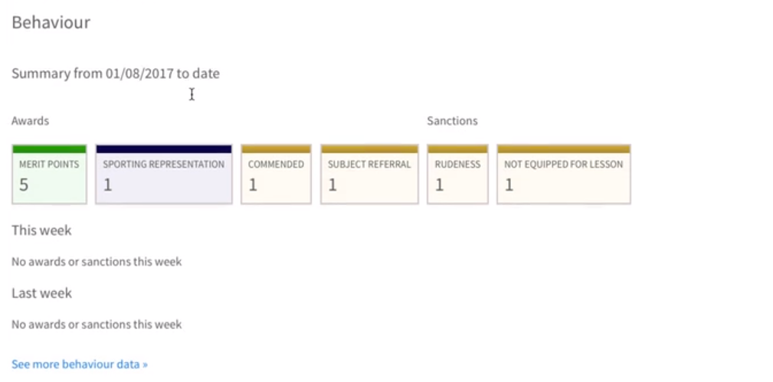
Timetable
Calendar
Subject information / resources
Homework
6th Form Bulletin
Extra Curricular
Parent portal
Achievement / Behaviour points
Notes:
Email on how to log on (NEED UPDATE TO DATE EMAIL). (SHEET).
Homepage on left- click child – sub heading behaviour (If blank=no points)

Slide 27
Printing
All Yr12 students have £12 credit on their printing account
Students who run out of credit have a £1 overdraft, but will need to update their printing account via ScoPay
Existing students who already have a ScoPay account can top up their account by clicking on the photocopying/printing tab
Students new to Highams Park will receive registration details about ScoPay

Slide 28
Mental Health Support
Tutors
Sixth form team:
Mrs Whitehead – HOY 12
Mrs Stephens – Head of sixth form
Ms Leona Wallace – HOY 13
Councillors in school
Mrs Caiger
External agencies

Slide 29
HIGHER EDUCATION APPLICATIONS
UCAS applications open in year 13
Completion of UCAS forms/applications begin in year 12.
Successful applications are built during year 12
Personal Statements
References
Work experience
Extra curricular opportunities

Slide 30
Target Grades
Each student will receive a target grade based on their GCSE results. This is what we believe is achievable with the right commitment by our students
We believe that our 6th form students can better their expected grades with the correct support from home and school and the right positive attitude
Students will receive these grades shortly

Slide 31
Choices
Vast number of options
University
Apprenticeship
Full time employment
Need to be doing their research now so that they are prepared and doing the right things ready for any application.

Slide 32
The Application Process
University – Personal Statement
Apprenticeships and Employment – Extended Application Form
Who they are beyond their grades, and how they have developed their interest outside of the classroom
Evidence based
Wider Reading, Documentaries, Podcasts, Taster Lectures, TED talks, Academic Magazines, Work Experience…

Slide 33
References & Predicted Grades
References are written by form tutors based upon feedback from subject teachers
Predicted grades are not “best possible”, they are the most likely grade a student will achieve at A Level, based on how they achieve in year 12
Universities will see the actual AS grades that a student achieves at the end of this Year 12

Slide 34
Getting Started
Students should be researching their choice from this week
Take advantage of courses, taster days, competitions, wider reading, volunteering etc
These will be in the Sixth Form Bulletin, parents and students should be reading this every week
Taking up opportunities from the bulletin or self researched.

Slide 35
Thank you all for listening
Please stay behind if you wish to speak with anyone from the 6th Form team.

