Slide 1
G8b Corrosion

Slide 2
Complete these word equations:
lead oxide
lead + oxygen → _________
aluminium + _______ → aluminium oxide
__________ + oxygen → potassium oxide
oxygen
potassium

Slide 3
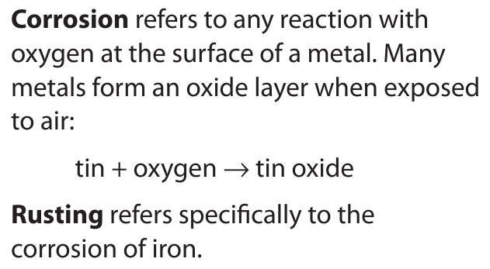
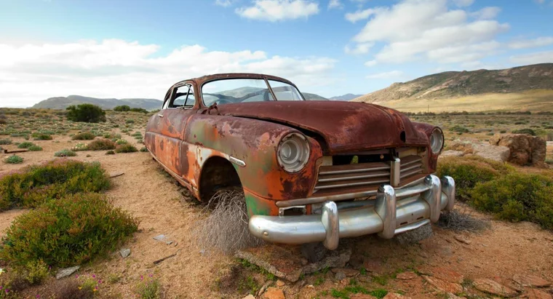

Slide 4
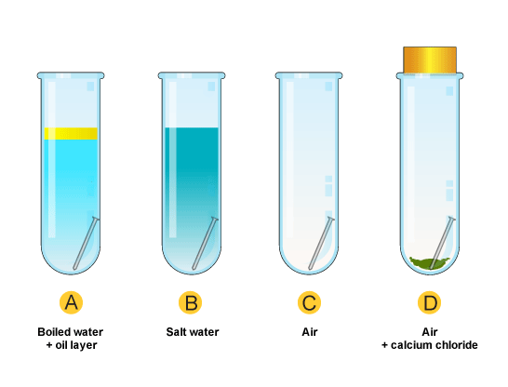
Investigating rusting
Set up the experiment as shown in the diagram above. Next lesson you will observe any changes

Slide 5
The chemical name for rust is hydrated hydroxide.
Rusting is a reaction between iron, oxygen and water.
Write this as a word equation.
iron + oxygen + water → hydrated hydroxide

Slide 6
Protecting from rust
All these methods provide a barrier between the iron and the oxygen and water vapour.
Oil
Plastic coating
Painting

Slide 7
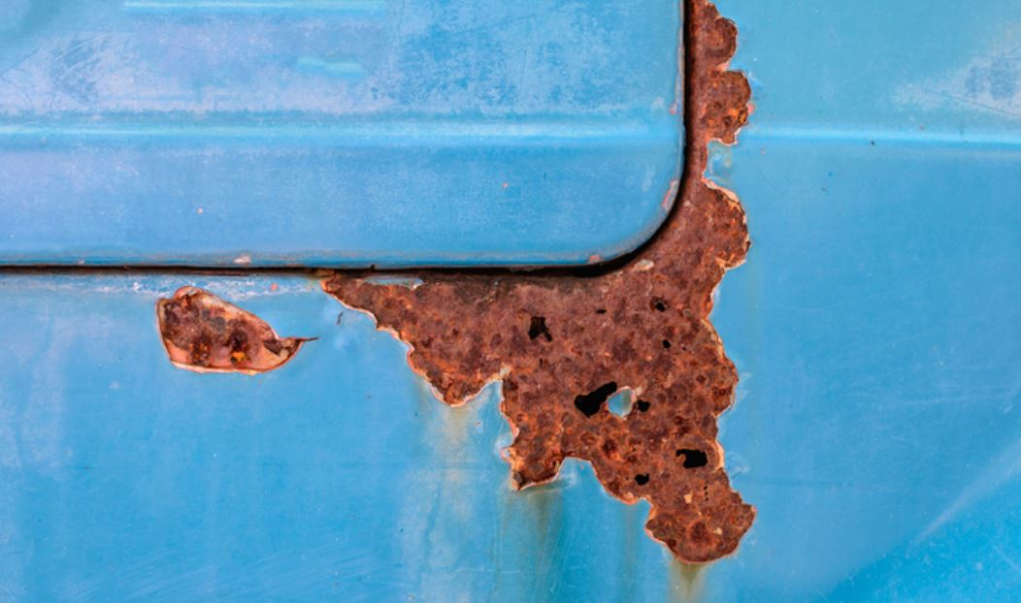
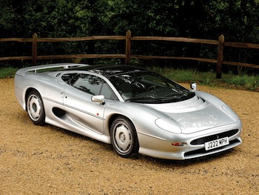
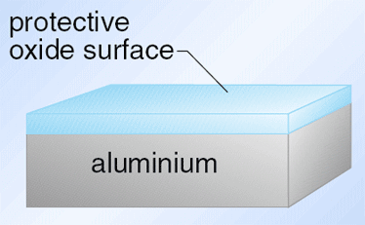
Rust is permeable so lets oxygen and water vapour through. Aluminium reacts with oxygen to form an impermeable aluminium oxide.

Slide 8
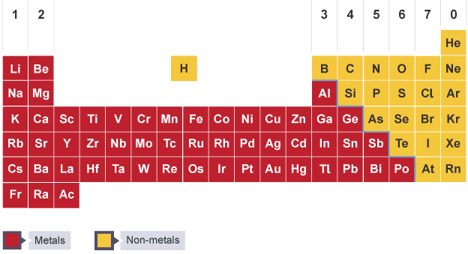
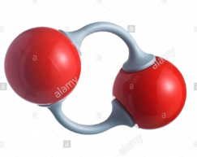
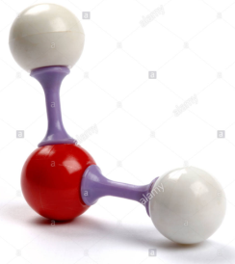
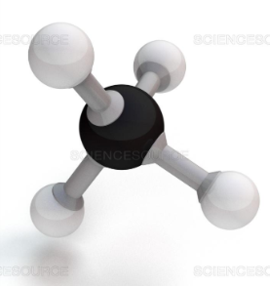
Chemical Formula
Model
Formula
O₂
H₂O
Black: carbon (C)
Red: oxygen (O)
White: hydrogen (H)
CO₂
CH₄

Slide 9
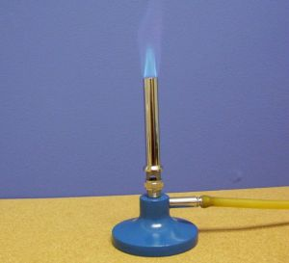
Chemical Equations
Methane (CH₄) reacts with oxygen (O₂) to produce carbon dioxide (CH₄) and water (H₂O).
Write a word equation for this reaction.
methane + oxygen → carbon dioxide + water

Slide 10
Balanced Symbol Equations
Methane (CH₄) reacts with oxygen (O₂) to produce carbon dioxide (CO₂) and water (H₂O).
methane + oxygen → carbon dioxide + water
Swap the words for the formulas
CH₄ + O₂ → CO₂ + H₂O

Slide 11
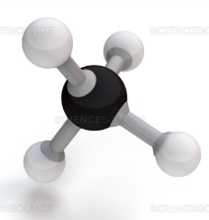
The number of atoms needs to be the same on each side of the equation.
+
→
+
CH₄ + O₂ → CO₂ + H₂O
2
2
C
1
1
H
2
4
X
4
O
4
2
X
3
X
4
+
→
+

Slide 12
Write the balanced symbol equation for the above reaction.
2
Mg + O₂ → MgO
2
© Pearson Education Ltd 2014. Copying permitted for purchasing institution only. This material is not copyright free.
Notes:
12

Slide 13
Balancing symbol equations
Examples for you to try
H₂ +
I₂ →
2
HI
© Pearson Education Ltd 2014. Copying permitted for purchasing institution only. This material is not copyright free.
Notes:
13

Slide 14
Balancing symbol equations
Examples for you to try
2
Na +
Cl₂ →
2
NaCl
© Pearson Education Ltd 2014. Copying permitted for purchasing institution only. This material is not copyright free.
Notes:
14

Slide 15
Balancing symbol equations
Examples for you to try
4
Li +
O₂ →
2
Li₂O
© Pearson Education Ltd 2014. Copying permitted for purchasing institution only. This material is not copyright free.
Notes:
15

Slide 16
Balancing symbol equations
Examples for you to try
4
Fe +
3
O₂ →
2
Fe₂O₃
© Pearson Education Ltd 2014. Copying permitted for purchasing institution only. This material is not copyright free.
Notes:
16

Slide 17
Tube B
Tube D
Tube A. Iron and _______
Tube B. Iron, water, ________ and salt
Tube C. Iron, oxygen and ________
Tube D. Iron and _________
Investigating rusting
Conclusion
Record your observations
Tube A
Tube C

Slide 18
