Slide 1
31/10/18 Models for circuits 7Jb c.w

Slide 2
C.W Learning objectives 31.10.11
Identify common circuit components and their symbols.
Model circuits using simple circuit diagrams
Recall that current is not used up.
State what is meant by: current.
Construct a circuit from instructions provided in the form of a circuit diagram.
Use a model to describe how an electrical circuit works
Evaluate a physical model for electric circuits on how well it explains data or observations.

Slide 3
The counter model
Get into allocated groups of 6.
Person A stands with a container and hands out a coin to each person that passes.
Person B, C, D and E move in a circle, collect a coin; hand it to person F and return by way of the circle to person A to collect another.
Repeat until each person has collected and handed over 3 coins.
What do the coins represent?
What does the person handing out counters represent (A)?
What do the people moving in a circle represent (B,C,D and E)?
What does the person collecting the coins represent (F)?

Slide 4
Stick the work sheet into your books. Answer the questions after reading the text

Slide 5
On your worksheet, tick the ideas/ statements that you think are correct

Slide 6
Set up instructions for practical
Get into allocated groups of 4.
Person A collects power pack
Peron B collects 2 bulbs
Person C collects ammeter
Person D collects connecting wires.

Slide 7
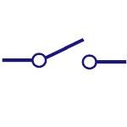
In your groups, set up the circuits below and read the current in each case. Answer the questions on your results sheet.

Slide 8
Results: Answer the following questions
What is the current in Amps in circuit A
2) What happens when the switch in open?
3) What is the current in Amps in circuit B?
4) What is the current in Amps in circuit C?

Slide 9
Write your conclusion by completing the word-fill below
When the switch is open, there is no_____________ flowing and the ___________ does not light.
Adding an extra bulb to the circuit ______________ the current.
Changing the position of the _____________ does not effect the current. This shows that the current is ______ _______ everywhere in the circuit.
current
bulb
reduces
ammeter
the same
the same different reduces increases current voltage bulb torch ammeter voltmeter

Slide 10
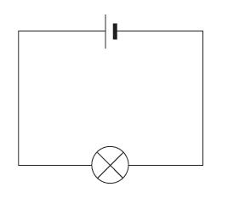
Extension: Which materials conduct electricity
Use your simple circuit with the bulb attached at one end to the battery pack. Use the crocodile clips to connect each material, in turn, to both the bulb and the battery pack so that it completes the circuit. In each case, observe whether the bulb lights or not.
Conductor | Insulator

