Slide 1
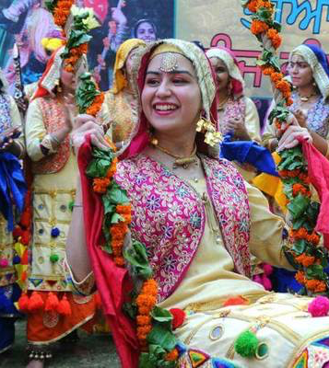
International Culture Day
Wednesday 8 March 2023

Slide 2
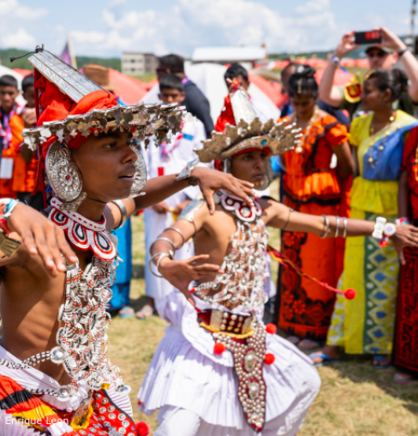
What are the opportunities and benefits of celebrating International Culture Day?
We live in a multicultural city and are surrounded by hundreds of different nationalities with many spoken languages.
Our borough Waltham Forest has won a prize for borough of culture so this day would be a fantastic celebration of diversity.
Culture is important in school. We work and learn with people from a variety of cultures and backgrounds in school and this day will help us to learn more about each other.
Every member of the school, including teachers, will be able to share, and explore different cultures.
Also, just in general cultural celebrations allow space for respect and open-mindedness from other cultures. Celebrating our interests as well as differences helps educate one another and make others understand to learn and appreciate other cultures.

Slide 3
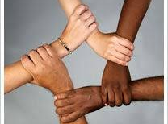
International Culture Day 2023
During this day, students will have the opportunity to:
Come in wearing their traditional clothes
Share traditional foods
Share traditional music
Cultural clothes fashion show
Incorporate culture day into lessons
Discuss and incorporate International Women’s day which falls on 8 March every year into our celebrations!

Slide 4
Frequently Asked Questions:
1. What do you mean by international culture?
On this day we want to learn about and celebrate cultures from all around the world.
2. Why are you running this day?
Highams Park has a wide diversity of students and staff from a range of nationalities. Students from Year 7- 13 have requested to have a day to celebrate this. We aim to be as inclusive as possible, allowing all students to participate. This event follows on from our successful International Literacy Week last November: Languages We Speak, Meanings We Share..... — Highams Park School (fireflycloud.net)
International Literacy Week 2021 — Highams Park School (fireflycloud.net)

Slide 5
Frequently Asked Questions:
3. What events will run on the day?
Music and whole school discussions of cultural differences.
The canteen will provide foods which have an international element to them.
Students will be encouraged to create PPT’s on international cultures which will be played in form time/lessons during the day.
Students and staff will have the opportunity to wear cultural clothing which respectfully celebrates the diversity of cultures which we have in Highams Park school. It would be great if as many staff could participate as possible.
Students will also run 2 stalls during lunchtime enabling students to come and try a range of international foods.
Students will have the opportunity to listen to international cultural playlists of music

Slide 6
Frequently Asked Questions:
4. I’m English and don’t have any known links to other countries in my immediate heritage – what can I do and wear?
You may however wish to wear the colours of your favourite international culture instead (or respectfully adorn anything else with a cultural link to that country). So, for example if you like the country Greece, you could wear white and blue clothes or green, black and yellow for Jamaica!
Students will be encouraged to create PPT’s on international cultures which will be played in form time/lessons during the day.
You can wear traditional English clothing.

Slide 7
Frequently Asked Questions:
5. Can I wear clothes which represent someone else’s culture?
Yes, you can. However, be mindful of cultural appropriation – it is important to show respect to other people’s culture, so if you choose to wear items from a culture which isn’t yours, please ensure that you wear them correctly and without causing offence to others.
You may alternatively wish to accessorise or wear the colours of your favourite international culture instead.
Please be open minded e.g., remember that someone wearing a sari who doesn’t obviously look Asian may have a cultural link to that heritage.

Slide 8
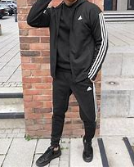
Frequently Asked Questions:
6. What can I wear instead of cultural clothing?
As this is a specific day, we respectfully ask that you either participate by wearing cultural clothing/colours or that you come in your normal school uniform. There is no in between option!
No tracksuits or school environment inappropriate cultural wear!
Trainers ARE allowed.
Remember this day is very important for many students and staff so do not disrespect them by wearing everyday wear.

Slide 9
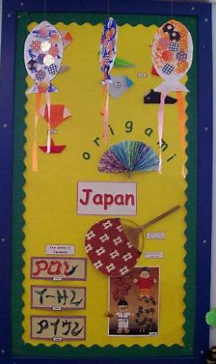
How else can I participate:
Student activities:

Slide 10
1. Create a PPT of your culture or your favourite international culture:
Please create an interesting, informative and eye-catching 6 slide (max) PPT on international culture and email this to spiggin@highamsparkschool.co.uk
by Friday 03 March 2023
These will be shown in lessons throughout the day.
Don’t forget to add your name and form to it!

Slide 11
2. Create posters of your own international culture/an international culture of your choice
Expectations
Ensure that they clearly identify the culture you are talking about.
Text must be of a readable size!
Images and information must be accurate and respectful to the culture you are talking about.
Don’t forget to add your name and form!
Email this to spiggin@highamsparkschool.co.uk
By Friday 03 March 2023
These will be displayed around the school

Slide 12
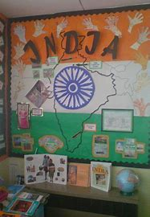
3. TUTOR GROUP ACTIVITY: Adorn your form notice board with information/images about one international culture of your choice.
Expectations:
This must be completed with your form/form tutor.
Ensure that the country of your international culture clearly features in the display
This must be completed by Monday 06 March 2023
Form tutors to take a picture of the completed door and email to Mrs Piggin: spiggin@highamsparkschool.co.uk

Slide 13
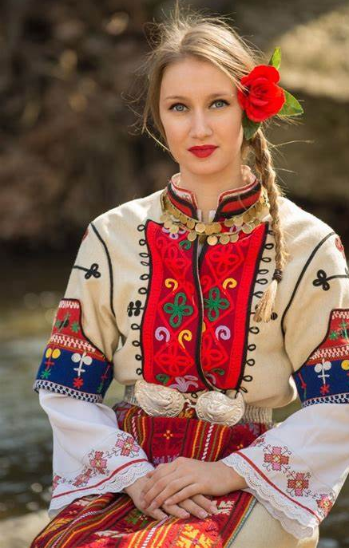
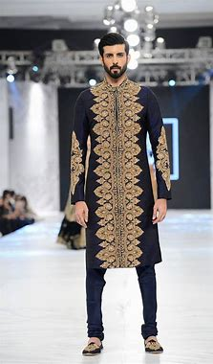
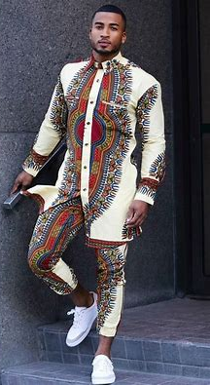
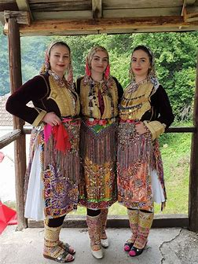
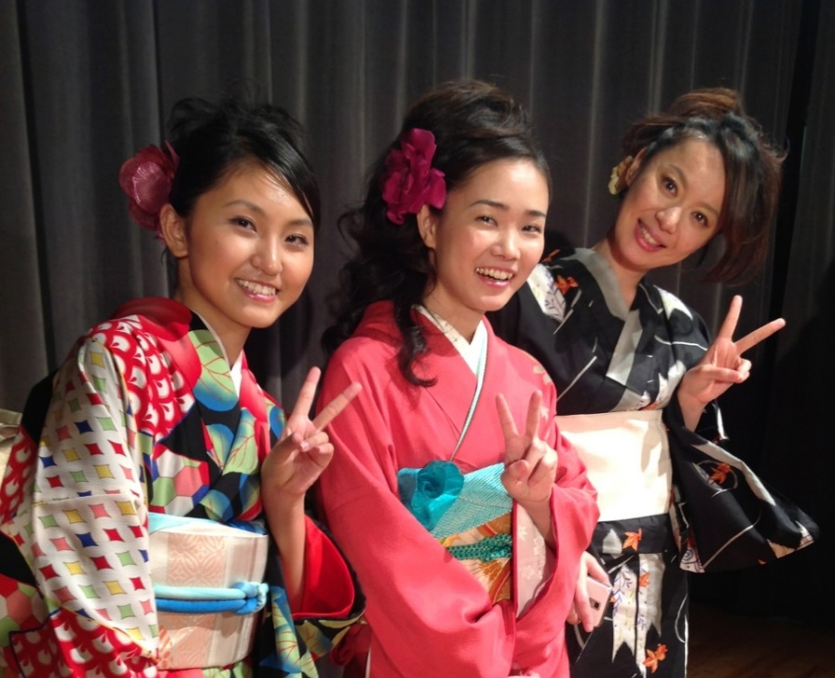
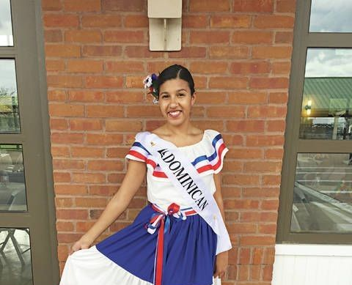
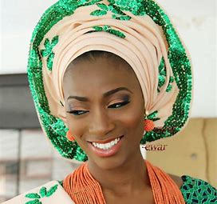
4. Participate in our International Cultural Day Fashion Show!
When: 3.30-4.15 on Wednesday 08 March 2023 in the Main School Hall
Email: spiggin@highamsparkschool.co.uk by 03/3/2023 to register your name and country.

Slide 14
Helpers
Many of you have already offered to help out on the day. Please do email me spiggin@highamsparkschool.co.uk so I can assign you to different activities as needed.
Please do this by Thursday 02 March 2023.

Slide 15
International Culture Day

