Slide 1
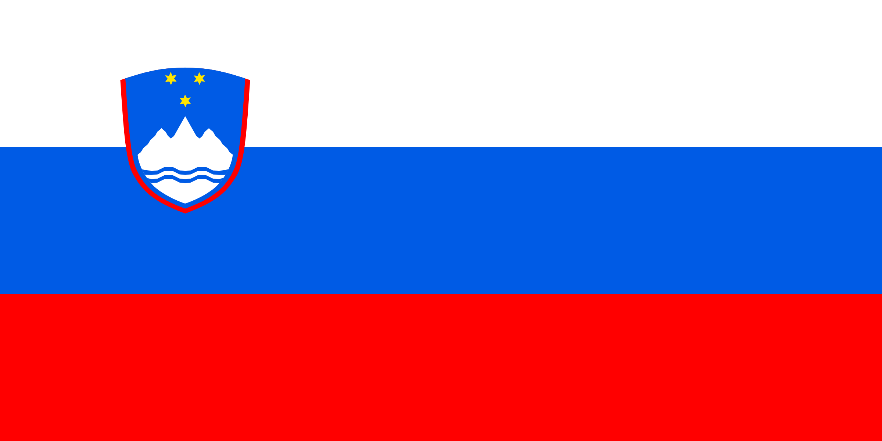
International culture day
Slovenia
By Edward Corbett 7F1 25.2.2023

Slide 2
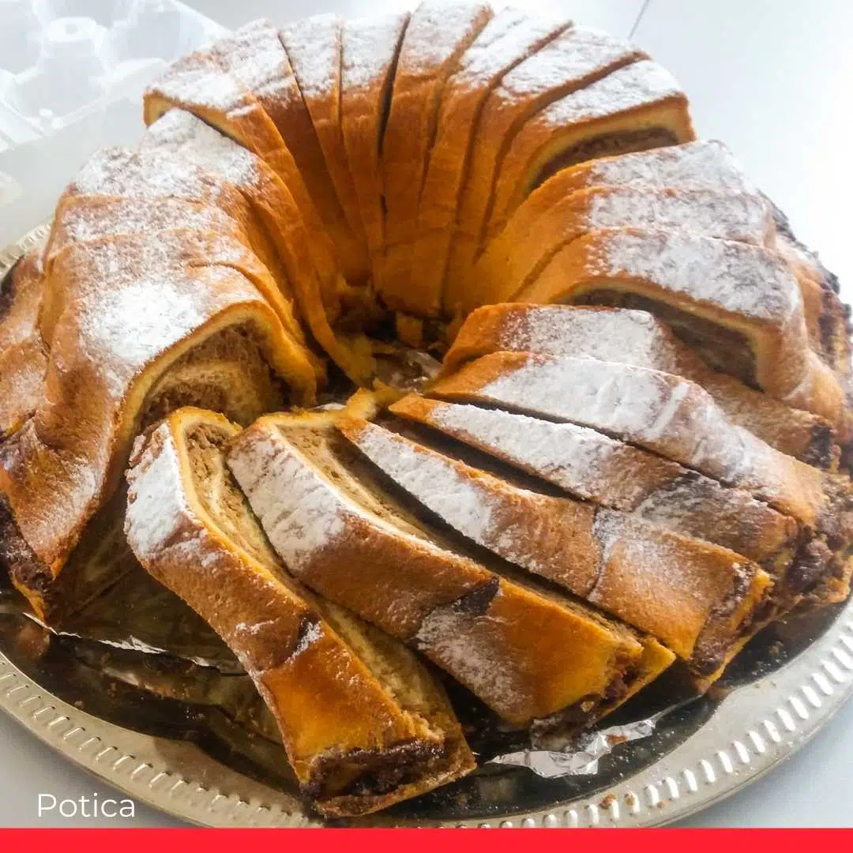
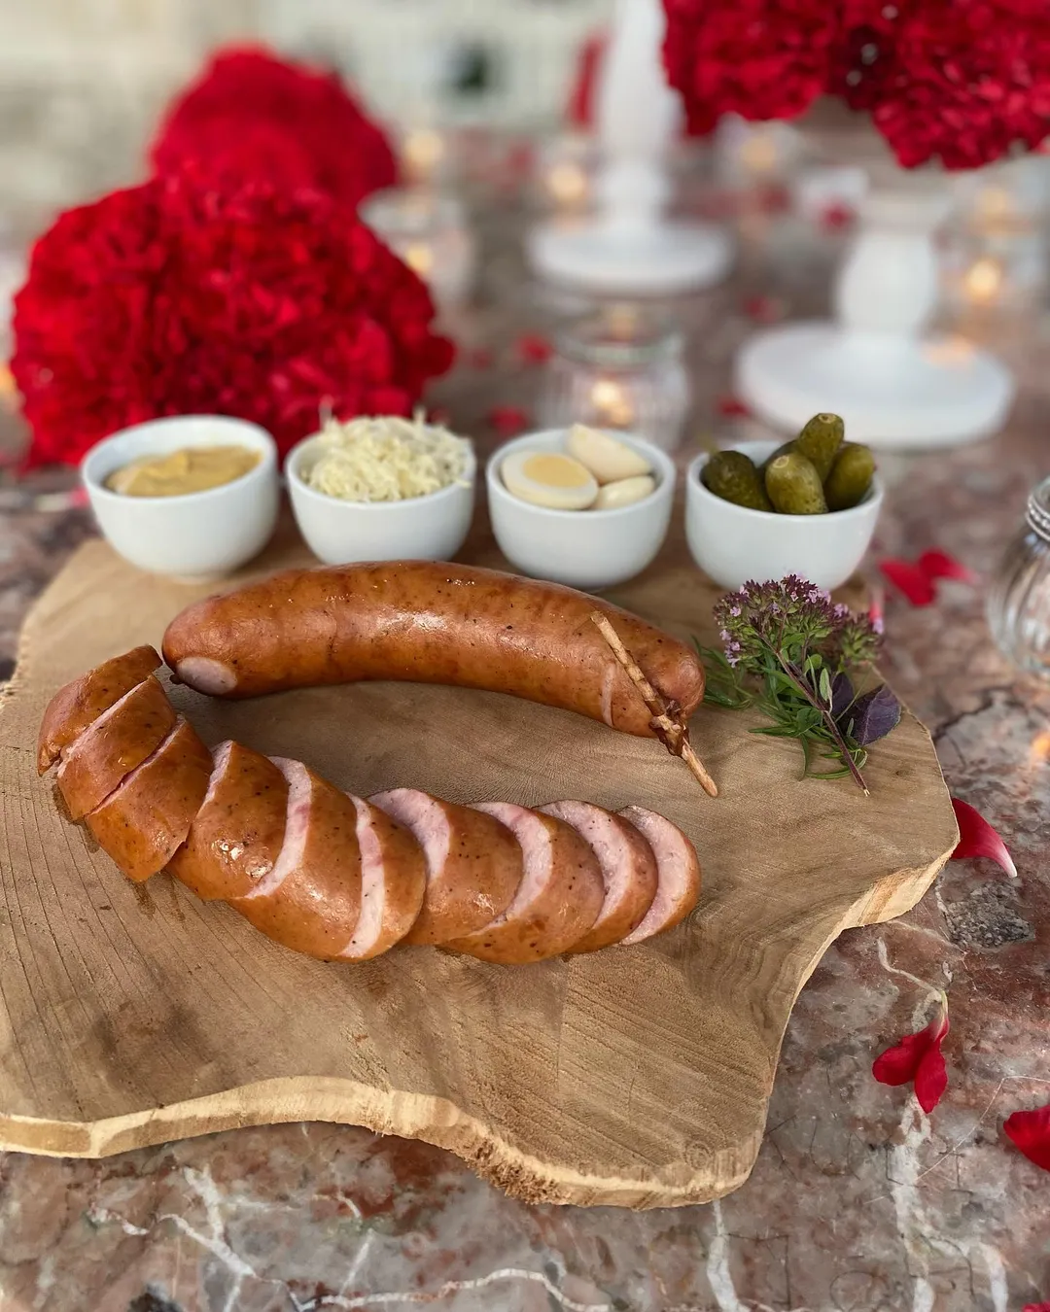
Food
Pražen Krompir (sautéed potatoes with onion)
Potica (nut roll)
Prekmurska Gibanica (layered cake)
Blejska Kremšnita (cream cake)
Jabolčni Štrudelj (Slovenian apple strudel)
Kranjska Klobasa (Carniolan sausage)

Slide 3
Clothes
The national costume of Slovenia is named “Gorenjska” (Upper Carniola) folk costume. But today, most people wear modern western clothing, like we do.

Slide 4
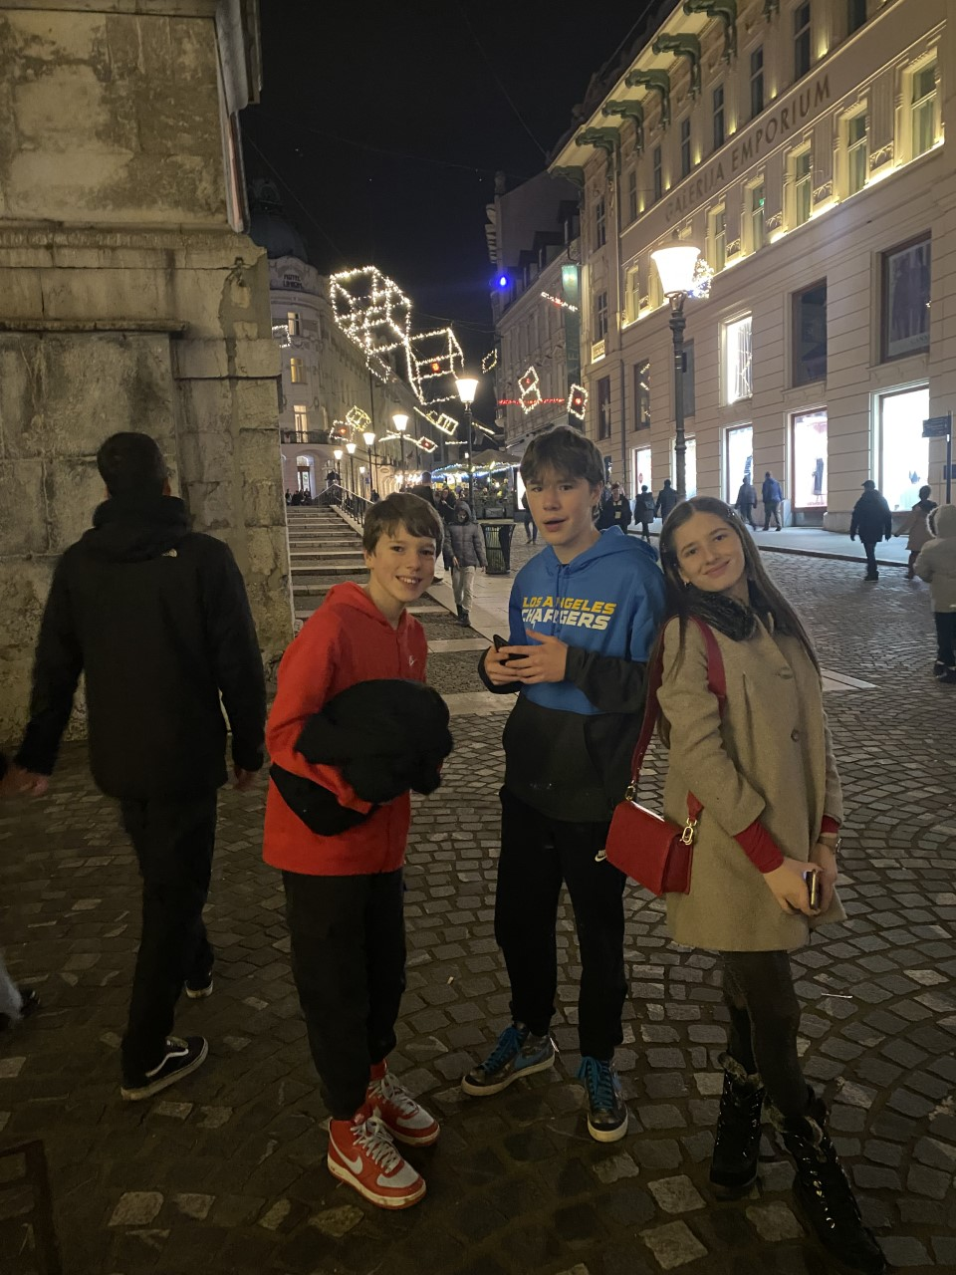
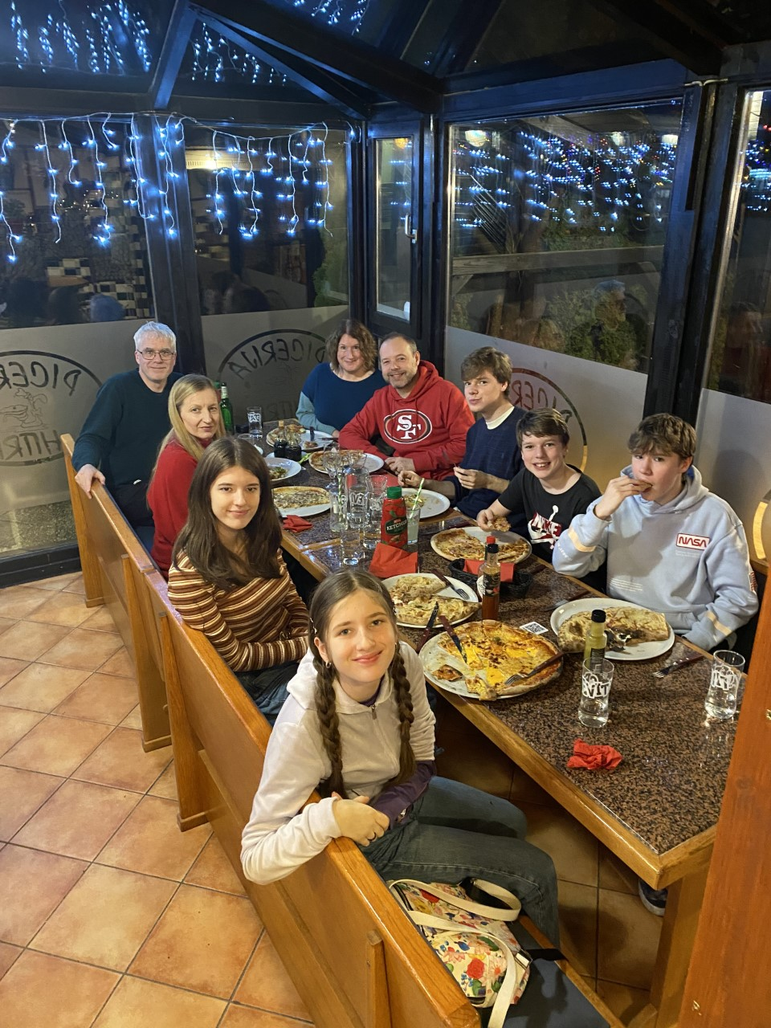
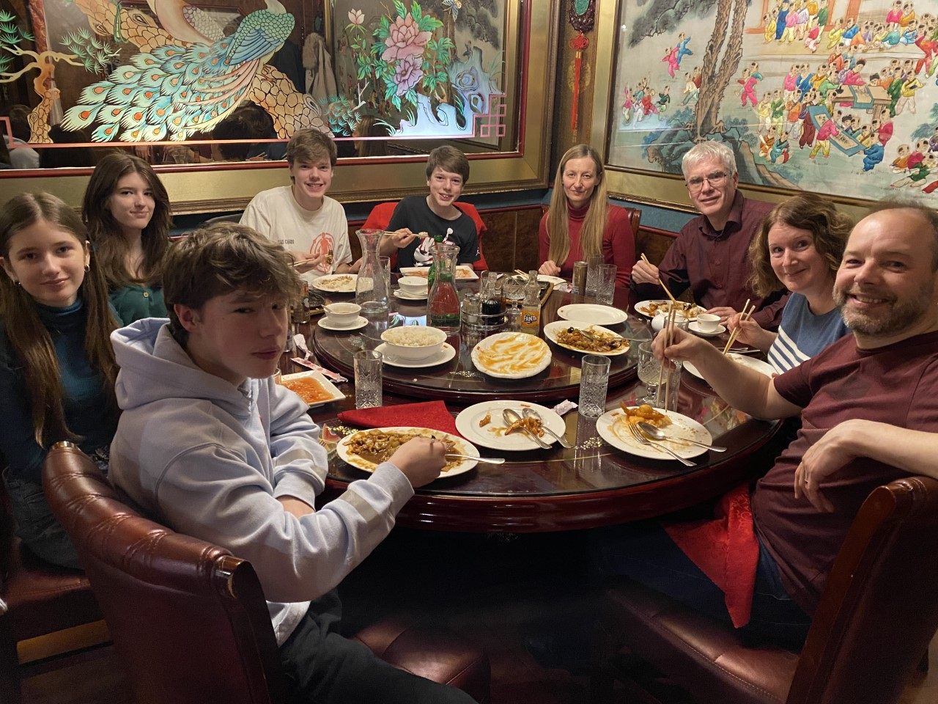
My family
My family live in Vhr, a town near Ljubljana (the capital city).
There are lots of mountains in Slovenia, the tallest being Triglav, which is shown in the flag.

Slide 5
Thank you for reading!

