Slide 1
CW
8Ab Weighting and bias
What does the word bias mean?
Bias in science can be a real problem.
@hpscience

Slide 2
Introduction for teachers
This lesson aims to get students to think about how science is reported in popular media and how ‘bad science’ is used to affect people’s opinion.
It uses the words bias and weighting.
There is not much writing to be done in this lesson. It is lesson that lends itself to thought and discussion.

Slide 3
Bias – a shift (move) away from the true value or meaning
Football supporters and politicians will have biased opinions about their own teams and political parties.
Weighting – using words (usually verbs) that have a more powerful or descriptive meaning.
Weighting is useful if you are trying to prove a point of have an argument.

Slide 4
A scientist may dismiss or ignore results that do not fit their hypothesis. This is being biased.
A scientist may use language that is more powerful than it needs to be to add weight to their argument.

Slide 5
A verb is a word that describes an action.
You can strengthen your verbs to make your language more powerful.
Adjectives are words that are used to describe nouns, e.g. big fat juicy hamburger. These can also be used to make your language more powerful.
A noun is a person, thing, place, idea or concept.

Slide 6
You can end this lesson here or you can continue to look at how bias in science can be a really bad thing.
You could do something else or potentially suffer death by powerpoint.

Slide 7
Bad Science and pseudoscience vs. The Scientific Method

Slide 8
Sometimes newspapers and other media sources, e.g. the internet, take a piece of science research and interpret it to make it sound more dramatic and alarming.
This makes the article more interesting and more people are likely to buy your newspaper or click on your article (clickbait).
This bending and stretching of the truth is known as ‘bad science’.

Slide 9
Bad Science
Reasons for bad science: poor research, poorly designed experiments, misconduct by researchers, and accidental or deliberate misinterpretation of data.
Sometimes this is not the fault of the scientists, for the media can take a small observation or a statement that is written in a guarded way as a possibility, and turn this into established facts. A “cure for all types of cancer” is one of the most common (and misleading) headlines.

Slide 10
Good video
https://www.youtube.com/watch?v=ZZYSBlLRxfs

Slide 11
WARNING - The video is high level and a bit boring
https://www.ted.com/talks/ben_goldacre_battling_bad_science
https://www.youtube.com/watch?v=h4MhbkWJzKk
Same video different source.
15 minutes

Slide 12
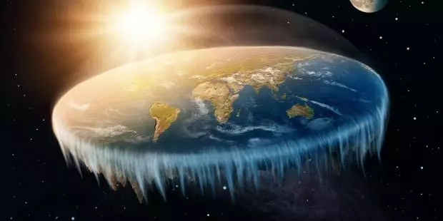
Pseudoscience
Pseudo – false or fake
Pseudoscience – false or fake science, e.g. flat earth theory.
Pseudoscience is incompatible with scientific method because it is reported as fact without valid evidence or scientific review.
Do you know any fake science?

Slide 13
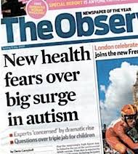
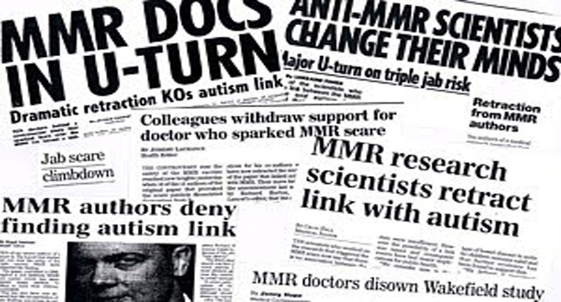
Both bad science and pseudoscience can be misleading and damaging and in some cases it can be extremely dangerous.

Slide 14
Case study – MMR causes autism
A scientist published his research that claimed that MMR vaccinations caused autism.
His research was seriously flawed. It was based on a study of just 12 children. It was not reviewed by other scientists.
However, many parents stopped given their children the MMR vaccination and some children have subsequently died as a result.

Slide 15
We sometimes hear people say;
I don’t need science
I don’t like science.
Science is boring.
Science is too hard.
Are you willing to be manipulated and influenced by bad science or pseudoscience?
We teach you science for a very important reason.
Being able to understand science and tell good science from bad science is extremely valuable.

Slide 16
When a scientist believes that they have discovered something new or different they have to publish their ideas in a Scientific Journal for other scientists to read and review.
This process is really important. It stops people from just publishing information that simply isn’t true and cannot be backed up with evidence.
This is part of the Scientific Method

Slide 17
The Scientific Method
The scientific method tries to minimize the influence of bias.
It is difficult for any scientist to totally remove bias because we all filter information based on our own experiences.
Unfortunately, this filtering process can cause a scientist to prefer one outcome over another.
In the scientific community, where results have to be reviewed and duplicated, bias must be avoided at all costs.

Slide 18
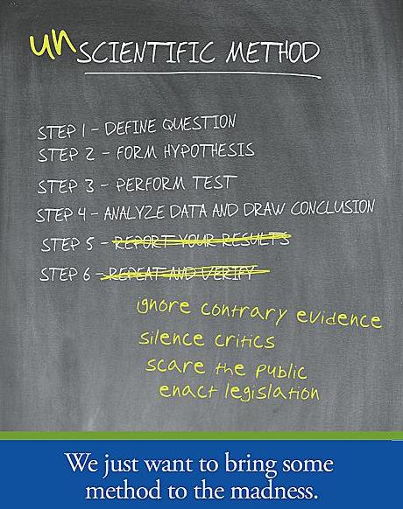
Question
Hypothesis
Prediction
Experiment
Data
Conclusion
Report
Do you remember this from year 7?

Slide 19
Is the method valid?
Can you spot good science?
Can you trust the source of information?
Watch out for bad science
Don’t be fooled by pseudoscience
Is it backed up by other scientists?
Are they ‘weighting’ their language?
Have they been biased?

