Slide 1
Comparing Gas Exchange
https://www.activeteachonline.com/product/view/id/335/page/48/mode/dps?modal=/player/video/id/389225

Slide 2
Objectives
• Compare respiration in plants and animals.
-Describe how gas exchange occurs in plants.
• Compare the human gaseous exchange system with those of other animals.
• Identify the limitations of lungs, gills and body surface covering as sites of gas exchange.

Slide 3
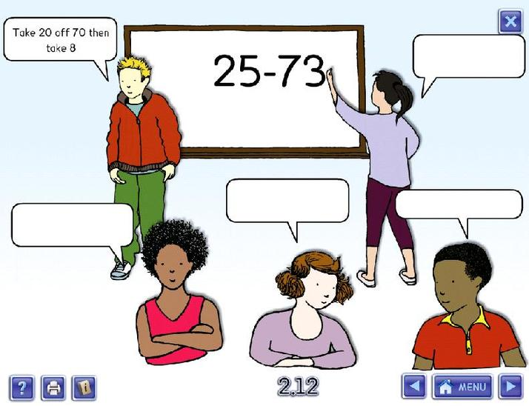
Which of these statements are the closest to the truth? Which are wrong? Why? You have 1 minute to think on your own, then one minute to discuss with a partner then we will share with the class.
Respiration is the scientific way of saying breathing
Introduction to Respiration
Respiration is a way to produce energy
Respiration is a chemical reaction that releases energy
Animals respire, plants photosynthesise

Slide 4
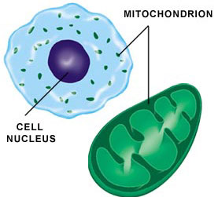
Aerobic Respiration
Tip:
Energy is not produced or made in respiration. The energy is RELEASED
This chemical reaction uses glucose and oxygen to release energy. The glucose reacts with the oxygen and is oxidised. Aerobic means in the presence of oxygen
What is the energy in respiration used for in organisms?
Movement
Growth/Repair
Building new molecules
Maintaining body temperature
The chemical reaction aerobic respiration takes place inside mitochondria which is an organelle found in animals and plant cells. (Remember plants respire also!)

Slide 5
Watch the video and make a list of different animals and how they exchange gases.
https://www.youtube.com/watch?v=LXGG-HgtJoI

Slide 6
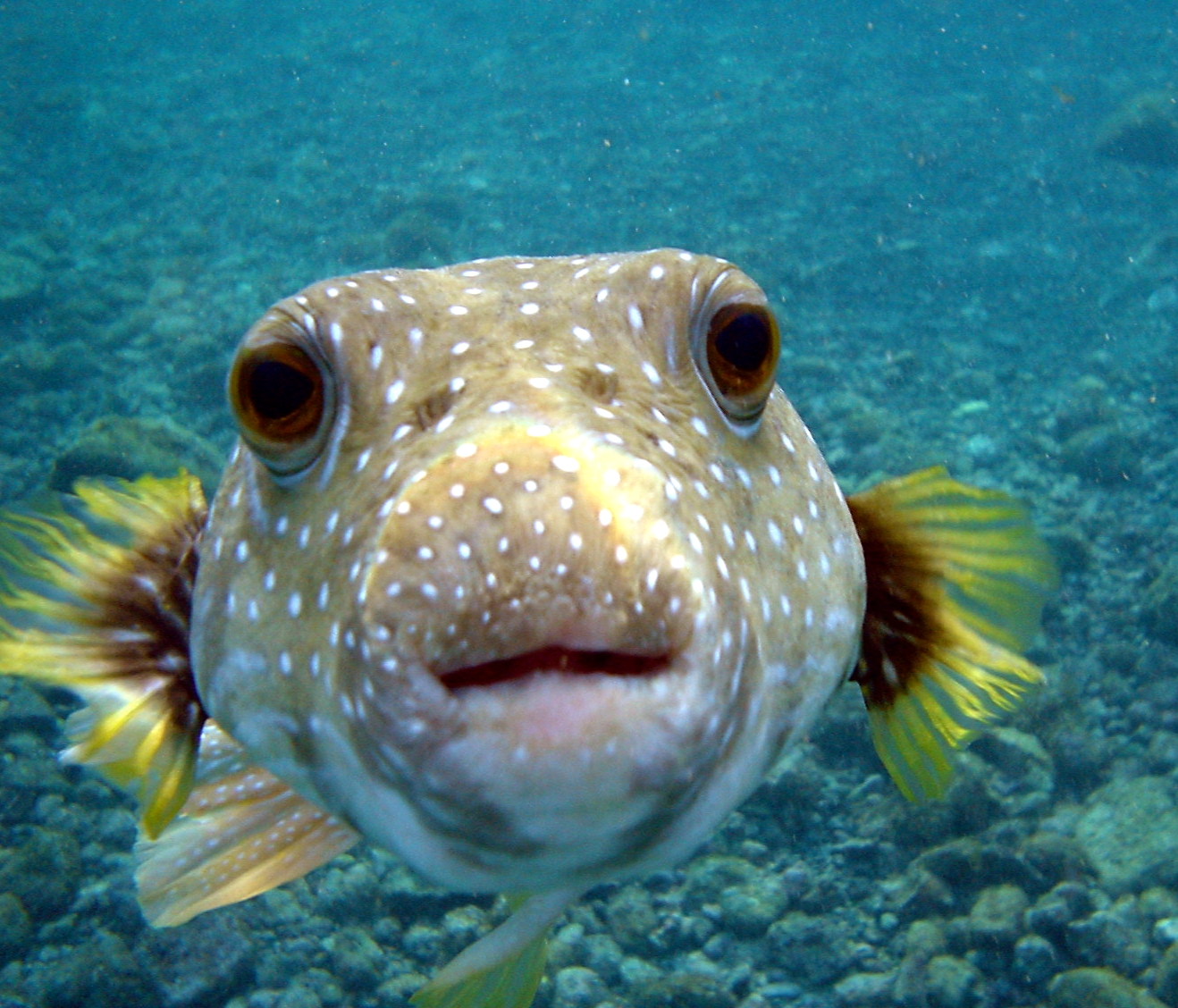
Do I still need oxygen to live?
How am I adapted to ‘breathe’ under water?

Slide 7
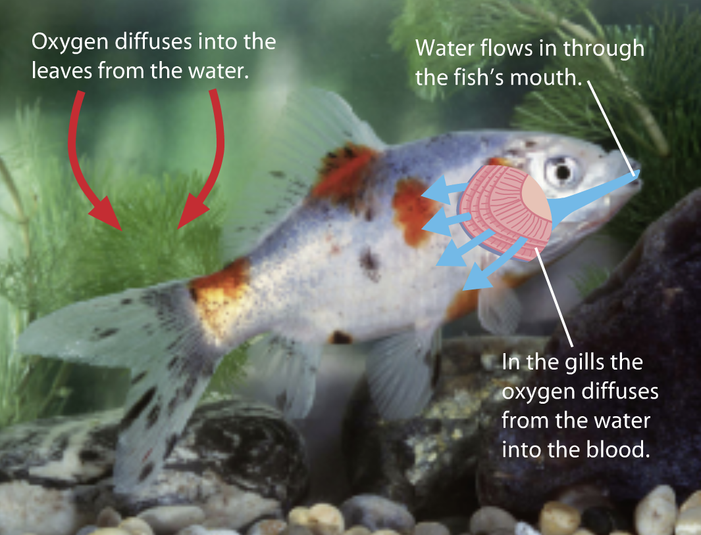
How are gills adapted in a similar way to alveoli to increase respiration?

Slide 9
https://www.activeteachonline.com/product/view/id/335/page/48/mode/dps?modal=/player/video/id/389226

Slide 10
Draw the table and write down the sentences (from the next slide) into the correct column.
Can be done as a cut and stick activity.
Only animals | Only plants | Both

Slide 11
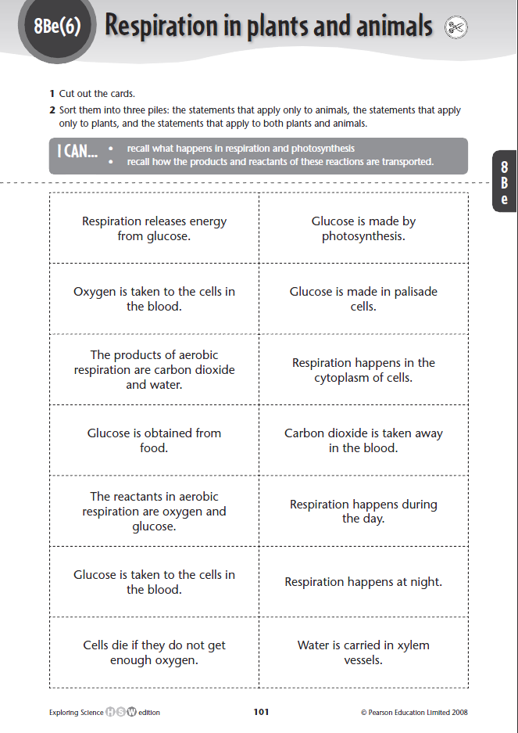

Slide 12
