Slide 1
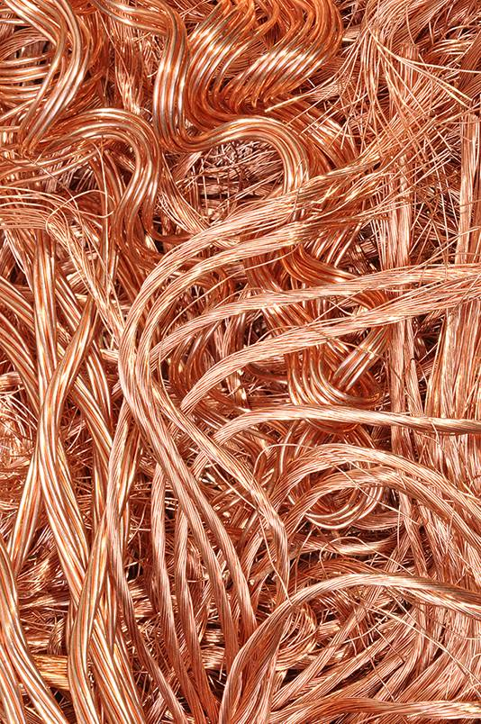
8Ge Pure Metals and Alloys
CW
Do Now:
Put these in order of most to least reactive; copper, gold, silver, platinum, iron, sodium, potassium

Slide 2
Alloys
Copy & Complete
Alloys are a mixture of a metal element with another element.
Bronze contains Cu and Sn (______ + ___)
Brass contains Cu and Zn (______ + ____)
Solder contains Pb and Sn (____ + ____)
Stainless steal Fe and C and Cr(____ + ______ + _________)
Duralumin Al, Cu + Mg (_________, ______, + __________)
copper
tin
copper
zinc
tin
lead
iron
carbon
chromium
copper
magnesium
aluminium

Slide 3
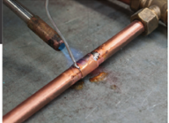
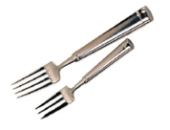
Alloys have different properties than the elements used to make them
Alloy Main metal Added element Improved property Example of use
Solder
Duralumin
Stainless steel
Copper &
magnesium
tin
Carbon and chromium
Stronger and more corrosion resistant than main metal
iron
aluminium
lead
solder
Lighter and stronger than main metal
Duralumin
Lower melting point than main metal
Stainless steel

Slide 4
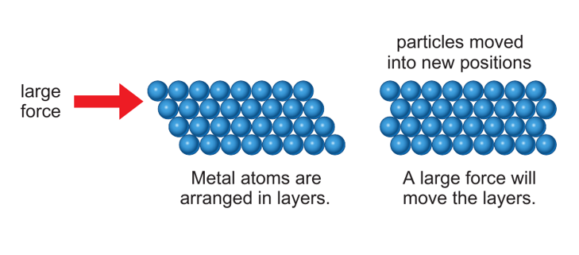
Write Down
Metals are malleable because layers of atoms can slide over each other when under stress

Slide 5
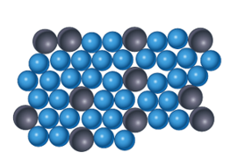
This is a particle model of an alloy. How would the addition of larger atoms affect the malleability ?
In and alloy the different atoms jam up the structure so the layers cannot easily slide.

Slide 6
Plot the graph.
Describe how the melting point changes as the percentage of tin increases.

Slide 7
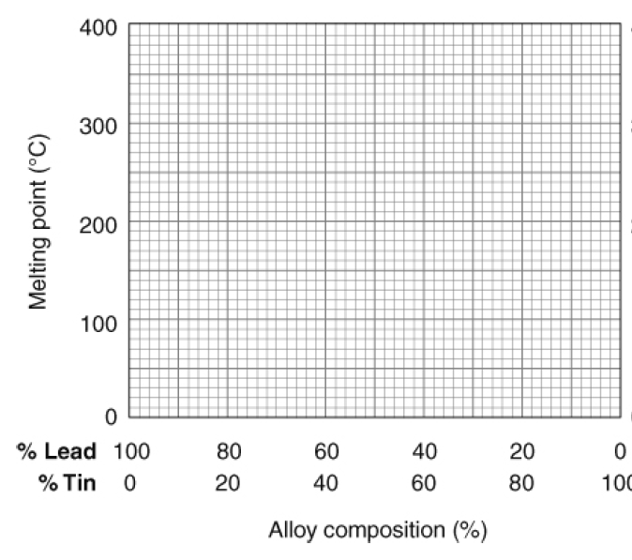
The melting point of solder steeply decreases down to 40% tin and then increases less steeply to 100% tin

Slide 8
Questions
Use your graph to identify the melting points of pure lead and pure tin.
Which mixture produces the solder with the lowest melting point?
Two old pieces of iron were tested. Iron X melted at exactly 1535°C. Iron Y melted between 1400 °C and 1450 °C.
3. Which sample was pure iron? Explain.
4. Suggest why most structures are made from iron alloys rather than pure iron.

Slide 9
Answers
Check your work
327 °C
60% Lead 40% tin
Sample X is the pure iron because it has a fixed melting point
Iron alloys are stronger and more corrosion resistant than iron

Slide 10
Melting Points
Write Down
Pure substances have fixed melting points.
e.g.
Sugar
Water
Iron
0 °C
186 °C
1,538 °C

Slide 11
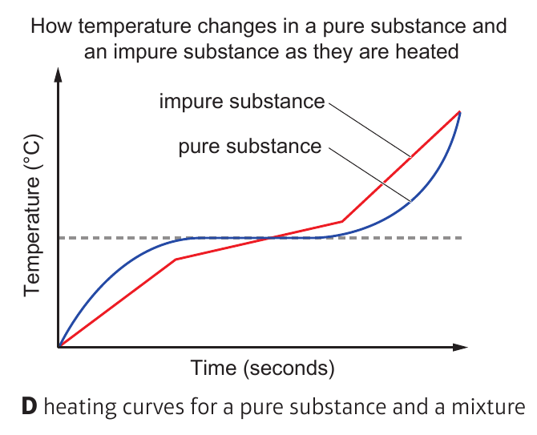
Add the labels ‘pure substance’ and ‘impure substance’
Impure substance
Pure substance

Slide 12
Alloy Main metal Added element Improved property Example of use
Copper &
magnesium
tin
Carbon and chromium
Stronger and more corrosion resistant than main metal
Solder
Duralumin
Stainless steel
iron
aluminium
lead
solder
Lighter and stronger than main metal
Duralumin
Lower melting point than main metal
Stainless steel

