Slide 1
7Ja Switches and Current
CW
Do Now:
How can you make a bulb light up?

Slide 2
Requisitions
Equipment | Worksheets
Wires Bulbs Batteries Conductors and Insulators | Circuit Symbols

Slide 3
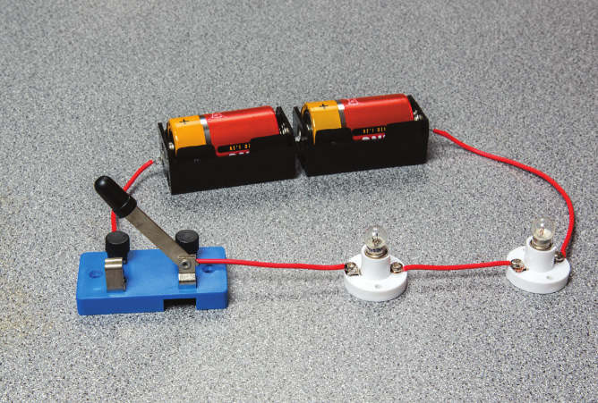
Why are the bulbs not lighting up?

Slide 4
Why are the bulbs not lighting up?

Slide 5
Flowing Electricity
Write Down
The current is the amount of electricity flowing around a circuit.
The current carries energy to bulbs or other components.
There must be a complete circuit or the current will not flow.

Slide 6
Copy & Complete
Electric current can flow freely in a conductor but cannot flow through an insulator
An example of a conductor is……………………
An example of an insulator is……………………

Slide 7
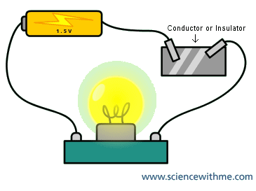
Conductor or Insulator?
Connect the different items into the circuit and see if they allow current to flow?
If they don't have current to flow, does that mean they have high or low resistance?

Slide 8
Materials | Conductor or Insulator?

Slide 9
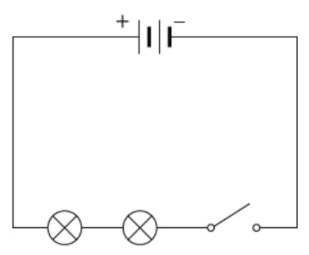
Are these the same circuit?
The bulbs are not lit because…

Slide 10
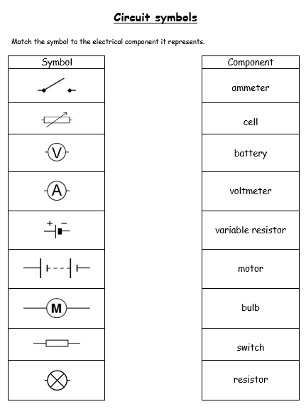
Circuit Symbols
Match the symbol to its name

Slide 11
Circuit Symbols
Symbol |  | Component
 |  | ammeter
 |  | cell
 |  | battery
 |  | voltmeter
 |  | variable resistor
 |  | motor
 |  | bulb
 |  | witch
 |  | Resistor

