Slide 1
Resources
Worksheets
8Fb2 – chemical physical changes practical sheet
Practical
8Fb2 run as circus
Teacher Demos

Slide 2
Objectives
Explain how chemical reactions are different to physical changes.
Explain the difference between physical and chemical properties of a substance.
Use observations to decide whether a chemical reaction has taken place.
Model simple chemical reactions using word equations.
Use a simple (Dalton’s) model to describe a compound.
Model more complex chemical reactions using word equations.
Describe how atoms are rearranged in chemical reactions.
Write simple chemical formulae from information on structure.
Interpret formulae to identify the types of and ratio of atoms in a compound.
Give a simple description of the valency of an element and use these to deduce the formula of compounds (containing two main group elements).
© Pearson Education Ltd 2014. Copying permitted for purchasing institution only. This material is not copyright free.

Slide 3
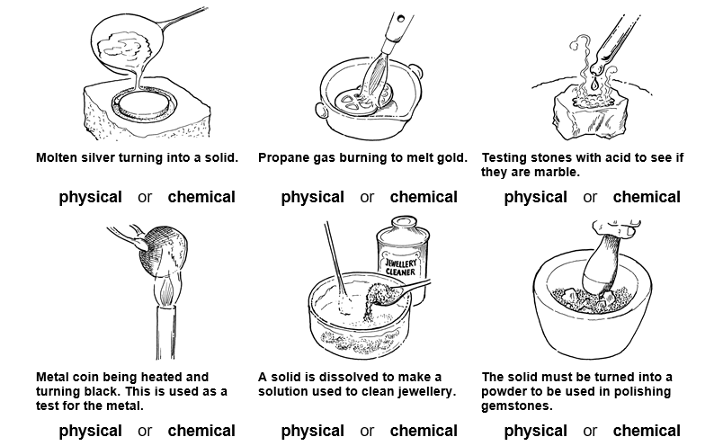
8Fb Chemical properties
Which of these pictures show chemical changes?
1
2
3
4
5
6
@hpscience

Slide 4
How can you spot a chemical reaction?
You might recognize that a chemical reaction is happening because the substances involved:
change colour
give off a gas
get hot
get cold
give out light
make smells
form solids.
New substances are formed in chemical reactions.
Chemical changes are often difficult to reverse.
The chemical properties of a substance describe how it reacts with other substances.
Notes:
Photo credit: © 2008 Jupiterimages Corporation

Slide 5
w/s 8Fb2 – Types of Change
Experiment | Observation | Physical or chemical?
1
2
3
4
5
6

Slide 6
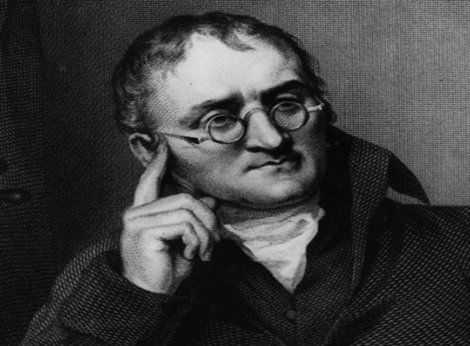
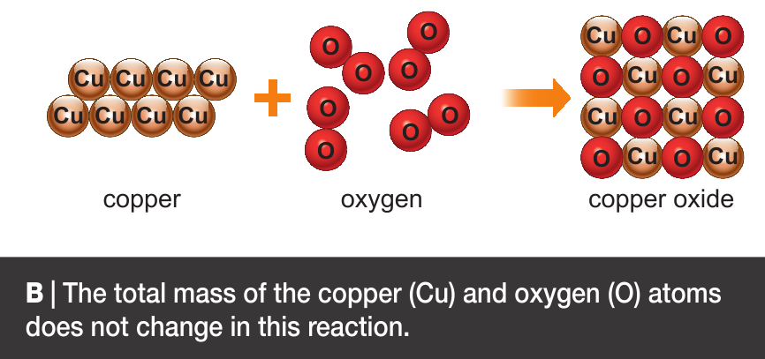
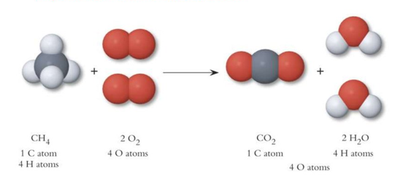
Mass of reactants = mass of products
Atoms are rearranged during a chemical reaction i.e. the are joined together (bonded) in different combinations and shapes
Dalton used this theory to predict that:

Slide 7
Word equations are used to represent chemical reactions
Remember: 7F &7H units
When carbon burns it combines with oxygen to form the compound carbon dioxide.
Write a word equation for this reaction.
Carbon + Oxygen → carbon dioxide
C + O₂ → CO₂
Which equation gives you more information?
Symbol equation using chemical formulae

Slide 8
What do the different parts of a Chemical Formula tell us?
The chemical formula tell you the ratio of the atom.
Here the ratio is
2 hydrogen : 1 oxygen
H₂O
The subscript (little) 2 tells you how many of each atom there are. If there are no subscript numbers then there is only 1 atom.
The letters tell you which atoms are in the formula. In this case hydrogen & oxygen.

Slide 9
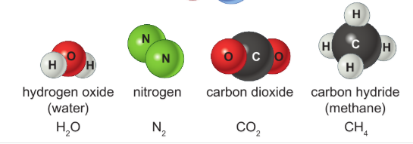
Chemical formulae of molecules
Some compounds and elements exist as molecules. The chemical formulae of these give the exact number of each atom in the molecule.

Slide 10
Homework:
w/s 8Fb7 – formula & mass calculations
w/s 8Fb4 & 8– formulae using valance & cross over method
Active learn:
Exercises 8Fb developing, secure & exceeding
Exercises 8Fb literacy 1 & 2
Date due:

Slide 11
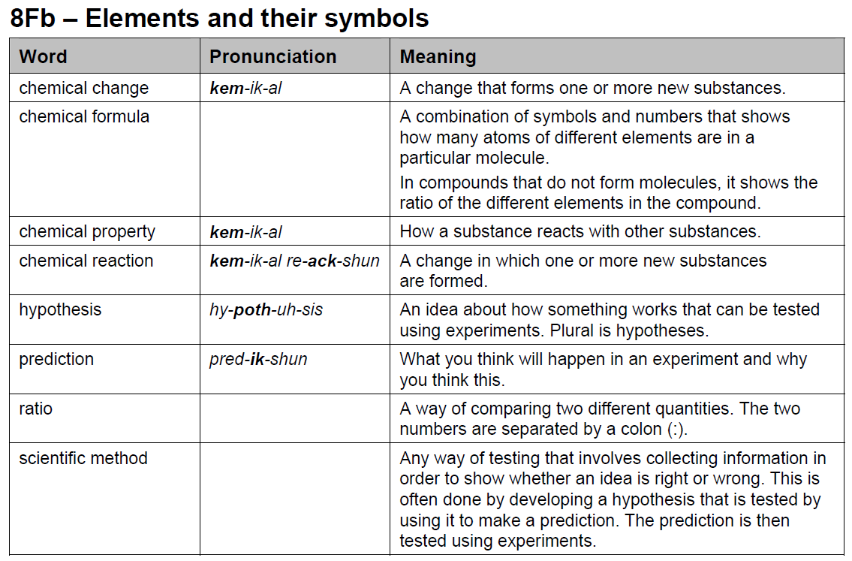
Key words

Slide 12
Formulae from valencies
Working out the formula of compounds
Use w/s 8Fb8 for notes

Slide 13
Formulae from valencies
The valency of an element equals the number of bonds it has to make when it combines with other elements to form compounds.
We can work out the formula for any compound by looking at the valencies of all the atoms it contains.

Slide 14
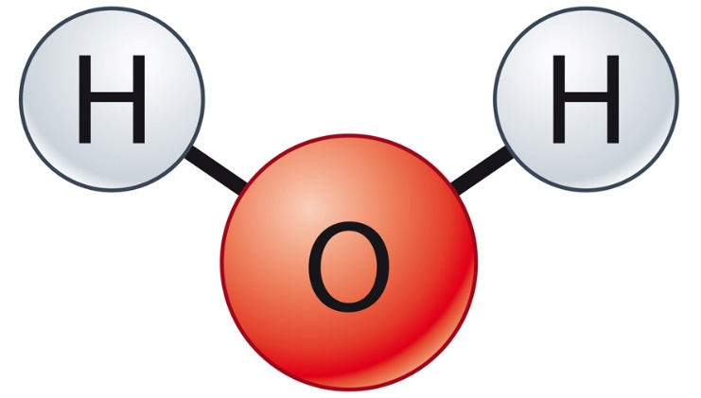
Formulae from valencies
Water is a compound of hydrogen and oxygen.
Oxygen has a valency of 2, so forms 2 bonds.
Hydrogen has a valency of 1, so forms 1 bond.
The formula for water is H₂O as there are 2 hydrogen atoms and 1 oxygen atom.
© Pearson Education Ltd 2014. Copying permitted for purchasing institution only. This material is not copyright free.
Notes:
14

Slide 15
Formulae from valencies
The periodic table can be used to predict the valency of atoms.
The valency of most elements follow this rule:
Group | 1 | 2 | 3 | 4 | 5 | 6 | 7
Valency | 1 | 2 | 3 | 4 | 3 | 2 | 1
© Pearson Education Ltd 2014. Copying permitted for purchasing institution only. This material is not copyright free.
Notes:
15

Slide 16
Formulae from valencies
If two atoms have the same valency, they both form the same number of bonds. This means there are no numbers in the formula, just the symbols of the two atoms.
For example:
Sodium (Na) is in Group 1, so has valency 1.
Chlorine (Cl) is in Group 7 and also has valency 1.
So, the formula for sodium chloride is ________ .
Magnesium is in Group 2 so has valency 2.
Oxygen is in Group 6 and also has valency 2.
So, the formula for magnesium oxide is _______ .
NaCl
MgO
© Pearson Education Ltd 2014. Copying permitted for purchasing institution only. This material is not copyright free.
Notes:
16

Slide 17
Formulae from valencies
If two atoms have different valencies, we use the cross-over method to work out the formula.
Let’s use methane as an example.
Write down the symbols of the atoms.
Write the valencies of the atoms under their symbols.
Cross-over the valencies.
C H
4 1
The formula for methane is CH₄
(we do not write 1 in the formula).
© Pearson Education Ltd 2014. Copying permitted for purchasing institution only. This material is not copyright free.
Notes:
17

Slide 18
Formulae from valencies
Use the cross-over method to find the formula of these compounds:
Magnesium chloride:
Symbols
Valencies
Cross-over for formula:
Mg Cl
2 1
MgCl₂
Lithium oxide:
Symbols
Valencies
Cross-over for formula:
Li O
1 2
Li₂0
© Pearson Education Ltd 2014. Copying permitted for purchasing institution only. This material is not copyright free.
Notes:
18

Slide 19
Formulae from valencies
Work out the formula of these compounds:
Potassium chloride
Answer:
Calcium oxide
Answer:
Sodium oxide
Answer:
Aluminium oxide
Answer:
KCl
CaO
Na₂O
Al₂O₃
© Pearson Education Ltd 2014. Copying permitted for purchasing institution only. This material is not copyright free.
Notes:
19

Slide 20
Objectives
Explain how chemical reactions are different to physical changes.
Explain the difference between physical and chemical properties of a substance.
Use observations to decide whether a chemical reaction has taken place.
Model simple chemical reactions using word equations.
Use a simple (Dalton’s) model to describe a compound.
Model more complex chemical reactions using word equations.
Describe how atoms are rearranged in chemical reactions.
Write simple chemical formulae from information on structure.
Interpret formulae to identify the types of and ratio of atoms in a compound.
Give a simple description of the valency of an element and use these to deduce the formula of compounds (containing two main group elements).
© Pearson Education Ltd 2014. Copying permitted for purchasing institution only. This material is not copyright free.

