Slide 1
Recent news

Slide 2
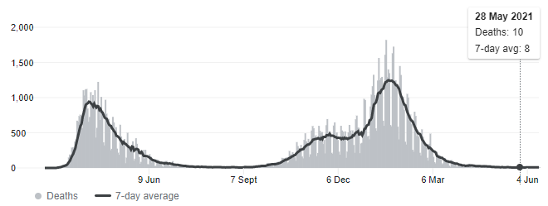
Corana Virus news Corona Virus deaths have decreased since the rise from the 6th of December to the 6th of March. Boris Johnson says Covid restrictions will end on the 19th of July.
Current deaths:
128K

Slide 3
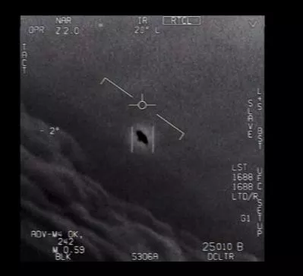
Nasa finding sightings of UAP's. --->
The UAP's have been seen in America and the government have pictures of it but some people still don’t believe them
Some experts/people who work in Nasa say;
Thomas Bania: Do any of us believe these are actual flying saucers from outer space? No. but there really isn’t enough information to evaluate what is going on.
Weinstein: It could be truly a UFO. I never want to say something could never be. It could be a phenomenon caused by nature—just a weather phenomenon. We learn something new every day, we’re flying at higher altitude than we’ve ever flown before, so maybe we’re seeing things that would look differently at a lower altitude.

Slide 4
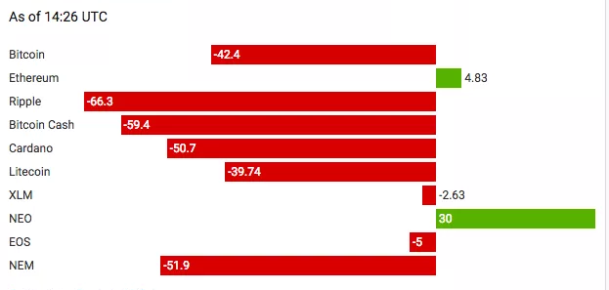
Bitcoin value is going down
Bitcoin Price Falls Below $8,000, Down 42% Since Start of the Year in 2019 and it still is and Invester's started not looking for it and investing for other things.

Slide 5
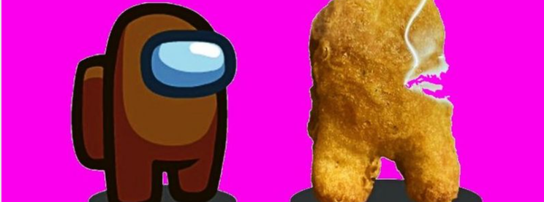
Chicken nugget sold for over almost £100,000 in online auction. An American seller called polizna put the McDonald's treat up on the online auction site Ebay after spotting it in a meal from the fast food restaurant.
The nugget is shaped like the crewmates featured in the game, and had more than 180 bidders before the auction finally closed just after 8am (UK time) on Friday.

Slide 6
MADE BY EDWARD,SHION,OLIVIER

