Slide 1
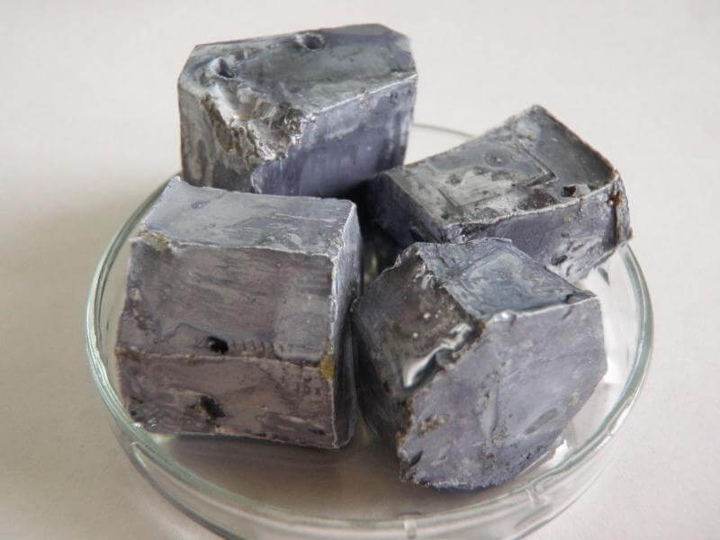
8Gd: Metals and Acid
CW
Do Now:
Describe how potassium behaves when reacting with water

Slide 2
Requisitions
Equipment | Worksheets
Metals and Acid: calcium, iron, copper, zinc and magnesium Dilute Sulphuric Acid HCl

Slide 3
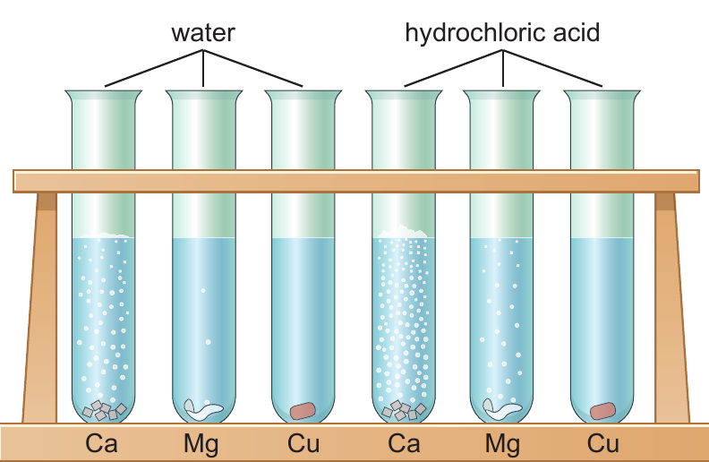
dilute sulphuric acid

Slide 4
Metals with Acid Investigation
Collect five test tubes and put about 3 cm depth of dilute hydrochloric acid in each of them.
Put small samples of calcium, iron, copper, zinc and magnesium in each of them. Collect the calcium from your teacher.
Observe, then put the metals in order of reactivity, the most reactive at the top and the least at the bottom.
Repeat the experiment with dilute sulphuric acid

Slide 5
Write Down
Hydrochloric acid
Calcium
Magnesium
Zinc
Iron
Copper
Sulphuric acid
Calcium
Magnesium
Zinc
Iron
Copper
Increasing reactivity

Slide 6
This list is called a reactivity series

Slide 7
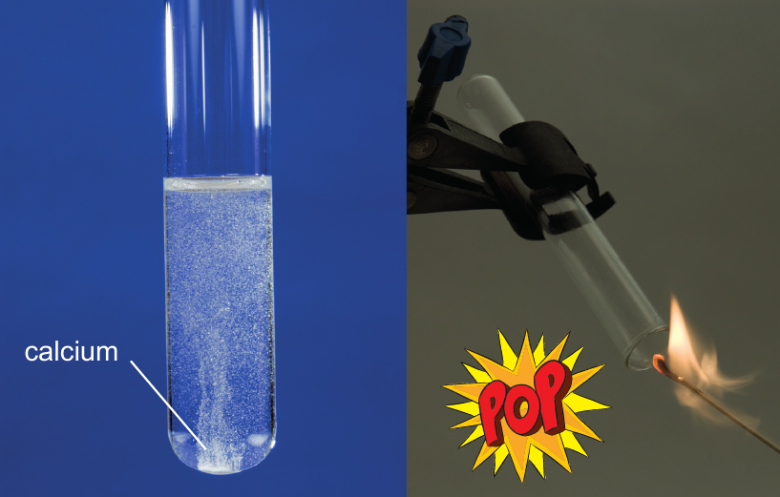
Put some magnesium in a test tube with acid and test with a burning splint.
magnesium

Slide 8
True or False?
Hands up for true
All metals react with dilute acid
The order of reactivity depends on the acid
Metals react faster with acid than they do with water
Hydrogen is produced when metals react with acid
Copper is a very reactive metal

Slide 9
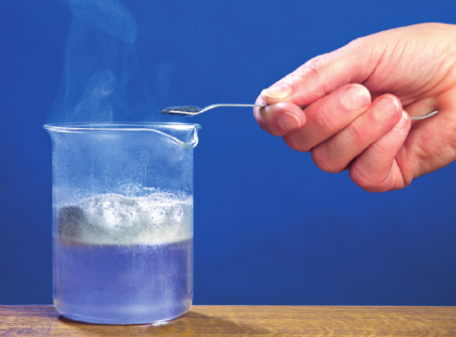
Write Down
General Equation
$$metal+acid →salt+hydrogen$$

Slide 10
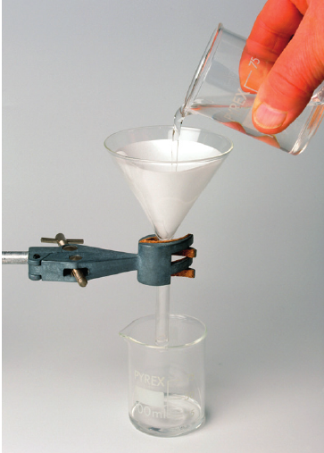
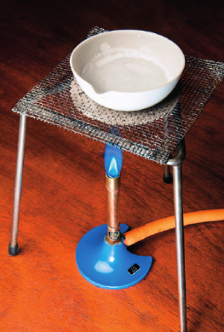
Write Down
Obtaining a solid sample of the salt
1. React excess metal with the acid
2. Filter the mixture to remove solid metal
3. Evaporate the water until crystals of salt start to form.

Slide 11
Match the name of the acid with the formula
Hydrochloric acid
Nitric acid
Sulphuric acid
HNO₃
H₂SO₄
HCl
All acids contain the element…
hydrogen

Slide 12
Naming Salts
Write Down
Hydrochloric acids make chlorides, sulfuric acid makes sulfates, nitric acid makes nitrates.
The name of the salt comes from the metal and the acid.
+
hydrochloric acid
+
magnesium
chloride
hydrogen
magnesium
→
The acid
The metal
The salt
+
magnesium
sulfate
+
hydrogen
Sulfuric
acid
magnesium
→

Slide 13
Word equations
iron + hydrochloric acid→
magnesium + sulfuric acid →
zinc + nitric acid →
Iron chloride + hydrogen
magnesium sulfate + hydrogen
zinc nitrate + hydrogen

Slide 14
Balanced symbol equations
Magnesium (Mg) reacts with hydrochloric acid (HCl) to form magnesium chloride (MgCl₂) and hydrogen (H₂)
Step 1 Write down the correct formulae. The reactants are on the left and the products are on the right.
Mg + HCl → MgCl₂ + H₂

Slide 15
Step 2 Balance the equation.
2
Mg + HCl → MgCl₂ + H₂
Mg
1
1
H
X
1
2
2
Cl
X
2
2
1

