Slide 1
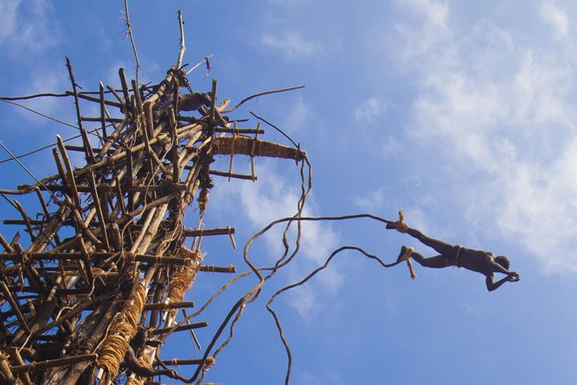
C/W
16/03/2021
7Kb L&C Making notes
What is this guy doing?!!

Slide 2
Objectives
Take effective notes from a video or presentation.
Use abbreviations to help in effective note-taking.
 Take notes as you watch the next video.

Slide 3
https://www.youtube.com/watch?v=-zvCUmeoHpw

Slide 4
What did you manage to note down?
Why was it hard?
How can we make it easier to take notes?

Slide 5
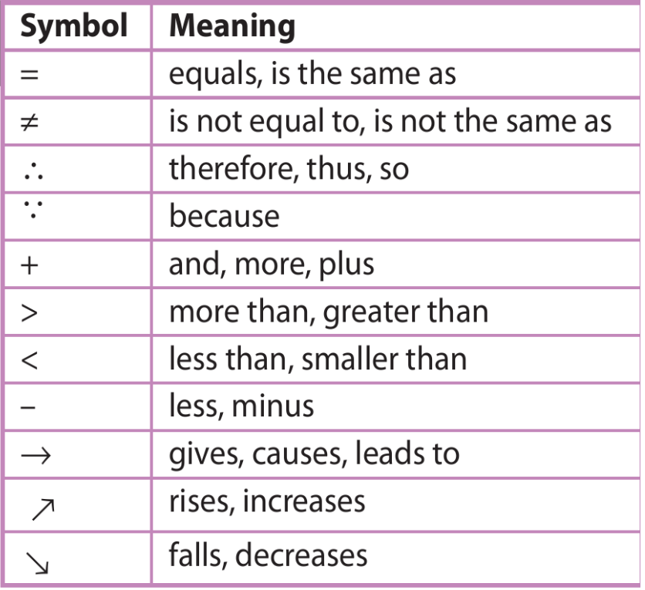

Slide 6
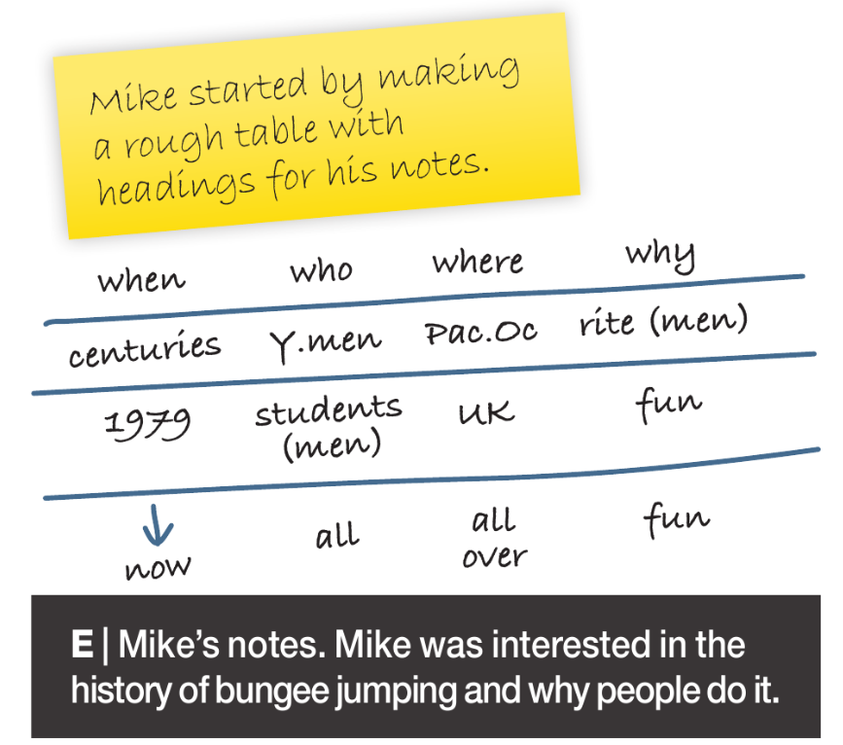

Slide 7
 Take notes using some of these hints as you watch the next video.

Slide 8
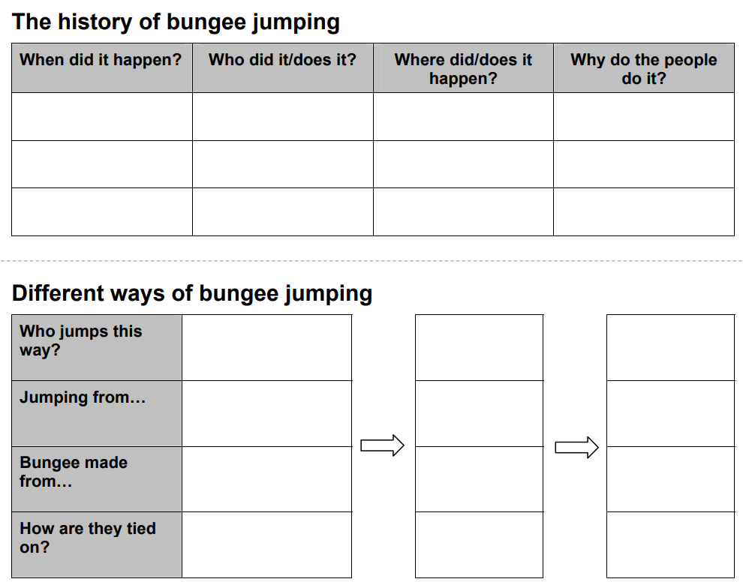
 You could get ready to take organised notes using a table like one of these.

Slide 10
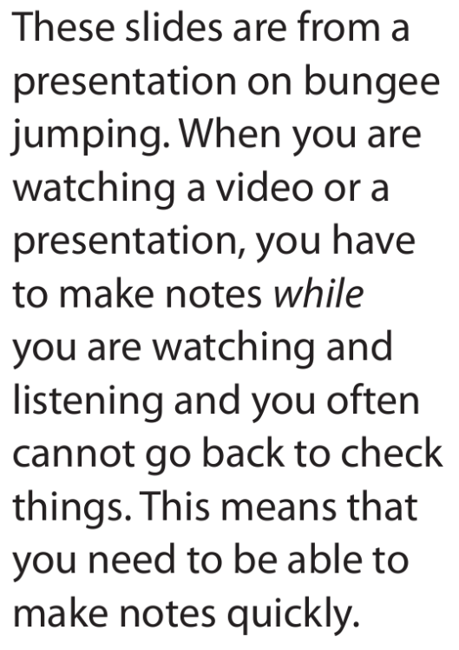
Bungee jumping
 Add to your notes from this short presentation.
A short history of bungee jumping

Slide 11
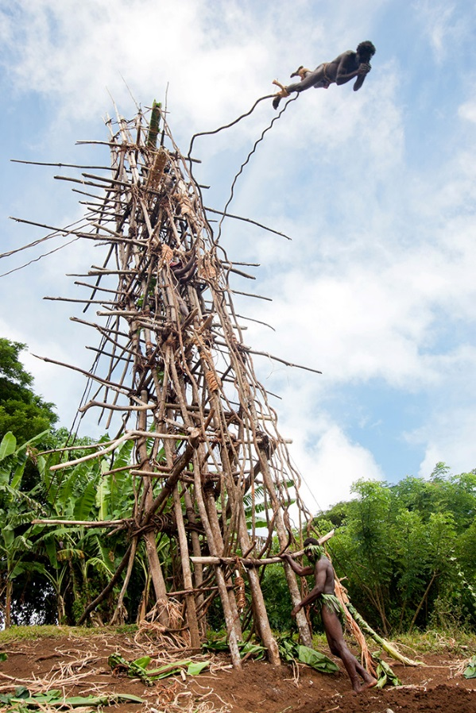
Bungee jumping
Young men taking part in ‘land diving’, an early form of bungee jumping on the Pacific island of Vanuatu.
They climb a tower made from wood and vines, bind vines to their ankles and then jump off.
The length of vine has to be just right: too long and they’ll hit the ground; too short they may just swing into the tower.
The jumps are done by boys to show that they are ready to become men.

Slide 12
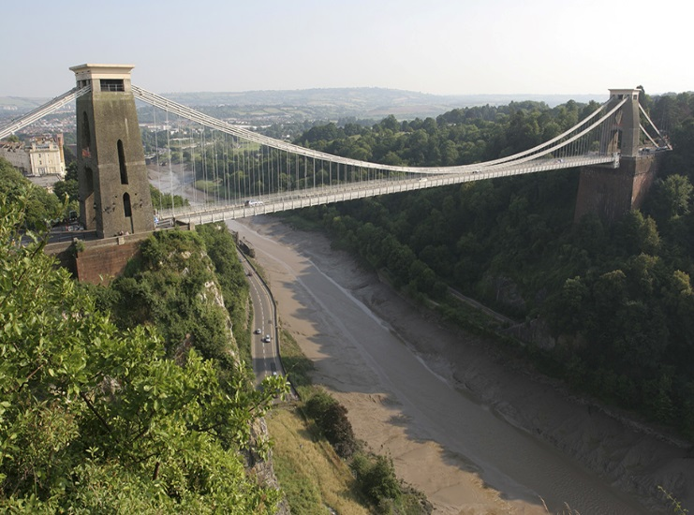
Bungee jumping
In the 1970s a group of men decided they wanted to use the Clifton Suspension Bridge in Bristol to copy the land divers of Vanuatu, but without having to travel to the Pacific island.
They used climbing harnesses to attach themselves to rubber cords. The length and the strength of the cords had to be carefully calculated to take on the 75 metre drop.
On 1 April 1979 they jumped safely from the bridge. However, they were all arrested as they had been denied permission to do so.

Slide 13
https://www.youtube.com/watch?v=-zvCUmeoHpw

Slide 14
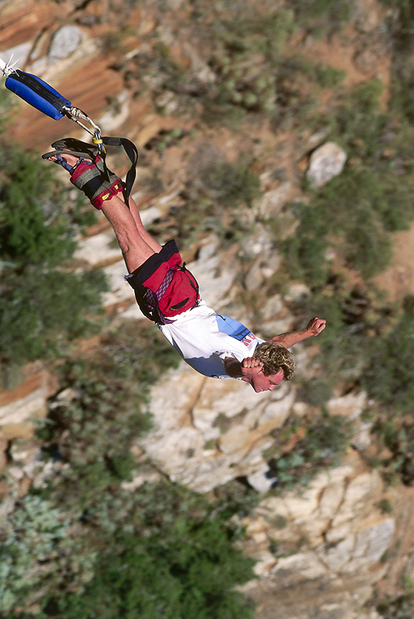
Bungee jumping
Nowadays the rubber bungee cord is attached to straps around the ankles, so that the jumper plunges head first.
Bungee jumping is now a popular activity around the world for thrill-seekers and people jump off different places such as bridges, platforms and cranes.
 Compare notes and add anything you are missing in green.

Slide 15
Use your notes to write out a neat summary of the history of bungee jumping.
If you need to use someone else’s notes for a section ,then write that in green and note this on a key.

Slide 16
Science Help & Support Drop-in
Every Wednesday after school in E3/E4
Do your H/W. Work on past papers. Get help on content from teachers and 6th Formers. Develop your understanding by helping others.
Notes:
A level

Slide 17
Objectives
Take effective notes from a video or presentation.
Use abbreviations to help in effective note-taking.

