Slide 1
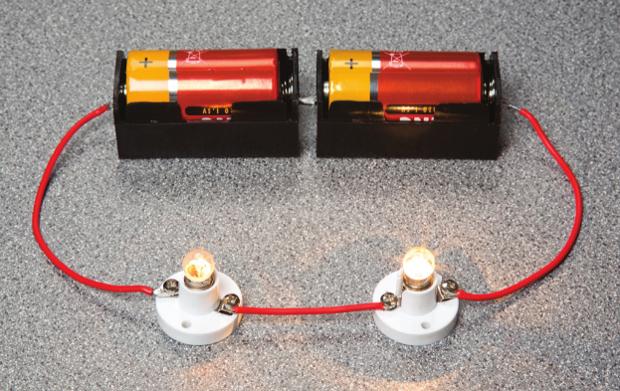
7Jc Series and Parallel Circuits
Do Now:
Draw two parallel lines

Slide 2
Requisitions
Equipment | Worksheets
Wires Bulbs Batteries Ammeter | Investigating Circuits WS

Slide 3
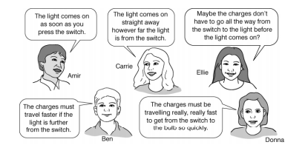

Slide 4
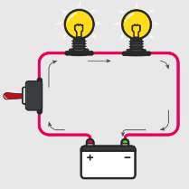
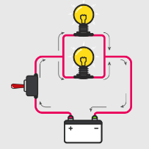
Write Down
Series Circuit
Parallel Circuit
All components in a single loop
Components in different branches

Slide 5
Write Down
In a series circuit, if one bulb breaks all the other go out – the broken bulb makes a gap in a circuit
In a parallel circuit, if one bulb breaks the bulbs in the other branches stay on
Do you think the lights in your house are on a series or a parallel circuit?

Slide 6
Investigating Circuits

Slide 7
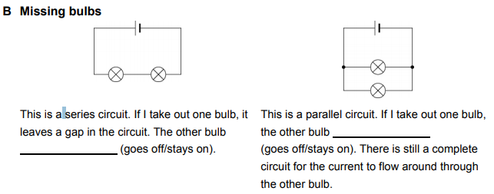

Slide 8
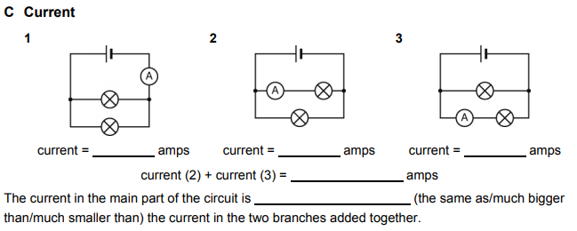

Slide 9
How could the PhET model be imprioved?
 Click image to run simulation.

Slide 10
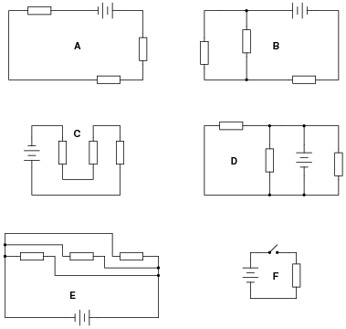
Series or Parallel Circuits?

Slide 11
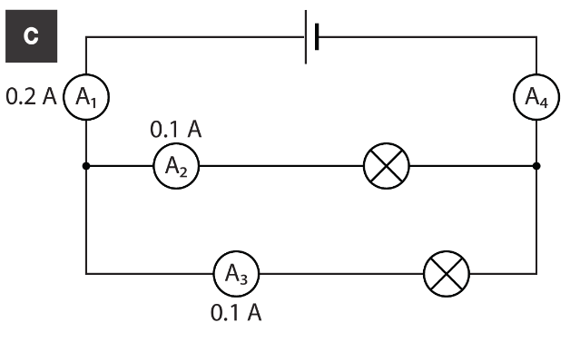
Current in Circuits
Write Down
In a series circuit the current is the same everywhere
In a parallel circuit the current from the battery splits when it comes to a branch

Slide 12
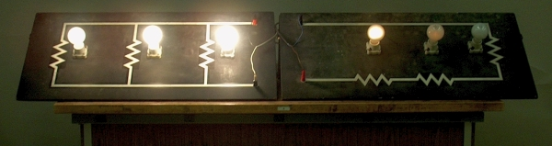
Write Down
More bulbs in a series circuit causes the bulbs to get dimmer as the current gets smaller
More bulbs in a parallel circuit doesn’t change the brightness, as the current splits and still flows

