Slide 1
7Fe: Neutralisation in Daily Life
Do Now:
What is a base?

Slide 2
Write Down
When an acid and an alkali are m_________, there is a chemical r________. This reaction is called n_________. If the right a________ of acid and alkali are mixed, the solution becomes n_________.
7 acidic alkaline amounts antacids bodies cancel
constant diluting heartburn higher lower mixed
neutral neutralisation reaction weaker
Extension:
List some everyday examples of neutralisation.

Slide 3
Watch and Complete (video)
Write Down
Antacids used to treat indigestion or heartburn. They contain a_____ to help n__________ the acid.
The food you eat produces acids in your mouth which can decay teeth. Toothpastes contain a________ which r______ with acids in your mouth.

Slide 4
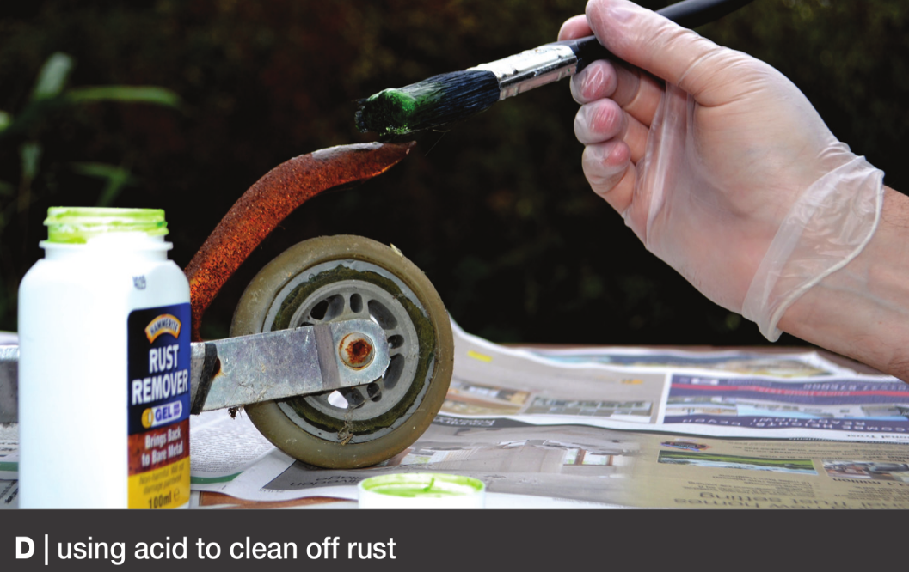
Uses of Acids and Alkalis
Write Down
Acids can be used to clean metals which have rusted.
Acidic waste gases from industries are neutralised by alkali before being released into the atmosphere

Slide 5
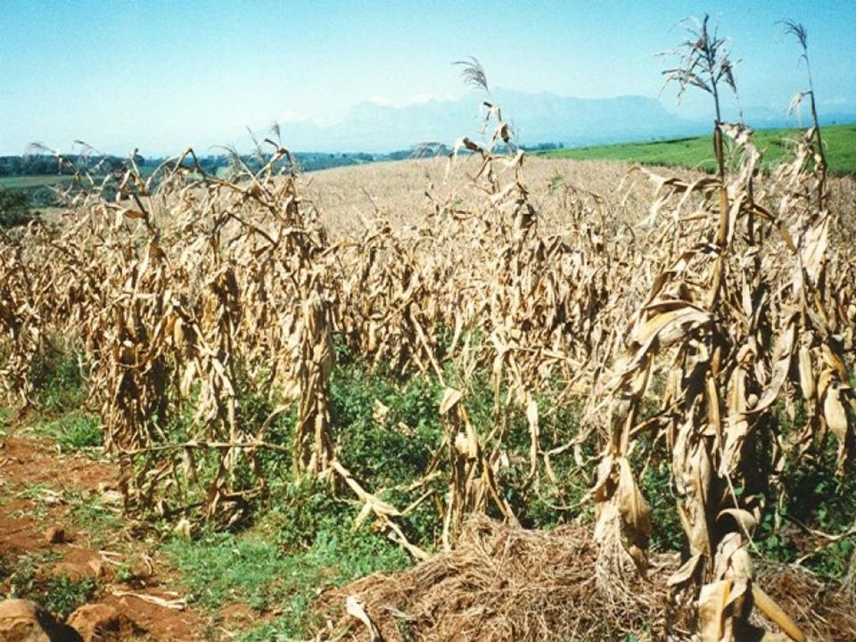
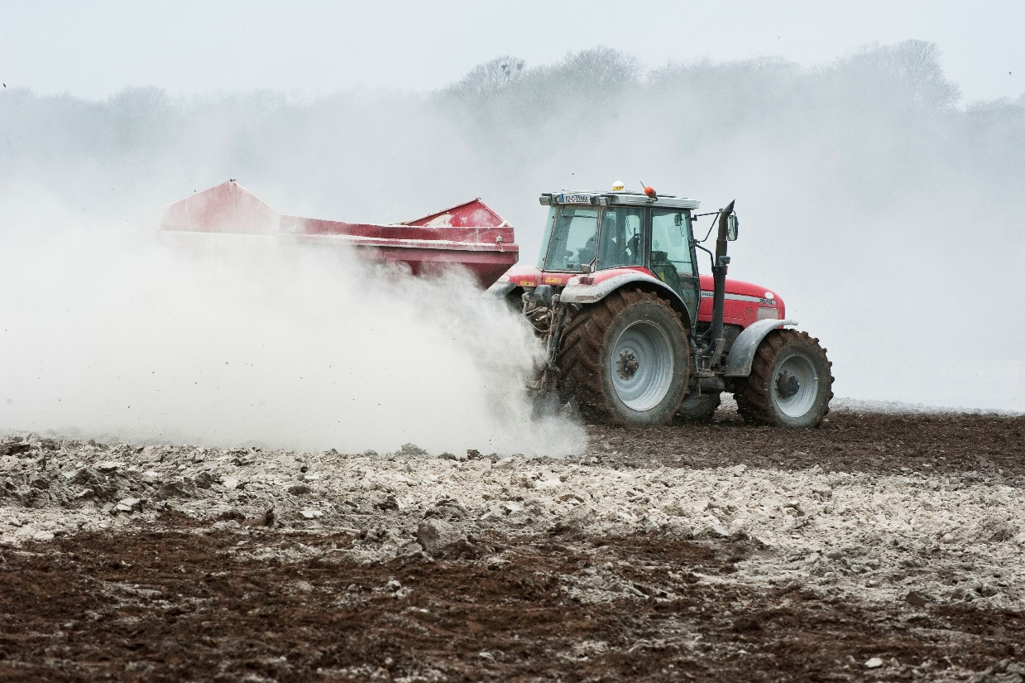
Write Down
Lime (calcium carbonate) is an alkali that can be used to neutralise acidic soil as this can stop healthy plant or crop growth

Slide 6
Neutralising Stings
How can you treat a bee/wasp sting?
A bee sting
is acidic.
A wasp sting
is alkaline.

Slide 7
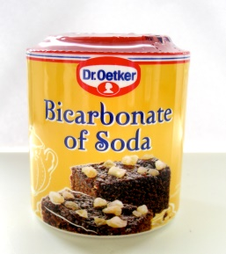
Write Down
You get stung by a bee. A bee sting is acidic. What substance can you use to neutralise the sting?
You could use a weak alkali, to neutralise the bee sting.
An example would be bicarbonate of soda.

Slide 9
Copy the table into your books.
Tables MUST be drawn neatly.
Indigestion Investigation
What’s the best remedy for indigestion or acid reflux?
Tube | Brand | Colour of pH Paper | pH
1
2
3
4

Slide 10
Risk Assessment and Health and Safety
Must wear goggles.
Acids and Alkalis are corrosive therefore must be handled safely and sensibly.
You will be working in pairs.
Anyone seen misbehaving will be sent out and banned from doing practicals for this unit!!

Slide 11
Apparatus
4 large test tubes
stirring rod
test tube rack
universal indicator paper
measuring cylinder
hydrochloric acid
4 samples of indigestion remedies

Slide 12
Method
Measure out 10 cm3 of hydrochloric acid into each of the large test tubes. Stand the test tubes in the test tube rack.
One at a time, put the small amount of each antacid you have been given into a separate test tube. After adding each amount, record the name of the remedy in the table.
Stir the mixture in each test tube.
After two minutes, dip a piece of pH paper in the first test tube and record the colour and pHnumber. Record what the mixture looks like. Do the same with the other test tubes. alkali or neutral.

Slide 13
Considering your Results/Conclusion
In which test tubes was the acid neutralised?
Which test tubes were cloudy at the end?
Which remedy do you think is the best? Explain your answer

Slide 14
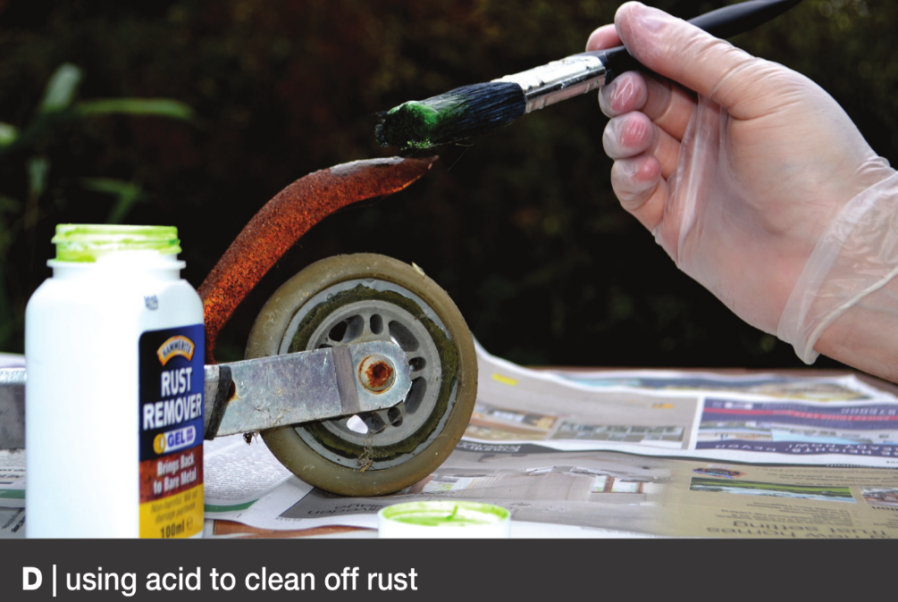

Slide 15
Answers

