Slide 1
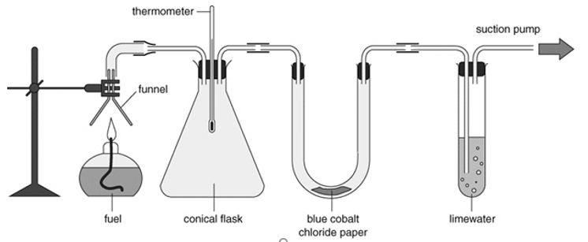
Requisitions
Demo:
Exploding hydrogen balloon
Products of combustion it will need some sort of thermometer.
worksheets:
8Ea-2 Burning a Fuel

Slide 2
Objectives
State the meaning of: fuel, combustion.
State the meaning of: hydrocarbon.
Describe the combustion of hydrocarbons (in terms of reactants and products).
Identify the products and reactants using a word equation.
Describe the tests for carbon dioxide and water.
Recall the fuel used in a fuel cell.
Model reactions using word equations.
Explain the formation of the products when hydrocarbons burn.
Describe how rocket engines obtain enough oxygen in space to explode by using oxidising agents.

Slide 3
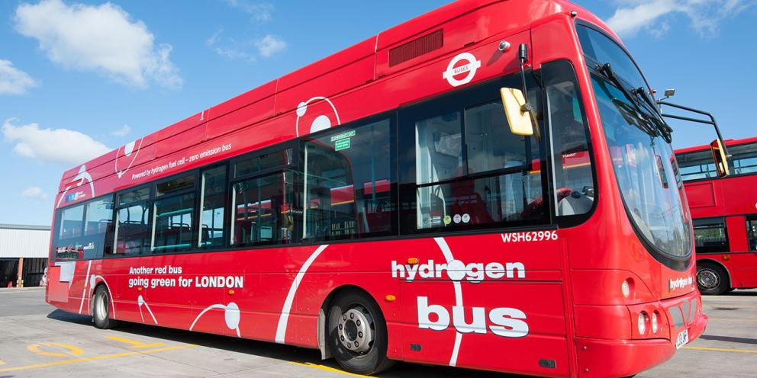
CW
8Ea Combustion
What fuels this bus?
@hpscience

Slide 4
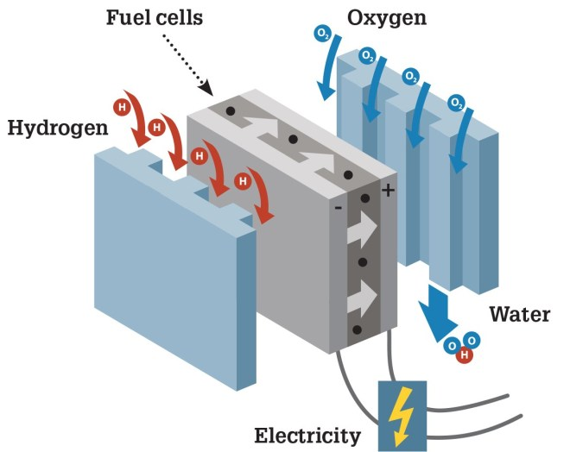
Write a definition for the word ‘fuel’
A substance that contains stored energy that can be transferred to make things happen.
What type of energy powers this bus?
Hint: think about 7J

Slide 5
Learning Objectives
Developing | Securing | Exceeding
Must… | Should… | Could…
State the meaning of: fuel, combustion. State the meaning of hydrocarbon. Describe the combustion of hydrocarbons (in terms of reactants and products). Identify the products and reactants using a word equation. Describe the tests for carbon dioxide and water. | Recall the fuel used in a fuel cell. Model reactions using word equations. Explain the formation of the products when hydrocarbons burn. | Describe how rocket engines obtain enough oxygen in space to explode using oxidising agents.

Slide 6
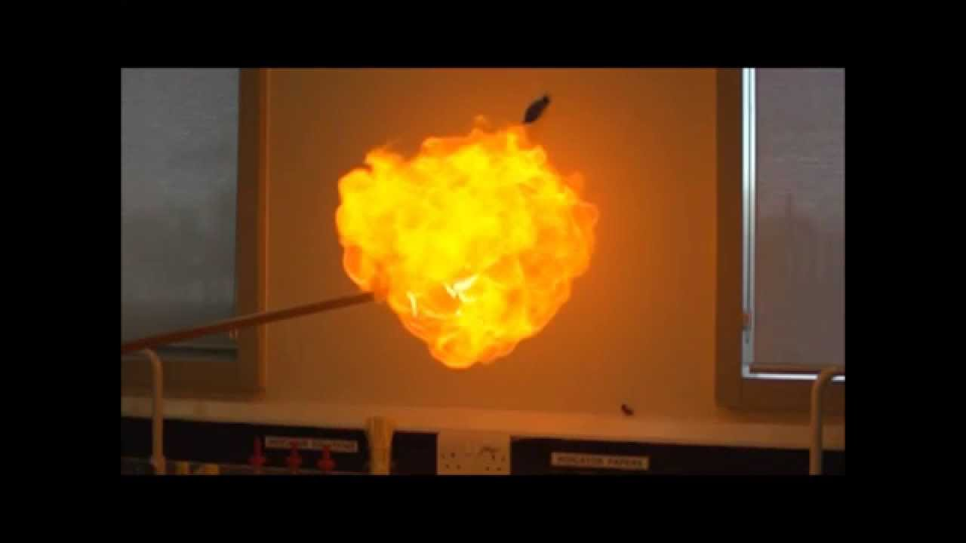
Write a definition for the word ‘combustion’
Demo Hydrogen balloon explosion or show video
https://www.youtube.com/watch?v=zX9x0piJ_Vo
What type of reaction is this?
Burning, usually in air. The reaction gives out energy, which is transferred to the surrounds by heating or light.

Slide 7
Write a chemical equation for this combustion reaction
Hydrogen + Oxygen → Water
Name the reactants & the product
Reactants: Hydrogen, Oxygen
Product: Water

Slide 8
Learning Objectives
Developing | Securing | Exceeding
Must… | Should… | Could…
State the meaning of: fuel, combustion. State the meaning of hydrocarbon. Describe the combustion of hydrocarbons (in terms of reactants and products). Identify the products and reactants using a word equation. Describe the tests for carbon dioxide and water. | Recall the fuel used in a fuel cell. Model reactions using word equations. Explain the formation of the products when hydrocarbons burn. | Describe how rocket engines obtain enough oxygen in space to explode using oxidising agents.

Slide 9
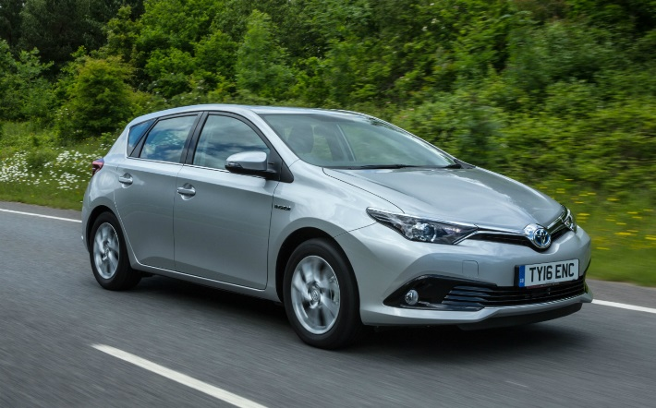
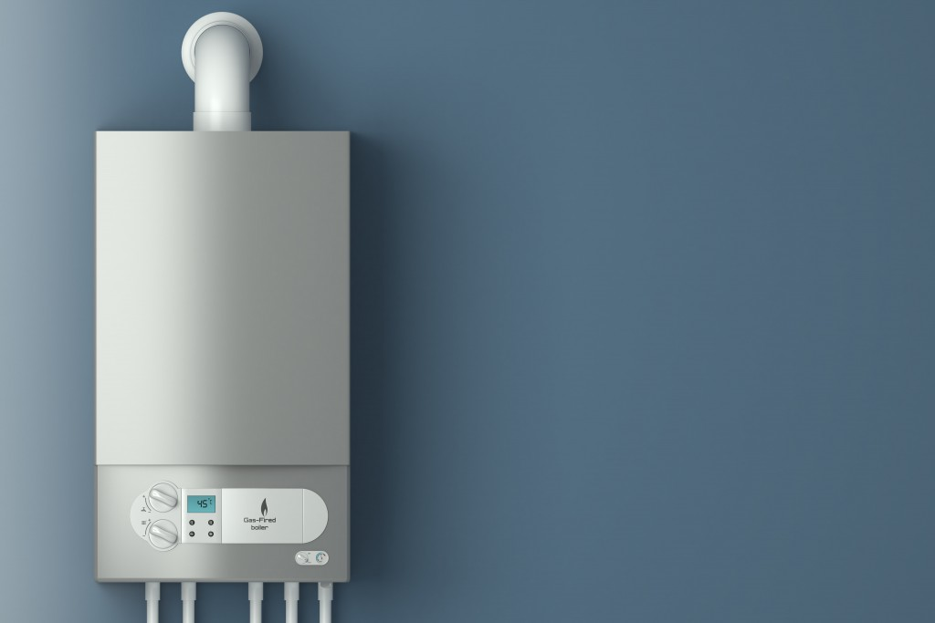
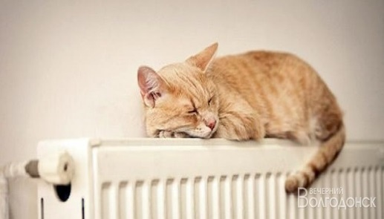
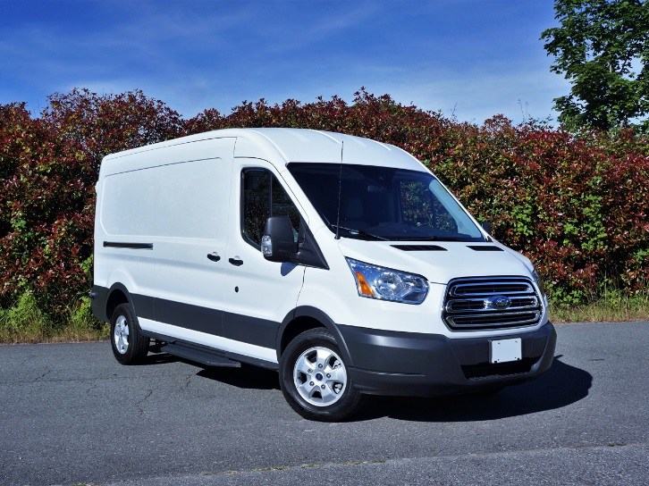
What fuels do these use?
When methane reacts with O₂ what gases will be produced?
Petrol
These are often called fossil fuels. Why?
Natural gas
Diesel
Hydrocarbon are substances which contain only carbon and hydrogen atoms e.g. Methane, CH₄

Slide 10
Learning Objectives
Developing | Securing | Exceeding
Must… | Should… | Could…
State the meaning of: fuel, combustion. State the meaning of hydrocarbon. Describe the combustion of hydrocarbons (in terms of reactants and products). Identify the products and reactants using a word equation. Describe the tests for carbon dioxide and water. | Recall the fuel used in a fuel cell. Model reactions using word equations. Explain the formation of the products when hydrocarbons burn. | Describe how rocket engines obtain enough oxygen in space to explode using oxidising agents.

Slide 11
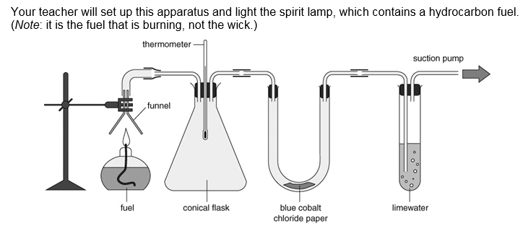

Slide 12
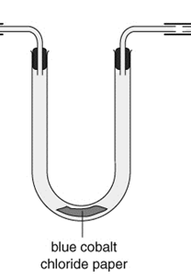
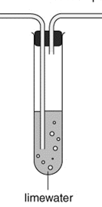
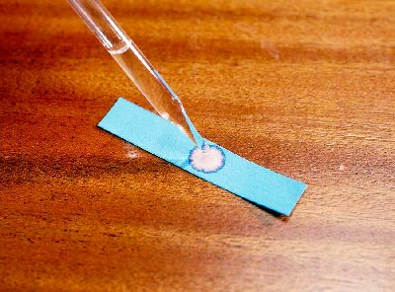
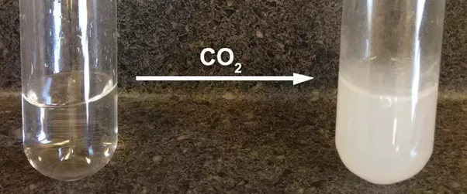
Cobalt chloride test
Limewater test
H₂O

Slide 13
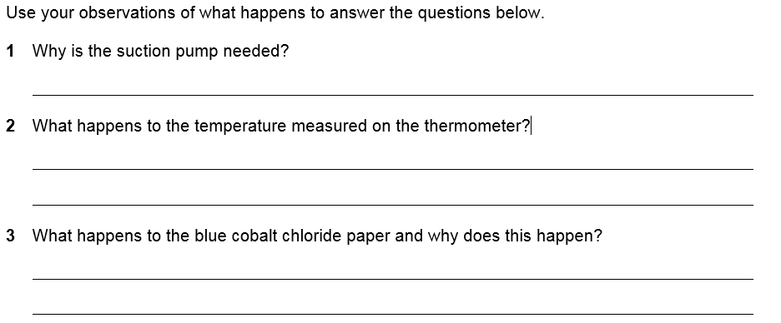
To draw the products of the combustion reaction through the equipment.
It rises.
It turns pink, because water is present.

Slide 14
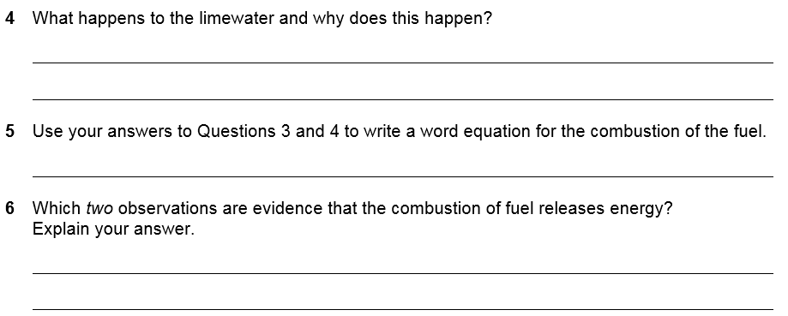
It goes cloudy, because carbon dioxide is present.
hydrocarbon + oxygen → carbon dioxide + water
The rise in temperature shows energy is transferred by heating.
The brightness of the flame shows energy is transferred by light.

Slide 15
Learning Objectives
Developing | Securing | Exceeding
Must… | Should… | Could…
State the meaning of: fuel, combustion. State the meaning of hydrocarbon. Describe the combustion of hydrocarbons (in terms of reactants and products). Identify the products and reactants using a word equation. Describe the tests for carbon dioxide and water. | Recall the fuel used in a fuel cell. Model reactions using word equations. Explain the formation of the products when hydrocarbons burn. | Describe how rocket engines obtain enough oxygen in space to explode using oxidising agents.

Slide 16
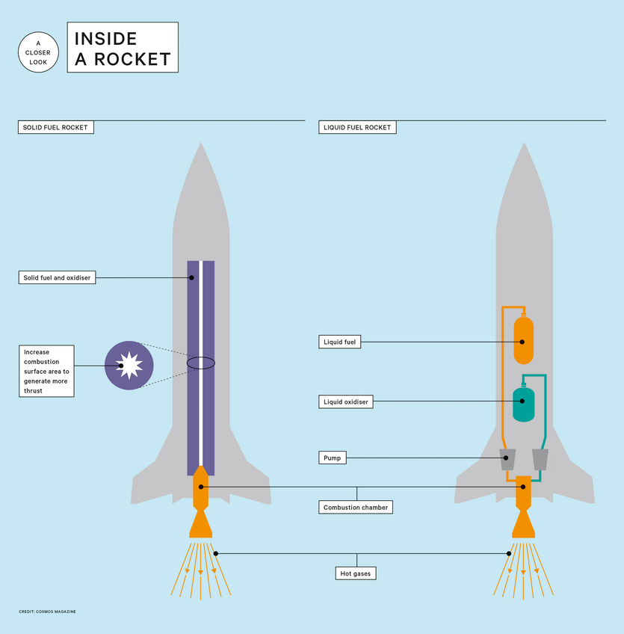
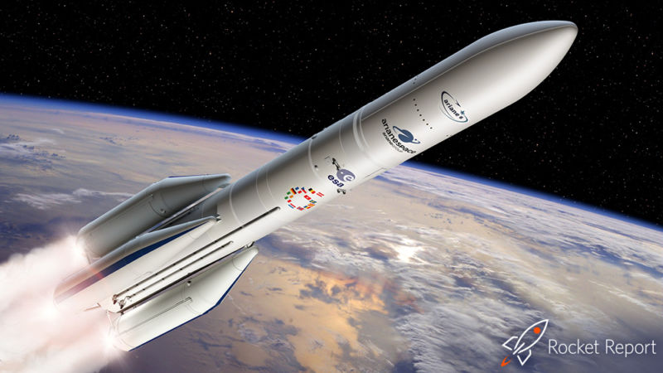
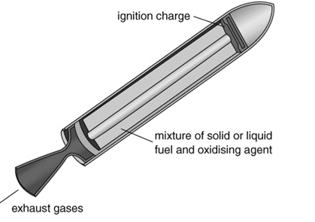
Why would a space rocket need an oxidiser as part of the fuel?

Slide 17
Learning Objectives
Developing | Securing | Exceeding
Must… | Should… | Could…
State the meaning of: fuel, combustion. State the meaning of hydrocarbon. Describe the combustion of hydrocarbons (in terms of reactants and products). Identify the products and reactants using a word equation. Describe the tests for carbon dioxide and water. | Recall the fuel used in a fuel cell. Model reactions using word equations. Explain the formation of the products when hydrocarbons burn. | Describe how rocket engines obtain enough oxygen in space to explode using oxidising agents.

Slide 18
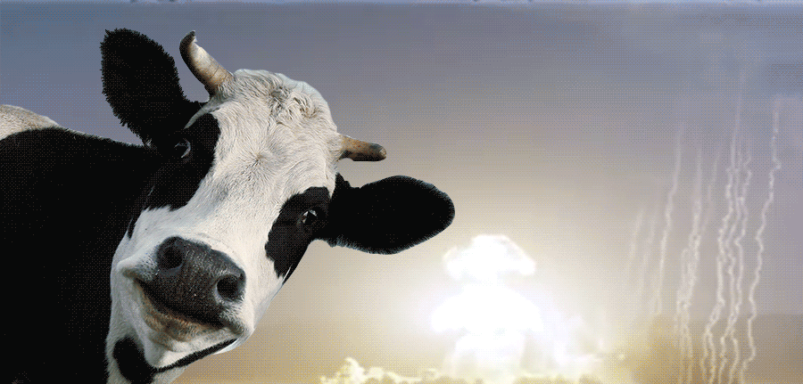
Homework:
w/s 8Ea4 – methane explosions
Active learn: Exercises 8Ea developing, secure & exceeding
Date due:

Slide 19
Burning fuel
What is produced by burning fuel?

Slide 20
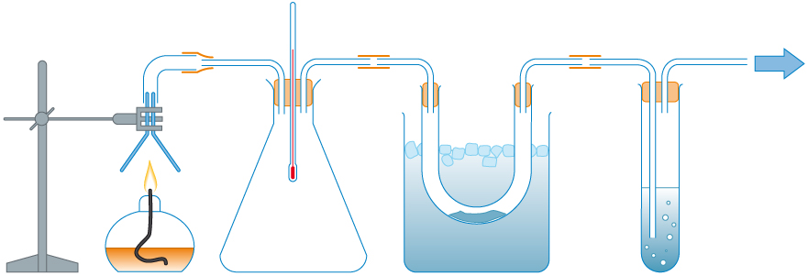
This apparatus shows us what is produced when fuel burns.
Can you see the mistakes in the labels?
What should they say?
The thermometer shows that heat energy is absorbed in the reaction.
The oxygen will condense inside this tube, because it is warm.
The salt water in this tube will show that one of the gases is carbon monoxide.
The spirit burner produces carbon monoxide and oxygen.
© Pearson Education Ltd 2014. Copying permitted for purchasing institution only. This material is not copyright free.

Slide 21
The spirit burner produces carbon and
monoxide
oxygen.
dioxide
water.
© Pearson Education Ltd 2014. Copying permitted for purchasing institution only. This material is not copyright free.

Slide 22
The thermometer shows that heat energy is in the reaction.
released
absorbed
The spirit burner produces carbon and
dioxide
water.
© Pearson Education Ltd 2014. Copying permitted for purchasing institution only. This material is not copyright free.

Slide 23
The thermometer shows that heat energy is in the reaction.
water
The will condense inside this tube, because it is
oxygen
released
warm.
cold.
The spirit burner produces carbon and
dioxide
water.
© Pearson Education Ltd 2014. Copying permitted for purchasing institution only. This material is not copyright free.

Slide 24
The thermometer shows that heat energy is in the reaction.
water
The will condense inside this tube, because it is
released
cold.
The in this tube will show that one of the gases is carbon
salt water
limewater
The spirit burner produces carbon and
monoxide.
dioxide
water.
dioxide.
© Pearson Education Ltd 2014. Copying permitted for purchasing institution only. This material is not copyright free.

