Slide 1
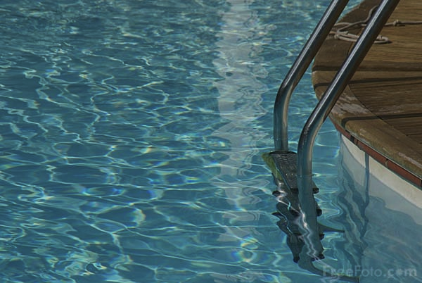
8Jc1 Refraction
CW
Do Now:
What seems strange about the steps when you get into a pool?

Slide 2
Requisitions
Equipment | Worksheets
Refract Practical | Roman Soldiers Diagram

Slide 3
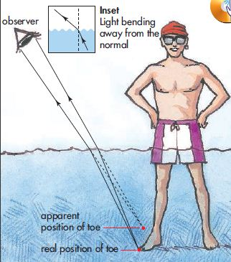
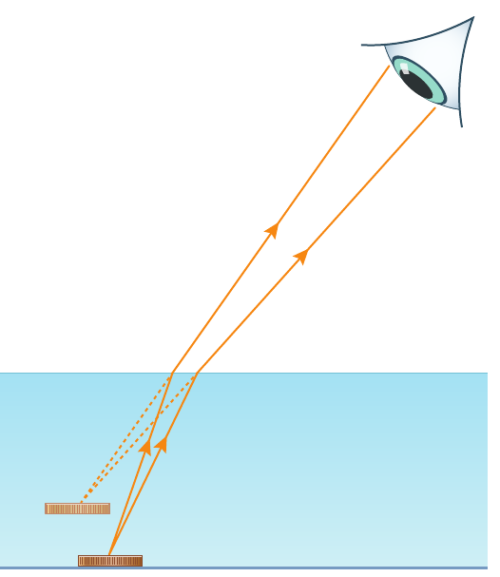
Can we predict the direction the light bends?

Slide 4
Objectives
State the meaning of: refraction, angle of refraction, refracted ray.
Recall that light and sound travel at different speeds in different materials.
Draw ray diagrams to describe the refraction of light as it passes into and out of different media.
Explain why refraction occurs.
Describe the effects of concave lenses on parallel beams of light.

Slide 5
1. Draw around your glass block and draw in 2 rays of light (use different colours) and the normal line as shown.
3. Join up your 2 red lines with another line showing the light as it travelled through the block (all the way to the edge).
2. Shine a ray of light along your red line at the block & mark in the position of the ray emerging from the block with dots. Join these up with a line all the way to the edge of the block.
4. Repeat for your blue ray and stick in your book.

Slide 6
 Add normal lines to your diagram where your rays leave the block:
What direction does the light bend as it goes into the block?
What direction does the light bend as it leaves the block?

Slide 7
Copy & Complete
As light passes from air to glass, it bends towards the n_____.
i
ormal
air
glass
i = angle of incidence
Where could we label angles of incidence, i?
r = angle of refraction
r
Where could we label angles of refraction, r?
i
glass
air
r
As light passes from glass to air, it bends a___ f____ the normal.
way
rom

Slide 8
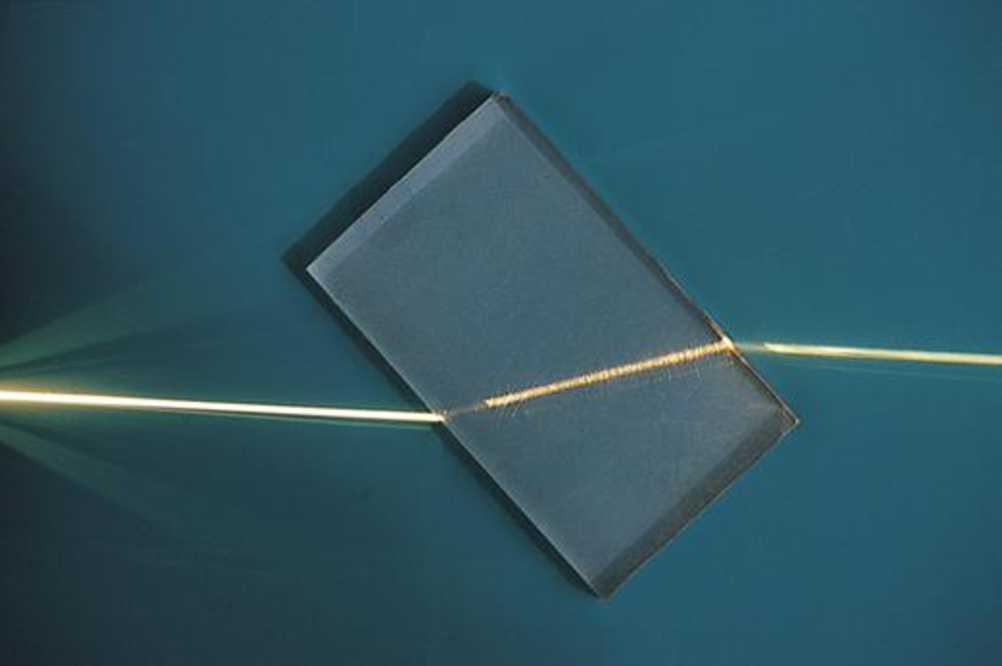
The light travels from the light source (i) hitting the glass, it then bends (r) as the glass is more dense.
When the light (i) leaves the glass, it bends (r) the opposite direction
i = angle of incidence
r = angle of refraction
i
air
glass
r
i
glass
air
r

Slide 9
Stick In
i
Normal
i = angle of incidence
r = angle of refraction
r
i
glass
air
r
Normal

Slide 10
Copy & Complete
As light passes from air to glass, it bends towards the n_____.
As light passes from glass to air, it bends a___ f____ the normal.
ormal
way
rom

Slide 11
 Teachers: Click image to run Doddle interactive.
Students: log in to Doddle & search for Labelling the refraction ray diagram.

Slide 12
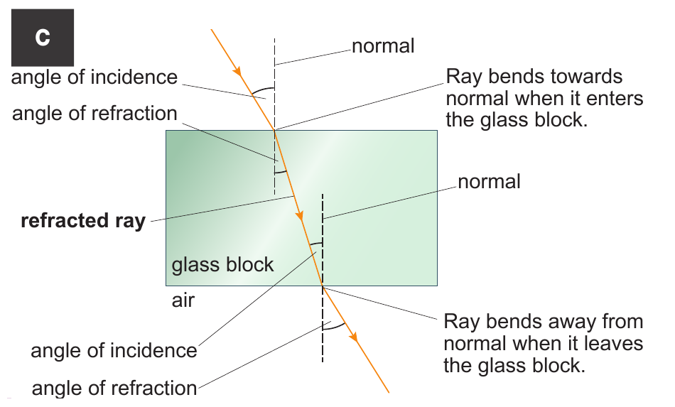
Why does the light change direction?

Slide 13
 Teachers: Click image then launch Doddle Presentation on slide 8.
Students: log in to Doddle & search for Light Waves Part 3 – Refraction, then launch slide 8.

Slide 14
Explaining Refraction
Write Down
Light travels slower in more dense materials e.g water
This means that light changes direction when it passes from one transparent material to another.
Can you think of another model to explain this?

Slide 15
The direction of bending can be explained using a model:
This causes the column to change direction.
These soldiers would reach the stream first, so slow down first.
These soldiers are still on the road so carry on at same speed.

Slide 16
 Give a clue or definition for these keywords.
Hot seat
refracted ray

Slide 17
 Give a clue or definition for these keywords.
Hot seat
refraction

Slide 18
 Give a clue or definition for these keywords.
Hot seat
angle of refraction

