Slide 1
Safer internet day
By aiza Fuzail islam 7P1

Slide 2
What Is the internet?
The internet is a global computer network providing a variety of information and communication facilities, consisting of interconnected networks using standardized communication protocols. The internet is a great place to do research for school, share pictures with friends, play video games, or check out the latest trending videos.

Slide 3
Why do we have to stay safe on the internet?
Its important to remember that there are billions of people who access the internet. And not everyone has good intentions when doing so. You should think carefully before you share personal information, pictures, or videos on the internet, even if you think its private. Nothing on the internet is completely private. It’s a good rule of thumb not to put up anything that could embarrass you later. If you wouldn’t want your grandmother to see it, then don’t post it.

Slide 4
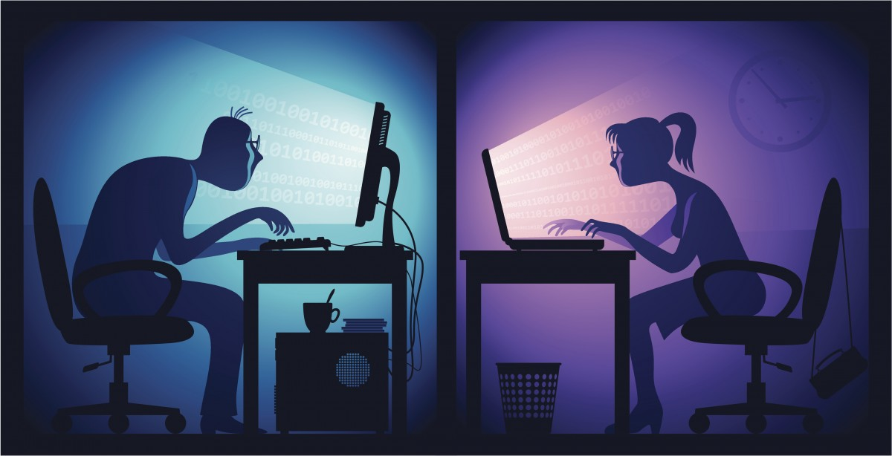
Stranger danger
Don’t share private information with people you don’t know. Trust your instincts. If someone approaches you online and makes you feel uncomfortable or in danger, stop communication with them immediately and tell a parent or another trusted adult. Its best not to meet in person someone you’ve only met online, even if you’ve been communicating with them for a long time. They may not be who they told you they are and it could be dangerous. If you do decide to meet someone from online, its best to meet them in a public place and to not go alone. Always take a friend along just to be safe, and let someone else know exactly where you are going and who you are going to meet.

Slide 5
Bullying online
Bullying someone online through email, social media, text messaging, or any other website or app is called cyber bullying. And is still a form of bullying. Its often better to block, delete, or try to ignore bullying messages than to respond to them. If that doesn’t work, getting help from a parent, school counsellor, or another trusted adult might be a good idea. That’s especially true if the cyber bullying contains threats.

Slide 6
conclusion
Remember to always keep your personal information private. Check your privacy settings to make sure that only your friends can see what you post, and never, ever share your passwords with anyone else. The internet could be a wonderful place to explore. Just remember to stay safe while doing it.

