Slide 1
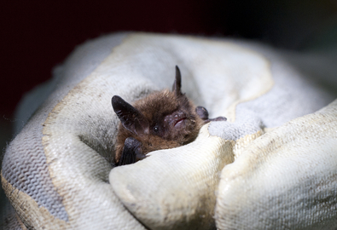
7Ld Using Sounds
CW
Do Now:
Make a list of all the ways in which humans and animals use sound
Notes:
Explain how human hearing can be damaged by sound.
Explain how animals can detect the direction from which a sound is coming.

Slide 2
Requisitions
Equipment | Worksheets
 | Sonar Diagram

Slide 3
We use sound in many different ways, including for communication. Sometimes the sound waves are converted into electrical signals and then back to sound waves, e.g. in a telephone.
What do we call sounds that have a lower frequency than we can hear?
Above what frequency is ultrasound?

Slide 4
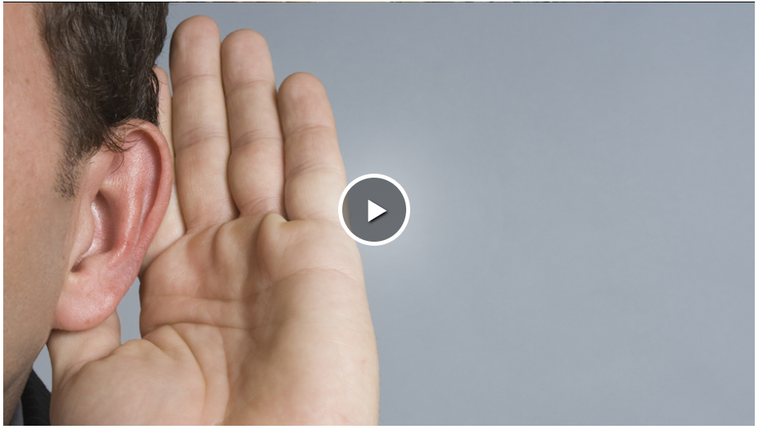

Slide 5
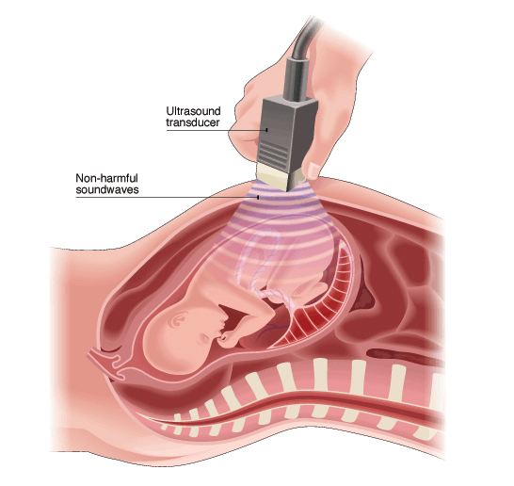
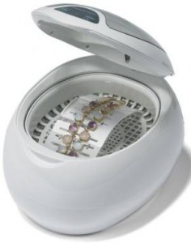
Ultra Sound
Copy & Complete
higher
Ultrasounds are sounds that have a ______ frequency than we can hear.

Slide 6
Write Down
Ultrasound can be used to:
Create images of inside a body (e.g. foetus in the womb)
Relieve pain but softening scar tissue.
Cleaning delicate objects - ultrasound waves create bubbles in a liquid which loosen dirt when they burst.

Slide 7
My Learning Journey……
Completed
Developing | Securing | Exceeding
State the meaning of absorb, transmit and reflect.
Explain how animals can detect the direction from which a sound is coming.
Explain how sonar and echolocation work.
Describe some uses of ultrasound
Calculate depth or distance from time and velocity of ultrasound.

Slide 8
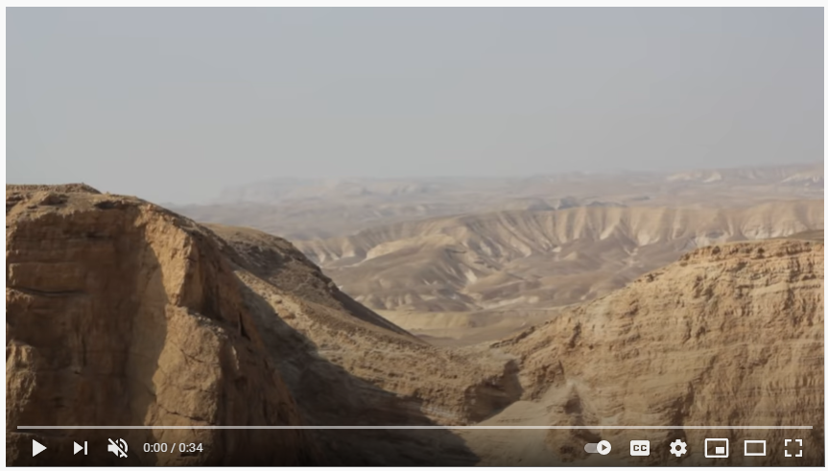
What is an echo?
How do some animals use echoes?

Slide 9
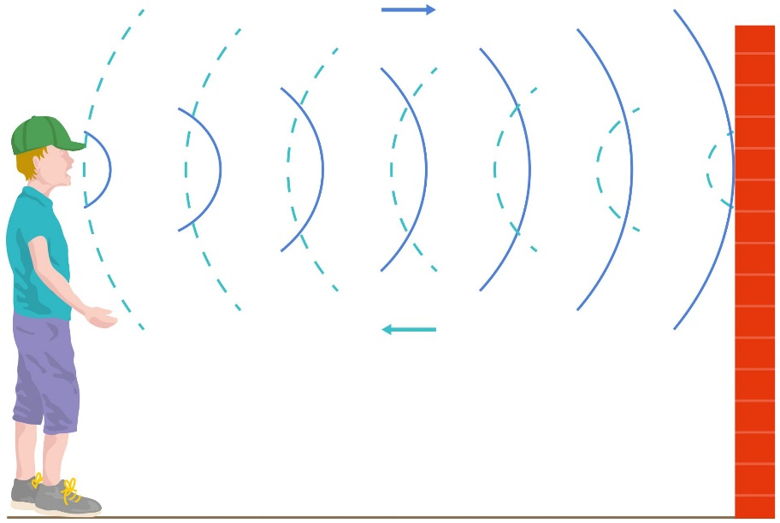
Copy & Complete
reflected
An echo is ________ sound.

Slide 10
As you watch the videos think about how you would draw and label a diagram to explain echolocation
Task - Draw and label a diagram to explain how animals use echolocation.
Things to include:
What happens to the ultrasound waves?
What can echolocation be used for?

Slide 11
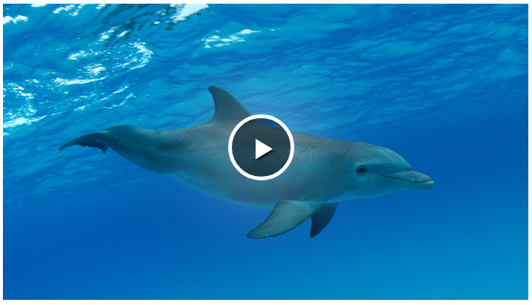

Slide 12
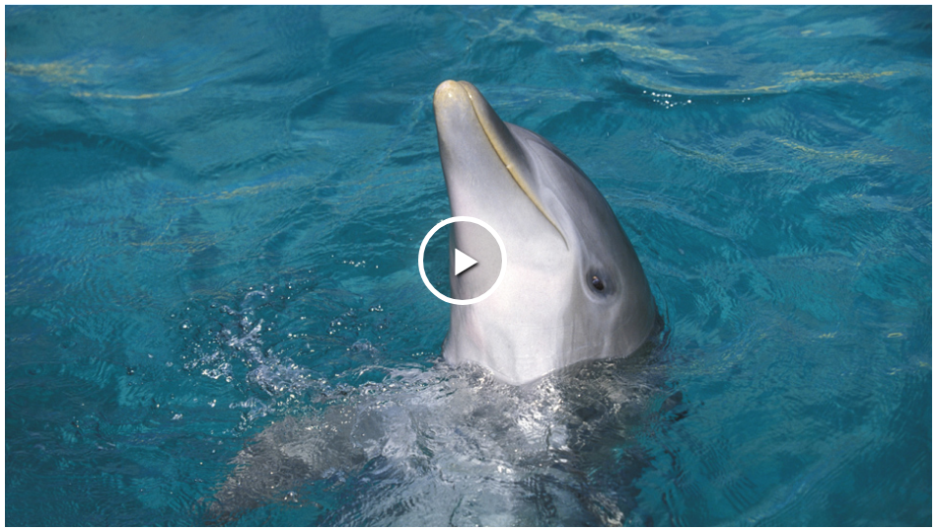

Slide 13
Check your work
Some animals use echolocation to find their way around and find their prey.
The animals produce bursts of ultrasound and listen for the reflected sound.
How can animals without echolocation work out the direction of a sound?
They can detect how far away and what direction the object is.

Slide 14
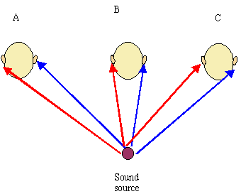
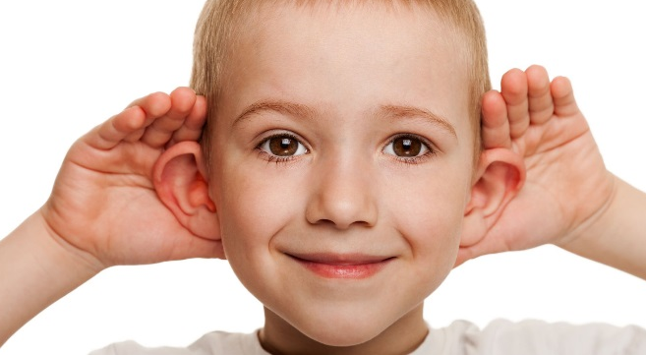
Having two ears detecting a sound wave means we can estimate exactly where the sound is coming from.
If we only had one ear, we would not be able to do this.

Slide 15
My Learning Journey……
Completed
Developing | Securing | Exceeding
State the meaning of absorb, transmit and reflect.
Explain how animals can detect the direction from which a sound is coming.
Explain how sonar and echolocation work.
Describe some uses of ultrasound
Calculate depth or distance from time and velocity of ultrasound.

Slide 16
Sonar
Humans use a form of echolocation called sonar.
Stick in your diagram and discuss in pairs what are some uses of sonar?
How could you calculate how deep the fish are?

Slide 17
Sonar
Stick In
Humans use a form of echolocation called sonar.
Discuss in pairs what are some uses of sonar?
How could you calculate how deep the fish are?

Slide 18
Write Down
In physics we use triangles rearrange equations.
Cover the letter you are trying to work out to find your ‘new’ equation.
x
s
t

Slide 19
Copy & Complete
Example 1
The boat detects the reflected ultrasound after 0.5s. The speed of sound in water is 1450m/s. What is the depth of the water?
x
s
t

Slide 20
Check your work
Example 1
The boat detects the reflected ultrasound after 0.5s. The speed of sound in water is 1450m/s. What is the depth of the water?
Distance = speed x time (x = s*t)
x
Distance = 1450m/s x 0.5s = 725m
s
t
The depth of water is only ½ the distance the sound has travelled, so
Depth = 725/2 = 362.5m

Slide 21
Example 2
The boat then detects another reflected ultrasound after 0.1s. How deep should the boat put it’s nets to catch the fish?
Distance = speed x time (x = s*t)
x
Distance = 1450m/s x 0.1s = 145m
s
t
The depth of water is only ½ the distance the sound has travelled, so
Depth = 145/2 = 72.5m

Slide 22
My Learning Journey……
Completed
Developing | Securing | Exceeding
State the meaning of absorb, transmit and reflect.
Explain how animals can detect the direction from which a sound is coming.
Explain how sonar and echolocation work.
Describe some uses of ultrasound
Calculate depth or distance from time and velocity of ultrasound.

Slide 23
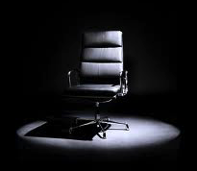
 Give a clue or definition for these keywords.
Hot Seat

Slide 24
Hot seat
 Give a clue or definition for these keywords.
Ultrasound

Slide 25
Hot seat
 Give a clue or definition for these keywords.
Echolocation

Slide 26
Hot seat
 Give a clue or definition for these keywords.
Absorbs

Slide 27
Hot seat
 Give a clue or definition for these keywords.
Sound wave

Slide 28
Hot seat
 Give a clue or definition for these keywords.
Reflected

Slide 29
Hot seat
 Give a clue or definition for these keywords.
Sonar

Slide 30
Hot seat
 Give a clue or definition for these keywords.
Echo

