Slide 1
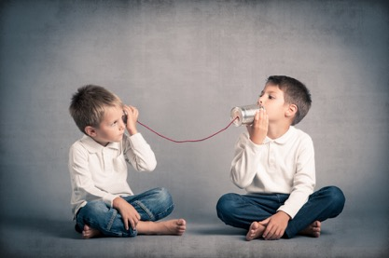
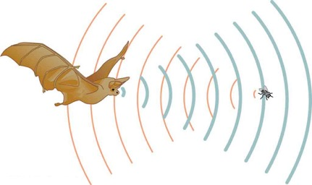
C/W
04/09/2018
7Ld – Using sound
What are the 3 things sound can do when it hits an object?
 In the back of your book. Make a list of the ways in which humans and animals use sound.
How might these be useful for humans and animals?

Slide 2
We use sound in many different ways, including for communication. Sometimes the sound waves are converted into electrical signals and then back to sound waves, e.g. in a telephone.
 Copy and complete the notes below after we have watched the video.
Uses of ultrasound
Ultrasounds are sounds that have a ______frequency than we can hear.
higher
What do we call sounds that have a lower frequency than we can hear?
Above what frequency is ultrasound?

Slide 3
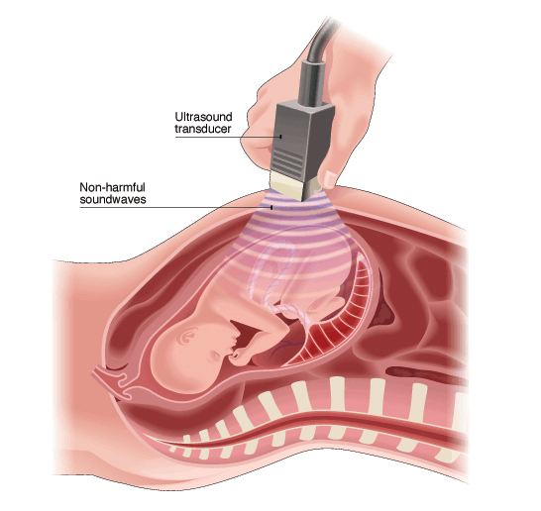
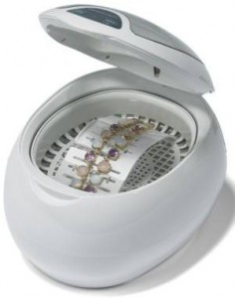
Ultrasound can be used to:
Create images of inside a body (e.g. foetus in the womb)
Relieve pain but softening scar tissue.
Cleaning delicate objects - ultrasound waves create bubbles in a liquid which loosen dirt when they burst.

Slide 4
My Learning Journey……
Completed
Developing | Securing | Exceeding
State the meaning of absorb, transmit and reflect.
Explain how animals can detect the direction from which a sound is coming.
Explain how sonar and echolocation work.
Describe some uses of ultrasound
Calculate depth or distance from time and velocity of ultrasound.

Slide 5
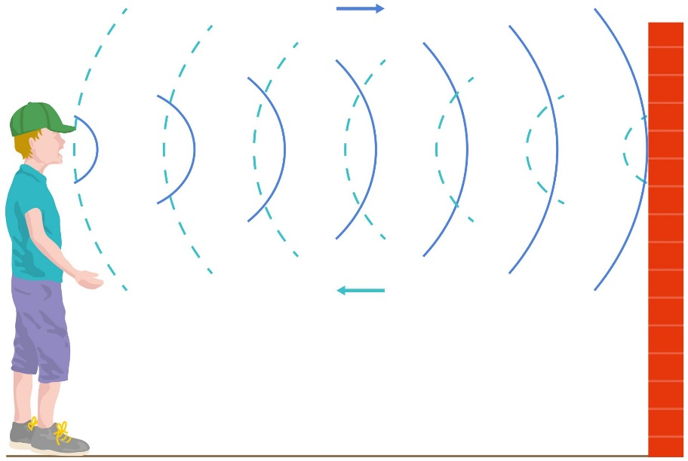
What is an echo?
Think about how you would define an echo as we watch the video.
Using echoes
An echo is a ________ sound.
reflected
How do some animals use echoes?

Slide 6
Twig video 1
Twig video 2
As you watch the videos think about how you would draw and label a diagram to explain echolocation
Task - Draw and label a diagram to explain how animals use echolocation.
Things to include:
What happens to the ultrasound waves?
What can echolocation be used for?

Slide 7
Self assess.
Some animals use echolocation to find their way around and find their prey.
The animals produce bursts of ultrasound and listen for the reflected sound.
How can animals without echolocation work out the direction of a sound?
They can detect how far away and what direction the object is.

Slide 8
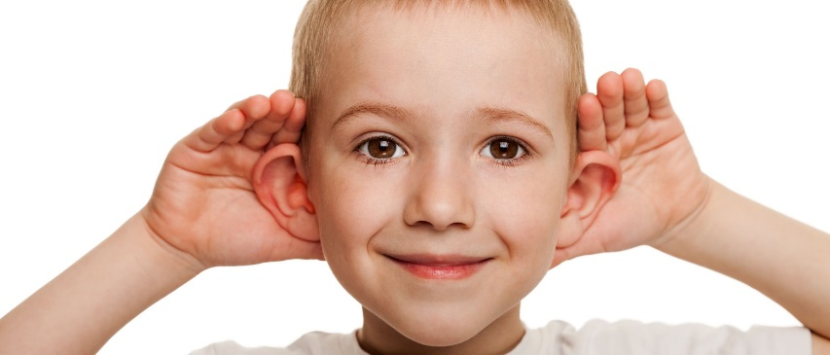
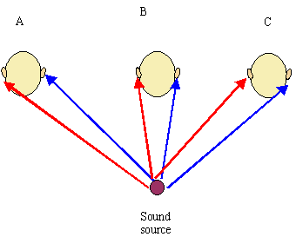
Having two ears detecting a sound wave means we can estimate exactly where the sound is coming from.
If we only had one ear, we would not be able to do this.

Slide 9
My Learning Journey……
Completed
Developing | Securing | Exceeding
State the meaning of absorb, transmit and reflect.
Explain how animals can detect the direction from which a sound is coming.
Explain how sonar and echolocation work.
Describe some uses of ultrasound
Calculate depth or distance from time and velocity of ultrasound.

Slide 10
Sonar
Humans use a form of echolocation called sonar.
Stick in your diagram and discuss in pairs what are some uses of sonar?
How could you calculate how deep the fish are?

Slide 11
Copy the equation
x
In physics we use triangles rearrange equations.
Cover the letter you are trying to work out to find your ‘new’ equation.
s
t

Slide 12
Copy the example question.
Calculate an answer for the depth of the water
x
s
t
Example 1
The boat detects the reflected ultrasound after 0.5s. The speed of sound in water is 1450m/s. What is the depth of the water?

Slide 13
Self assess.
Example 1
The boat detects the reflected ultrasound after 0.5s. The speed of sound in water is 1450m/s. What is the depth of the water?
x
Distance = speed x time (x = s*t)
s
t
Distance = 1450m/s x 0.5s = 725m
The depth of water is only ½ the distance the sound has travelled, so
Depth = 725/2 = 362.5m

Slide 14
Self assess.
Example 2
The boat then detects another reflected ultrasound after 0.1s. How deep should the boat put it’s nets to catch the fish?
x
Distance = speed x time (x = s*t)
s
t
Distance = 1450m/s x 0.1s = 145m
The depth of water is only ½ the distance the sound has travelled, so
Depth = 145/2 = 72.5m

Slide 15
My Learning Journey……
Completed
Developing | Securing | Exceeding
State the meaning of absorb, transmit and reflect.
Explain how animals can detect the direction from which a sound is coming.
Explain how sonar and echolocation work.
Describe some uses of ultrasound
Calculate depth or distance from time and velocity of ultrasound.

Slide 16
Homework
Doddle quiz - 7Ld Using Sound

Slide 17
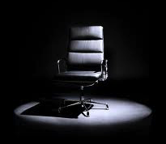
 Give a clue or definition for these keywords.
Hot Seat

Slide 18
Hot seat
 Give a clue or definition for these keywords.
Ultrasound

Slide 19
Hot seat
 Give a clue or definition for these keywords.
Echolocation

Slide 20
Hot seat
 Give a clue or definition for these keywords.
Absorbs

Slide 21
Hot seat
 Give a clue or definition for these keywords.
Sound wave

Slide 22
Hot seat
 Give a clue or definition for these keywords.
Reflected

Slide 23
Hot seat
 Give a clue or definition for these keywords.
Sonar

Slide 24
Hot seat
 Give a clue or definition for these keywords.
Echo

Slide 25
Reqs
Class practical
-
Demos
-
Worksheets
7Ld - Sonar diagrams (OWN)

