Slide 1
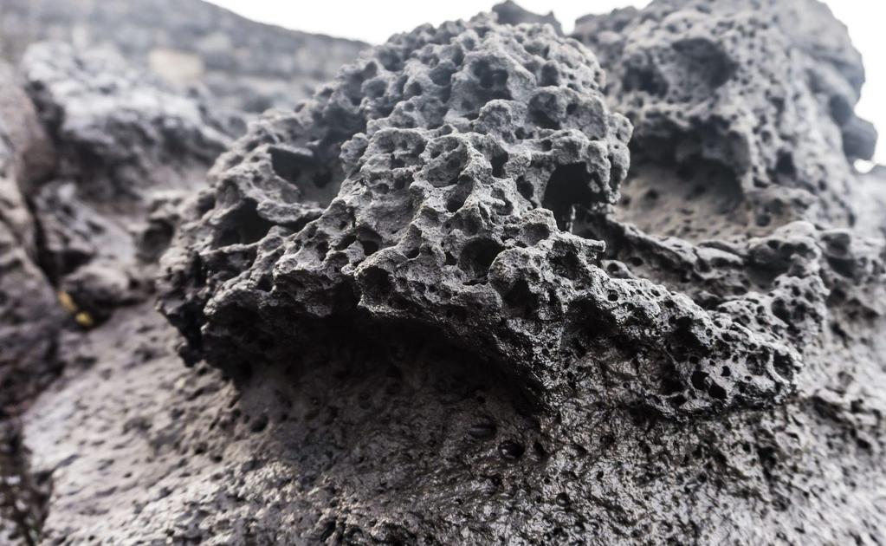
8Ha2 Permeable Rock Investigation
CW
Do Now:
Examine the samples carefully using the hand lens
Choose three rocks you are going to test

Slide 2
Requisitions
Equipment | Worksheets
Permeable Rock Practical Various small rock samples Hand lens Beakers Mass Balances Paper towels Stop Watches | 8Ha1

Slide 3
Objectives
Recall some uses for rocks and some products made from limestone.
State what rocks are made of.
Recall why different rocks have different properties.
Recall some examples of rocks with different textures.
Explain why certain rocks are porous and/or permeable.

Slide 4
Practical – Permeable Rocks
Write your aim and prediction for the experiment
Aim:
To find out how permeable different rocks are by finding how much water they will absorb.
Prediction:
Which rock do you think will absorb the most water? Explain your prediction.

Slide 5
Results
Rock Name | Dry Mass (g) | Mass after soaking (g) | Mass of water absorbed | Mass of water absorbed per gram of dry rock (g)
Chalk
Sandstone
Pumice
Limestone
Granite

Slide 6
Results
Rock Name | Dry Mass (g) | Mass after soaking (g) | Mass of water absorbed | Mass of water absorbed per gram of dry rock (g)
Chalk | 87.72 | 90.49 | 2.77 | 0.03
Sandstone | 49.63 | 50.17 | 0.54 | 0.01
Pumice | 7.5 | 7.86 | 0.36 | 0.05
Limestone | 58.2 | 58.29 | 0.09 | 0.0002
Granite | 19.32 | 19.34 | 0.01 | 0.0005

Slide 7
Method
Make a copy of this table for your results.
Find the mass of each rock sample. Write the masses in the ‘dry mass’ column in the table.
Put the rock samples into a beaker of water. Leave them for 10 minutes. While you are waiting complete W/S 8Ha1 rocks and their uses.
After 10 minutes the rocks out of the water and dry them using paper towels. Find the masses again, and write them in the table.
Work out how much water each rock has absorbed by subtracting the dry mass from the mass after soaking.
Now divide the mass of water by the dry mass of the rock. This will give you the mass of water absorbed per gram of dry rock.

Slide 8
Conclusion
Answer the following in full sentences
Which rock absorbs the most water?
Why does this rock absorb the most water?
Was your prediction correct?

Slide 9
Evaluation
Make a copy of this table for your results.
Why did you have to divide the mass of water absorbed by the dry mass of the rock?
Could you have just used readings for the mass of water absorbed?

Slide 10
Extension/ H/W
Complete W/S 8Ha6

