Slide 1
 Stick in and complete your worksheet.

Slide 2
 Self assess.

Slide 3
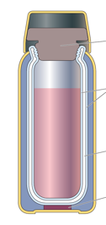
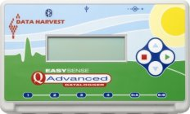
C/W
17/03/2019
8Kc2 – Accuracy & Precision
What was the conclusion from last lessons experiment?
What makes a valid conclusion in an experiment?

Slide 4
Copy the text below
A valid conclusion is based on evidence and answers the question asked by the experiment.
The data from the experiment needs to be accurate and precise

Slide 5
Copy and complete the wordfill below
measurement
A ____________ is accurate if it is close to the true ______ being measured.
Measuring devices that have smaller _________on their scales are more accurate than the ones with larger divisions
value
divisions
value measurement divisions

Slide 6
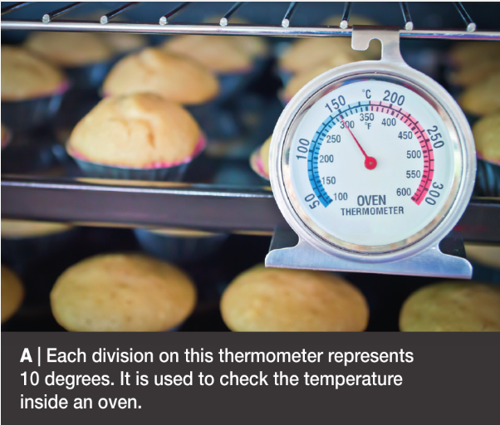
What is the difference between the two thermometers?
How is each thermometer related to its purpose?

Slide 7
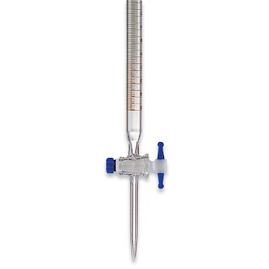
Accurate measures may take more time, may be harder to make or may require complicated equipment.
Why not always use the highest level of accuracy?

Slide 8
The level of accuracy used must always be justified with what you are measuring.

Slide 9
Watch the clip then write in your own words what you think ‘Precision’ is
Precision is a measure of how close together repeat readings are.

Slide 10
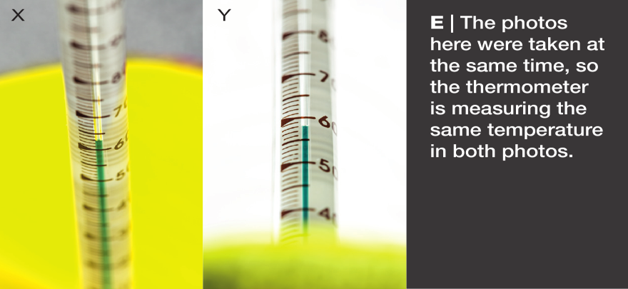
Match up the sentence starters and endings
A systematic error is when all readings from an instrument
A systematic error will reduce accuracy
An example of a random error
But not affect precision
Is when you look at a thermometer reading from a slightly different angle each time
Are incorrect by a similar amount
How can this be avoided?

Slide 11
Have a go at these questions in full sentences in your book

Slide 12
Have a go at these questions in full sentences in your book

Slide 13
Have a go at these questions in full sentences in your book

Slide 14
 Stick in and complete your worksheet.

Slide 15
 Self assess.

Slide 16
 Self assess.

Slide 17
Homework
N.A

Slide 18
 Give a clue or definition for these keywords.
Hot seat

Slide 19
Conduction

Slide 20
Insulation

Slide 21
Infrared
radiation

Slide 22
Convection

Slide 23
Heating

Slide 24
Reqs
Worksheets
8kc6_keeping_warm
8kc7_accuracy_and_precision

Slide 25
Science Help & Support Drop-in
Every Wednesday after school in E3/E4
Do your H/W. Work on past papers. Get help on content. Develop your understanding by helping others. Talk geek stuff.
We would like to see everyone. If you are not meeting your MNE we expect you to be here. If you have a Wed Period 6 speak to your teachers to organise an alternative time.
Notes:
A level

Slide 26
Teach your own physics lesson
The best way of finding out whether you understand something is to try to teach it to someone else.
Simply choose a lesson that interests you by looking around on Firefly and let your teacher know.
This will be easier for current Year 11 as resources for the OCR Gateway units are already set up. Year 10s are welcome to identify topics from the Exam Specification or online textbook.

