Slide 1
7Ia1 Energy in Food
CW
Do Now:
How can we compare the energy stored in different foods?
Why do scientists measure how much energy different foods contains?

Slide 2
Requisitions
Equipment | Worksheets
 | 7Ia2

Slide 3
Learning Objectives
State the meaning of: Fuel
Recall the factors that affect the amount of energy needed in a person’s diet
Describe the factors that affect body mass
Recall some substances that are used as sources of energy
Compare the temperature rise of water when some fuels are burnt
Identify situations in which energy is stored
Identify situations in which an energy transfer has taken place
Explain the differing energy needs of people of different ages and activity levels
Calculate the energy requirements for a person or activity

Slide 4
Try this!
Re-write the muddled up sentences correctly
Energy need move We to
Lots Crisps energy of have
Than more carrots Cheese energy has
Than less bread have Apples energy
Beat energy hearts to need Our
Lots energy uses Running of
Energy We grow need to

Slide 5
Burning Foods Practical
Read your worksheet
Label the diagram
Fill in the missing words in the method
Notes:
https://activeteach-prod.resource.pearson-intl.com/r00/r0028/r002870/r00287065/current/7ia2_energy_in_food_1.pdf

Slide 6
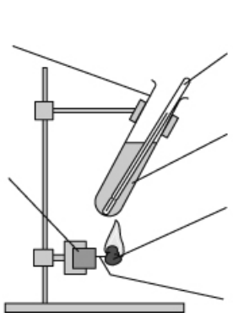
Boiling tube
Thermometer
Water
Cork
Food
Mounted Needle

Slide 7
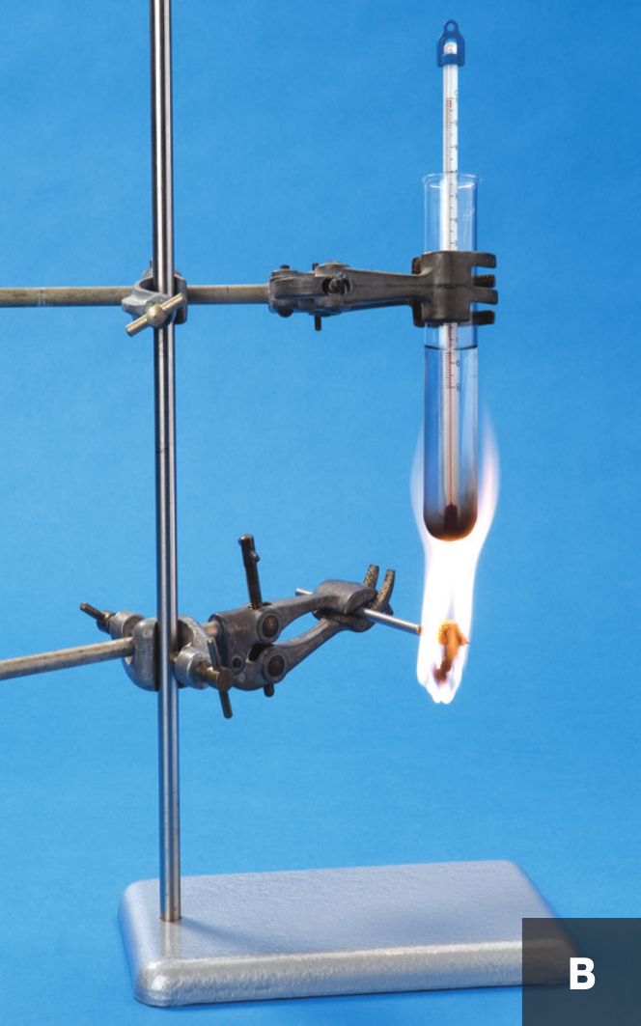
Set up for equipment as demonstrated

Slide 8
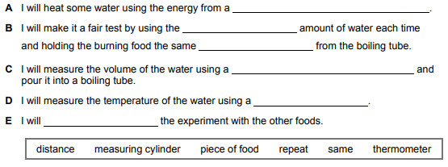

Slide 9
Recording Results
Food | Temperature at the Beginning (°C) | Temperature at the End (°C) | Temperature difference (°C)
When the food burned the energy stored in it was transferred to the water and made it hotter. The food that gave the highest temperature was the _______________. This is the food which stores the __________________energy.

Slide 10
Comparing Foods
Food | Mas Burnt (g) | Temperature rise (°C) | Temperature Rise per gram of food (°C/g)
Salted Peanuts | 4.0 | 24
Cashew Nuts | 3.0 | 18
Sunflower Seeds | 2.0 | 12
Raisings | 5.0 | 15
Dried Apricots | 15.0 | 27
Complete the table
Write the foods in order of the temperature rise
a. Explain why it is useful to workout the temperature rise per gram b. Explain why it is useful to write foods in order of temperature rise per gram.

Slide 11
Comparing Foods
Raisins: Typical Values | 100g contains | 1 serving (20g) contains
Energy | 1240kJ | 250kJ
Dried Apricots : Typical Values | 100g contains | 1 serving (20g) contains
Energy | 755kJ | 225kJ
Compare the energy per 100g of the two foods.
Compare the energy per serving of the two foods.
Why do you think that food packets usually give the energy per 100g and the energy per serving?

Slide 12
Evaluation
Answer the following questions using full sentences.
Foods come in different sized pieces. How could this have affected your results?
Did all the energy transferred from burning the food go into the water? Explain your answer.
How could you improve the experiment?

Slide 13
Self Assessment (use a different colour)
The amount of energy released/temperature rise depends on the mass of food, as well as how much energy that type of food stores.
No, some was transferred to the glassware, and some to the surrounding air.
Insulate the boiling tube so energy released by the burning food stays in the water.

