Slide 1
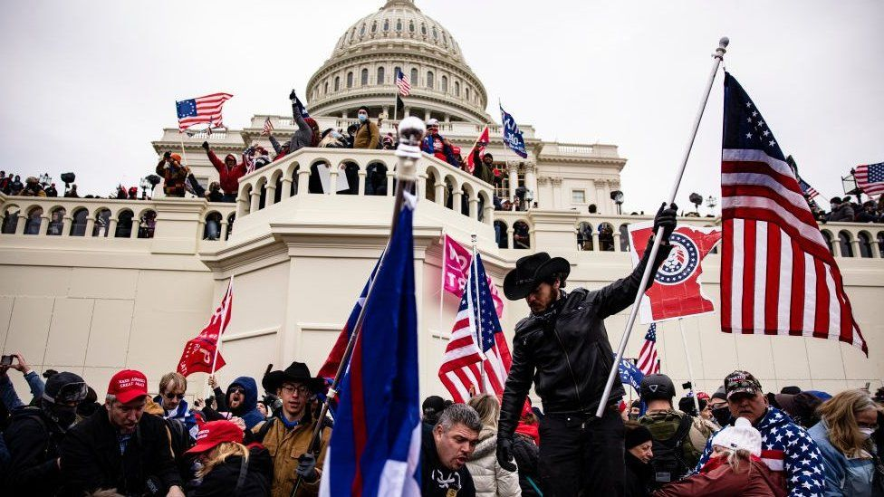
2021 key events
By adrija
The Capitol riot
On January 6th 2021 the United States Capitol Building in Washington was stormed during a riot and violent attack.
A mob of supporters of president Donald trump attempted to overturn his defeat in the 2020 presidential election. They assembled to count electoral votes to formalize joe biden’s victory

Slide 2
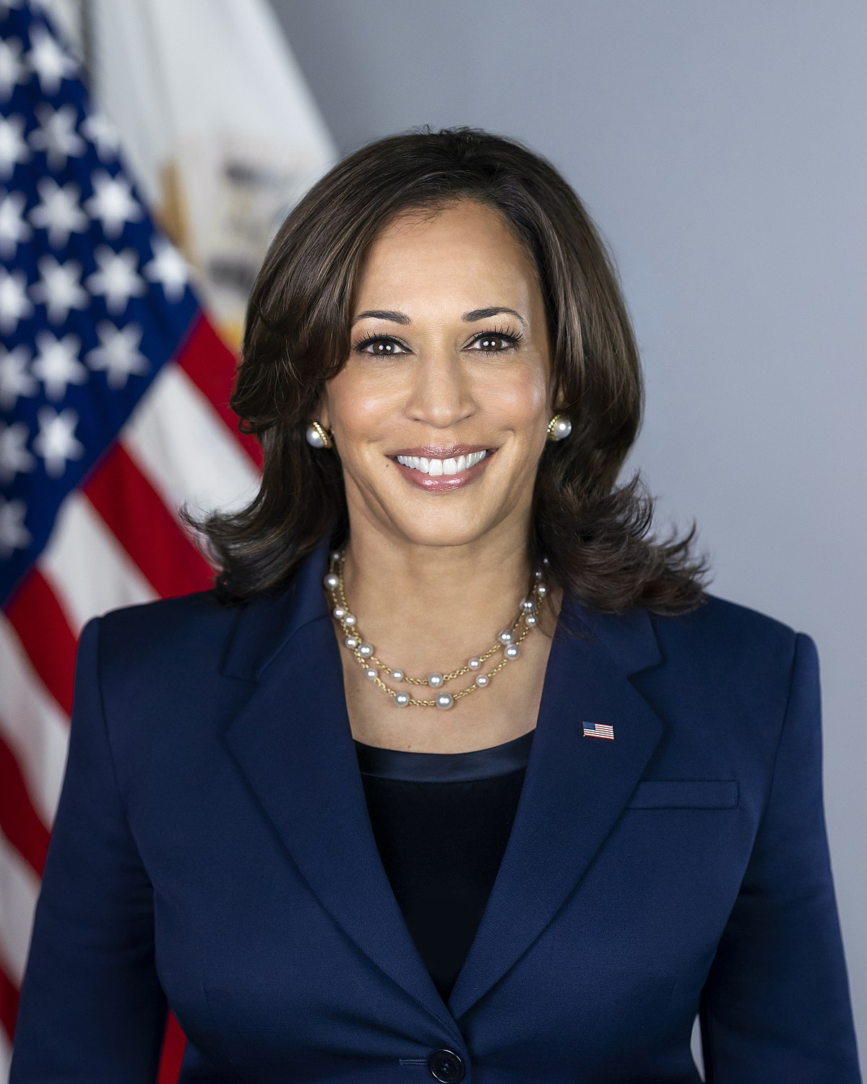
Kamala Harris
By Natalia
Kamala Harris becomes first female, first black and first Asian-American vice president. She was sworn in just before joe biden took the oath of office to become the 46th US president.
Ms harris, who is of Indian-Jamaican heritage, initially ran for the democratic nomination.

Slide 3
Corona virus
By Ipek
Coronavirus disease is a contagious disease caused by severe acute respiratory syndrome. The first known case was identified in Wuhan, China in December 2019. The disease has since spread worldwide, leading to an ongoing pandemic. Symptoms of COVID-19 are variable, but often include fever, cough, headache, fatigue, breathing difficulties, and loss of smell and taste.

Slide 4
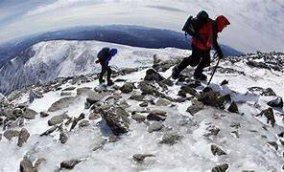
Extreme weathers in the UK
By Oliwia
A report by the independent Climate Change Committee predicts warming will hit the UK harder than first thought . It warns of more severe heatwaves, especially in big cities, and more intense rainfall, with an increased flood risk across most of the UK.
It says homes, infrastructure and services must be made resilient to floods, heat and humid nights

