Slide 1
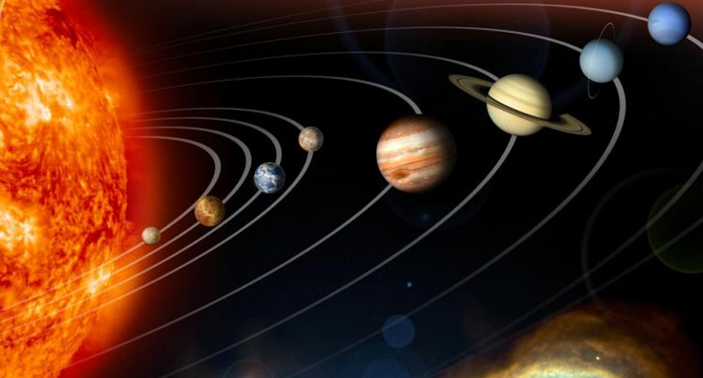
8La2 Models of the Solar System
CW
Do Now:
List the planets in order from the sun in the back of your book

Slide 2
Requisitions
Equipment | Worksheets
 | 8La-4

Slide 3
Objectives
Explain how we see the Moon.
Describe how the Earth, Moon and the planets move.
Describe the positions of the Earth and planets in the Solar System.
Describe some ways of investigating the planets.
Compare the geocentric and heliocentric models of the Solar System.
Use a model to explain why we see phases of the Moon.
Explain how technological developments have increased our knowledge of the Solar System.
Explain why the heliocentric model is our current model of the Solar System.
Compare different theories for the origin of the Moon.
Use a model to explain why we have partial and total solar eclipses.

Slide 4
Label the planets on your diagram.
Add a (silly) phrase to help you remember the order.
Are the planets actually arranged like this?
What is missing?

Slide 5
Mercury
Outer planets
Earth
Jupiter
Uranus
Sun
Saturn
Neptune
Mars
What is missing?
Venus
Inner planets

Slide 6
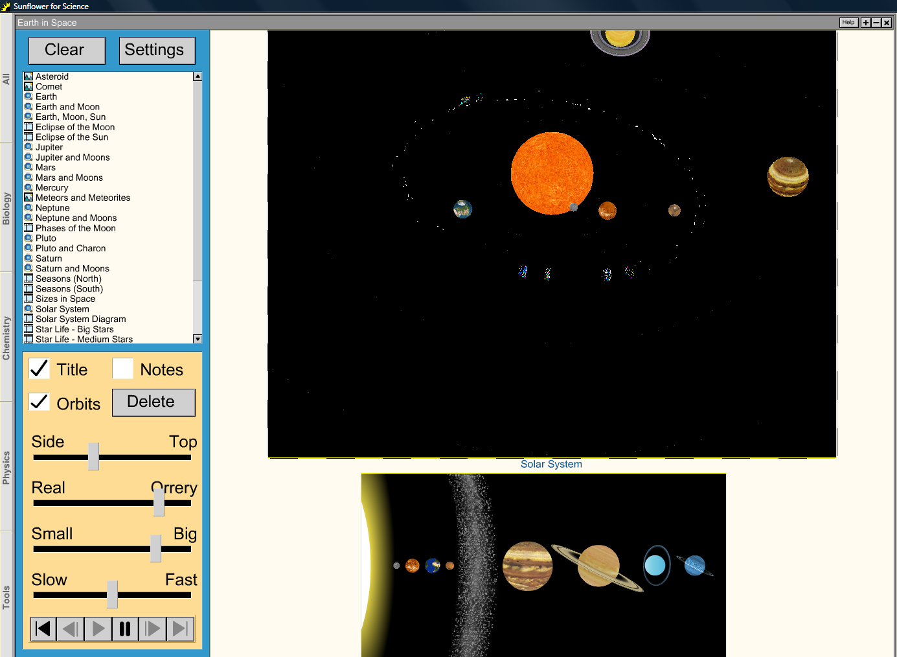
What does this animation show that isn’t on our diagram?
EXAMPLE SCREENSHOT ONLY:
IN SCHOOL ONLY Run Sunflower for Science as external application & choose ‘Earth in Space → Examples → Solar System’.
Notes:
EXAMPLE SCREENSHOT ONLY:
IN SCHOOL ONLY Run Sunflower for Science as external application & choose ‘Earth in Space → Examples → Solar System’.

Slide 7
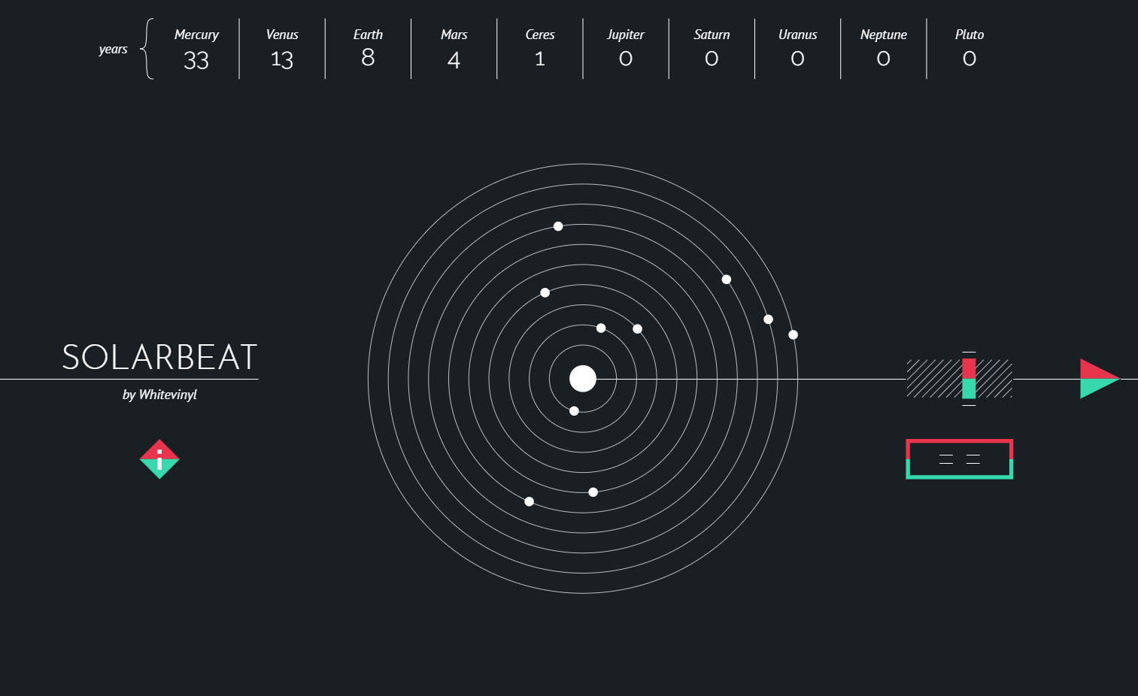
Click image to play “Solarbeat”.

Slide 8
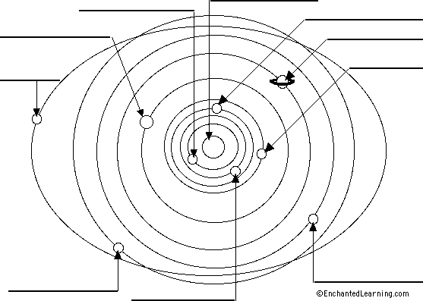
Add some asteroids to your 1st diagram & label the planets on the 2nd.
What is the best way of doing this?
Sun
Mercury
Earth
Jupiter
Saturn
Mars
(Pluto)
Have humans always known the Solar system is like this?
Uranus
Neptune
Venus

Slide 9
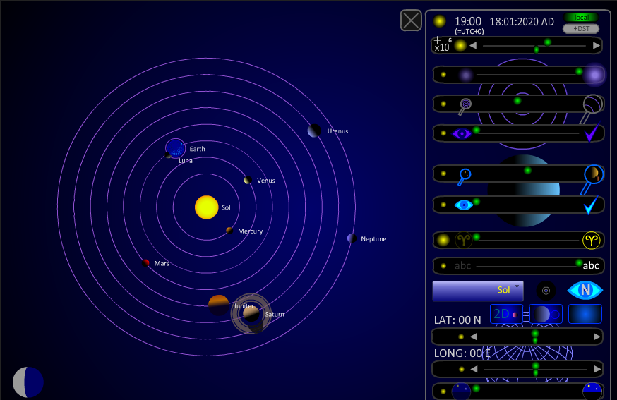

Slide 10
Heliocentric model of Solar System
What did we used to think was at the centre?
Use your diagram to describe the heliocentric model in words.
Sun
Mercury
Earth
Jupiter
Saturn
Mars
(Pluto)
What do we call this other model?
Have humans always known the Solar system is like this?
Uranus
Neptune
Venus

Slide 11
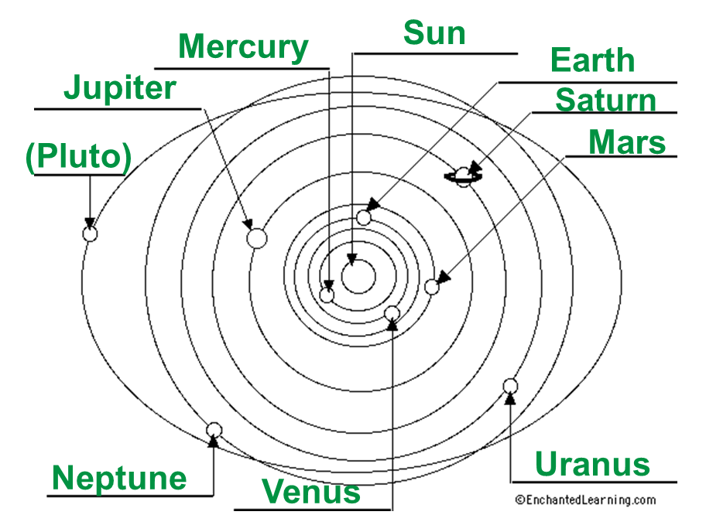
Heliocentric model of Solar System
The Sun is at the centre of the Solar System, with the Earth and other planets orbiting it.
Have humans always known the Solar system is like this?
What did we used to think was at the centre?
What do we call this other model?

Slide 12
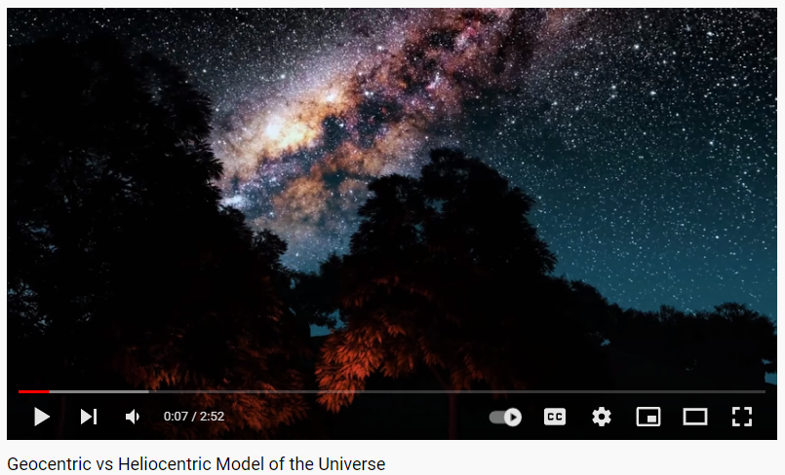

Slide 13
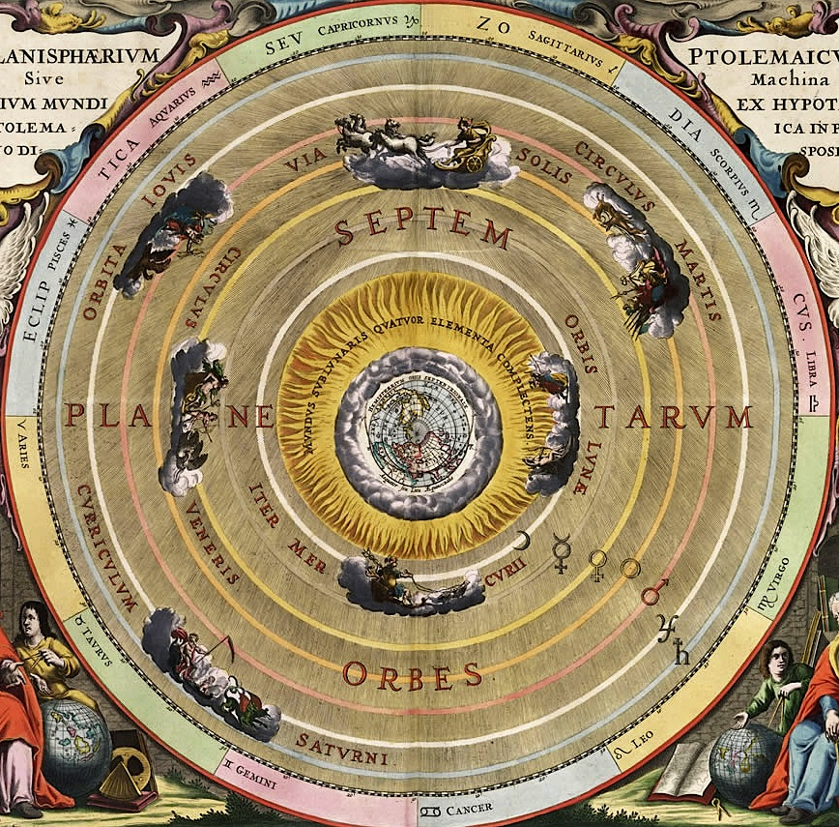
Geocentric model
Instead of the Sun, this model had…
the Earth at the centre, with the Moon, Sun and other planets orbiting it.
Why did this change?
Why did people including scientists think this model was correct?

Slide 14
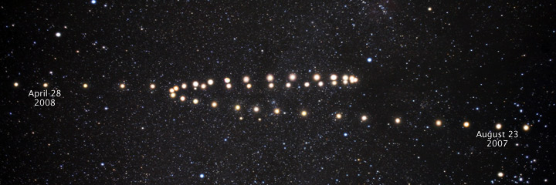
Retrograde motion

Slide 15
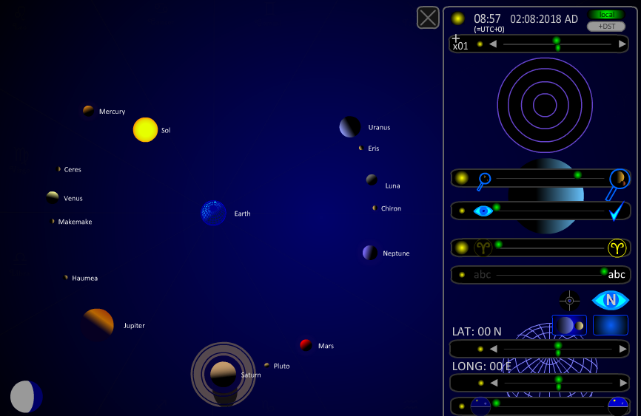

Slide 16
 Teachers: Click image to run Doddle interactive.
 Students: log in to Doddle & search for “Changing Ideas Solar System”.

Slide 17
 Teachers: Click image to run Doddle interactive.
 Students: log in to Doddle & search for “Solar System timeline”.

Slide 18
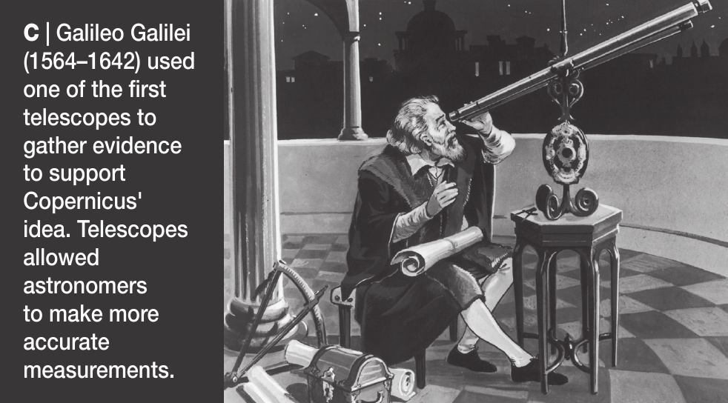

Slide 19
Describe Kepler’s heliocentric model and explain why it is our current model of the Solar System (5 marks)
Kepler’s model has the Sun at the centre (1)
… with the planets moving around it in elliptical orbits. (1)
The geocentric model cannot easily explain observations of how the planets move across the sky (eg retrograde motion). (1)
… so the correct model must be heliocentric. (1)
Better telescopes have meant more accurate observations (1)
… only by assuming the planets move in ellipses can the model fit these observations. (1)
How else has technology improved our knowledge of the Solar System?

Slide 20
Use of technology
From the next video, explain some of the ways technological developments have improved our knowledge of the Solar System.
What is the technology?
What has it allowed us to find out?

Slide 21
Students:

Slide 22
Use of technology
From the next video, explain some of the ways technological developments have improved our knowledge of the Solar System.

Slide 23
 Give a clue or definition for these keywords.
Hot seat
geocentric

Slide 24
 Give a clue or definition for these keywords.
Hot seat
planets

Slide 25
 Give a clue or definition for these keywords.
Hot seat
Sun

Slide 26
 Give a clue or definition for these keywords.
Hot seat
heliocentric

Slide 27
 Give a clue or definition for these keywords.
Hot seat
ellipse

