Slide 1
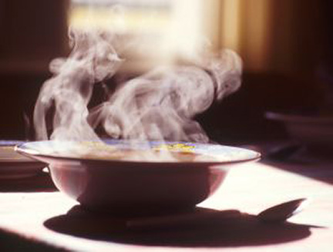
7Ec: Evaporation
CW
Do Now: What’s happening in the picture? How do you know?

Slide 2
Requisitions
Equipment | Worksheets
Separating salt from rock salt

Slide 3
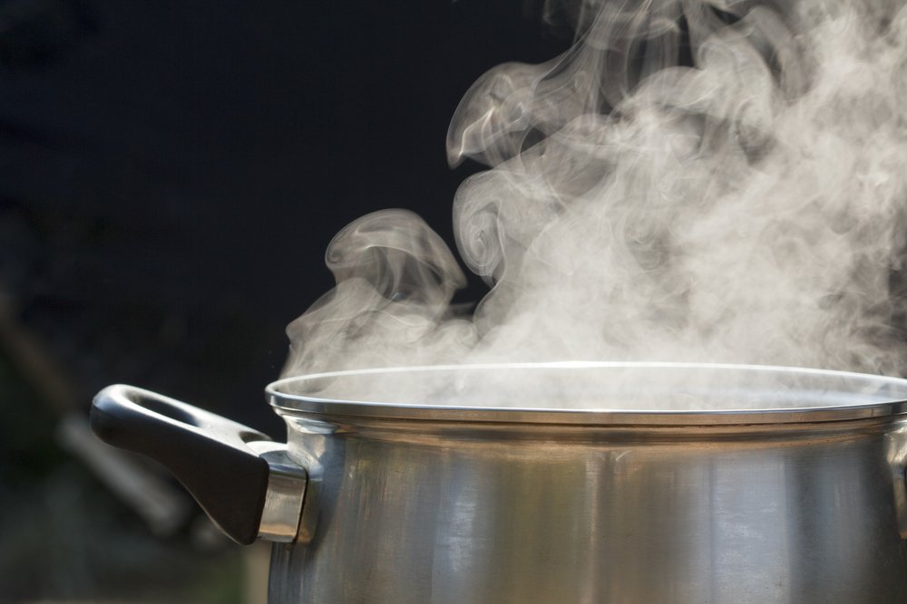
Copy & Complete
During evaporation of a solution, the liquid turns into a ____ which escapes into the air. This leaves behind the solid that was ________in it.
gas
dissolved

Slide 4
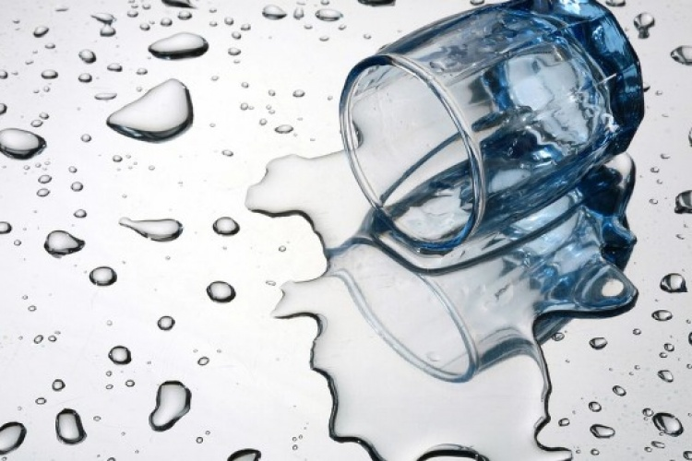
Key Temperatures
What temperature does water evaporate?
What is the boiling point of water?

Slide 5
Key Temperatures
Evaporation can happen at any temperature. Think of water that’s been spilt, if its left, all the water will evaporate.
The boiling point of water is 100°C. Boiling is when liquid is turning to gas throughout all the liquid.

Slide 6
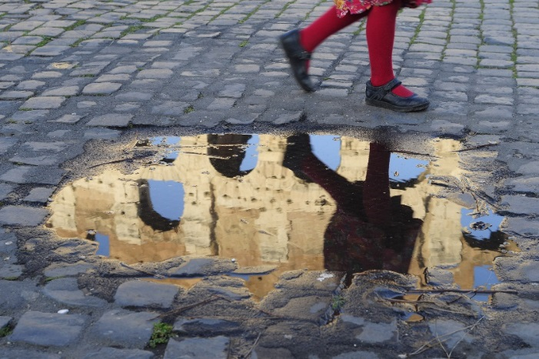
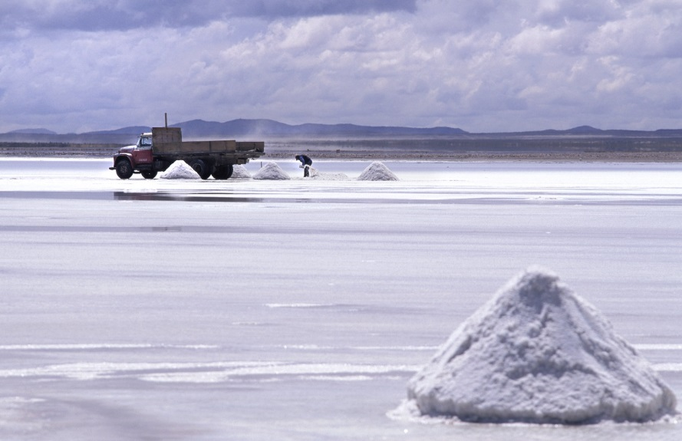
Evaporations
The rate of evaporation increases as the temperature increases
During summer months, whole lakes can evaporate. Salt crystals form as water evaporates from this lake.

Slide 7
Producing Salt (video)
Copy & Complete
What is the chemical formula for salt?
What are the uses of salt?
How do we obtain rock salt?
NaCl
Cooking, melting ice on roads
Mining and evaporation

Slide 8
Separation
Come up with a method to separate salt from rock using the following equipment:
Beaker Stirring Rod Bunsen Burner Bench Mat | Tripod Gauze Funnel Filter Paper

Slide 11
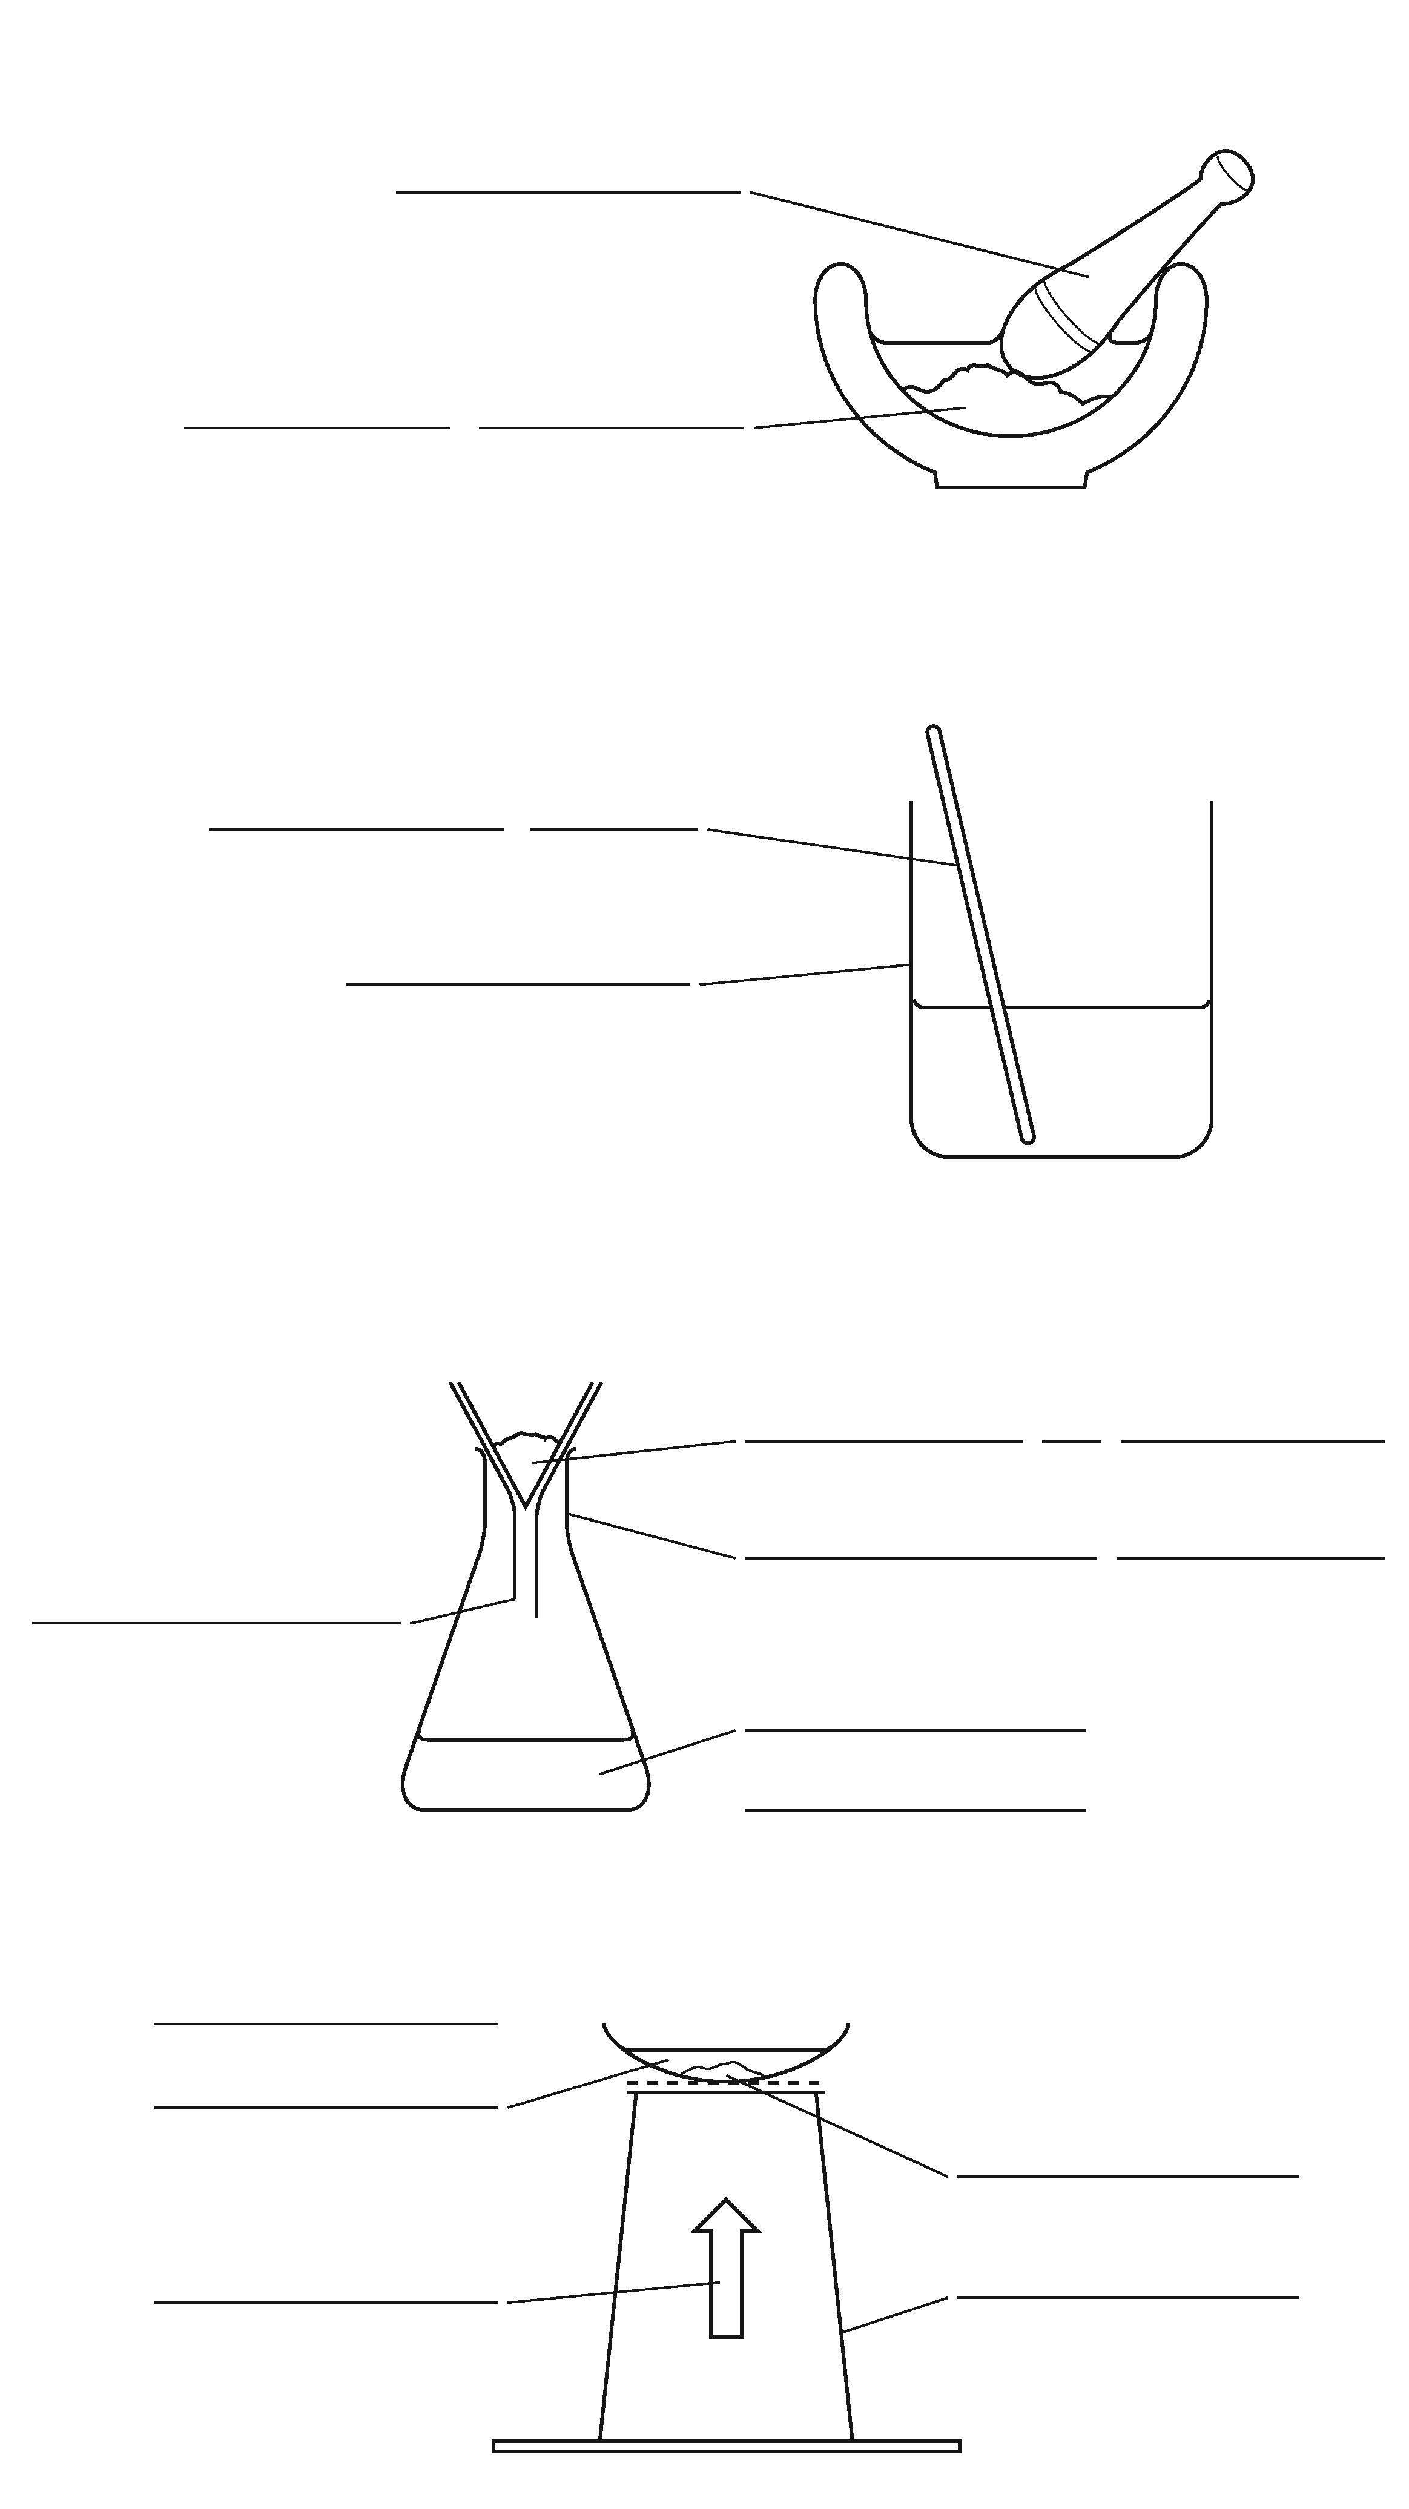
mortar
B Crush up the rock salt using a mortar and pestle.
F This makes sure that there is no salt trapped inside bits of rock.
rock salt
E Put the crushed-up rock salt into a beaker and add water.
stirring rod
G The salt is soluble and will dissolve. The bits of rock are insoluble and will not dissolve.
beaker
J Stir the mixture to help the salt to dissolve
A Filter the mixture.
bits of rock
C The insoluble bits of rock will be trapped in the filter paper. Salty water will go through the filter paper.
funnel
conical flask
salty water
I The filter paper does not trap the salt because the salt is dissolved in the water.
evaporating basin
pure salt
D You can get the salt from the salty water by evaporating the mixture.
heat
tripod
H The water evaporates and leaves the salt behind

Slide 12
B Crush up the rock salt using a mortar and pestle.
F This makes sure that there is no salt trapped inside bits of rock.
E Put the crushed-up rock salt into a beaker and add water.
G The salt is soluble and will dissolve. The bits of rock are insoluble and will not dissolve.
J Stir the mixture to help the salt to dissolve
A Filter the mixture.
C The insoluble bits of rock will be trapped in the filter paper. Salty water will go through the filter paper.
I The filter paper does not trap the salt because the salt is dissolved in the water.
D You can get the salt from the salty water by evaporating the mixture.
H The water evaporates and leaves the salt behind

Slide 13
Risk Assessment
Hazard – item that could cause a risk e.g. Bunsen burner, hot glass
Precaution – how to prevent something happening due to a hazard e.g. wear goggles, keep equipment in middle of the desk
Risk – what could go wrong (include hazard in answer) e.g. hot glass could break, Bunsen burner could cause burns

Slide 14
Risk Assessment
Hazard | Why is it a risk? | How can I reduce the risk?

Slide 15
1 What E happens when a liquid turns to gas only at its surface?
2 What DS is left behind when a solution is heated?
3 Which SC is a substance found in rock salt?
4 What B means salty water?
5 What SS is made by evaporating sea water?
6 What B is when all parts of a liquid are turning into a gas at once?
7 Which BP is the temperature at which a liquid boils? 8 What HTD is the way to recover the solutes from a solution?

Slide 16
You're stranded on a desert island, and your only source of water is from a stream or from the ocean. Write a method to source your own drinking water.

Slide 17
