Slide 1
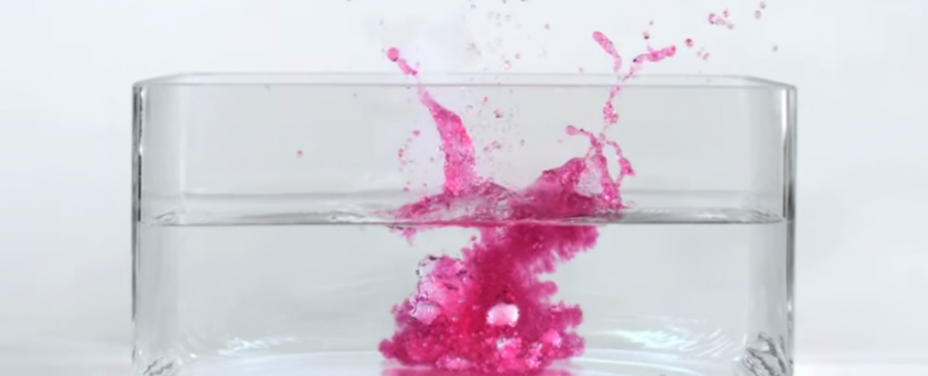
8Gc Metals and Water

Slide 2
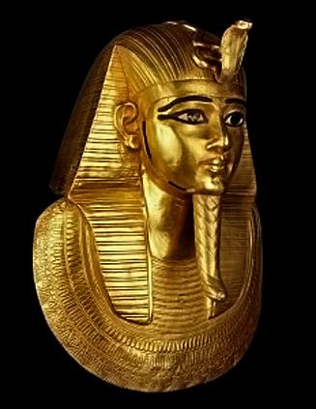
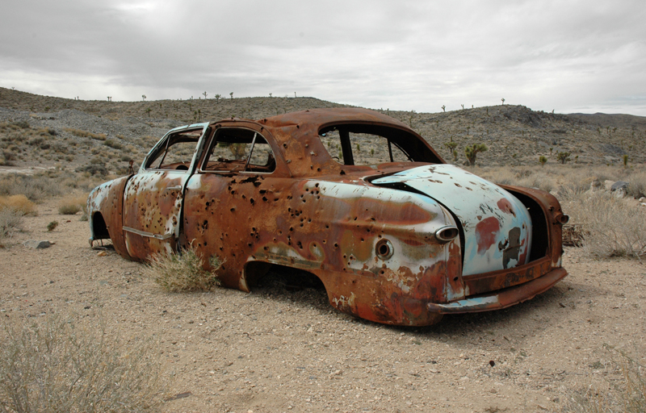
Gold Iron Copper
What is the order of reactivity?
Iron
Copper
Gold
Increasing
reactivity

Slide 3
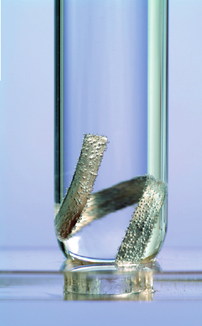
Fill a test tube with water, place some magnesium ribbon in it. Put your thumb over the top and place it upside down in a beaker half full of water.
Next week you will look at the test tubes and observe any changes.

Slide 4
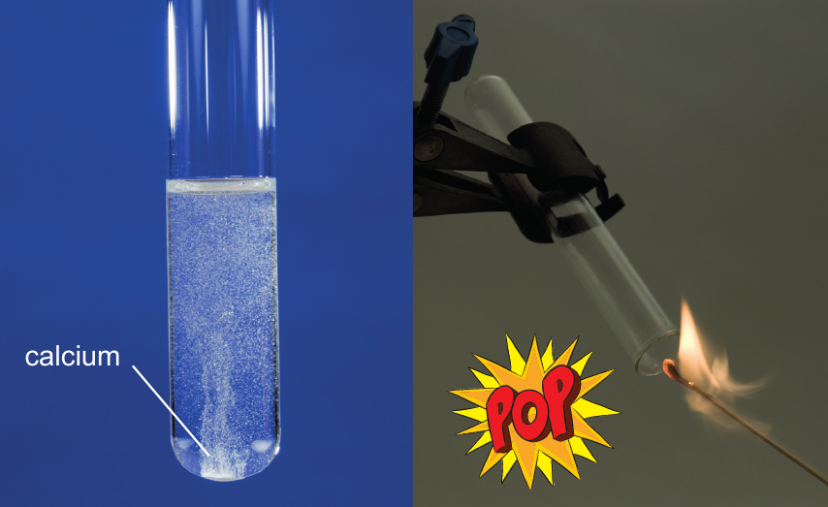
Use the tweezers and place a granule of calcium in a test tube of water.
Put your thumb over the top and wait for about 30s, then test the gas with a burning splint.

Slide 5
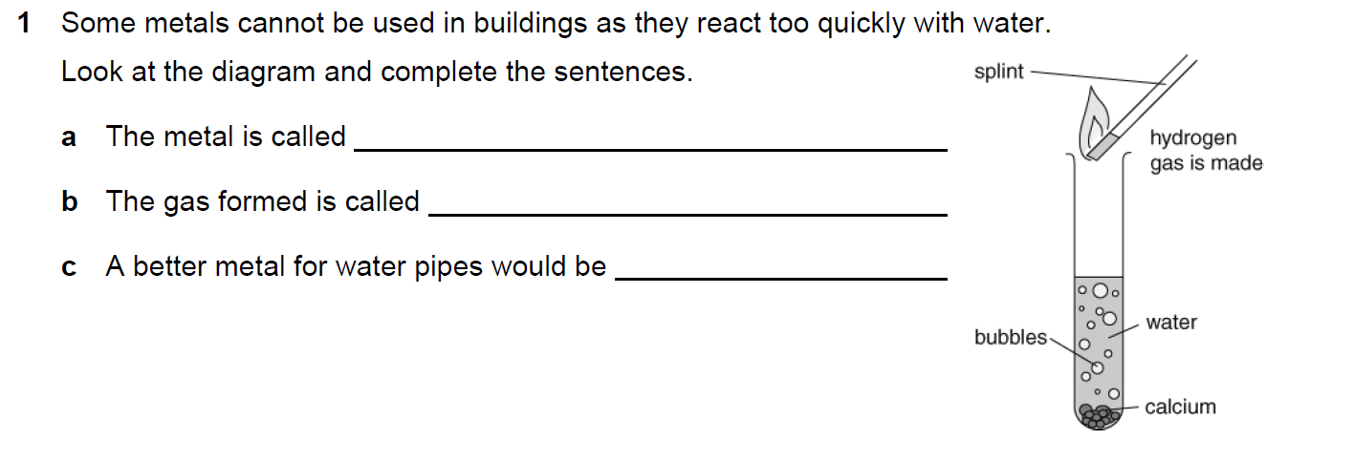
calcium
hydrogen
copper

Slide 6
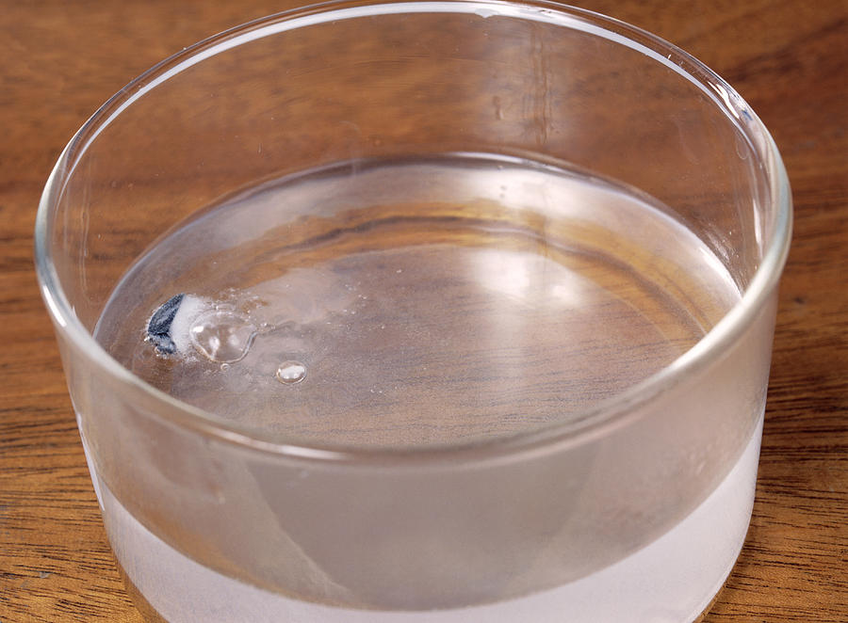
You will now see your teacher demonstrate how potassium, sodium and lithium react with water.

Slide 7
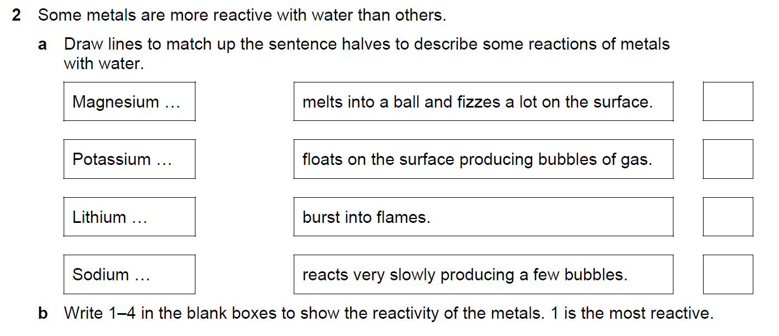

Slide 8
General Equation
Metals react with water to form hydrogen and metal hydroxide.
metal + water → hydrogen + metal hydroxide

Slide 9
✔
✔
✔

Slide 10
fizz
hydrogen
most
flames
calcium
melt
hydrogen
alkali

Slide 11
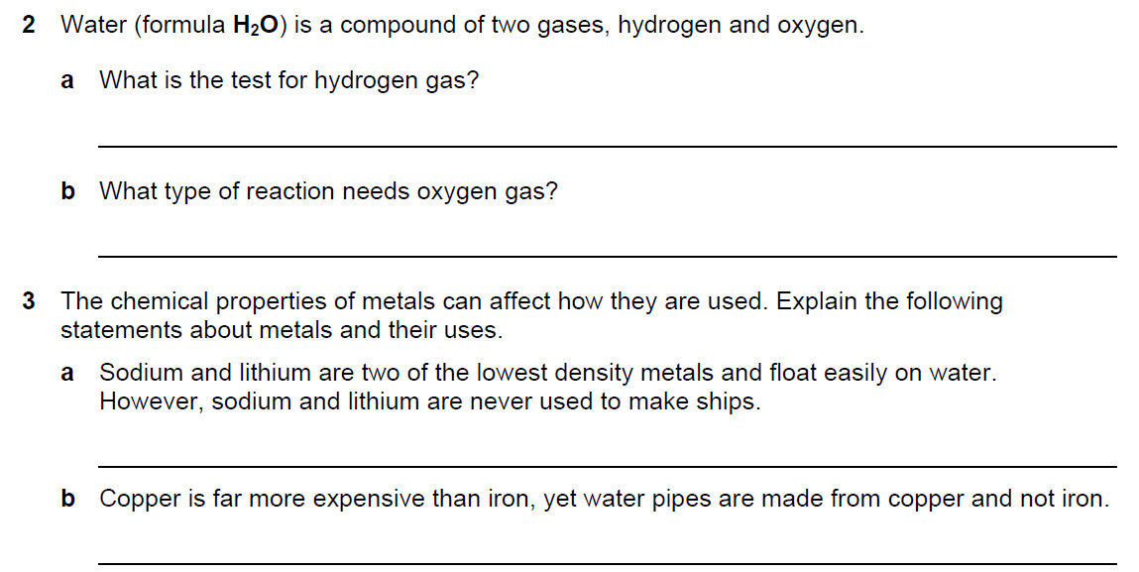
Ignite it with a burning splint
An oxidation reaction
They react quickly with water
Copper is less reactive than iron.

Slide 12
