Slide 1
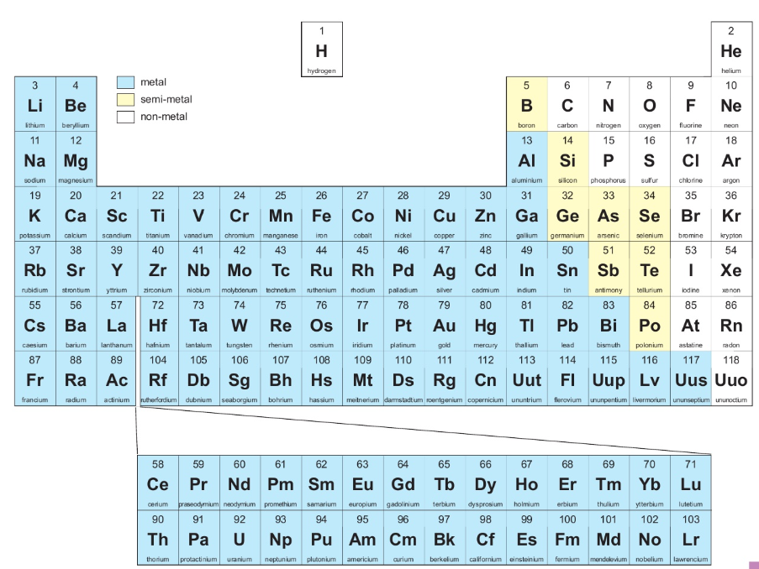
7Hc Metals and Non-Metals
Most elements are ___________.
The non-metals are found on the _______ hand side of the periodic table.
The semi-metals are _________ the metals and non-metals.
metals
left
inbetween

Slide 2
Material | Electrical conductor? | Magnetic? | Metal?
Magnesium
Rubber
Zinc
Wood
Aluminium
Carbon
Iron
Rubber
Nickel
Glass
Connect the material into a simple series circuit with a bulb using the crocodile clips.

Slide 3
Are all metals typically magnetic?
Did all metals conduct electricity?
Did any of the non-metals conduct electricity?
Which materials were elements?

Slide 4
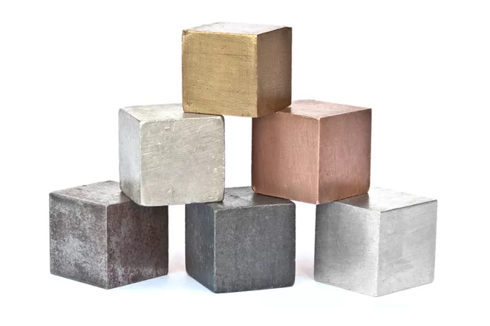
Typical properties of metals
Go to the back of your book and list as at least three typical properties of metals.

Slide 5
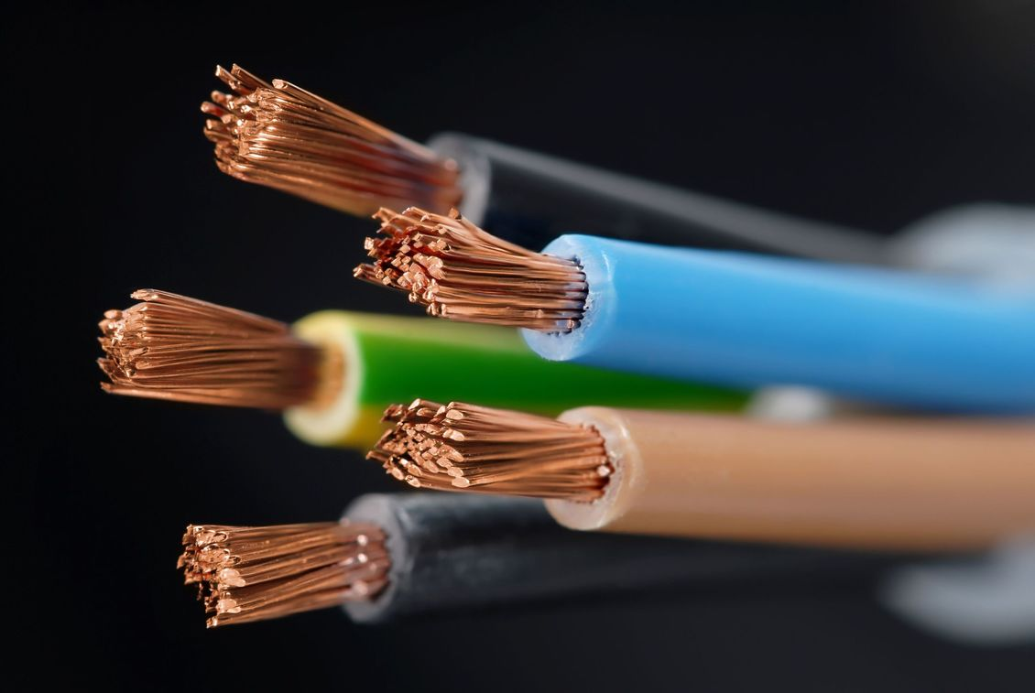
Good electrical conductor

Slide 6
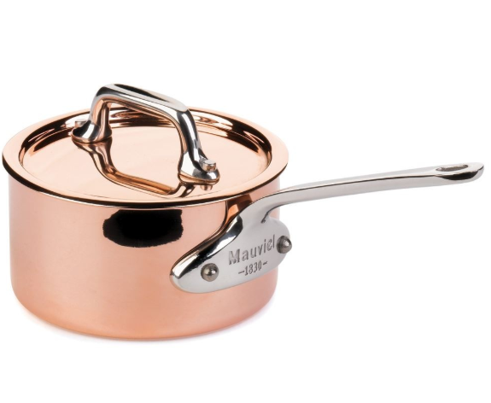
Good heat conductor

Slide 7
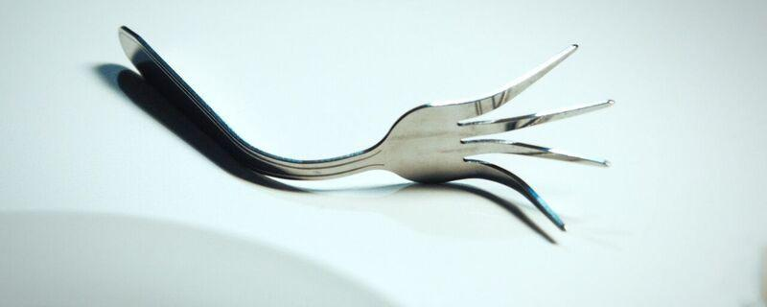
Malleable (bends without breaking)

Slide 8
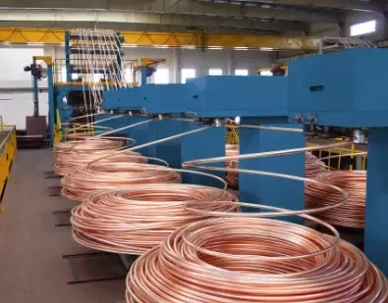
Ductile (drawn into a wire)

Slide 9
Strong

Slide 10
Shiny

Slide 11
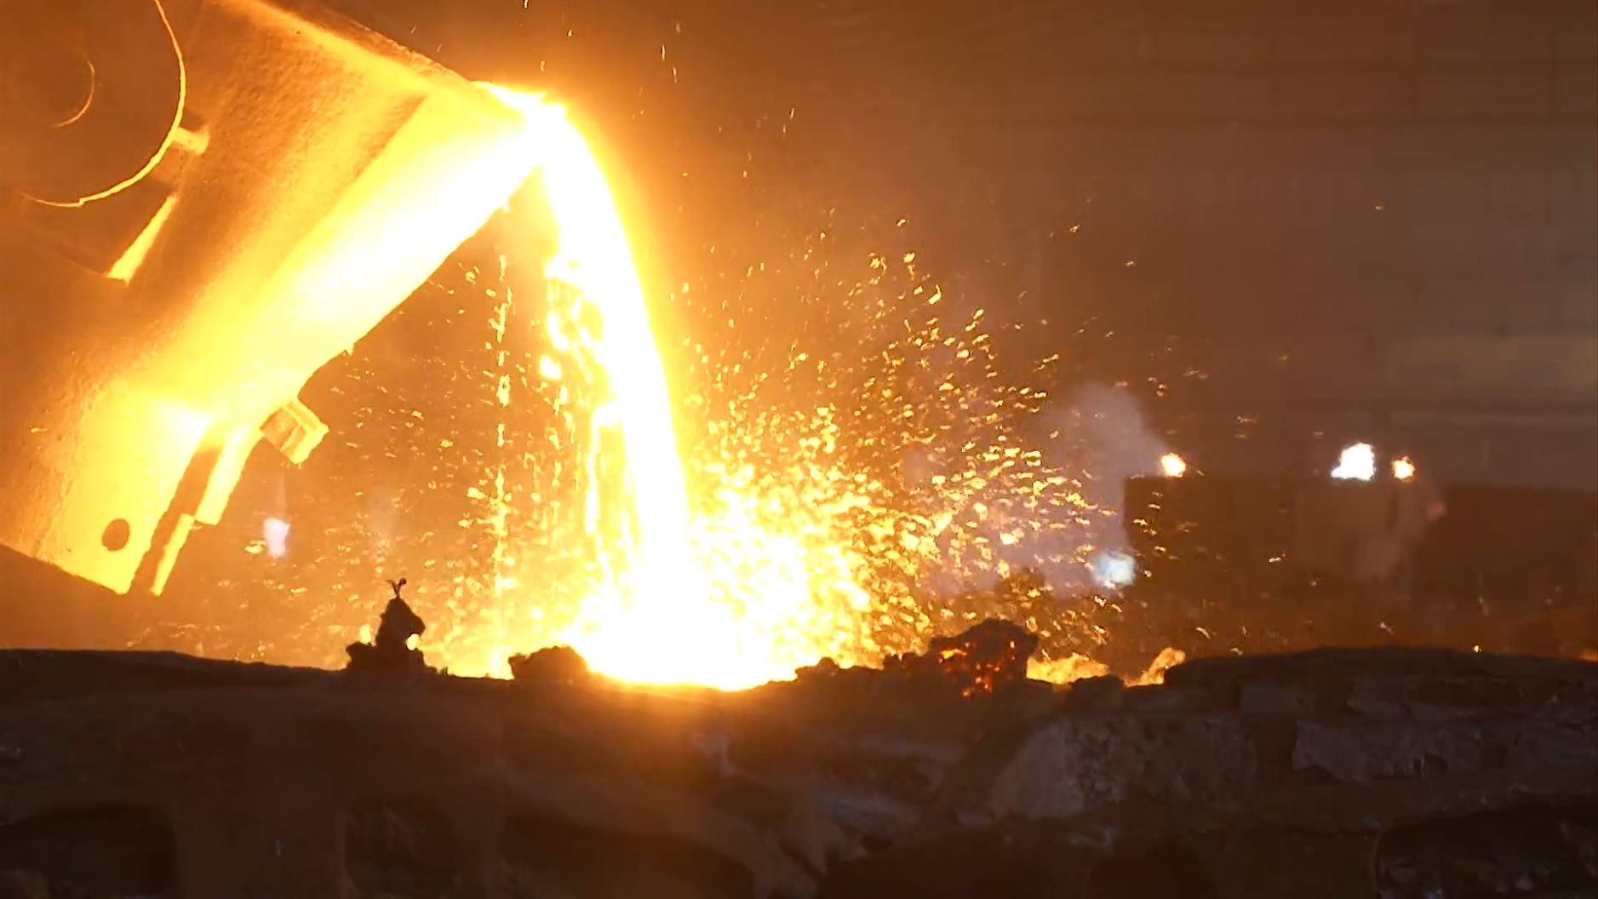
High melting point

Slide 12
Typical properties of non-metal elements

Slide 13
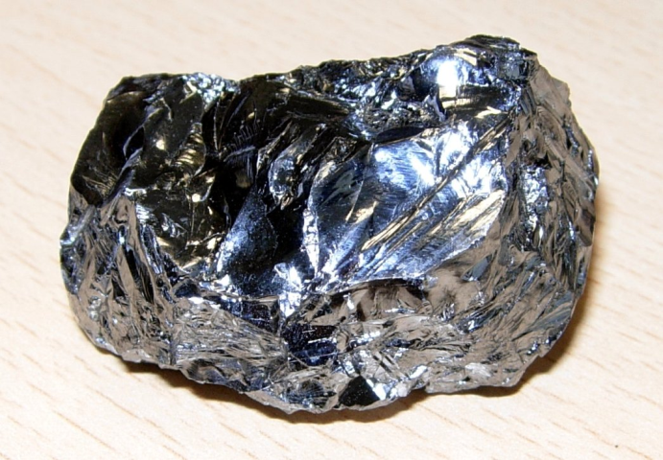
Exceptions
https://www.youtube.com/watch?v=cvRcUeWjBu0
Find these elements:
Ga
C_{(graphite)}
Hg
Si
Gallium
Mercury
Carbon
Silicon
Silicon
Use the pictures YouTube video and your experimental data to decide how these elements differ from typical
Mercury

Slide 14
Material | Electrical conductor | Magnetic | Metal
Magnesium
Rubber
Zinc
Wood
Aluminium
Carbon
Iron
Rubber
Nickel
Glass

