Slide 1
Resources
Worksheets
8Fa3
8Fa5
h/w recommendation 8Fa4 or 7
Practical
Teacher Demos

Slide 2
Objectives
Recall that different elements have different physical properties.
Identify the chemical symbols for some common elements and vice versa.
Record two letter symbols correctly.
Describe Dalton’s ideas about atoms.
Use a simple (Dalton’s) atomic model to describe an element.
Use a simple (Dalton’s) atomic model to describe a compound.
Use the idea of atoms to explain why different elements have different physical properties.
Use information about reaction ratios to calculate atomic masses.

Slide 3
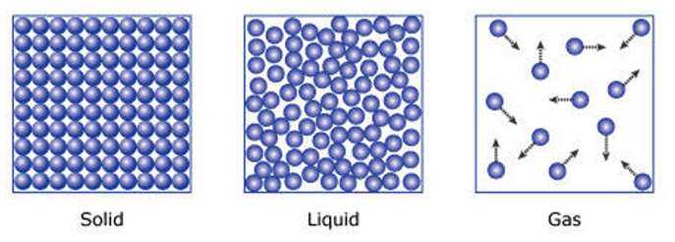
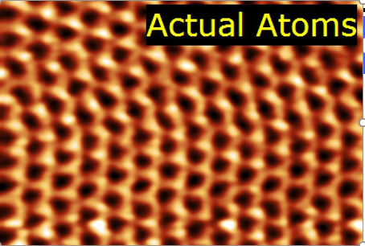
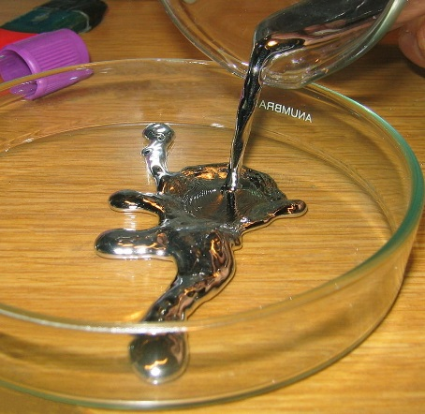
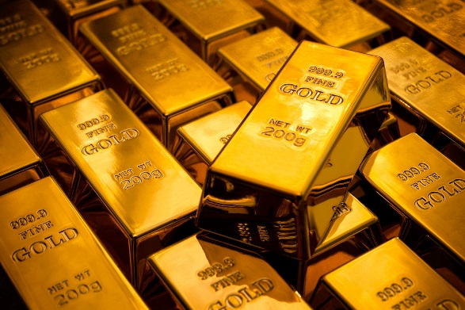
CW
8Fa Dalton’s atomic model
Draw particle pictures for the following substances
@hpscience

Slide 5
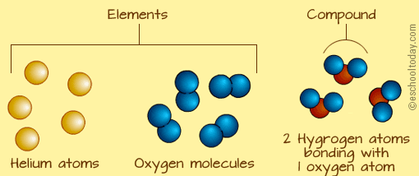
What is the difference between these particles?

Slide 6
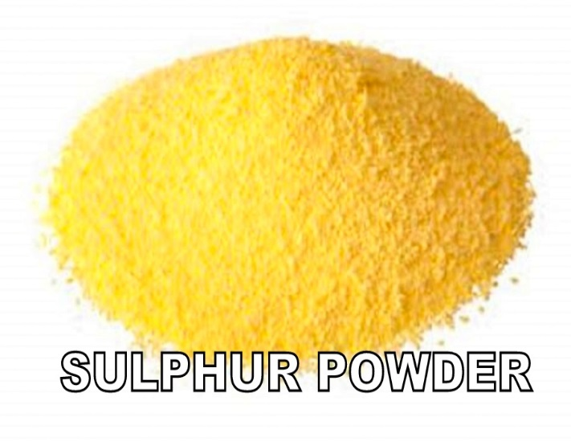
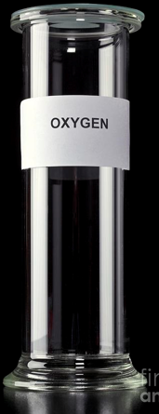
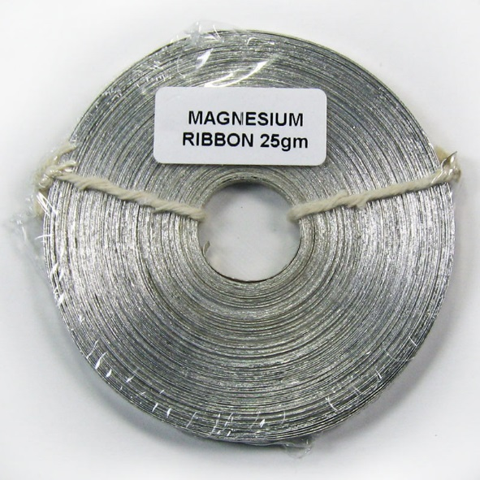
Physical properties
These substances are all elements, how are they different from each other?
Bromine

Slide 7
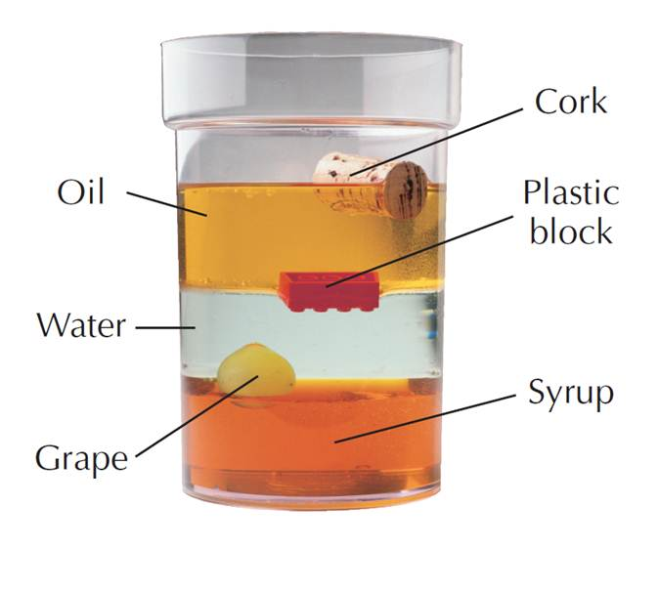
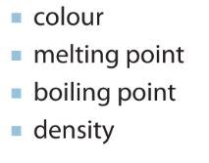
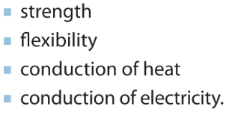
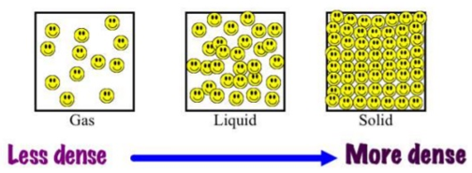
The differences in the atoms give each element its own, distinct properties, such as …
w/s 8Fa3

Slide 8
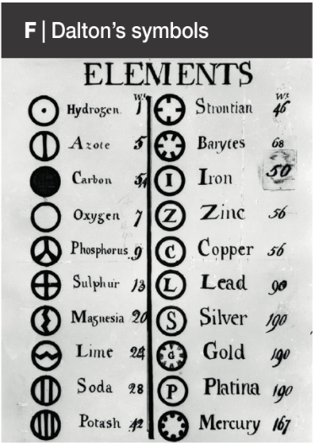
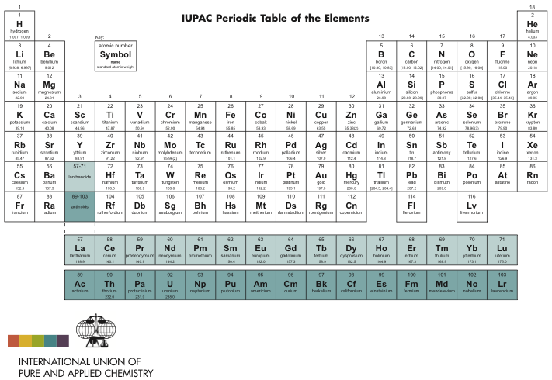
How are these tables similar?

Slide 9
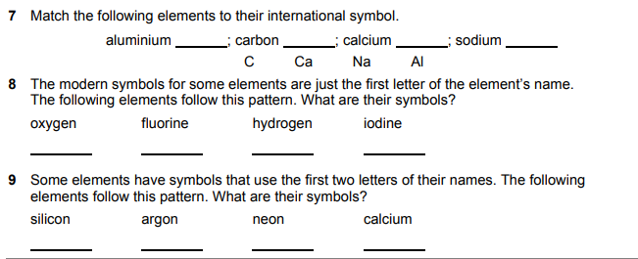
Al
C
Ca
Na
O
F
H
I
Si
Ar
Ne
Ca
Use the Periodic table in your planner to answer Qs 7 – 9 on w/s 8Fa5

Slide 10
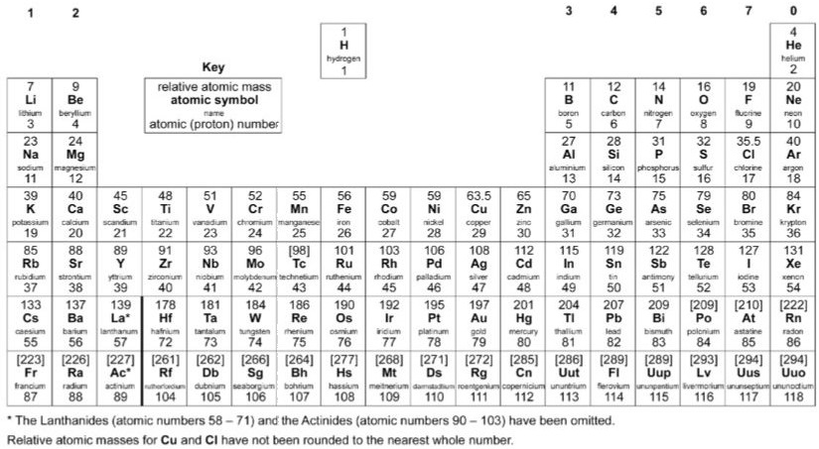
The modern periodic table tells us the relative mass of 1 atom of each element
24
Mg
Magnesium
12
1
H
Hydrogen
1
16
O
Oxygen
8
32
S
Sulphur
16
Compare O & Mg – how many times heavier is Mg?
Compare O & S – how many times heavier is S?
Dalton used data from experiments to work out these masses – w/s 8Fa7
Compare H & O – how many times heavier is O?

Slide 11
Homework:
w/s 8Fa5 – complete remaining questions
w/s 8Fa4 – relative masses bar chart
w/s 8Fa7 – relative masses using experimental data
Active learn: Exercises 8Fa developing, secure & exceeding
Date due:

Slide 12
Key words

Slide 13
Thinking skills
Thinking about Dalton’s ideas
© Pearson Education Ltd 2014. Copying permitted for purchasing institution only. This material is not copyright free.

Slide 14
Which is the odd one out in this list?
Element Compound Mixture
Possible answers
Next question
© Pearson Education Ltd 2014. Copying permitted for purchasing institution only. This material is not copyright free.

Slide 15
Which is the odd one out in this list?
Element Compound Mixture
Element contains only one kind of atom.
Compound contains different atoms joined together to make one substance.
Mixture contains two or more different substances.
Possible answers
Next question
© Pearson Education Ltd 2014. Copying permitted for purchasing institution only. This material is not copyright free.

Slide 16
Consider all the possible answers to this statement:
A substance contains the atoms of three different elements.
Possible answers
Next question
© Pearson Education Ltd 2014. Copying permitted for purchasing institution only. This material is not copyright free.

Slide 17
Consider all the possible answers to this statement:
A substance contains the atoms of three different elements.
It is a mixture of three separate elements.
It is a mixture of one element and one compound.
It is a single compound.
Possible answers
Next question
© Pearson Education Ltd 2014. Copying permitted for purchasing institution only. This material is not copyright free.

Slide 18
Think of a Plus, a Minus and an Interesting point about this statement:
There should only be 26 elements.
Possible answers
Next question
© Pearson Education Ltd 2014. Copying permitted for purchasing institution only. This material is not copyright free.

Slide 19
Think of a Plus, a Minus and an Interesting point about this statement:
There should only be 26 elements.
Plus: Each element could have a different single letter symbol.
Minus: There would be fewer compounds and some useful compounds might not exist.
Interesting: If we can choose which elements to keep, which ones would be most useful? There were 23 elements on the list of known elements prepared by Lavoisier in 1789.
Possible answers
Next question
© Pearson Education Ltd 2014. Copying permitted for purchasing institution only. This material is not copyright free.

Slide 20
Consider all the possible answers to this statement:
In one experiment 4 g of oxygen reacts with an unknown element. In another experiment 8 g of oxygen reacts with the same unknown element.
Possible answers
End show
© Pearson Education Ltd 2014. Copying permitted for purchasing institution only. This material is not copyright free.

Slide 21
Consider all the possible answers to this statement:
In one experiment 4 g of oxygen reacts with an unknown element. In another experiment 8 g of oxygen reacts with the same unknown element.
Twice the mass of the unknown element was used the second time.
A different compound was formed the second time (with twice the number of atoms in it.
An error was made in measuring the masses.
Possible answers
Back to start
End show
© Pearson Education Ltd 2014. Copying permitted for purchasing institution only. This material is not copyright free.

Slide 22
Objectives
Recall that different elements have different physical properties.
Identify the chemical symbols for some common elements and vice versa.
Record two letter symbols correctly.
Describe Dalton’s ideas about atoms.
Use a simple (Dalton’s) atomic model to describe an element.
Use a simple (Dalton’s) atomic model to describe a compound.
Use the idea of atoms to explain why different elements have different physical properties.
Use information about reaction ratios to calculate atomic masses.

