Slide 1
Welcome to Year 13 Parent information Evening
Notes:
JB sign people in at front door & hand UCAS/App booklet
Key dates information

Slide 2
Programme
1)Achievements, Key Dates & Assessment Information
Mrs Stephens
Head of 6th Form, student’s academic & pastoral support.
dstephens@highamsparkschool.co.uk
2) Academic Progress & Support
Ms Wallace
Head of Year 13
lwallace@highamsparkschool.co.uk

Slide 3
Highams Park Sixth Form Results
Mrs Stephens

Slide 4
Results Overview
A Level ALPS
Red 3
Progress based on CAG targets
Notes:
Several Red subjects – keeping our ALPS progress score in the Top 25% of schools nationally.
A level QI score = 1.00
With 57% of grades at A*-B
Remember Progress based on CAG targets

Slide 5
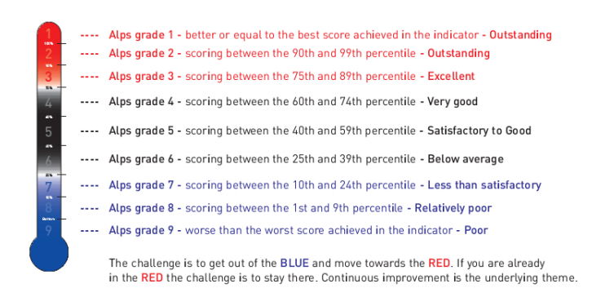

Slide 6
Results Overview
Results have equated to fantastic individual achievements and pathways
134 out of 176 students (72%) have accepted University places
Notes:
Many have attained their firm choice

Slide 7
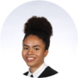
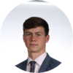
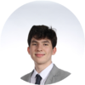
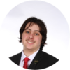
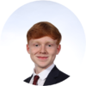
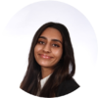
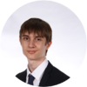
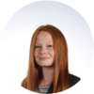
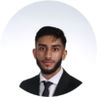
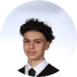
Successes:
Nicholas Crossley –
A*,A*,A*,A* (Further Maths, Maths, Chemistry & Physics)
Engineering - University of Cambridge
Samuel Raine-Jenkins
A*,A*,A (Geography, History, Philosophy),
History - University of Cambridge
Straight A*
Aiden Crowe-Economics- Queen Mary University of London
Amy Johnson– Art - London Metropolitan
Valentine Rabrenovik – Electrical Engineering - Southampton
A*A*B
A*A*A
Harry Bond,
Madhiya Khan
Nazim Masseus
Madeline Drew,
Haroon Malik,
Lois Mayfield,
Luke Newbury-Neale,
Afolabi Nurse
Martina Rabrenovic
Ethan Olliver
D*D*, D*– (Business BTEC & IT Technical Award)
Project Search Barts Healthcare Trust
Samuel White
D*D* B, A(Sport BTEC History & EPQ)
Sport Management
Loughborough University
Alternative Courses
Reggie Dunsdon – Astrophysics
Dilara Eygul – Midwifey
Emma Findlay– Police Force
Romana Haque – Global Studies with Politics
Frank Marsden – Aerospace Engineering
Jonathan Mohamed – Film and Screen Studies
Ellie Ward-Mills– Zoology
Joseph Darnborough
A,A,C (Business, Geography, English Language)
TFL General Management Level 6 Degree Apprenticeship
Mahima Miah
A,A,B (Biology, Chemistry, Economics) Neuroscience
University College London
Notes:
Results have equated to fantastic individual achievements and pathways (145 out of 153 (94%) accepted Uni places)

Slide 8
8, 8, 8 Rule
8 hours of Academic Work
8 hours of Leisure and Relaxation Time
8 hours of Sleep
The most successful students are able to strike a good balance in all areas, in order to do this students should not be doing more than 8 hours a week in part time employment
Notes:
Want more of the fantastic results NAY talked about.
But need balance!

Slide 9
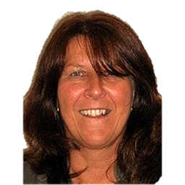
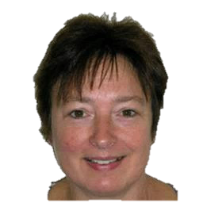
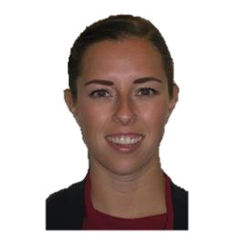
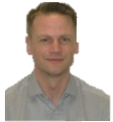
…………….
6th Form Team
Head of Year 12
Head of Year 13
6th Form Secretary
Head of 6th Form
Jenny Browne
Mrs Whitehead
Ms Wallace
Deputy Head of Year (Destinations of students)
Deputy Head of Year (Bridging Curriculum)
Mrs Stephens
Study Supervisor
Sheridan Vickers
Ms Clump
Dr Moore
9
Notes:
6th Form Team 2022 - 23

Slide 10
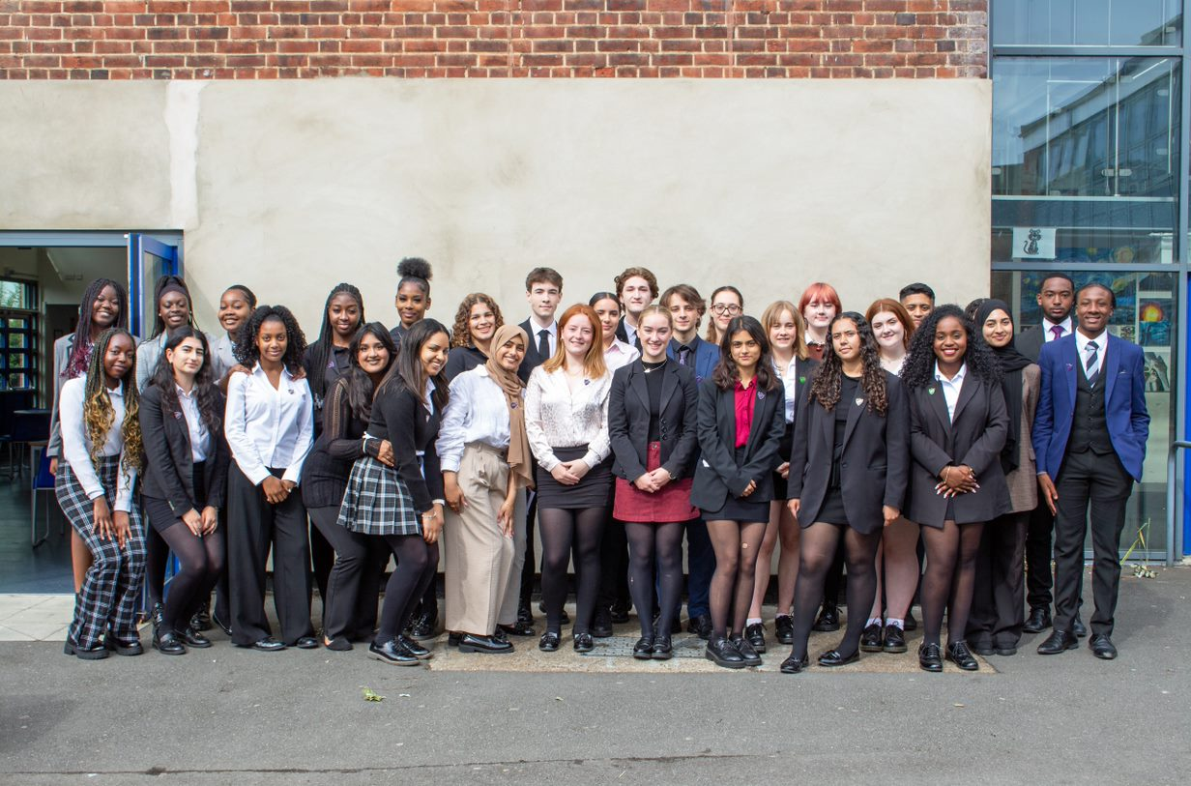
Well done!
Zunairah Mustaq
Karima Srhir
Pheobe Dewar
Lily Peter
Roanna Reid
Meenakshi Hari
Ti-Anna Hepburn
Jack Hill
Jasmine Nsbuga
Maddie McDermott
Akari Dobson
Rojda Aydemir
Doreen Akomeah
Ava Stephenson
Eli Naylor
Shilah Bowes- Armstrong
Eliana Richards
Conor Dunne
Digby Gough- Boyack
Gracie Purton
Nasra Gram
Fatima Zait
Bianca Durche
Alice Jarvis
Aaron Wilson
Omari Wallace Corbett
Lily Etherington
Hassan Akhtar
Shauna Lawrance
Hadeea Sohail
Jada Byfield
Prefects

Slide 11
Senior Prefects
2022 - 23
Eliana Richards
Conor Dunne
Digby Gough- Boyack
Gracie Purton
Notes:
Welcome done to the senior leadership team- please encourage all students to be involved with anything organised.

Slide 12
Key Dates & Assessment Information
Mrs Stephens
Notes:
HOY will provide UCAS key dates

Slide 13
Key Dates
Friday 9th September 2022
Student individual photographs
Friday 16th September 2022
Subject change deadline (4 subjects)
Friday 23rd September 2022
Bursary application deadline

Slide 14
Key Dates
December Mock Exam Weeks
- Monday 5th – Thursday 15th December 2022
Year 13 Parents Evening
Thursday 12th January 2023
UCAS national application deadline
- Wednesday 25th January 2023
Progress day
TBC

Slide 15
External Examinations
Mock Exam Week 2
- Monday 20th March – Friday 1st April 2023
Friday 19th May 2023
- Final day of A Level lessons
Monday 22nd May 2023
- A Level exams commence

Slide 16
Thank you all for watching
Please attend our TEAMS meeting on
Thursday 8th September 4.30pm - 5.30pm
Notes:
If you have any questions …. please attend
The details on this will be sent shortly.

Slide 17
ACADEMIC PROGRESS AND SUPPORT
Ms Wallace

Slide 18
Year 13 Expectations
Arrive at 08:30 every day: (Students arriving after 08:35 will be required in school at 08:00 the following school day if there is no authorised reason for their lateness. Parents will receive a phone call if their son/daughter arrives late to school)
An attendance record of 96 – 100%
Students must go to ALL lessons: but are able to study at home after lunch if they have no subject lessons in the afternoon (a privilege for year 13 that can be taken away)
Notes:
100% vouchers allocated

Slide 19
Year 13 Expectations
Commitment and dedication to studies: utilising the Study Centre to ensure students keep on top of their work
Working hard in lessons: meeting homework deadlines, re-reading class notes throughout the academic year
Act as a role model for the students in Yrs7-12: demonstrating a courteous manner towards both staff and students
Notes:
100% vouchers allocated

Slide 20
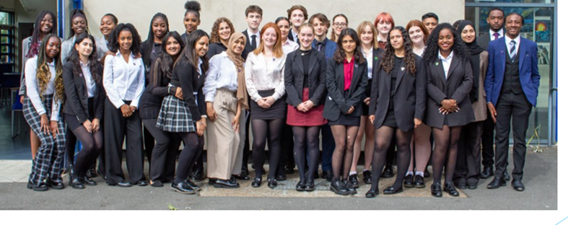
6th Form Dress Code
Students’ overall appearance should be business-like and professional
Compulsory:
A formal suit– all dark-coloured.
Formal collared shirt with a tie / collared blouse.
A formal business dress, with a blazer.
Skirts and dresses must be of a reasonable length and trousers should not be skin-tight.
Dark, plain, un-patterned socks or tights may be worn (no leggings).
Formal dark-coloured shoes (not boots or trainers).
Optional​
A plain dark jumper or cardigan may be worn.​
A waistcoat (not in place of a suit jacket)​
A coat, but not worn indoors.​
​​

Slide 21
Timetable:
8.30 - 8.50 |  | Registration | Registration
08:50 - 08:55 (Lesson Changeover)
1 | 08:55 - 09:55 | Period 1 | Period 1
09:55 - 10:00 (Lesson Changeover)
2 | 10:00 - 11:00 | Period 2 | Period 2
11:00 - 11:05 (Lesson Changeover)
3 | 11:05 - 12:05 | Period 3 | Period 3
Lunch - 12.05 - 13.05 |  | Lunch | Lunch
4 | 13:10 - 14:10 | Period 4 | Period 4
14:10 - 14:15 (Lesson Changeover)
5 | 14:15 - 15:15 | Period 5 | Period 5
15:15 - 15:20 (End of P5 - See Dismissal Times Below)
6 | 15:20 - 16:20 | Period 6 | Period 6
 |  | 6th Form Gate | 6th Form Gate
 |  | 15:15 | 15:20
Students must return to school by 1:05pm
Students can go home at 14.15pm if they do not have a period 5 or 6.
Notes:
1 Differences:
3 lessons, then 2 / 3 lessons.
1 hour lunch, instead of 2 30 mins = more time to get lunch down the shop.
Lunch can be offsite / Group study / Courtyard (not canteen or study)
Bring food to eat p1 -3 if in group Don’t be back LATE!
If in Group / Study – stay in here, not wander around school – meet staff at arranged time.
Bell Changes (may ring while in lesson)
Can leave after period 4 (2.10pm)

Slide 22
Organisation
Know what needs to be done and by when; students should record information in a planner
Keep work materials efficiently and effectively; make sure lesson notes are dated with teacher’s initials and filed chronologically
Print out past exam papers, examiner reports and specifications; students will need these for their revision
Equipment
Timetable​
Calendar​
Subject information / resources​
Homework​
Messages from Teachers​
Timetable Changes​
6th Form Bulletin​
Extra Curricular​
Parent portal

Slide 23
Mental Health Support
This year it is essential that good mental health is a priority for us all.
Using Form Time to educate about Mental Health
Creating spaces for breaks and conversations
Supporting students with engaging with outside help where needed
Support from:
Form Tutor
Head of Year and Sixth Form Team
Outside help from Mentors, Educational Psychologist, CAMHS etc

Slide 24
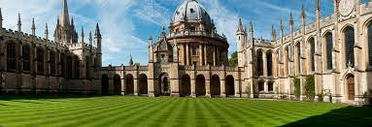
Where they should be now University
1st Draft of Personal Statement should be done and handed in to form tutor – Tuesday 13th September
University and subject choices need to be shortlisted

Slide 25
Next Steps University
Finalise their choices and put into UCAS form.
1-2 ambitious choices
2-3 on their predicted grades
1 insurance choice
There are still virtual open days available, and many universities run offer days
Redraft and perfect Personal Statement – work with form tutor and subject teacher.
Focus on the subject they are applying for
Evidence based
4000 characters (approx. 1 side of A4)
Pay and send!
DO NOT COPY!!!

Slide 26
Admission test deadlines
1 September - Registration opens
16 September - Deadline to apply for modified papers (e.g. enlarged print); deadline for schools to apply to run our admissions tests (deadline is 12 noon BST for school applications)
30 September at 18:00 - Registration closes; deadline to apply for access arrangements (e.g. extra time). Students should aim for no later than Monday 26th – we can then spend that week chasing if needed. Hazel / Ang would need to be aware before Wednesday 28th September.
18 October - Assessment date for BMAT and TMUA.
19 October - Assessment date for University of Cambridge pre-registration assessments.
2 November - Assessment date for University of Oxford admissions tests.

Slide 27
References & Predicted Grades
References are written by form tutors based upon feedback from subject teachers
Predicted grades are not “best possible”, they are the most likely grade a student will achieve at A Level. We will be using the in-class assessments to get an accurate picture of where students are to decide these grades
We cannot do this until they have paid and sent, and it can take 2-3 weeks.

Slide 28
Next Steps University
Offers – can be instant, can be as long as April
U – unconditional offer
C – conditional offer
I – called to interview
REJ – rejected
Students get to select two of their offers
Firm choice
Insurance choice – grades MUST be lower than the firm
Register for Student finance and apply for accommodation – More information at Parents Evening

Slide 29
Key UCAS Dates

Slide 30
Where they should be now Apprenticeship and Work
Know what they want to do
Be familiar with key apprenticeship websites and on their mailing lists
Identified at least one apprenticeship they are interested in
Have a CV and first draft of a personal statement
Have or be trying to find relevant work experience
Have attended or be booked onto virtual education and careers fairs
Applying to University as a back-up option

Slide 31
Next Steps Apprenticeships and Work
Every application is different, and are offered at different times of the year
Entrance assessments
English and Maths
Written Application
They should be doing drafts of this and getting their form tutor to check it
References and predicted grades
Assessment centres and interviews
Need to do their research before accepting
Pay and Send!

Slide 32
So much information!
Sixth form bulletin and firefly
Speak to us if you have any concerns

Slide 33
Thank you all for watching
Please attend our TEAMS meeting on
Thursday 8th September 4.30pm - 5.30pm
Notes:
If you have any questions …. please attend
The details on this will be sent shortly.

Slide 35
POST-18 APPLICATIONS
Mrs Whitehead

Slide 36
Next Steps University
Redraft and perfect Personal Statement – work with form tutor and subject teacher.
Focus on the subject they are applying for
Evidence based
4000 characters (approx. 1 side of A4)
UCAS, ULAS, Which? University
DO NOT COPY!!!

Slide 37
Where they should be now University
UCAS application form should be almost finished – AS qualifications need to be entered ASAP
1st Draft of Personal Statement should be done and handed in to form tutor
Majority of choices should be finalised and on the UCAS form

Slide 38
Key UCAS Dates

Slide 39
Where they should be now Apprenticeship and Work
Know what they want to do
Be familiar with key apprenticeship websites and on their mailing lists
Identified at least one apprenticeship they are interested in
Have a CV and first draft of a personal statement
Have or be trying to find relevant work experience
Have attended or be booked onto virtual education and careers fairs
Applying to University as a back-up option

Slide 40
Next Steps Apprenticeships and Work
Every application is different, and are offered at different times of the year
Entrance assessments
English and Maths
Written Application
They should be doing drafts of this and getting their form tutor to check it
References and predicted grades
Assessment centres and interviews
Need to do their research before accepting
Pay and Send!

Slide 41
So much information!
Sixth form bulletin and firefly
Speak to us if you have any concerns

Slide 42
Attendance
95% attendance = ½ day missed every fortnight
1 school year at 96%attendance = 2 whole weeks of lessons missed (10 days)
9% attendance over 2 years of Sixth Form = 4 weeks missed
Every 10% drop in attendance below 96% will see a student drop a grade
Notes:
100% vouchers allocated

Slide 43
Punctuality
Year 13 students are expected in school from 8:30am.
Students arriving after 08:35 will be required in school at 08:00 the following school day if there is no authorised reason for their lateness
Parents will receive a phone call / email if their child arrives late to school

Slide 44
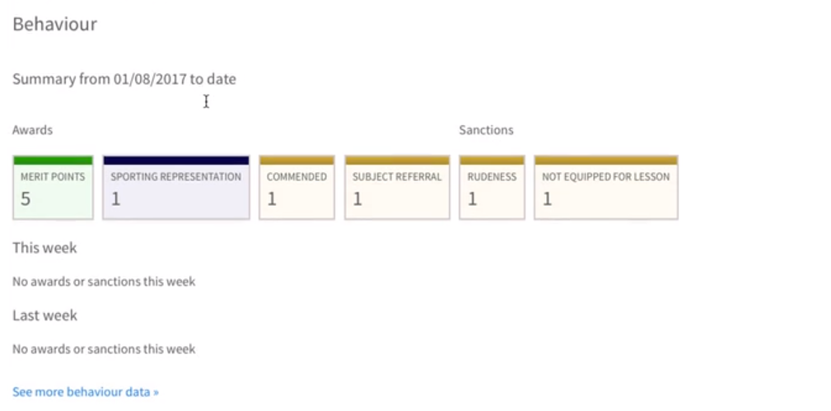
Timetable
Calendar
Subject information / resources
Homework
Messages from Teachers
Timetable Changes
6th Form Bulletin
Extra Curricular
Home Learning
Access to technology and the internet
Keeping up with school work
Checking School email and Firefly Every day
Parent portal
Achievement / Behaviour points
Recent Reports
Homework, Coursework and Messages from Teachers
Notes:
Email on how to log on (NEED UPDATE TO DATE EMAIL). (SHEET).
Homepage on left- click child – sub heading behaviour (If blank=no points)

Slide 45
Equipment
Water bottle
Food or drink
Lesson equipment (pen / exercise books)
New timetable
Advised to bring own sanitising kit

Slide 46
Lunch Arrangements
Yr13 students are allowed off site for lunch at 12:05pm, all students must return to school by 1:05pm as all students will have either a lesson or Silent Study during Period 4 or 5 every day.
Yr13 students can use the canteen in the Sixth Form Group Study Area at lunch, and can pay for refreshments with cash or card.

Slide 47
Thank you all for watching
Please attend our TEAMS meeting on
Thursday 8th September 4.30pm - 5.30pm
Notes:
If you have any questions …. please attend
The details on this will be sent shortly.

