Slide 1
C/W
29/03/2019
8Kd Power and efficiency
Can you cook a chicken with a lightbulb?!

Slide 2
https://www.youtube.com/watch?v=-zvCUmeoHpw

Slide 3
We can use many electrical appliances in the home eg an electric heater for heating or an oven for _______.
The amount of energy transferred per second is the power of the appliance, measured in the units watts (W) or ____watts (kW).
1 watt = 1 joule transferred every second
_____ W = 1 kW
cooking
kilo
1000
Which appliances have the highest power ratings?

Slide 4
Appliance | Power rating | Transfers energy by…
Kettle Toaster Drill Phone / tablet Standard filament bulb Energy saving bulb Electric shower
W or kW?
Options: heating, sound, light, forces

Slide 5
 Add the power shower to your table.

Slide 6
a) Which appliance transfers the most energy per second?
b) Why do you think this is?
2. What do you notice about the appliances with the highest power ratings?
The electric shower.
It has to heat a lot of water very quicker.
They all transfer energy by heating.

Slide 7
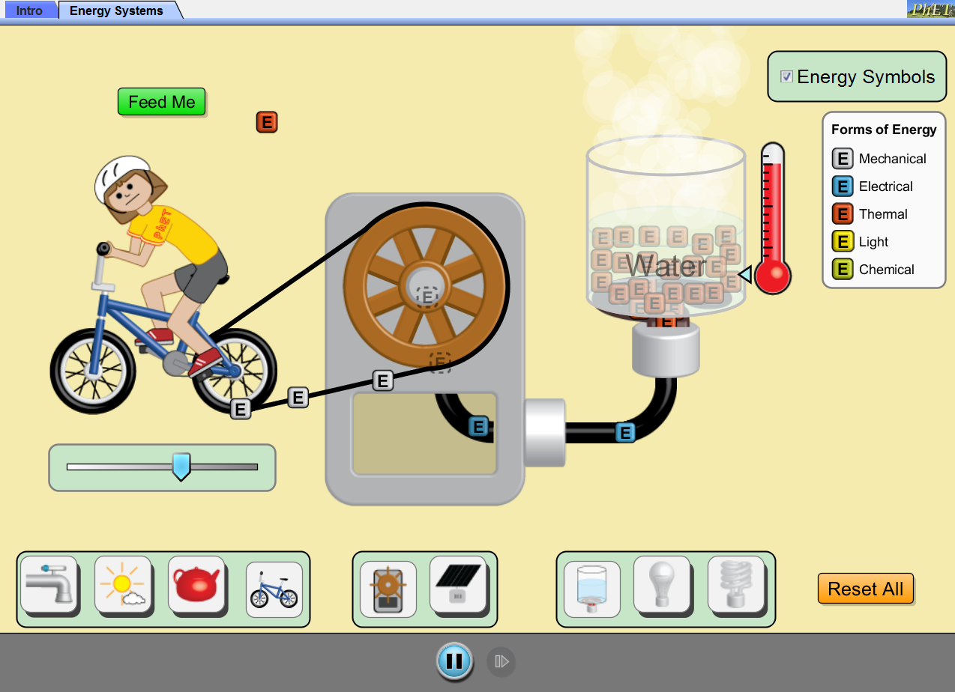
 Click image to run simulation.
Is all the energy transferred usefully?

Slide 8
https://www.youtube.com/watch?v=-zvCUmeoHpw

Slide 9
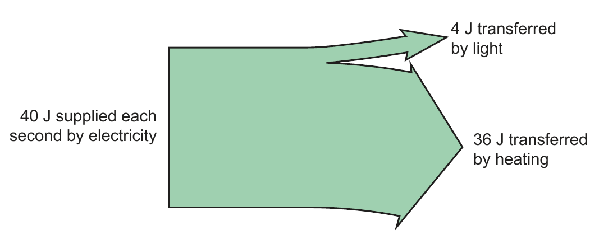
Efficiency is a way of comparing the amount of useful energy transferred with the total amount of energy supplied.
We can show this on a Sankey diagram, with the width of each arrow representing the proportion of the energy. eg for a standard filament light bulb:
What is the efficiency of this bulb?
Draw and fully label the diagram.

Slide 10
Calculate the efficiency of this light bulb.

Slide 11
Efficiency = ? Total energy supplied = J
Useful energy transferred = J

Slide 12
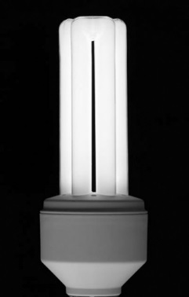
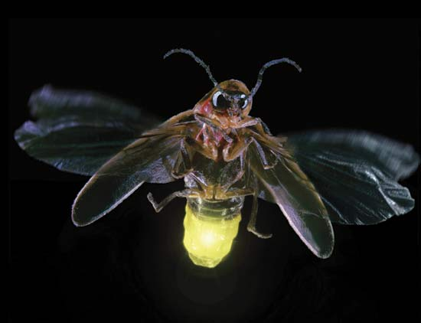
So why do lightbulbs make better cookers than lights?

Slide 13
https://www.youtube.com/watch?v=-zvCUmeoHpw

Slide 14
 Give a clue or definition for these keywords.
Hot seat
power

Slide 15
 Give a clue or definition for these keywords.
Hot seat
efficiency

Slide 16
 Give a clue or definition for these keywords.
Hot seat
wasted

Slide 17
 Give a clue or definition for these keywords.
Hot seat
kilowatts

Slide 18
 Give a clue or definition for these keywords.
Hot seat
useful

Slide 19
 Give a clue or definition for these keywords.
Hot seat
energy

Slide 20
 Give a clue or definition for these keywords.
Hot seat
Sankey diagram

Slide 21
 Give a clue or definition for these keywords.
Hot seat
watts

Slide 22
 Give a clue or definition for these keywords.
Hot seat
energy transfer

