Slide 1
Knife crime

Slide 2
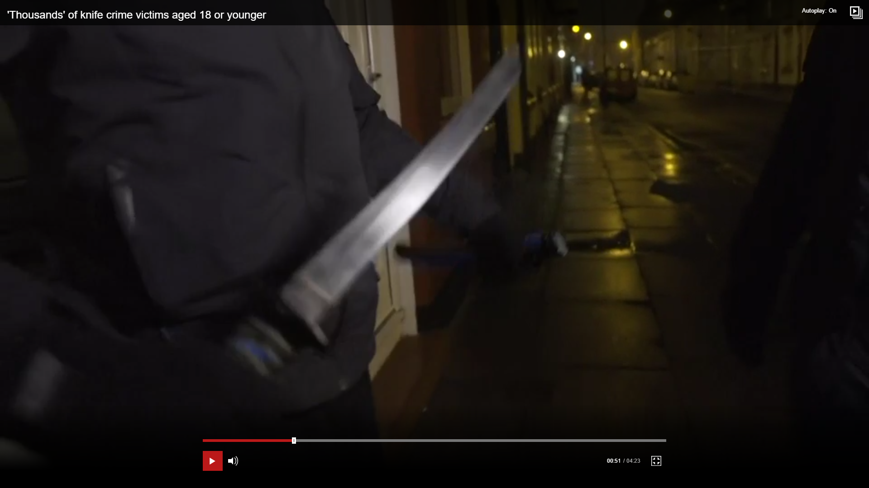
"We know that if you carry a knife you are far more likely to get stabbed, probably with that knife," Matt Watson, of the Integrated Gangs Unit
A knife or blade was used in a crime every 16 minutes on average last year
Incidents involving machetes has risen by more than 60% over the last 3 years in England and Wales
Gang activity accounted for less than 5% of London knife crimes
Knife crime across England and Wales is up 11% in the last year and in London by 16%, in the past two years
Over 10,000 stabbings recorded across London in the last three years

Slide 3
Where to get HELP
Click on a Hyperlink

