Slide 1
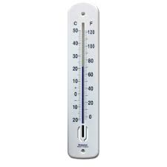
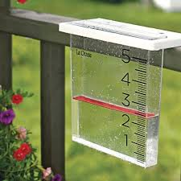
7Db Adaptations
Write the title, date and classwork
Discuss with your neighbour what you think are meant by ‘physical environmental factors’ with examples

Slide 2
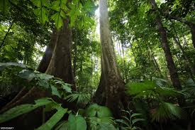
Copy the sentence below
The conditions in a habitat are its environment. These are caused by physical environmental factors e.g.
Amount of light
How wet it is
Temperature

Slide 3
Learning outcomes
Identify the physical environmental factors that make up the environment in a habitat.
Describe the adaptations of a range of organisms to their habitats.
Compare similar adaptations in plants and animals that live in similar places.
Identify and give examples of inherited variation
Explain how particular adaptations increase the chances of survival.
Explain how inherited variation is caused (does not include genes).
Correctly use the terms: community and ecosystem
Explain how particular adaptations limit an organism's distribution.

Slide 4
What would the physical environmental factors be in these habitats?

Slide 5
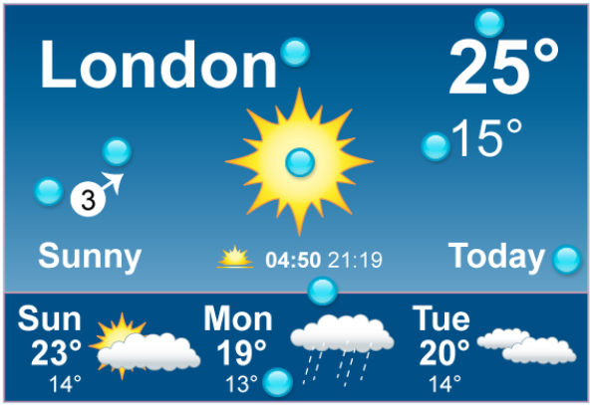
What physical environmental factors does the weather forecast tell us about?
https://www.activeteachonline.com/product/view/id/295/page/60/mode/dps?modal=/player/interactive/id/286865

Slide 6
Copy and complete the wordfill
Survive
Organisms have features that let them __________ in the environments where they live. They are ________ for their habitats.
For example fish have _______ and fins which are adaptations for living under water.
They could not breathe air or ______ on land so fish could not survive on land
adapted
gills
walk
adapted
walk
Survive
gills

Slide 7
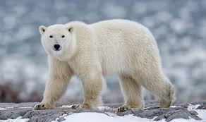
Write the subtitle polar bear, copy each feature named and explain how you think it is an adaptation for its environment
Small ears
Thick fur
Rough soles on feet
Feet with large surface area
White fur
Minimise heat loss
Thermal insulation
To grip the ice (friction)
Reduce pressure vs. sinking in snow
Camouflage for hunting

Slide 8
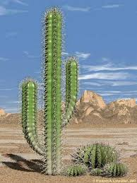
Write the subtitle Cactus plant, copy each feature named and explain how you think it is an adaptation for its environment
Thick stem
spines
No leaves
Roots spread out
Stores water
To protect it from being eaten
Large area to absorb water from

Slide 9
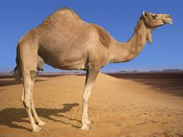
How you think a camel is an adaptation for its environment?
Long eyelashes to keep sand out of its eyes
Nostrils than can close so sand doesn’t get up its nose
Can drink up to 46L of water at one time and can go for a week without water
Can change body temperature to avoid sweating when external temperature rises and therefore conserve water
Wide feet to prevent them sinking in sand

Slide 10
What other behaviour adaptations do animals living in hot climates have?

Slide 11
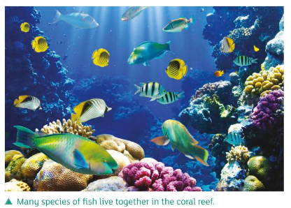
Copy the text below then name the common adaptation for each of the following slides
A community is the animals and plants that live in a particular habitat
Members of the community may have similar adaptations to their environment e.g. large ears to lose heat easily ( Elephants and jack rabbits)
An ecosystem is the community of organisms and the physical environmental factors in a habitat

Slide 12
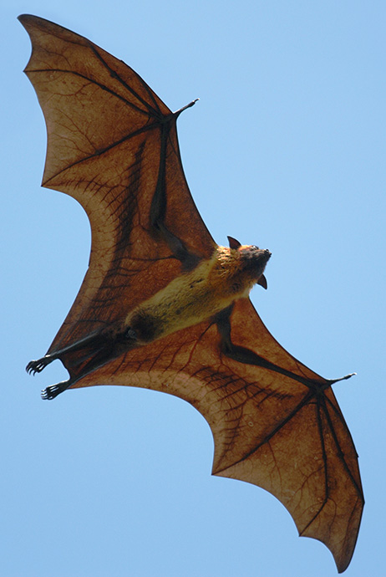
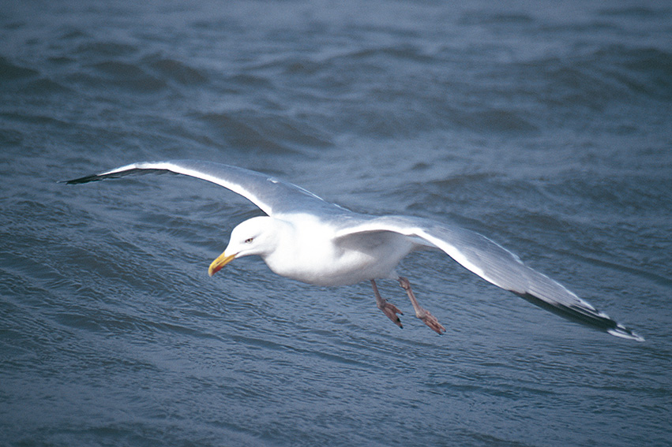
Identify the animals:
Fruit bat
Gull
What similar adaptation do they have?
Wings for flying
What habitat do they share?
The air

Slide 13
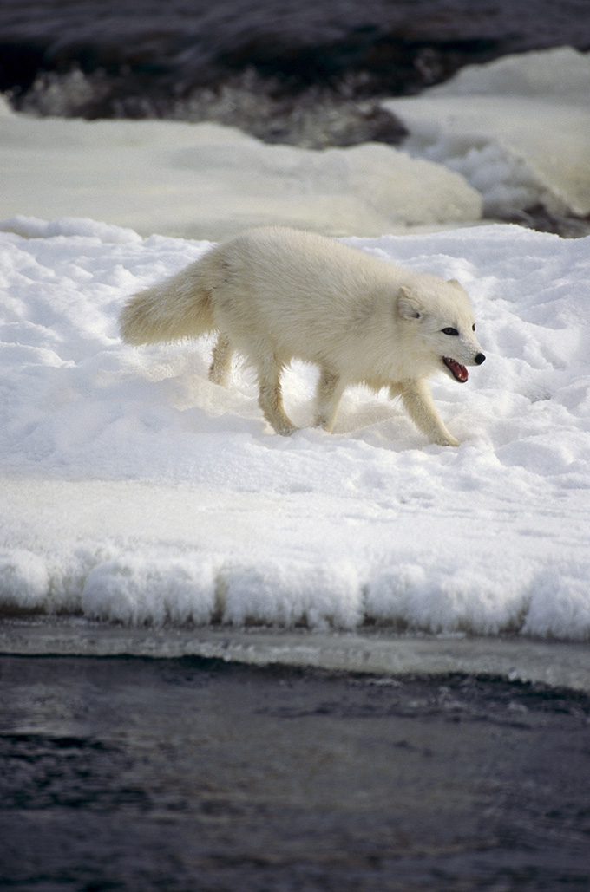
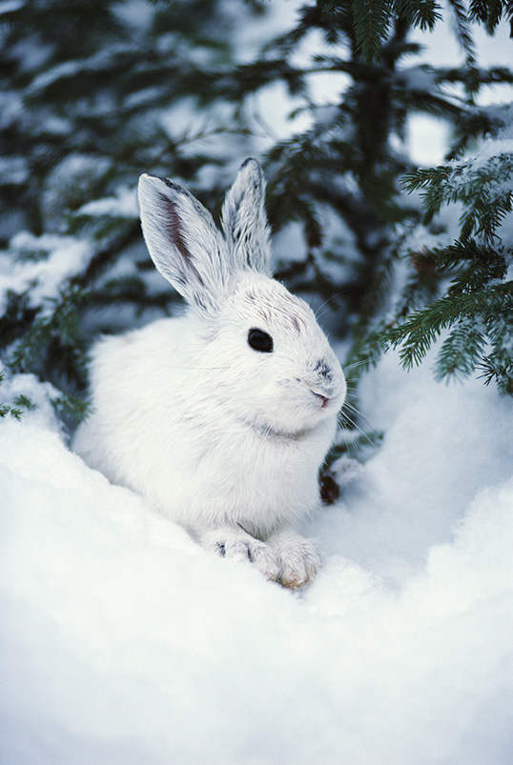
Identify the animals:
Arctic hare
Arctic fox
What similar adaptation do they have?
White fur
What habitat do they share?
Arctic (or polar) region
© Pearson Education Ltd 2014. Copying permitted for purchasing institution only. This material is not copyright free.
Notes:
13

Slide 14
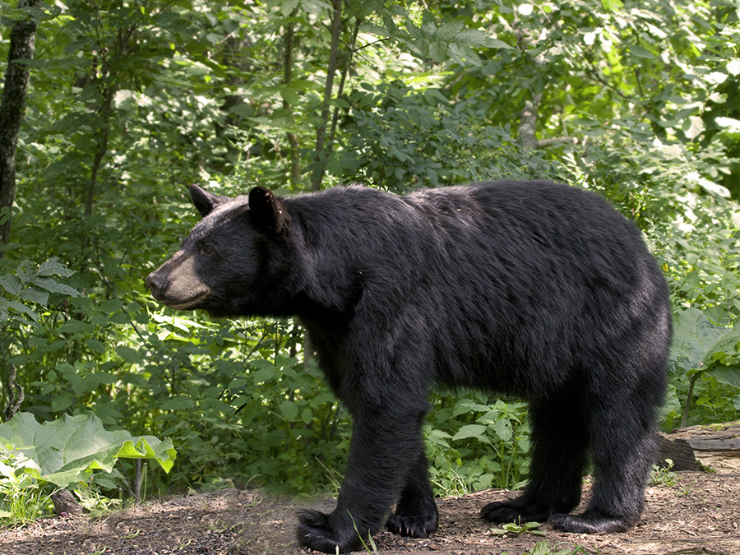
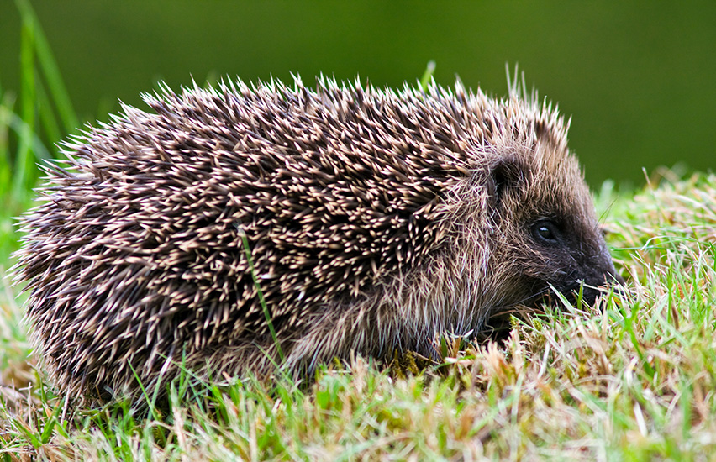
Identify the animals:
Hedgehog
Black bear
What similar adaptation do they have?
Winter hibernation
What habitat do they share?
Temperate forests
© Pearson Education Ltd 2014. Copying permitted for purchasing institution only. This material is not copyright free.
Notes:
14

Slide 15
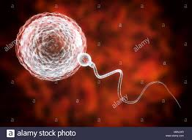
Watch the clip and complete the wordfill
https://www.youtube.com/watch?v=a5yzRRvROpE
Variation
Inherited _________ are differences caused by what genes are passed to us from our __________. All gametes carry slightly different __________ for features. A different sperm and _______ cell are used to produce each offspring so each inherits a different mix of __________
parents
Instructions
egg
features
egg
Variation
features
parents
instructions
What exception is mentioned in the clip?

Slide 16
Copy the Venn diagram below in your
Copy the Venn diagram below into your books
Inherited
Both
Environmental

Slide 17
Decide the if the characteristic below are inherited, environmental or both. Put it in the correct part of the Venn diagram
Intelligence
Cystic fibrosis
Mass
Blood group
Influenza
Language spoken
hair colour
Height
Skin tone
Piercings
eye colour

Slide 18
Swap books, peer review in green pen. Make corrections and give your partner a mark out of eleven
Inherited
Environmental
Both
Blood group
Height
Influenza
hair colour
Intelligence
Language spoken
eye colour
Mass
Piercings
Cystic fibrosis
Skin tone

Slide 19
Thumbs up thumbs down True of false
Trees growing in a forest are a physical environmental factor
Animals living in cold climates have thick fur to reduce loss of body heat
Adaptations to environment are the changes to an animal or plant’s body or structure to suit it’s environment
Arctic foxes and polar bears both have white fur for camouflage in the snowy environment they live in. These are common adaptations
Variation in humans is a result of the mixture of genes they inherited from their parents
Identical twins show no variation
The size of your bones is due to inherited variation

