Slide 1
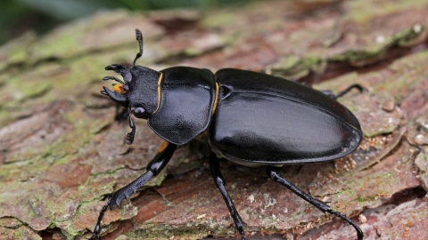
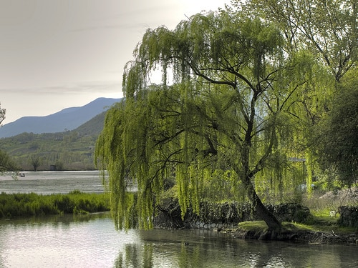
7Dd Effects on the environment
Write the title, date and classwork the copy the text below and write down in the back of your books what resources you think animals and plants need to survive and grow
Organisms need resources from a habitat in order to survive and grow. If any of these are missing, the numbers of an organism (its population) will decrease

Slide 2
Learning objectives
To use food chains to create food webs and identify food chains within food webs.
To use a food web to identify food sources for different animals and give reasons for identifying organisms as: carnivores, consumers, herbivores, omnivores, predators, prey, producers.
State the resources that organisms need from their habitats and ecosystems
Explain why organisms are in competition in a given habitat. §
Describe how the distribution of organisms is controlled by the availability of resources.
Explain how changes in a population or community in an ecosystem affect other populations and use food webs to predict the effects of changes in populations.
Evaluate food chains and food webs as models of feeding relationships.

Slide 3
Complete the Venn diagram showing which reesources animals and plants compete for
Resources:
Food
Light
Water
Space
Mates
Minerals
Animals
Plants
Both

Slide 4
Assess you work
Animals
Plants
Both
Food
Light
Space
Water
Mates
Minerals

Slide 5
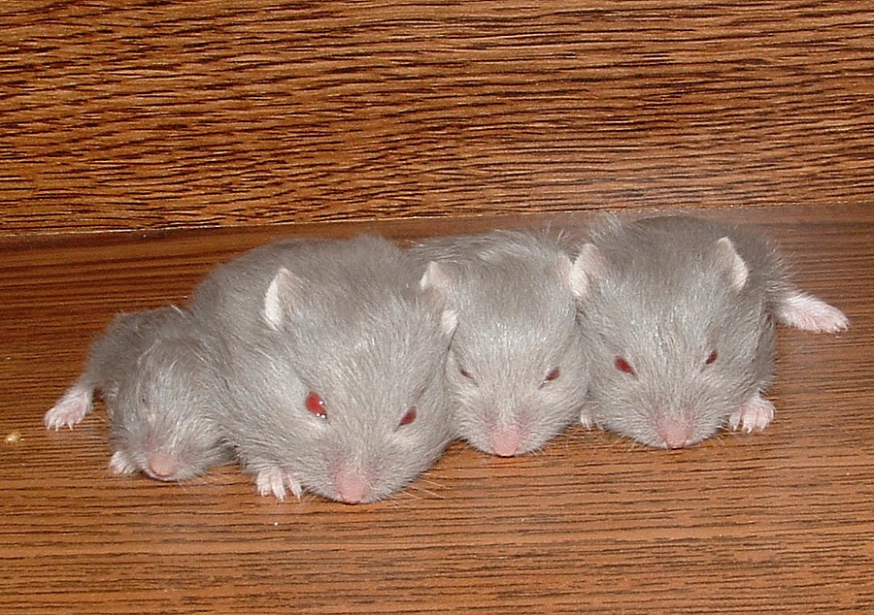
Copy the text below
Organisms are in competition with one another for resources. The organisms with the best adaptations to get the resources are more likely to survive and reproduce. The others may move away or die

Slide 6
Copy and match up the terms and definitions
Producer |  | An animal that hunts other animals
 |  | An animal that gets its energy from eating plants
Consumer |  | An animal that gets its energy from eating plants
 |  | An animal that feeds on other animals
Herbivore
 |  | This is passed on from one organism to another
Carnivore |  | This is passed on from one organism to another
 |  | An organism that makes its own food
Omnivore |  | An animal that feeds on both animals and plants
Predator |  | An animal that eats its food
Energy

Slide 7
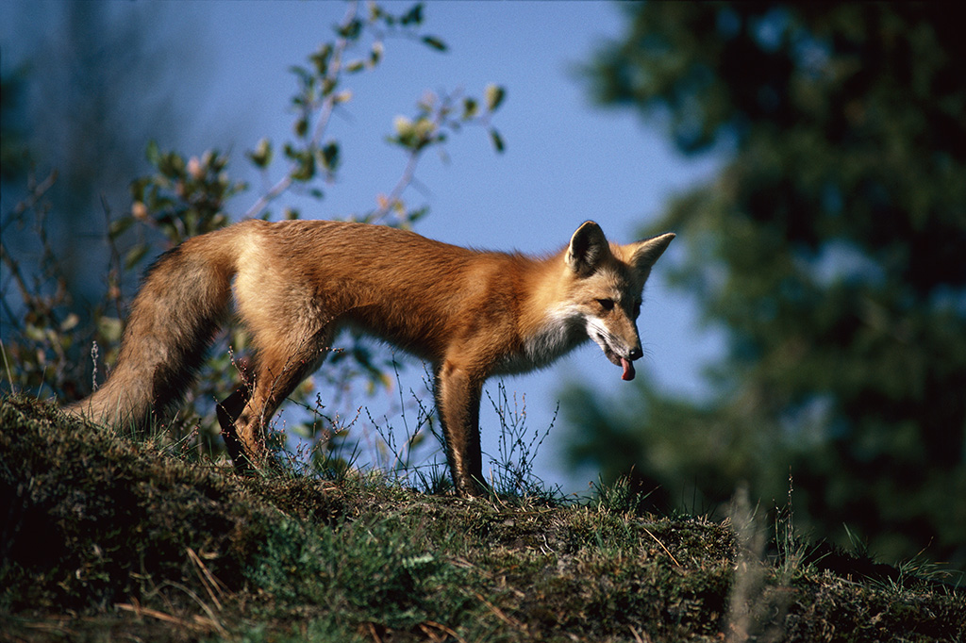
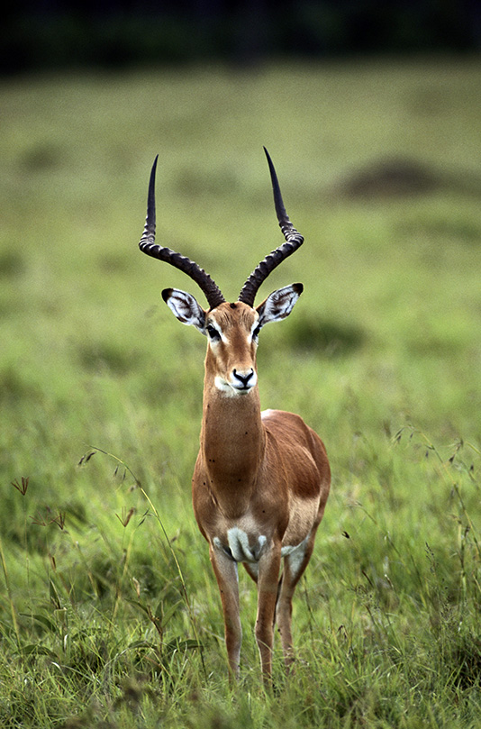
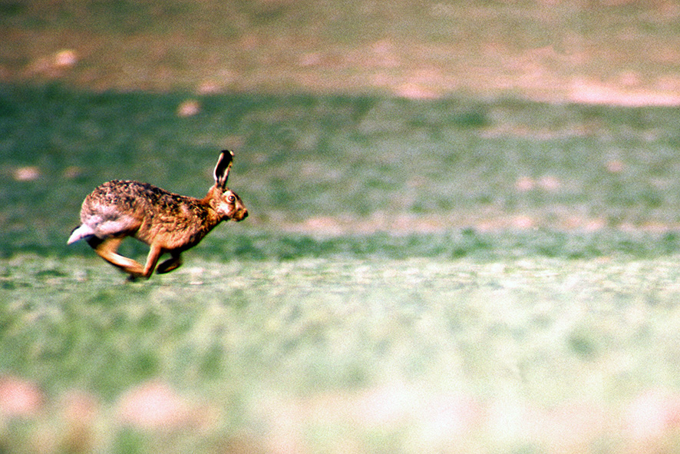
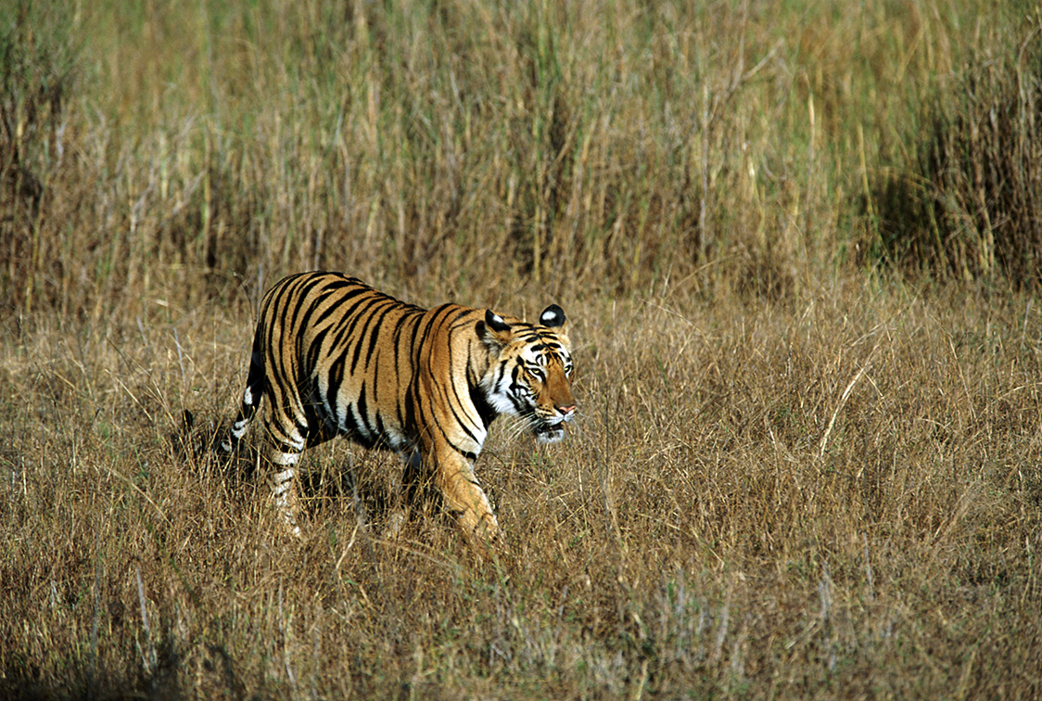
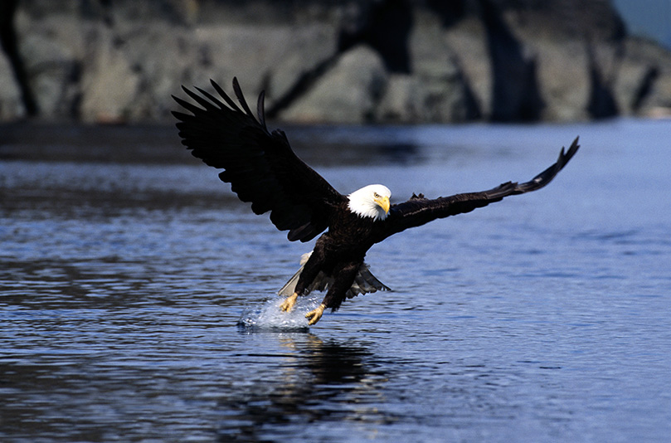
Discuss with your neighbour, for the following examples, whether you think they are predators or prey
Prey: hunted by foxes and birds of prey
Predator: hunts mice and frogs
Prey: hunted by lions and cheetahs
Predator: hunts fish
Predator: hunts deer and wild boar

Slide 8
We can see what eats what in a habitat by looking at a food chain. Copy the food chain, and label the following:
Producer
Energy
Carnivore
Herbivore
Predator

Slide 9
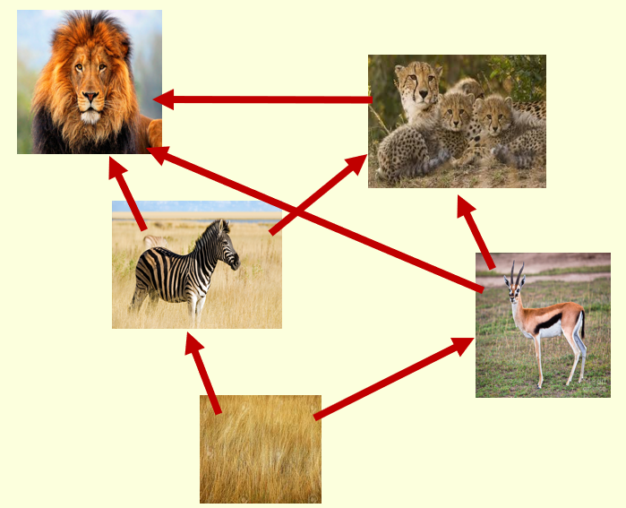
https://www.activeteachonline.com/product/view/id/295/page/66/mode/dps?modal=/player/animation/id/312561 Watch the clip and copy and complete the wordfill below
Organisms living in the same __________ can be part of more than one food chain. Food chains can be added together to form a _________ _______. Food webs can be used to see which animals __________ with one another for food and which animals depend on others for ____________.
Habitat
Food web
compete
Survival
Food web
Survival
compete
Habitat

Slide 10
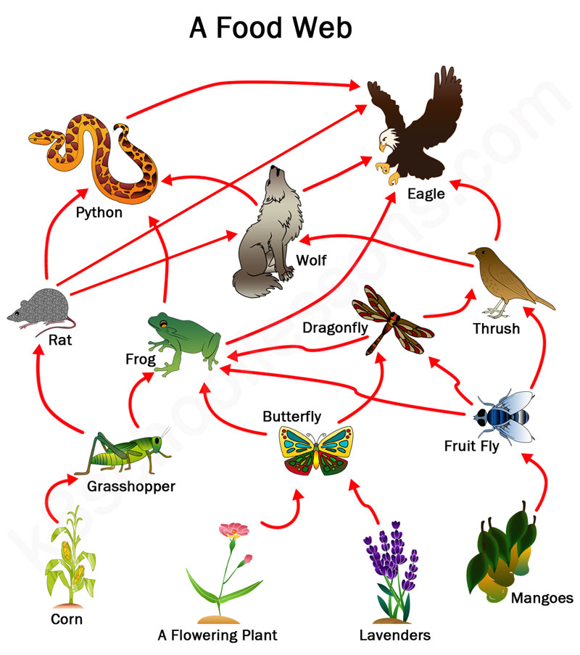
Stick in your food web then answer these questions in full sentences:
If the grasshoppers were to die, what would happen to the population of frogs and rats?
What would be the result of this change to the frog and rat population?
Extension: draw your own food web

Slide 11
Assess you answers in green pen
If the grasshoppers were to die; the numbers of frogs and rats would decrease as they would have less food
As a result of this the numbers of pythons, wolves and eagles would also be affected
The wolves and eagles would need to hunt more thrushes, so their numbers would also decrease

Slide 12
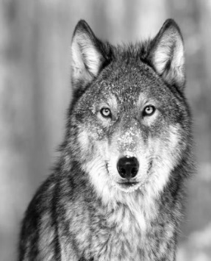
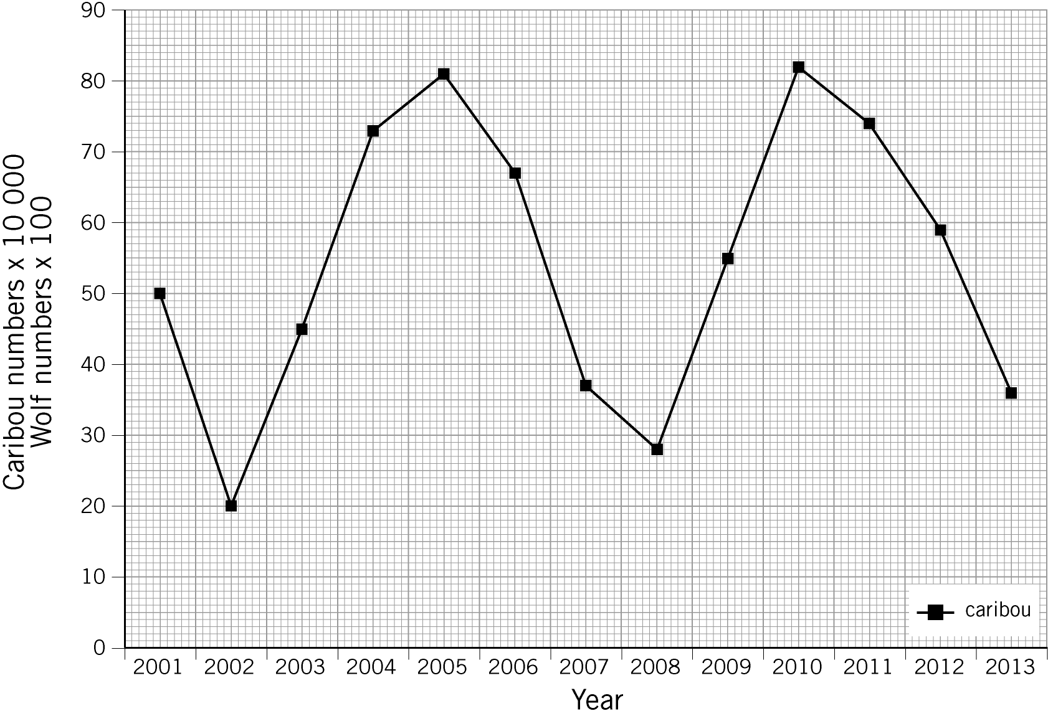
Use the data to add the number of wolves to your graph to see how the predator and prey influence each other’s population
Year | 2001 | 2002 | 2003 | 2004 | 2005 | 2006 | 2007 | 2008 | 2009 | 2010 | 2011 | 2012 | 2013
Number of wolves in Quebec (x100) | 47 | 52 | 45 | 21 | 12 | 29 | 51 | 53 | 21 | 17 | 45 | 58 | 55

Slide 13
Create a flow diagram by writing the statements below in the correct order and connecting them with arrows.
When there are lots of prey, the population of predators increases
The prey population will now increase as fewer are being eaten
The cycle starts again
There is now not enough food for all the predators so the predator population decreases
The large predator population will cause the prey population to decrease

Slide 14
Mark your work and make corrections if needed
The large predator population will cause the prey population to decrease
When there are lots of prey, the population of predators increases
There is now not enough food for all the predators so the predator population decreases
The prey population will now increase as fewer are being eaten
The cycle starts again

Slide 15
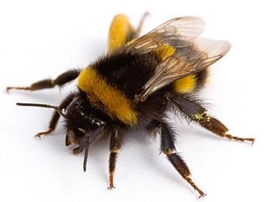
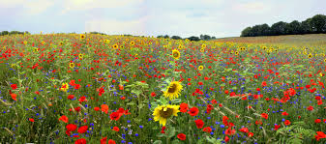
Consider the following question:
How are bees and flowers linked?

Slide 16
Copy the text below
Bees and flowers are said to be interdependent - they depend on each other to survive
If the population of bees falls, less pollination occurs, so fewer plants are produced

Slide 18
Year | 2001 | 2002 | 2003 | 2004 | 2005 | 2006 | 2007 | 2008 | 2009 | 2010 | 2011 | 2012 | 2013
Number of wolves in Quebec (x100) | 47 | 52 | 45 | 21 | 12 | 29 | 51 | 53 | 21 | 17 | 45 | 58 | 55
Year | 2001 | 2002 | 2003 | 2004 | 2005 | 2006 | 2007 | 2008 | 2009 | 2010 | 2011 | 2012 | 2013
Number of wolves in Quebec (x100) | 47 | 52 | 45 | 21 | 12 | 29 | 51 | 53 | 21 | 17 | 45 | 58 | 55

