Slide 1
CW
7Ce Drugs
What is the scientific definition of a drug?
Write it in the back of your books.
In the back of your books make a list of all the drugs you can name.
@hpscience

Slide 2
Drug – A substance that affects the way the body works.
Some examples;
Paracetamol – medicine, legal, painkiller
Coffee (caffeine) – legal, recreational drug, stimulant, addictive
Tobacco (Nicotine) – legal, recreational drug, stimulant, highly addictive
Alcohol (spelling) – legal, recreational drug, depressant, addictive

Slide 3
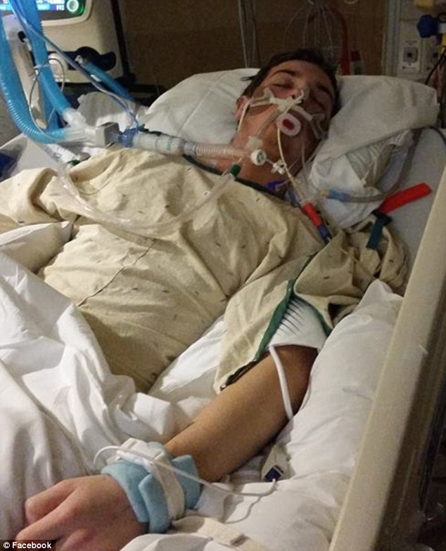
Some drugs can be useful, e.g. medicines. However, they can also have harmful side-affects.
Paracetamol is a useful painkiller but it can also cause damage to the liver.
This person has overdosed on drugs and suffered severe brain damage. Drugs can be harmful and very dangerous.

Slide 4
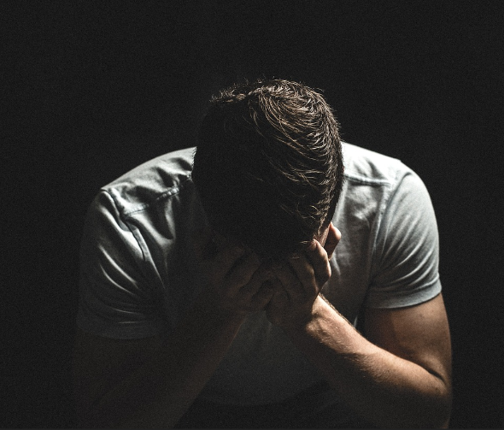
Some drugs are additive. This means that people (addicts) feel like they can’t do without them.
Addicts may continue to misuse a drug even after it causes damage to the body.
This is known as substance misuse.

Slide 5
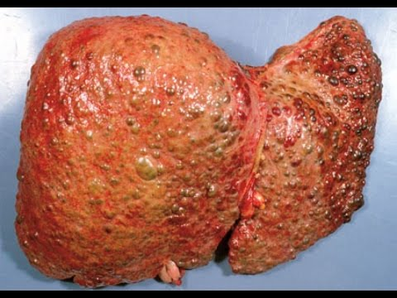
Alcohol misuse causes damage to the brain and liver.
Drugs often cause harm to the liver because this is where drugs are broken down.

Slide 6
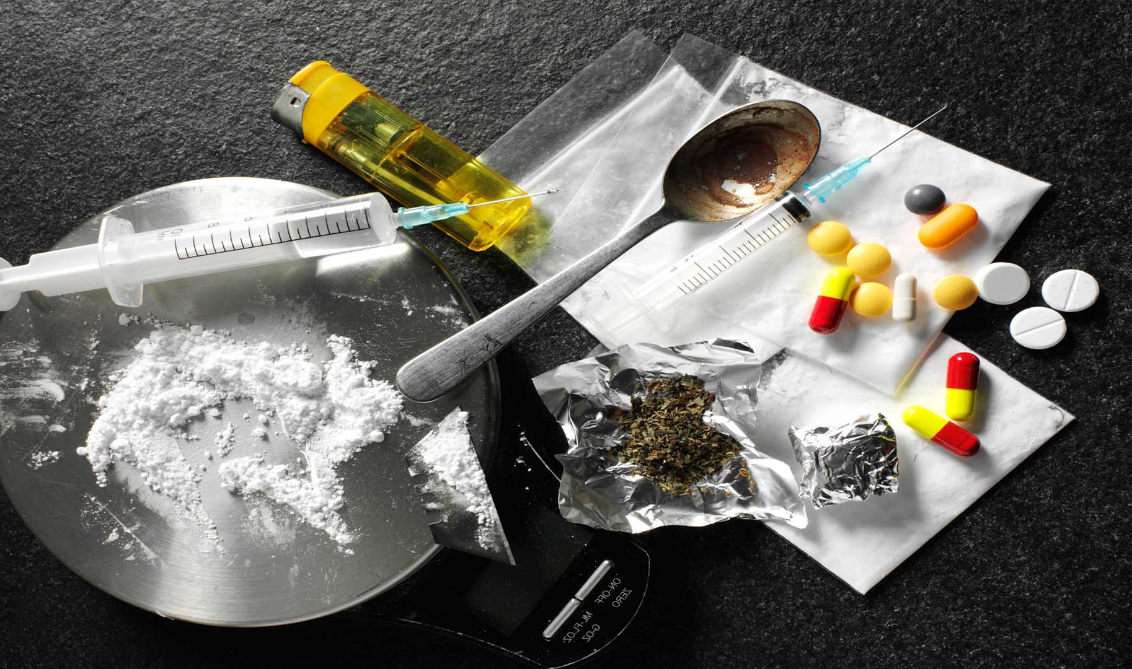
Recreational drugs – Drugs that people use because they enjoy their affects.
They can be legal, e.g. caffeine, nicotine, alcohol.
Or they can be illegal, e.g. cannabis, ecstasy, cocaine, heroine.

Slide 7
Why might some drugs be illegal (against the law)?
Some drugs are illegal because their side-affects are very harmful.
For example,
Cannabis causes memory loss and mental illness
Ecstasy causes mental illness
Cocaine is addictive and cause heart problems
Heroin is very addictive, very easy to overdose, slows breathing.
Drug misuse can seriously affect your life and your family.

Slide 8
Stimulant – a substance that speeds up nerve impulses and decreases reaction times.
Examples – caffeine, nicotine and cocaine.
Depressant – a substance that slows down nerve impulses and increases reaction times.
Examples – alcohol, heroin, solvents.

Slide 9
How does alcohol affect a persons ability to drive safely?
Read do not copy

Slide 10
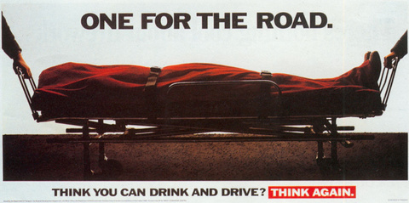
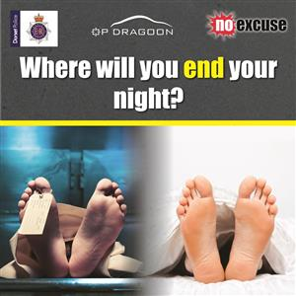
Alcohol is a depressant and slows down your reaction time.
This is dangerous when driving because it will slow down your ability to respond to a situation.
This delay in reactions might be this difference between someone stopping in time or crashing.

Slide 11
The side-affects of cannabis are often underestimated.
Here is an extract from https://www.talktofrank.com/
make you anxious, panicky, or even aggressive
cause hours (or days) of anxiety, paranoia and hallucinations, which only settle down if the person stops taking it – and sometimes don’t settle down at all
cause a serious relapse for people with psychotic illnesses like schizophrenia
increase your chances of developing illnesses like schizophrenia, especially if you have a family background of mental illness and you start smoking in your teenage years
Cannabis can have some seriously bad side-affects.

Slide 12
Everyone, write this information down in the back of your book
For honest advice on drugs www.talktofrank.com
0300 123 6600

