Slide 1
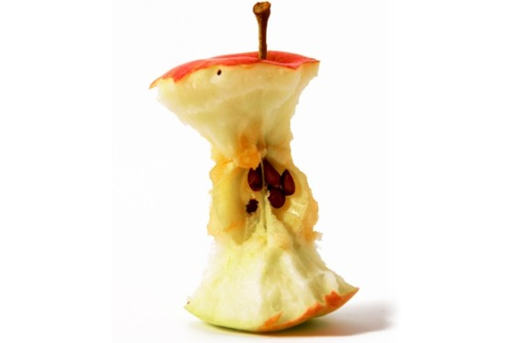
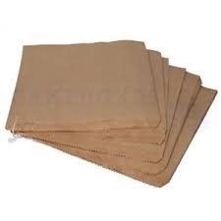
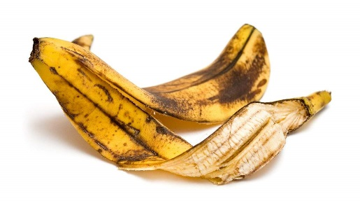
7Ga Solids, Liquids and Gases
CW
Do Now:
A paper bag containing an apple core and a banana skin is dropped on the top of Ben Nevis, how fast does each break down?
2 months
1 month
2 years

Slide 2
Requisitions
Equipment | Worksheets
Range of solids, liquids and gases to run as circus | Solid Liquid Gas Circus Table

Slide 3
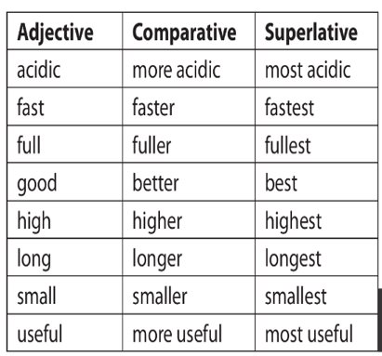
Comparing is an important aspect of scientific investigations
What do the words at the top of the table mean?

Slide 4
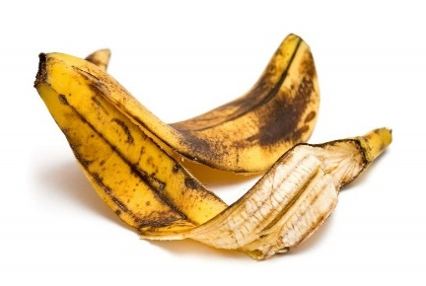
Comparative Language
Write Down
We use an adjective to describe observations or measurements.
Use a comparative adjective for comparing two observations or measurements.
Use a superlative adjective when we have three or more observations or measurements.
slow
slower
slowest

Slide 5
Turn your book sideways and draw this table:
Write Down
Object Name | Fixed shape? | Does it flow? | Easy to squash? | Change its volume? | Heavy or light? | Solid, Liquid or gas?
What makes something a solid liquid or gas?
What is meant by volume?

Slide 6
You are going to investigate the properties of solids liquids and gases.
You will have 5 minutes at each table.
Work with the people on your table to help answer the questions.
Pick an object from the selection on your table.
Answer the questions in the table.
Decide if the object is solid, liquid or gas.
Try to observe three objects from each table.

Slide 7
Write Down
Object Name | Fixed shape? | Does it flow? | Easy to squash? | Change its volume? | Heavy or light? | Solid, Liquid or gas?

Slide 8
Copy & Complete
liquid
Everything in the world is made of either solid, ______ or gas. These are called the states of_______. Solids are hard to change shape or volume and are ______ dense than both liquids and gas.
Liquids can change ______ and flow, but they cannot be compressed (squashed). They are more dense than gas, but _____ dense than solids.
Gases can______, change shape and be compressed. They are less ______ than solids and liquids.
matter
more
shape
less
flow
dense
Liquid matter more shape less flow dense

Slide 9
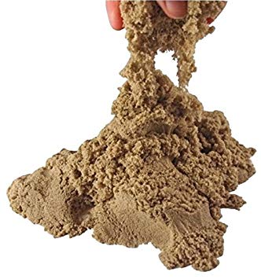
w/s 7Ga 6
Some things are more difficult to classify
1. Write down all the reasons why you might think sand is a solid.
2. Why might we also think that sand is a liquid?
keeps its shape; has a fixed volume; does not flow; is dense
A pile of sand can flow.

Slide 10
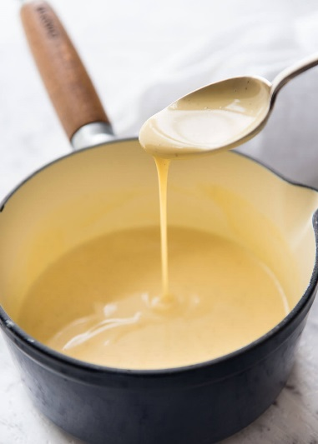
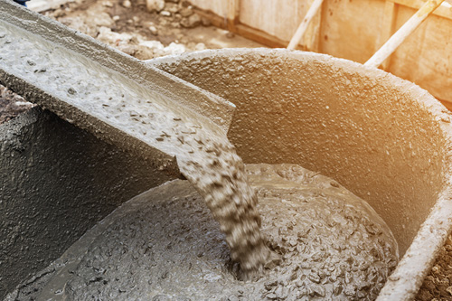
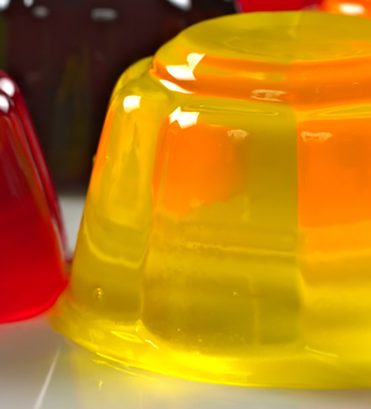
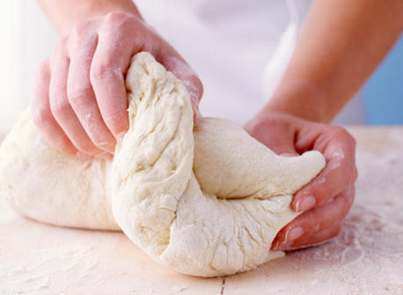
Are the materials in the images above solid or a liquid?
Write down all the reasons for thinking it is a solid?
Write down all the reasons for thinking it is a liquid?

Slide 12
Key Words

Slide 13
