Slide 1
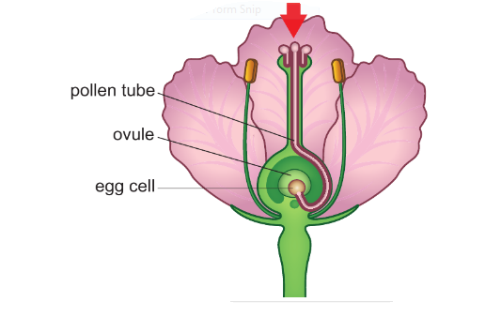
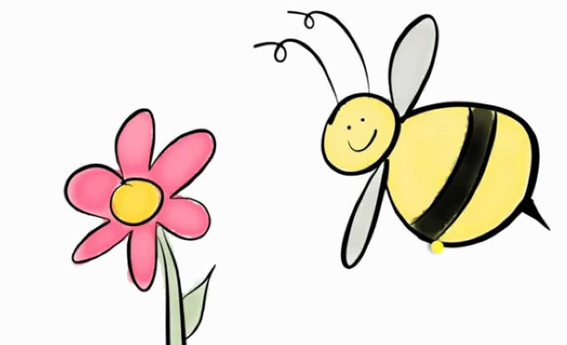
C/W
8Bd Fertilisation and dispersal
Name the male and female parts of the flower from last lesson.
What do you think happens after pollination?
@hpscience

Slide 2
What happens after pollination?
https://www.activeteachonline.com/product/view/id/335/page/30/mode/dps?modal=/player/animation/id/350144

Slide 3
If a pollen grain reaches a stigma of the same species it will grow a p____ t___.
The stigma makes a sugary solution which is a source of e_____ for the pollen tube to grow down the style into the o____. Next the egg cell and the male g_____ from the pollen grain join together at FERTILISATION and form a z_____.
Copy and complete the passage
ollen ube
nergy
vary
amete
ygote

Slide 4
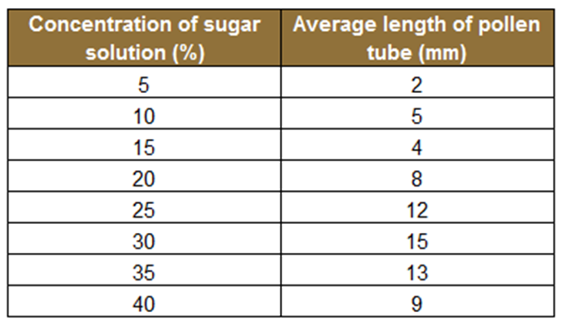
A group of students carried out an experiment where they investigated how the concentration of a sugar solution affects the growth of pollen tubes.
They put pollen grains in sugar solution of different concentrations and measured the lengths of the pollen tubes that grew in a certain time.

Slide 5
Plot a graph of sugar solution concentration against average length of pollen tube.

Slide 6
One of the readings was anomalous.
a What does 'anomalous' mean?
b Which reading was anomalous?
What conclusion can you draw from the graph?

Slide 7
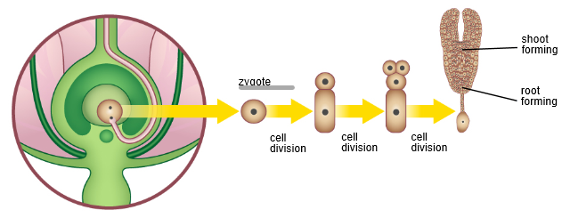
The zygote splits into 2 by cell division and the cells divide again and again to form an e______.
The ovule becomes the s____ and inside the seed the embryo develops a tiny root and tiny shoot with a store of food.
mbryo
eed

Slide 8
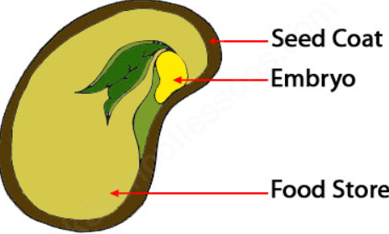
Inside the seed there is:
a tiny shoot which will eventually grow leaves,
a tiny root which absorbs water,
a food store which is the seed’s energy source,
a strong seed coat which protects the seed.
The ovary swells up and becomes the fruit around the seed.
Answer questions 2 and 4 on worksheet 8Bd-1

Slide 9
Seed dispersal
Fruits spread seeds away from thee parent plant, this is called seed dispersal and it allows plant species to spread into new areas and reduce competition for resources such as light, space and water.
Look at the following slides and see if you can determine the method used by each plant to disperse their seeds, then write some seed dispersal examples:

Slide 10
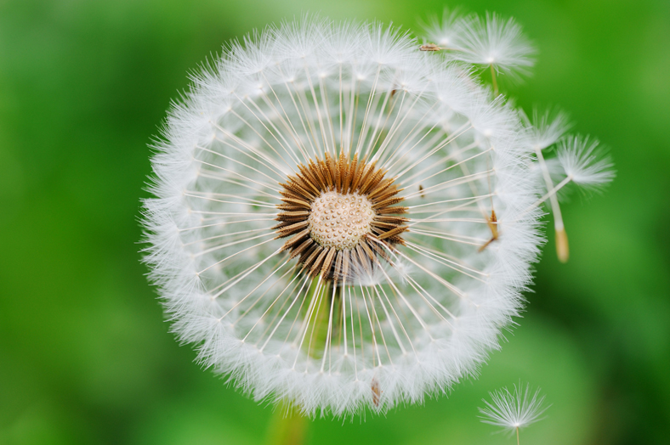
How does this plant disperse its seeds?
Wind dispersal
The fluffy heads of the seeds help them float on the wind.

Slide 11
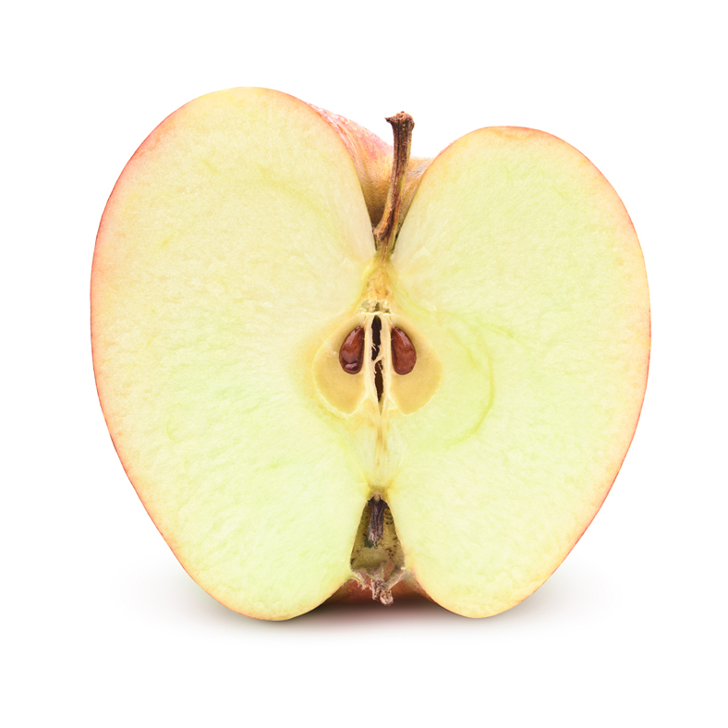
How does this plant disperse its seeds?
Animal dispersal
Animals eat the fruit and then pass the seeds out in their faeces away from the parent tree.
© Pearson Education Ltd 2014. Copying permitted for purchasing institution only. This material is not copyright free.
Notes:
11

Slide 12
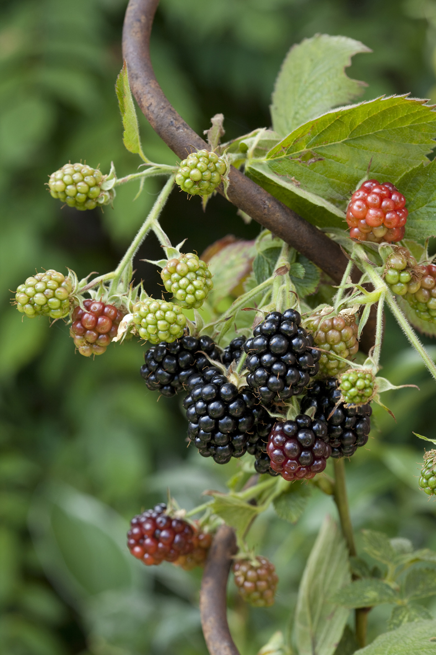
How does this plant disperse its seeds?
Animal dispersal
Animals eat the fruit and then pass the seeds out in their faeces.
© Pearson Education Ltd 2014. Copying permitted for purchasing institution only. This material is not copyright free.
Notes:
12

Slide 13
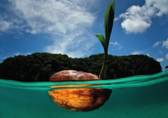
How does this plant disperse its seeds?
Water dispersal
The coconut fruit is very light and floats on the water.
© Pearson Education Ltd 2014. Copying permitted for purchasing institution only. This material is not copyright free.
Notes:
13

Slide 14
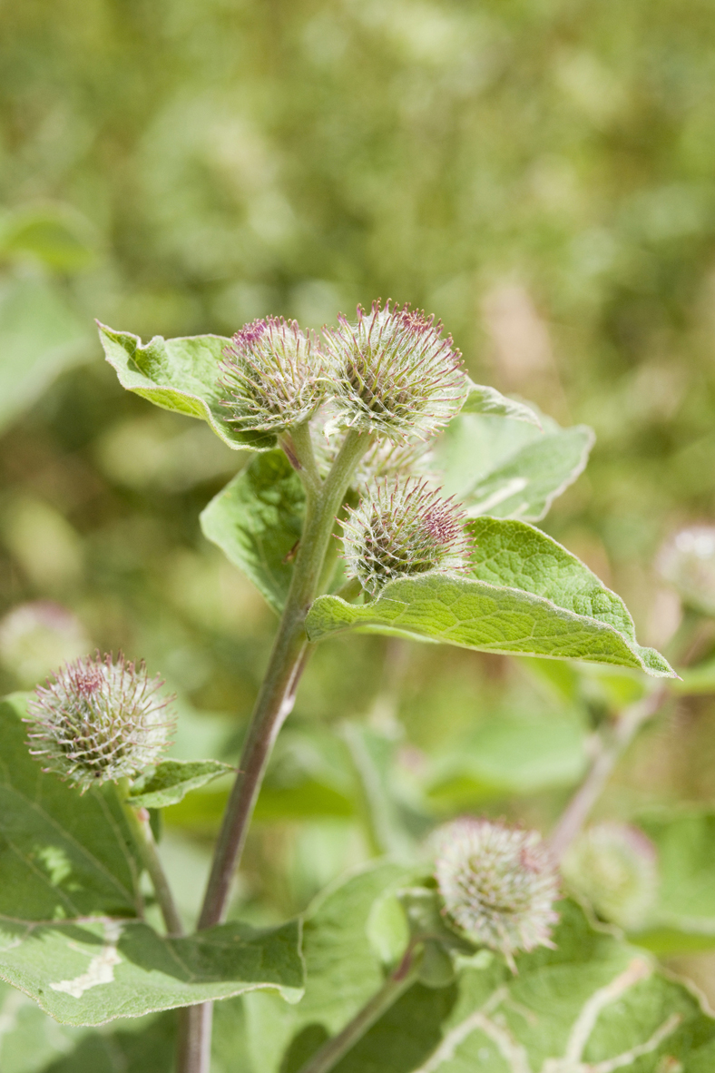
How does this plant disperse its seeds?
Animal dispersal
The hooks on the seeds attach to fur on an animal and are carried away.
© Pearson Education Ltd 2014. Copying permitted for purchasing institution only. This material is not copyright free.
Notes:
14

Slide 15
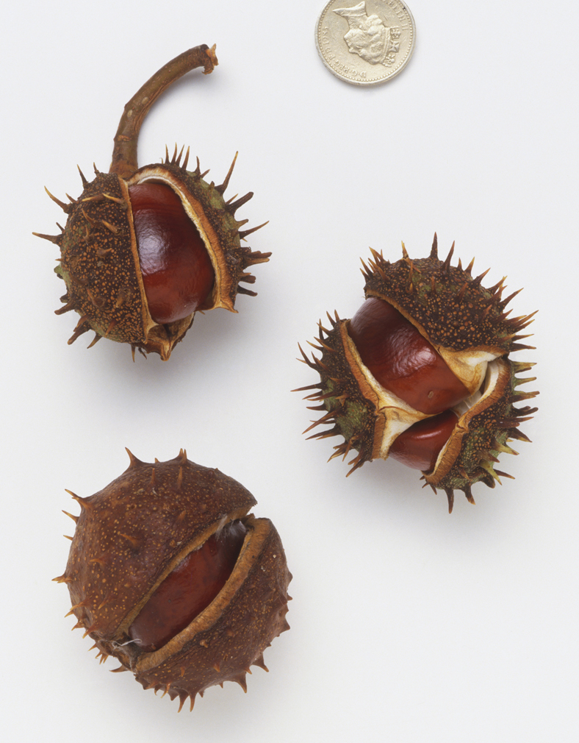
How does this plant disperse its seeds?
Animal dispersal
Animals collect the seeds and take them away from the tree to eat them. However some are dropped or forgotten.
© Pearson Education Ltd 2014. Copying permitted for purchasing institution only. This material is not copyright free.
Notes:
15

Slide 16
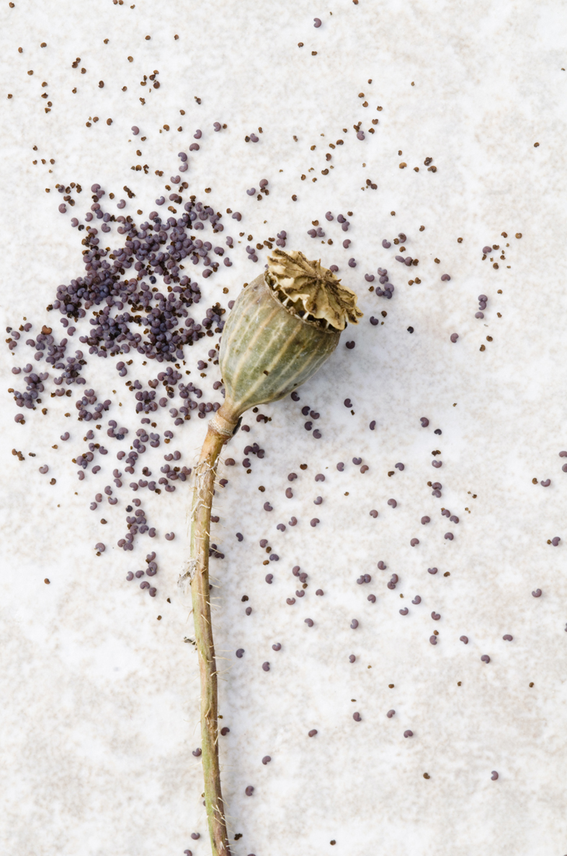
How does this plant disperse its seeds?
Wind dispersal
The wind shakes the poppy head and the seeds rattle out.
© Pearson Education Ltd 2014. Copying permitted for purchasing institution only. This material is not copyright free.
Notes:
16

Slide 17
Complete the questions on your worksheet (8Bd-1 )
Answer questions 1,2 and 4 on worksheet 8Bd-1
Answer questions 1,2 and 4 on worksheet 8Bd-1

Slide 18
Practical
Use worksheet 8Bd – Spinners 1 to investigate how the lengths of the wings on a spinner affect the time it takes to fall.

Slide 19
Challenge
Use worksheet 8Bd-10 to evaluate seed dispersal.
This sheet enables you to :
Discuss evaluation of different methods of seed dispersal.
Describe the importance of hybridisation in plant breeding.
Explain the production of seedless fruits (e.g. watermelons) using hybridisation.

Slide 20
Homework
Use worksheet 8Bd-7 Making and dispersing seeds

Slide 21
Objectives
Identify different structures within a seed.
Identify different kinds of fruits and describe how they disperse seeds.
Describe the events that occur after pollination leading to fertilisation.
Describe how the fusing of male and female gametes, and their nuclei, during fertilisation form a fertilised egg cell (or zygote).
© Pearson Education Ltd 2014. Copying permitted for purchasing institution only. This material is not copyright free.

Slide 22
Objectives
Describe how a fertilised egg cell grows into an embryo.
Explain the functions of the different parts of a seed.
Explain the importance of seed dispersal.
Evaluate different methods of seed dispersal.
Describe the importance of hybridization in plant breeding.
Explain the production of seedless fruits (e.g. watermelons) using hybridisation.
© Pearson Education Ltd 2014. Copying permitted for purchasing institution only. This material is not copyright free.

Slide 23
Equipment
graph paper
Worksheet 8Bd-1 Fertilisation and seed dispersal.
Practical: piece of paper
ruler
scissors
2 paper clips or staples
stopwatch
Worksheet 8Bd-3 Spinners 1
For evaluation challenge - Worksheet 8Bd-10 Evaluating seed dispersal.
For homework – Worksheet 8Bd-7 Making and dispersing seeds.

