Slide 1
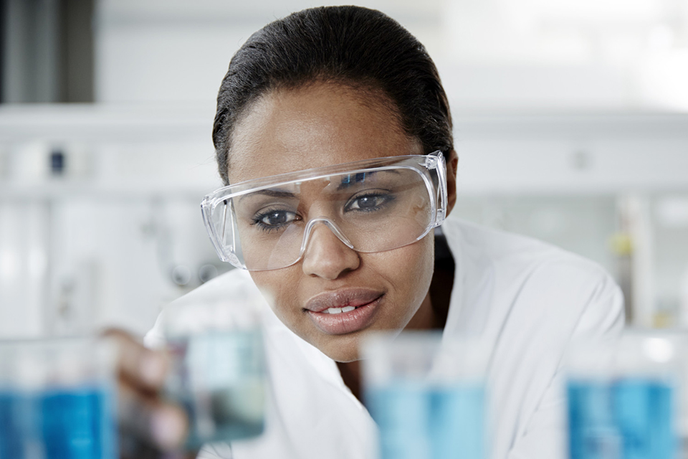
CW
7Cb Scientific questions (WS)
What is the first step in the scientific method?
Q
H
P
E
D
C
What does critical thinking mean?
In an earlier lesson you learnt about the importance of the scientific method.
@hpscience

Slide 2
Note to teacher – this is a lesson for thinking and discussion. There are not many notes to take.
I quite like this lesson – it is worth doing.
If there are slides with loads of writing on, get the students to read them in silence and then discuss the content.
There are two good riddles towards the end. Try to get to them.

Slide 3
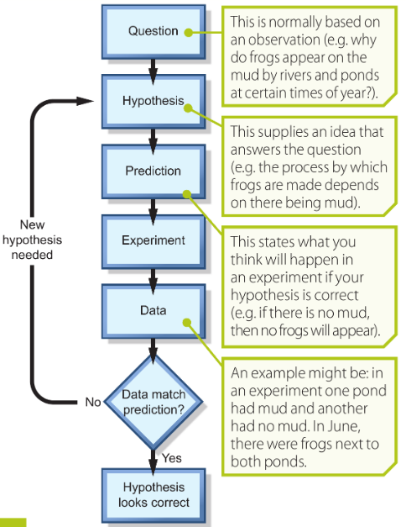
The scientific method (recap)
The scientific method is a process for experimentation that is used to explore observations and answer questions.
It provides an objective, standardised approach to conducting experiments and improves their results. What does this mean?
By using a standardised investigation method, scientists can feel confident that they will stick to the facts and limit the influence of personal, preconceived notions (bias). Really important.
Do not copy, do not discuss, move on.

Slide 4
Science begins by asking questions and then seeking answers. Young children understand this intuitively as they explore and try to make sense of their surroundings. However, science education focuses upon the end game of “facts” rather than the exploratory root of the scientific process. Encouraging questioning helps to bring the true spirit of science into our educational system, and the art of asking good questions constitutes an important skill to foster for practicing scientists.
(Ronald D. Vale, Mol Biol Cell. 2013 Mar 15; 24(6): 680–682)
https://www.youtube.com/watch?v=bqfQpURDoCo

Slide 5
Top 10 skills that employers will be looking for in 2020
The World Economic Forum published a report that lists the top ten skills you are going to need in the future when you are looking for employment.
Science teaches, tests and develops the top three skills on this list. This is why you are taught science in schools.
Through learning science you will learn these skills. You are preparing yourself for a successful future.
DISCUSS

Slide 6
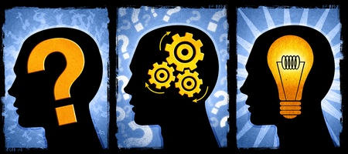
What is this image trying to tell us?

Slide 7
Critical thinking
Question
Think
Solution

Slide 8
Critical thinking is based on universal intellectual values that transcend subject matter divisions: clarity, accuracy, precision, consistency, relevance, sound evidence, good reasons, depth, breadth, and fairness.
Someone with critical thinking skills is able to do the following :
understand the logical connections between ideas
identify, construct and evaluate arguments
detect inconsistencies and common mistakes in reasoning
solve problems systematically
identify the relevance and importance of ideas
reflect on the justification of one's own beliefs and values

Slide 9
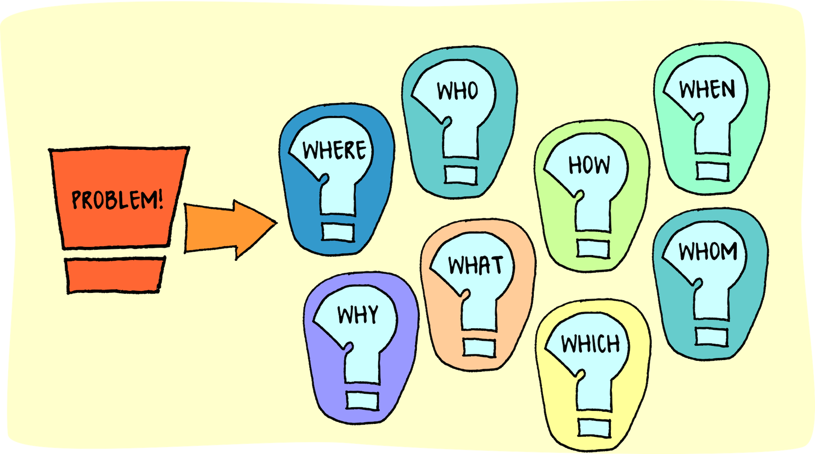
What is this image trying to tell us?

Slide 10
Perhaps it is showing us that in order to solve a problem you need to ask the right questions??

Slide 11
Problem solving - the process of finding solutions to difficult or complex issues.
You learn the skills to enable you to do this during science lessons.
https://www.youtube.com/watch?v=HnJ1bqXUnIM
https://www.youtube.com/watch?v=dItUGF8GdTw

Slide 12
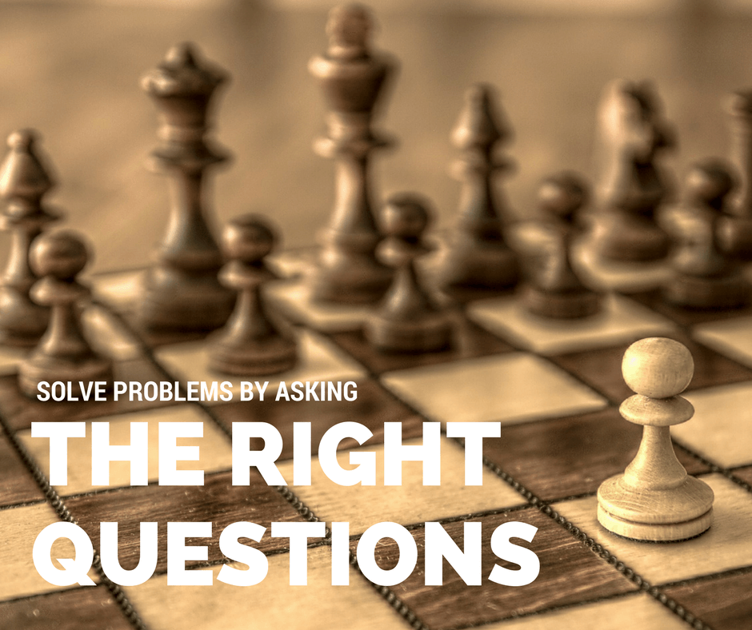

Slide 13
As science teachers we are often asked “why do I need to learn about all this science stuff”. The fact is that much of the ‘stuff’ you are taught may not be useful to you when you leave school. Some of you may find it interesting whilst others do not.
However, and this is the really, really, really important part, science teaches you how to ask relevant questions and understand complex ideas.
It gives you the ability to think critically and to solve problems through a thoughtful process.
These are two highly sort after skills regardless of whatever job profession you may choose when you are adults.

Slide 14
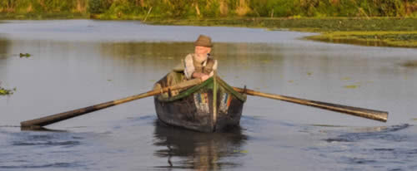
A man has to get a fox, a chicken, and a sack of corn across a river.
He has a rowboat, and it can only carry him and one other thing.
If the fox and the chicken are left together, the fox will eat the chicken.
If the chicken and the corn are left together, the chicken will eat the corn.

Slide 15
The man and the chicken cross the river, (the fox and corn are safe together), he leaves the chicken on the other side and goes back across.
The man then takes the fox across the river, and since he can't leave the fox and chicken together, he brings the chicken back.
Again, since the chicken and corn can't be left together, he leaves the chicken and he takes the corn across and leaves it with the fox.
He then returns to pick up the chicken and heads across the river one last time.
https://www.mathsisfun.com/puzzles/tricky-puzzles-index.html

Slide 16
Four people need to cross a bridge in 17 minutes in the middle of the night. The bridge can only hold two or less people at any time and they only have one flashlight so they must travel together (or alone).
The flashlight can only travel with a person so every time it crosses the bridge it must be carried back. Tom can cross in 1 minute, John can cross in 2 minutes, Sally can cross in 5 minutes, and Connor can cross in 10 minutes.
If two people cross together they go as fast as the slower person. How can they cross the bridge in 17 minutes or less?
This is more challenging than the previous riddle.

Slide 17
Move | Time
(1) & (2) Cross with Torch | 2
(1) Returns with Torch | 1
(5) & (10) Cross with Torch | 10
(2) Returns with Torch | 2
(1) & (2) Cross with Torch | 2
 | 17
The trick was to get the two slowest people to cross together. This is how you can save time. But you have to set it up so that there is a fast person to bring the torch back.
If you solved this riddle then you have good problem-solving skills.

Slide 18
Conclusion
The scientific process starts by asking the right questions.
Science is important because it teaches us how to solve problems and to think critically.
Critical thinking and problem solving are two very important skills.
Science teaches us these skills.
This is why science is so important.
Copy these notes.

