Slide 1
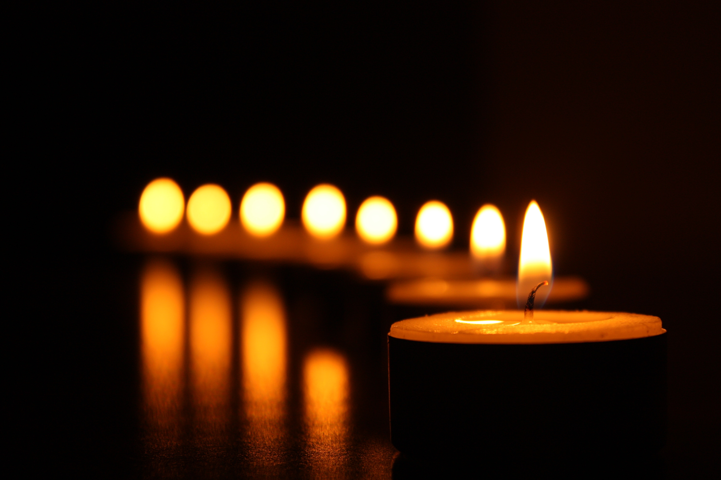
7Ha2 Handling Data
CW
Do Now:
What would you measure and keep the same in an experiment to find out how quick different waxes will burn?

Slide 2
Requisitions
Equipment | Worksheets
Candle Various Beakers Stopwatches

Slide 3
Variables
Write Down
Three types of variable:
Independent: The variable where you decide the way it changes
Dependent: The variable that changes and gives you your result (the thing you measure)
Control: Variables that could change but you need to control it to make it a fair test

Slide 4
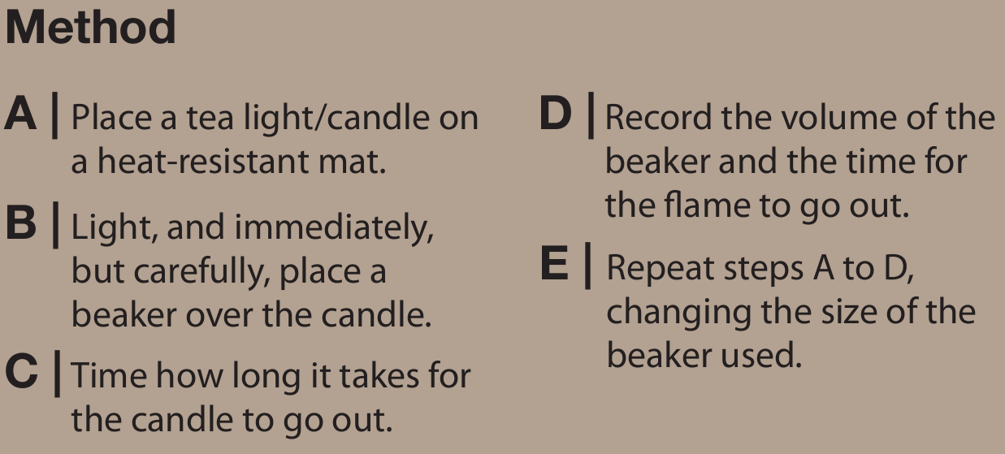
The burning candle experiment
Volume of air in beaker/ml | Burning time/s
100
250
300
600
1000
2000
Tip
Use some Blutac to block the gap in the upturned beaker.
The teacher will demonstrate the 2000ml beaker, then you can record the result

Slide 5
The burning candle experiment
Volume of air in beaker/ml | Burning time/s
100
250
300
600
1000
2000
Tip
Use some Blutac to block the gap in the upturned beaker.
The teacher will demonstrate the 2000ml beaker, then you can record the result

Slide 6
Results
Copy & Complete
This data is quantitative (made of numbers).
In this experiment we are looking at how the _____________ affects the _____________
volume of air
burning time
Volume of air
Independent variable:
Dependent variable:
Controlled variable:
Burning time
Candle

Slide 7
Graph
Plot a graph using the results.

Slide 8
This data is called continuous data

Slide 9
Conclusion
The points on the scatter graph follow a pattern so there is a relationship. We can make the relationship clearer by drawing a line of best fit

