Slide 1
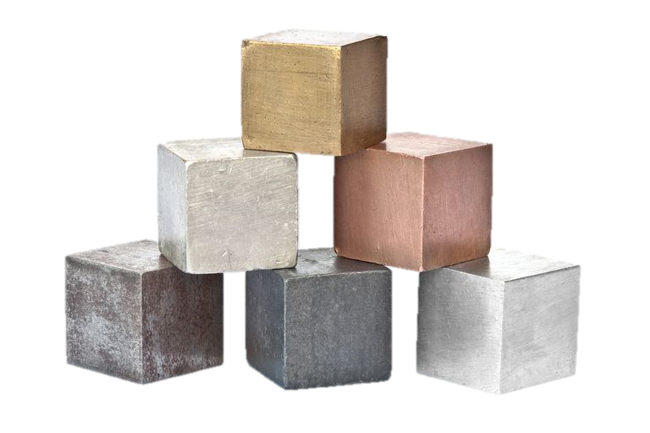
8Ga: Metal Properties
Which of the following words could be used to describe metals
Hard High melting point
Shiny Brittle Good conductor Transparent Silver Low boiling point

Slide 2
Requisitions
Equipment | Worksheets
Conductivity and Magnetism of metals and non metals | 8Ga Properties and Uses Print Out

Slide 3
Objectives
Describe some common properties of metals and non-metals.
Relate the uses of different elements to their properties.
Recall some reactions that happen slowly and some that happen quickly.
Relate the uses of different elements to their chemical properties.

Slide 4
Objectives
Name the compounds formed by a reaction between a metal and a non-metal.
Describe how catalysts affect the speed and rate of a reaction.
Describe some applications of catalysts in everyday use.
Model simple reactions of metals and non-metals using word equations.
Use valencies to deduce the formula of simple two element compounds including transition metals.
© Pearson Education Ltd 2014. Copying permitted for purchasing institution only. This material is not copyright free.

Slide 5
Typical Physical Properties
Use the images on the next few slides to help you list some of the typical physical properties of metals
Write Down

Slide 6
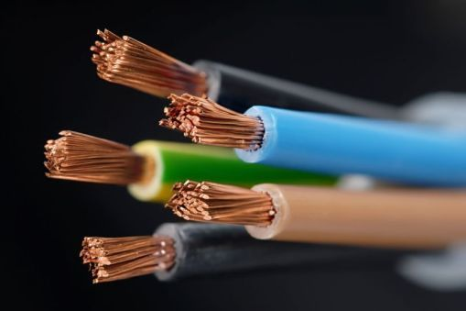
Good Electrical Conductors

Slide 7
Good Thermal Conductors

Slide 8
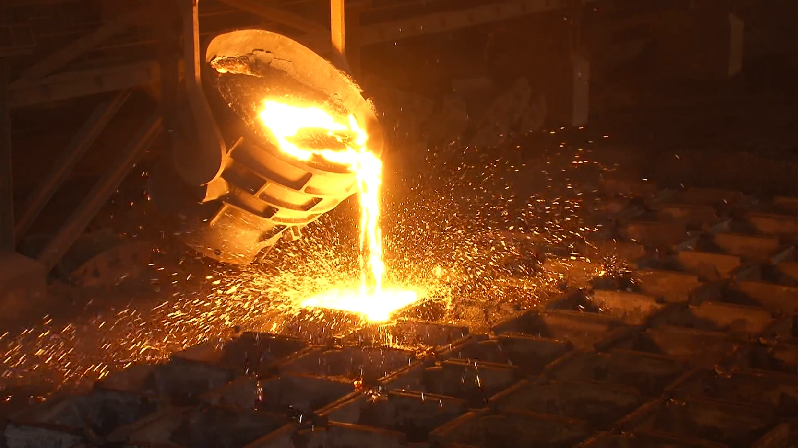
High Melting Point

Slide 9
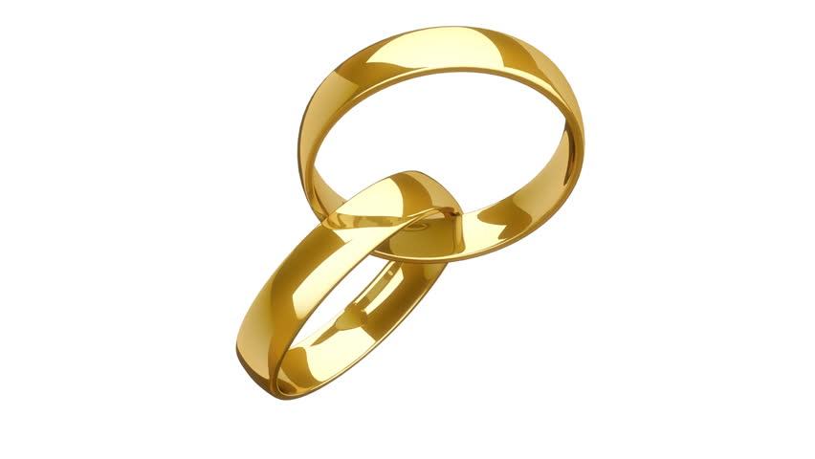
Shiny (lustrous)

Slide 10
Strong

Slide 11
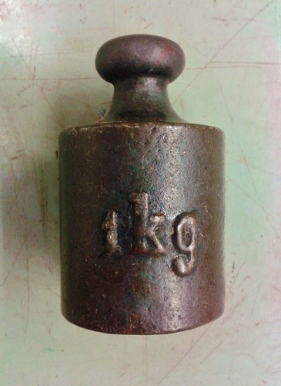
Dense (makes objects feel heavy)

Slide 12
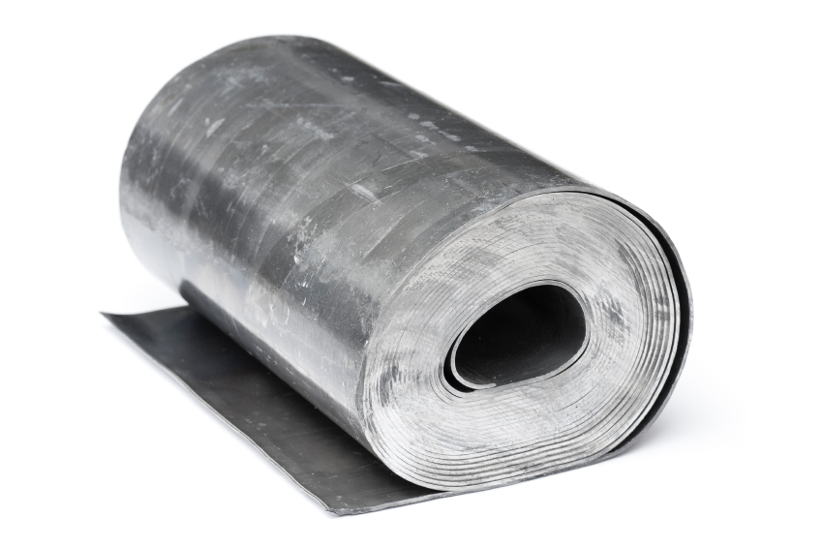
Malleable
Able to be hammered or pressed into shape without breaking

Slide 13
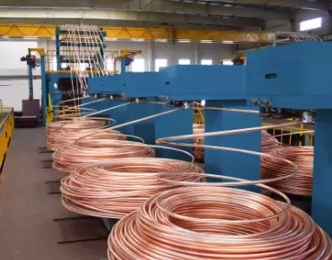
Ductile
Able to be drawn out into a thin wire.

Slide 14
Typical Physical Properties
Write Down
Electrical Conductor
Thermal Conductor
High Melting Point
Shiny
Strong
Dense
Malleable
Ductile

Slide 15
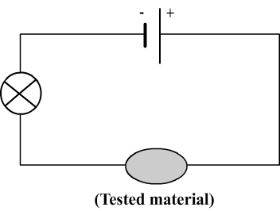
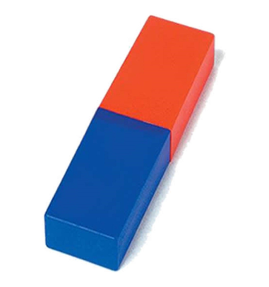
Testing materials
Using a circuit and a magnet we will test the conductivity and magnetism of different materials
Use the table on the next slide to record your observations and decide if the material is a metal or not.

Slide 16
Testing materials
Write Down
Material | Conduct Electricity? | Magnetic? | Metal?

Slide 17
Testing materials
Write Down
Material | Conduct Electricity? | Magnetic? | Metal?
Iron
Glass
Plastic
Magnesium
Graphite
Rubber
Copper
Wood

Slide 18
Testing materials
Write Down
Material | Conduct Electricity? | Magnetic? | Metal?
Iron | Y | Y | Y
Glass | N | N | N
Plastic | N | N | N
Magnesium | Y | N | Y
Graphite | Y | N | N
Rubber | N | N | N
Copper | Y | N | Y
Wood | N | N | N

Slide 19
True or False?
Hands up for true
Metals conduct electricity
All non-metals are insulators
All metals are magnetic

Slide 20
Match the Metal with its Property and Use
Iron
Aluminium
Copper
Gold
Light and strong
Strong
Shiny and does not corrode
Good electrical conductor
Wiring
Aircraft bodies
Railway lines
Jewellery

Slide 21
Task:
Write a paragraph about the properties of metals (3-4 lines)
Use some examples to help to come up with your answer.

Slide 22
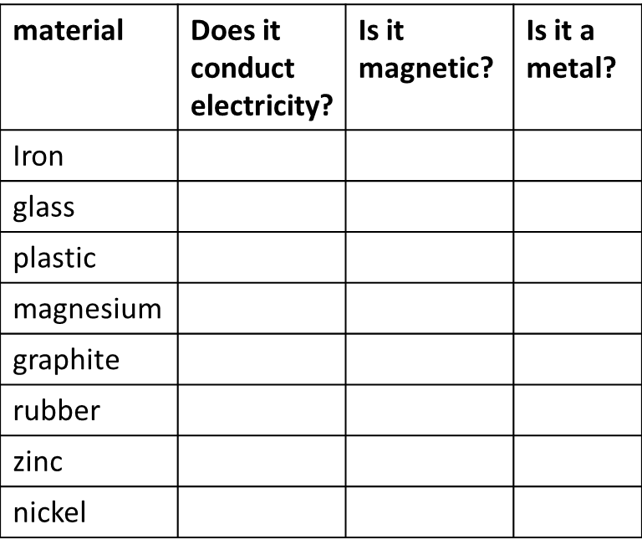
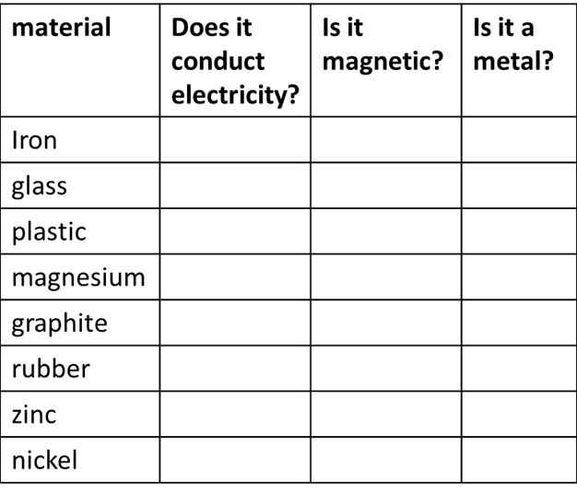

Slide 23
