Slide 1
7Lb Moving Sound
CW
Do Now:
Draw particle pictures
solid
liquid
gas
vacuum

Slide 2
Reqs
Class practical
Metal hangers with string & spoons / spatulas to tap them.
Premade string telephones
4 x short slinky
Demo
1 long slinky with one coil marked with tape
Plastic / polystyrene cup to amplify slinky laser sounds
Worksheets
7Lb - Pressure wave diagram

Slide 3
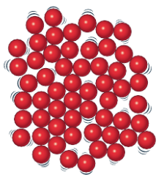
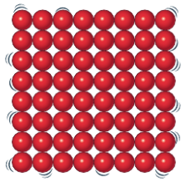
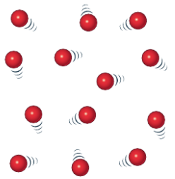
solid
liquid
gas
vacuum
Which will it be easiest for sound to travel through?

Slide 4
Can sound travel in space?
Recall light travels faster than sound and use data to compare speed of sound in solids, liquids, gases.
Evaluate the use of a slinky model to describe sound
Use particle models to explain how sound travels through different materials at different speeds.
Recall sound travels through materials by vibrations.
Why?
Explain why sound intensity decreases as distance from source increases.
Describe sound as a wave using frequency, amplitude, speed. Recall that waves transfer energy but not matter

Slide 5
A sound travels through a material (a medium) by the particles ________.
Sound cannot travel through a vacuum (eg in space), because there are no _______ to vibrate.
vibrating
particles
How does the sound keep going?
In what direction do the particles vibrate?

Slide 6
My Learning Journey……
Developing | Securing | Exceeding
Describe how sound changes as you get further from the source
Recognise all matter is made of particles and identify solid, liquid, gas.
Recall light travels faster than sound and use data to compare speed of sound in solids, liquids, gases.
Evaluate the use of a slinky model to describe sound
Use particle models to explain how sound travels through different materials at different speeds.
Recall sound travels through materials by vibrations.
Explain why sound intensity decreases as distance from source increases.
Describe sound as a wave using frequency, amplitude, speed. Recall that waves transfer energy but not matter

Slide 7
A vibrating loudspeaker makes the air particles close to it vibrate.
These vibrations are passed on to the next particles and so on. This is called a sound wave.
What is transferred all the way to the right?

Slide 8
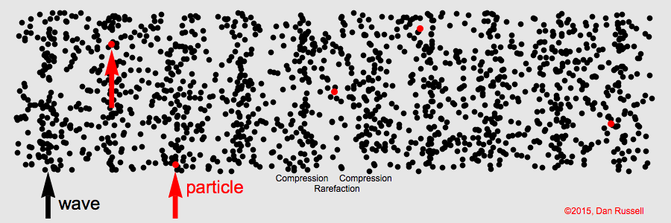
What is transferred all the way to the right?
What is NOT transferred all the way to the right?

Slide 10
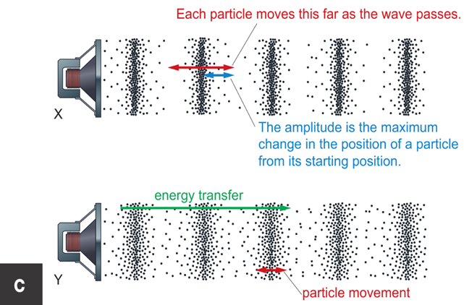
Label regions of high & low pressure on one of your diagrams.
high pressure
low pressure

Slide 11
Sound waves are also called p_______waves.
They transfer vibrations and e_____,
but they do not transfer p______.
ressure
nergy
articles
So what will be best at transferring vibrations – solid, liquid or gas?

Slide 12
My Learning Journey……
Developing | Securing | Exceeding
Recognise all matter is made of particles and identify solid, liquid, gas.
Recall light travels faster than sound and use data to compare speed of sound in solids, liquids, gases.
Evaluate the use of a slinky model to describe sound
Use particle models to explain how sound travels through different materials at different speeds.
Recall sound travels through materials by vibrations.
Explain why sound intensity decreases as distance from source increases.
Describe sound as a wave using frequency, amplitude, speed. Recall that waves transfer energy but not matter
Describe how sound changes as you get further from the source

Slide 13
How does sound travel in different materials?
How does the arrangement of particles affect the sound wave?
How does this affect the amplitude and speed of the sound wave?
Try out the coat hanger, slinky and string telephone mini practicals.

Slide 14
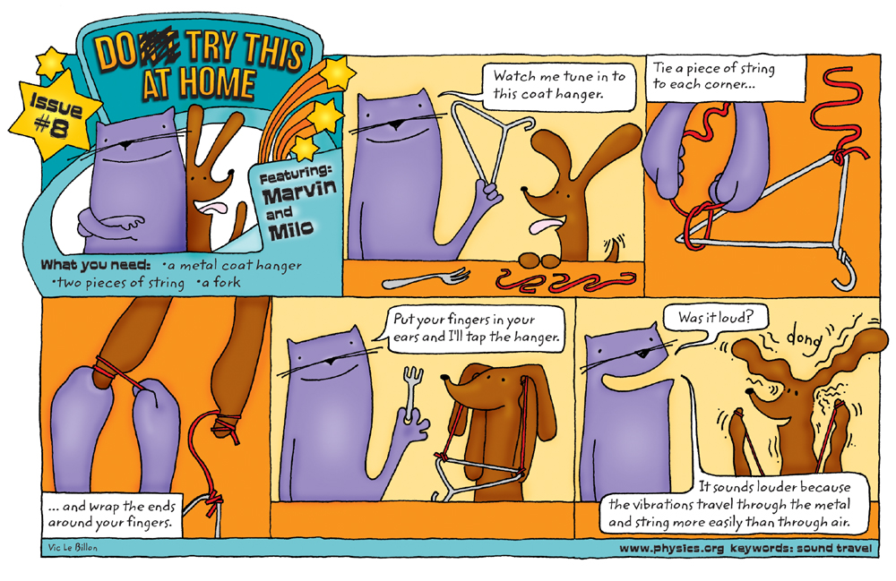

Slide 16
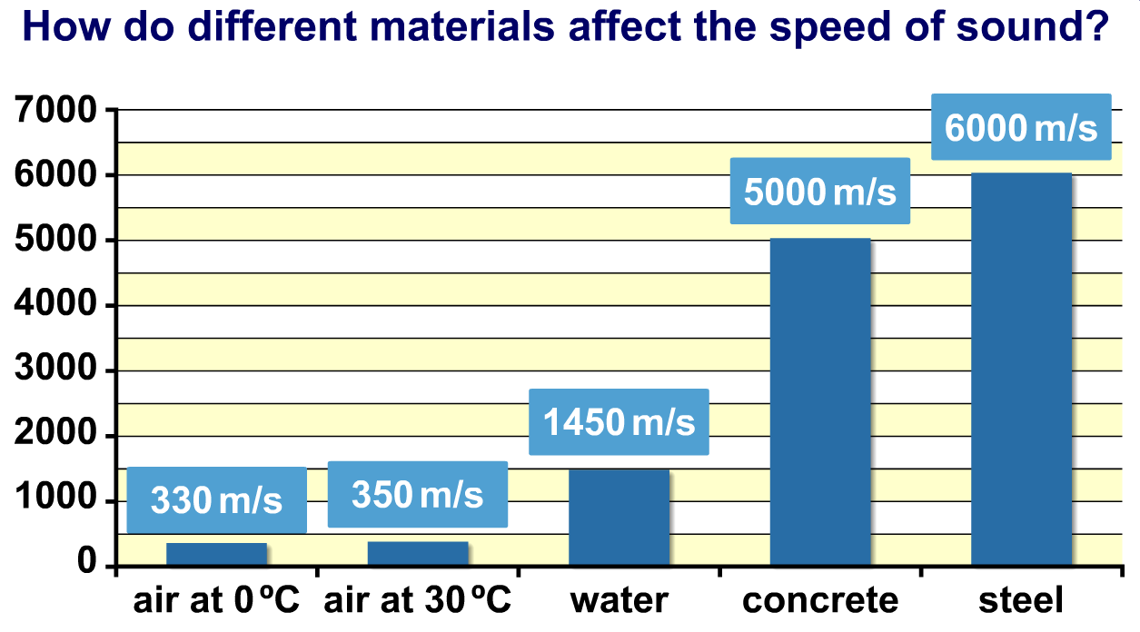

Slide 17
sound travels faster
solid
liquid
gas
most particles should be touching

Slide 18
Copy & Complete
speeds
Sound travels at different _______in different materials.
The _________ are passed on more easily when the _______ are close together, so sound travels _____ in a solid compared to a liquid or gas and the sound is also louder through a ____.
vibrations
particles
faster
solid
vibrations speed particles faster slower solid liquid gas

Slide 19
My Learning Journey……
Developing | Securing | Exceeding
Recognise all matter is made of particles and identify solid, liquid, gas.
Recall light travels faster than sound and use data to compare speed of sound in solids, liquids, gases.
Evaluate the use of a slinky model to describe sound
Use particle models to explain how sound travels through different materials at different speeds.
Recall sound travels through materials by vibrations.
Explain why sound intensity decreases as distance from source increases.
Describe sound as a wave using frequency, amplitude, speed. Recall that waves transfer energy but not matter
Describe how sound changes as you get further from the source

Slide 20
What happens to a sound as it gets further from the source?
Sound gets quieter

Slide 21
Explain what happens to sound as you get further away from a source. (4 marks)

Slide 22
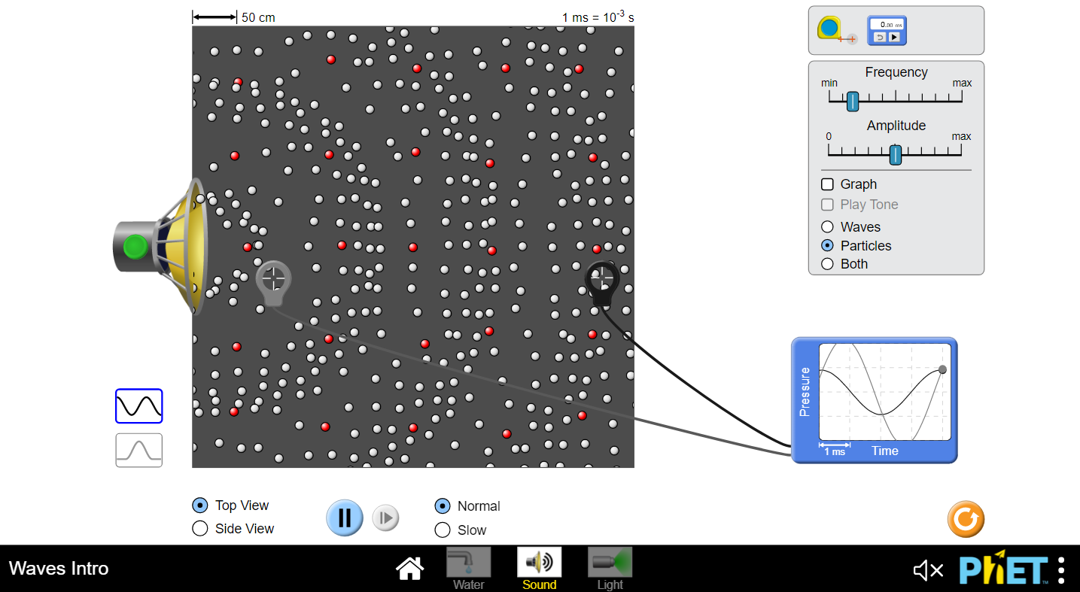
Click to open PhET sim. (Sound / Particles)
Explore the amplitude close to & further away from the speaker

Slide 23
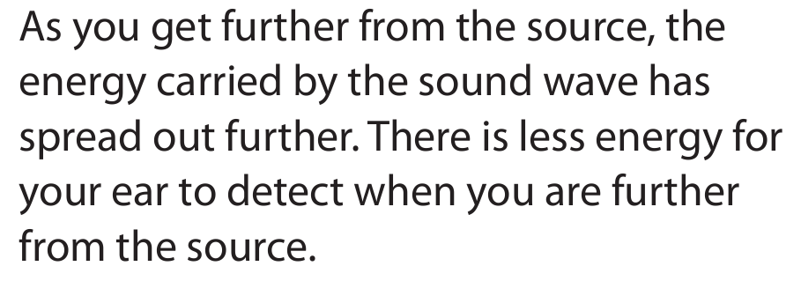
✓
✓
(
)
✓
So the amplitude gets less and the sound is quieter.
✓

Slide 25
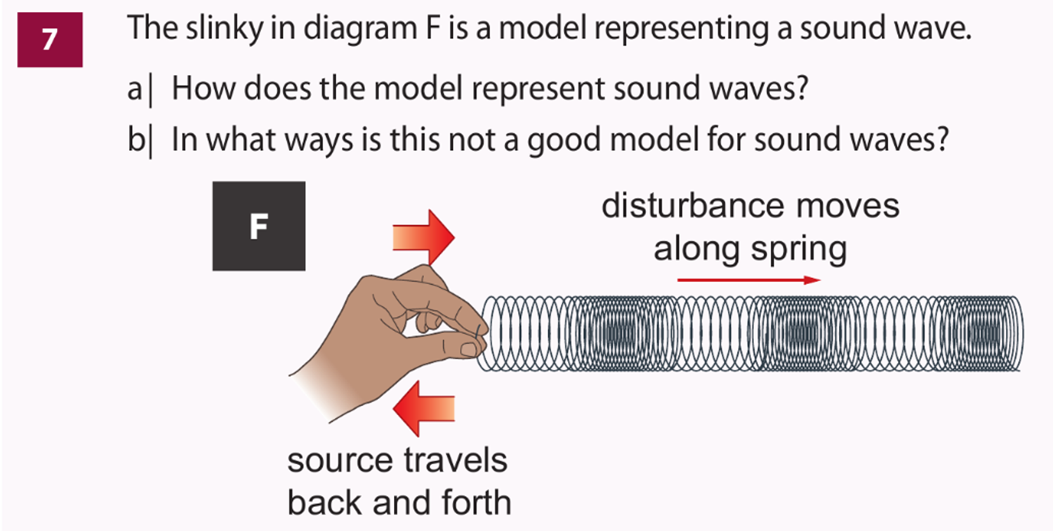

Slide 26
My Learning Journey……
Completed
Developing | Securing | Exceeding
Recognise all matter is made of particles and identify solid, liquid, gas.
Recall light travels faster than sound and use data to compare speed of sound in solids, liquids, gases.
Evaluate the use of a slinky model to describe sound
Use particle models to explain how sound travels through different materials at different speeds.
Recall sound travels through materials by vibrations.
Explain why sound intensity decreases as distance from source increases.
Describe sound as a wave using frequency, amplitude, speed. Recall that waves transfer energy but not matter
Describe how sound changes as you get further from the source

Slide 27
 Give a clue or definition for these keywords.
Hot Seat

Slide 28
Hot seat
 Give a clue or definition for these keywords.
Particles

Slide 29
Hot seat
 Give a clue or definition for these keywords.
energy

Slide 30
Hot seat
 Give a clue or definition for these keywords.
Speed of sound

Slide 31
Hot seat
 Give a clue or definition for these keywords.
Sound wave

Slide 32
Hot seat
 Give a clue or definition for these keywords.
Pressure

Slide 33
Hot seat
 Give a clue or definition for these keywords.
amplitude

