Slide 1
C/W
06/10/2018
8Jd L&C Preparing a Presentation
Which slides do you like in a lesson?
Which slides do you hate?!

Slide 2
Objectives
Present information using a mixture of text, diagrams, charts and graphs.
Develop clear points to present ideas and opinions, structure paragraphs in a clear manner and develop logical sequences of points in writing.
Outline some ways in which the same scientific information should be presented for named audiences.
Evaluate different ways of presenting the same information.

Slide 3
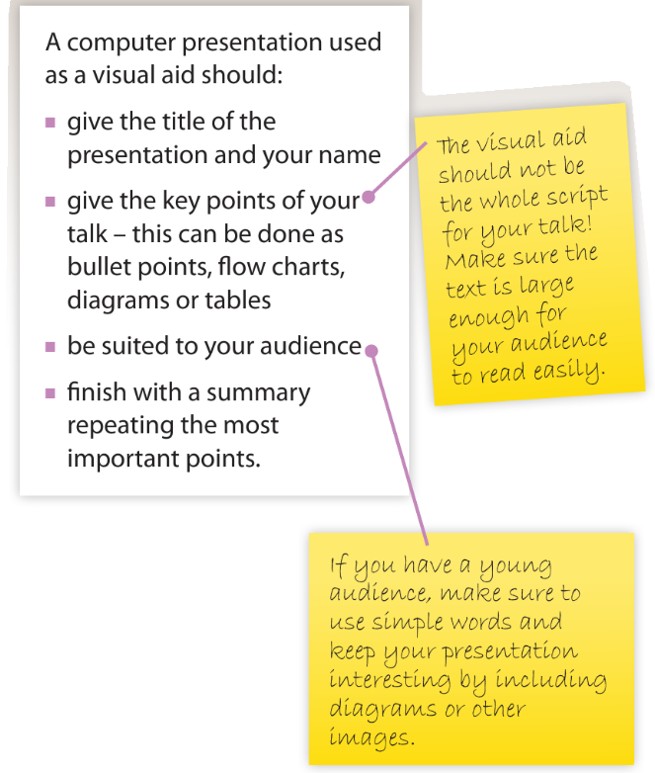
How many times have you got bored as someone reads off their slides?

Slide 4
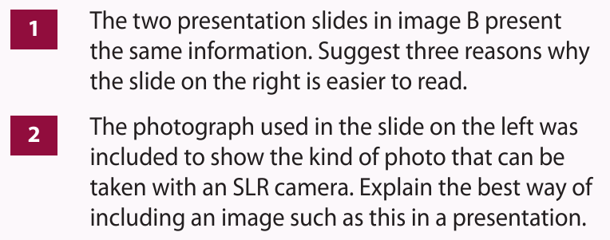
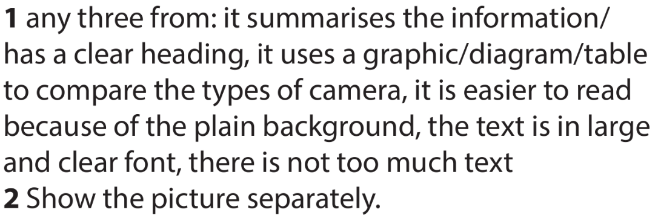
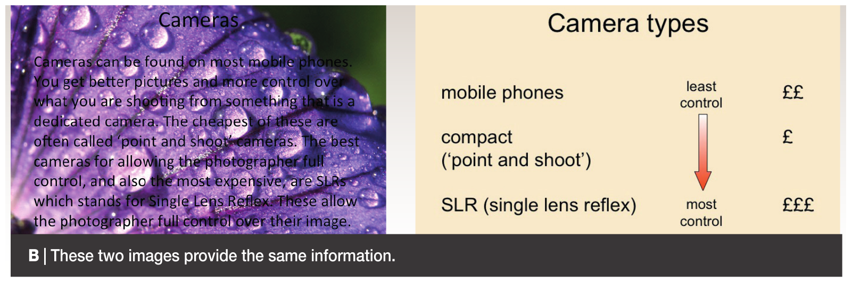

Slide 6
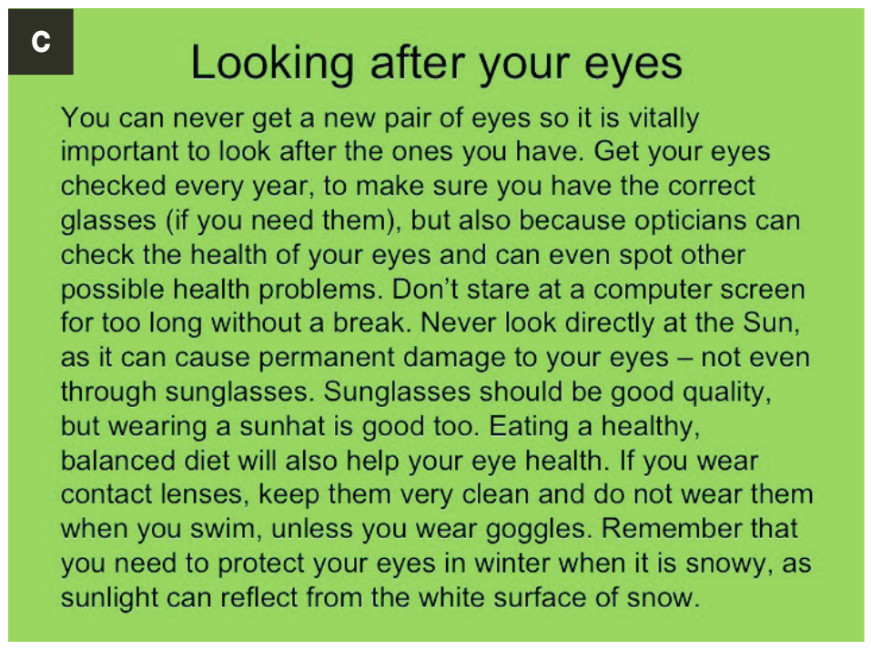
Would this be a good slide?

Slide 8
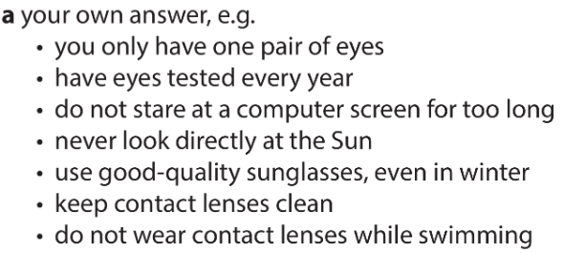

Slide 9
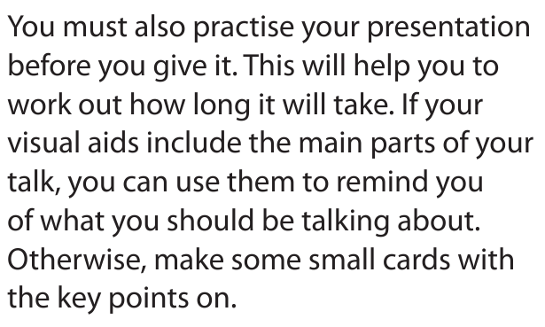
Why might this second idea be best?
Where is the screen / audience?

Slide 10
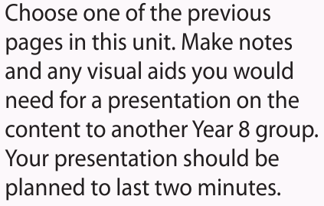
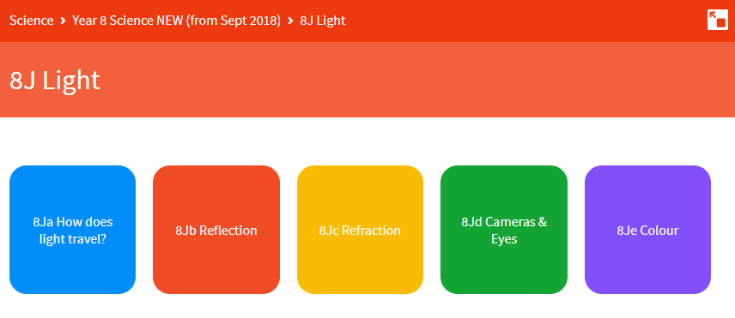
Challenge task – also very useful for revision!

Slide 11
Objectives
Present information using a mixture of text, diagrams, charts and graphs.
Develop clear points to present ideas and opinions, structure paragraphs in a clear manner and develop logical sequences of points in writing.
Outline some ways in which the same scientific information should be presented for named audiences.
Evaluate different ways of presenting the same information.

