Slide 1
Getting Oxygen
Describe how substances reach respiring cells from the blood and how waste products are returned to the blood.
Describe the effects of nicotine, tar and carbon monoxide in tobacco smoke. • Describe how asthma, emphysema and tobacco tar can reduce gas exchange. • Explain some of the effects of reduced oxygen supply on the body.

Slide 2
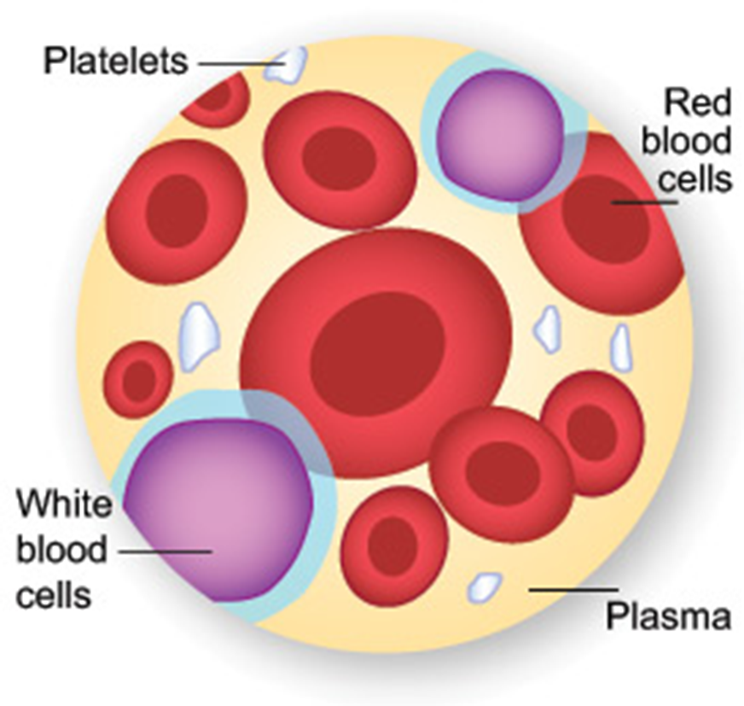
What would you find in your blood?
Food products (amino acids, glucose), hormones, antibodies, water, and waste products (e.g. CO2, urea).

Slide 3
Blood vessels

Slide 4
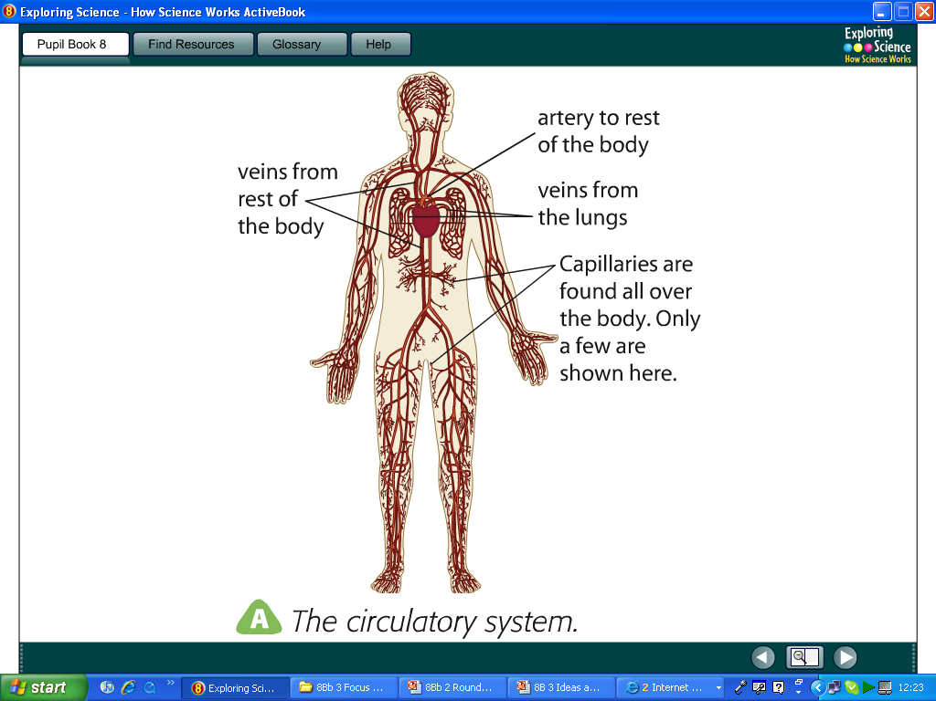
Fill in the blanks with words from below…
blood vessel
A capillary is a type of ____ _____ – a tube carrying blood pumped by your ______. There are two other sorts of larger blood vessels; ________ carry blood away from your heart and _____ carry blood into your heart.
The heart and blood vessels form the __________ _______.
heart
arteries
veins
circulatory
system
heart, circulatory system, blood vessel, veins, arteries,
Why do we need capillaries?

Slide 5
Blood
The blood carries oxygen and dissolved food to all the body’s cells so that respiration can take place.

Slide 6
1) What is the function of the haemoglobin?
2) What is the function of the tissue fluid?
3) How are waste products returned to the blood?

Slide 7
Lack of Oxygen

Slide 8
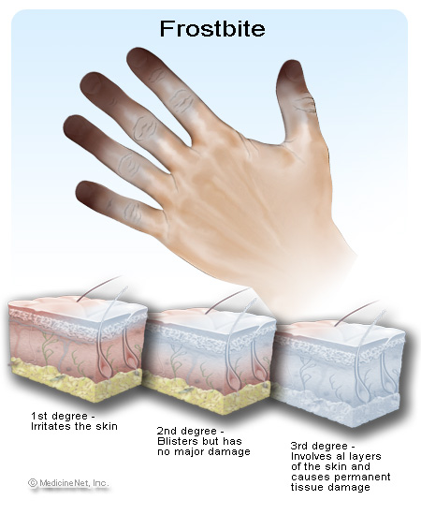
Frostbite… …happens when the blood vessels in your skin become n____ due to the cold. Less blood reaches the cells. If cells don’t get enough o____ and g____ for a long time they die.
Narrow
Oxygen
glucose

Slide 9
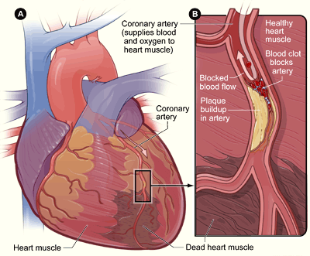
Heart disease… …happens when the b____ vessels supplying the h____ muscles get blocked. The heart muscle cells then start to d____ because they are not getting enough oxygen, this is called a heart a_____.
1. Blood
2. Heart
3. Die
4. Attack
Beta blockers are drugs used to treat heart attacks. They slow the heart down and make it pump less powerfully. This means the heart muscles require less oxygen and glucose.

Slide 10
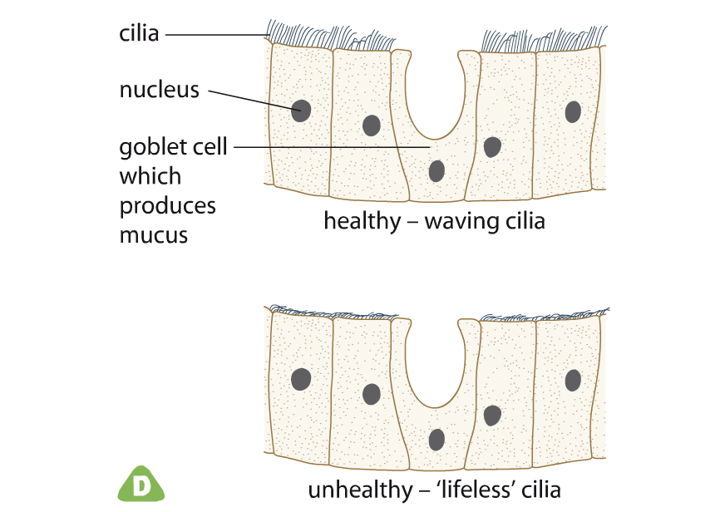
Reduced gas exchange
Chemicals in cigarette smoke stop cilia working. Mucus collects in the lungs and reduces surface area for gas exchange.

Slide 11
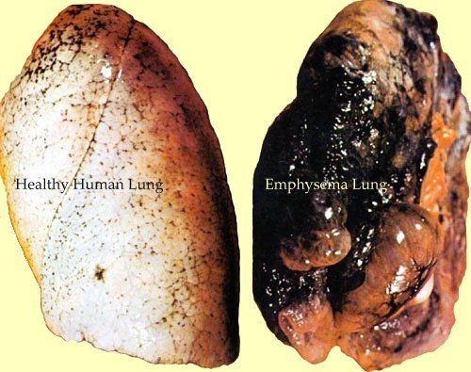
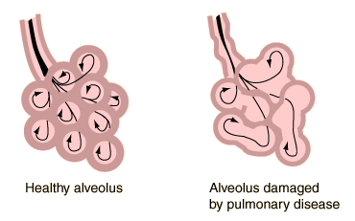
Emphysema
Smoke irritates alveoli. Over time this causes the alveoli to break down which again reduces surface area.
What’s Happening inside?
Clue: surface area

Slide 12
Tobacco Smoke – Drag & Drop
Tobacco smoke
Copy and complete using the following keywords: Tar, Surface Area, Cilia, Carbon Monoxide, Nicotine and Cancer

Slide 13
Tobacco Smoke – Drag & Drop
Tobacco smoke
1.Nicotine
2.Carbon Monoxide
3.Tar
4.Cancer
5.Surface Area 6.Cilia

Slide 14
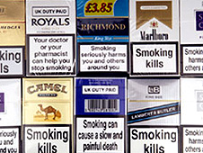
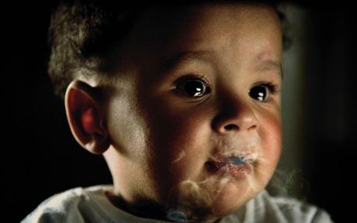
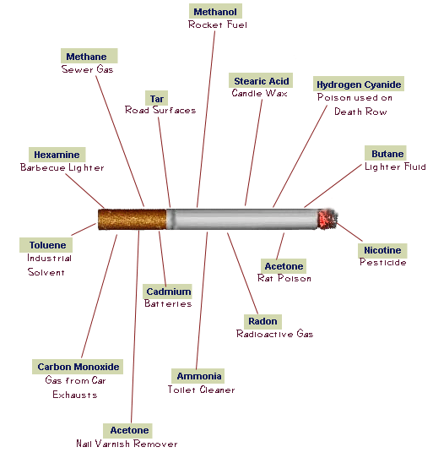
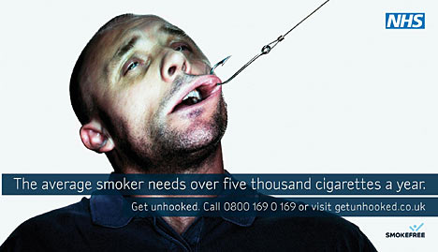
Discuss the message behind these adverts.

Slide 15
Asthma
Cigarette smoke can also trigger asthma, in which the tiny tubes in the lungs become narrow and start filling with mucus. Therefore less air can get in and out of the lungs, causing shortness of breath.
https://www.activeteachonline.com/product/view/id/335/page/44/mode/dps?modal=/player/video/id/389224

