Slide 1
International Literacy Day: Student Survey Responses

Slide 2
Thank you, students, for filling in this survey!

Slide 3
1. Do you speak any other languages in addition to English? Please list
Gujarati
Swahili
Pashto
Dari
Farsi

Slide 4
2. Do you read and write in any other language in addition to English?
Gujarati
Polish
Pashto
Dari
Farsi

Slide 5
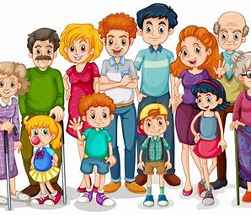
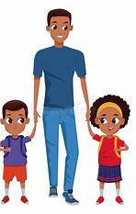
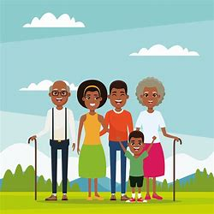
3. With whom do you use these languages:
With family at home

Slide 6
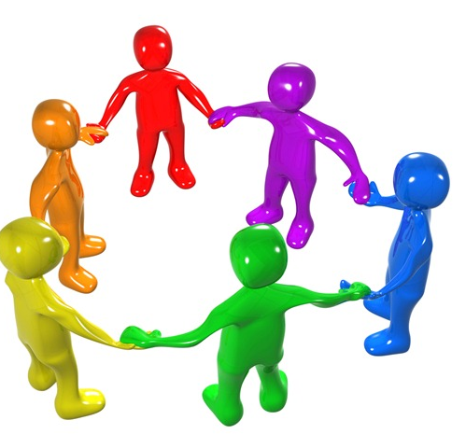
Not losing my mother tongue. Enabling my children to speak in Gujarati with their grandparents who cannot speak English Not losing my identity, culture, traditions and beliefs-- able to read texts on these It is beneficial and more friendly to speak in Swahili with the local Kenyan people when I go back home Some words in certain languages actually originate from another language Builds a stronger community Understanding where and how the language was formed, may enable to understand other cultural traditions Helps when travelling/ holiday-- eg French Spanish Italian.
Possibility to communicate with wider community, learning about different cultures. Helping others with translation. Using language while abroad.
Breaks the language barrier in most situations.

Slide 7
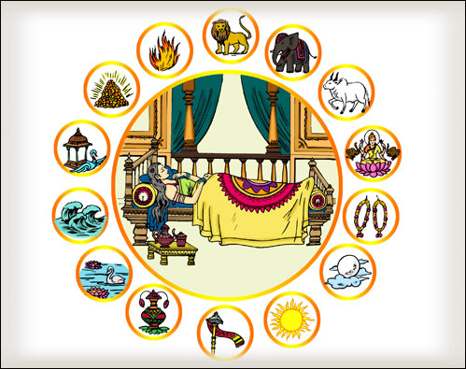
5. What stories have been read to you in another language?
Story about our Lord Mahavir and his mother Trishala's 14 dreams before his birth.
Grimms Fairy Tales, Hans Anderson Fairly Tales, Winnie The Pooh.
Folklore, nursery rhymes, bedtime stories.

Slide 8
6. How many letters of the alphabet or symbols are used in the other languages you use?
37 in Gujarati plus 13 ways to differentiate the sounds, for eg ae , aa, aei...
Some from the ancient Greek.
45 letters in Pashto 32 in Dari 32 in Farsi

Slide 9
7. What would you like us to understand about the other language(s) you speak?
The Gujarati language is more than 700 years old. It is spoken by more than 55 million people worldwide. It is the fourth most commonly spoken language in the U.K. It is the mother tongue of Gandhiji.
Polish a Slavic language with one of the most difficult grammar. For example verbs change endings according to who speaks and what she/he/it does.
Some words in English derive from the etymological root words in Dari and Farsi. Pashto and Dari are very,very old languages and have been around for millennia. Pashto and Dari are the two official languages of Afghanistan. Farsi is the official language of Iran.

Slide 10
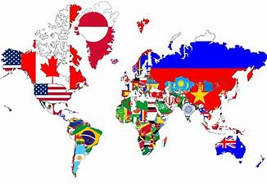
8. In some parts of the world Literacy rates are very low. (Many more people cannot read and write compared to the UK). What might some reasons be for poor literacy levels in other parts of the world?
Not enough schools, poorly educated parents, not enough resources, cost, poverty, no free schooling, social status No schooling for girls in certain countries.
Poverty, Lack of education.
Reasons could vary from war (which would lead to people not being able to learn because of the danger and threat to their lives) to opportunity (some people who live in poor parts of the country would not have the opportunity for an education just because it can be very expensive and many do not have access to homes let alone education).

